Slide 1
EmpowHer
EmpowHER: Empowering Girls for Corporate Excellence Java Curriculum

Slide 2
Agenda Week 1
Java Essentials
Design Principles

Slide 3
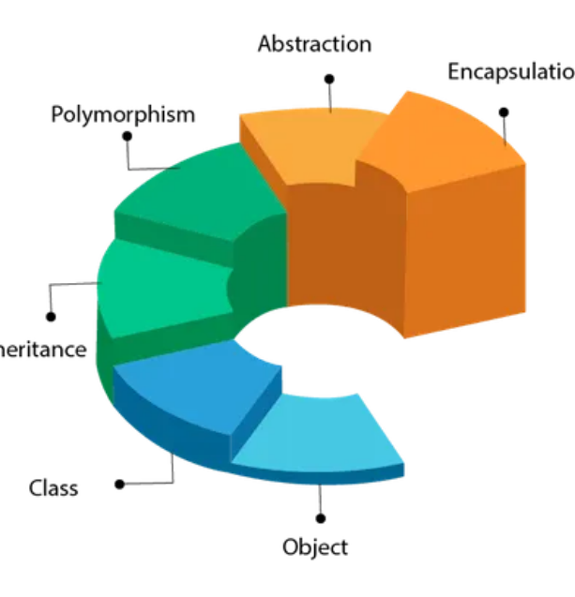
Topic 1 : Java Essentials: OOPs
OOPS – Object Oriented Programming Language
An Object can be defined as an instance of a class. An object contains an address and takes up some space in memory. Objects can communicate without knowing the details of each other's data or code.
Example: A dog is an object because it has states like colour, name, breed, etc. as well as behaviours like wagging the tail, barking, eating, etc.

Slide 4
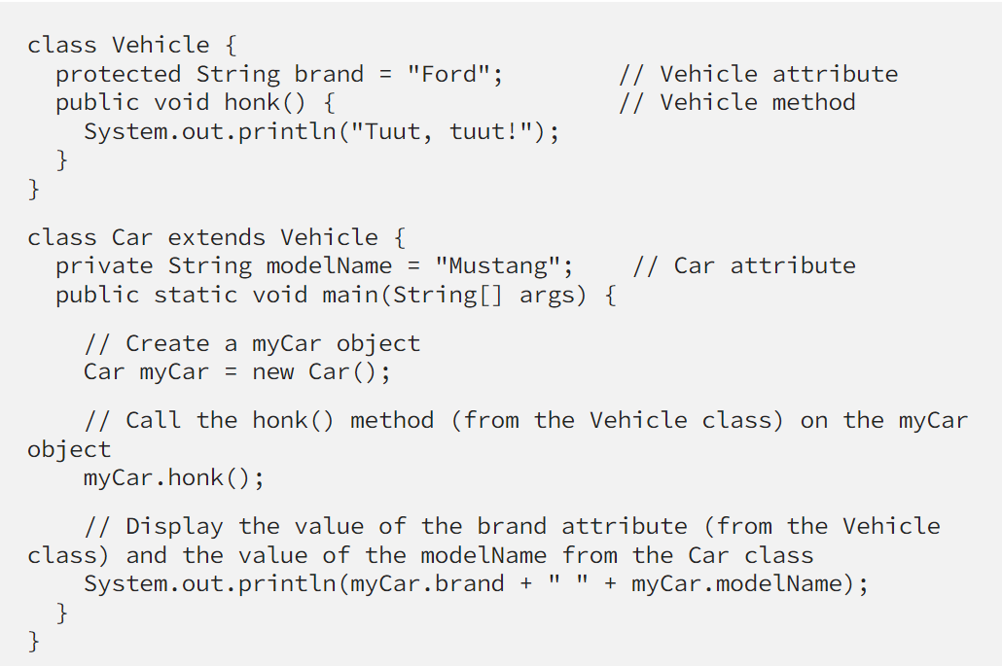
Topic 1 : Java Essentials : Class & Inheritance
When one object acquires all the properties and behaviors of a parent object, it is known as inheritance. It provides code reusability. It is used to achieve runtime polymorphism.
Inheritance
Class
Collection of objects is called class. It is a logical entity.
A class can also be defined as a blueprint from which you can create an individual object.

Slide 5
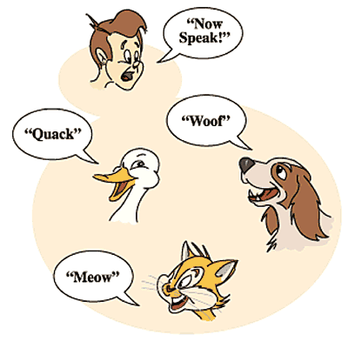
Topic 1 : Java Essentials
Same behavior in different forms.
Can someone guess what is this concept?

Slide 6
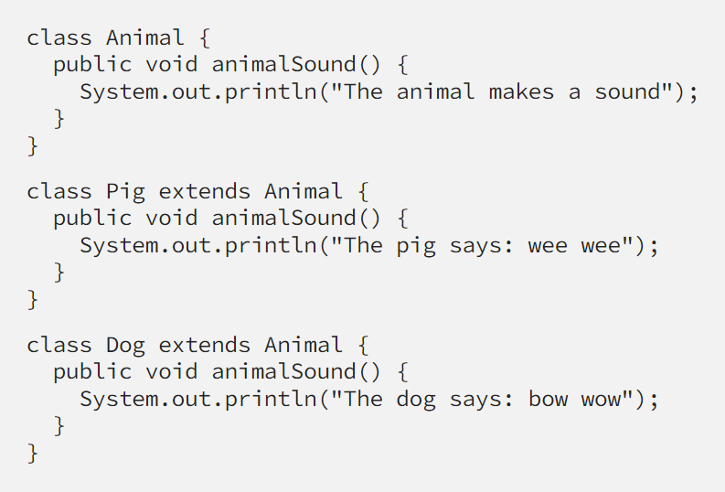
Topic 1 : Java Essentials : Polymorphism
Polymorphism
If one task is performed in different ways, it is known as polymorphism.
In Java, we use method overloading and method overriding to achieve polymorphism.

Slide 7
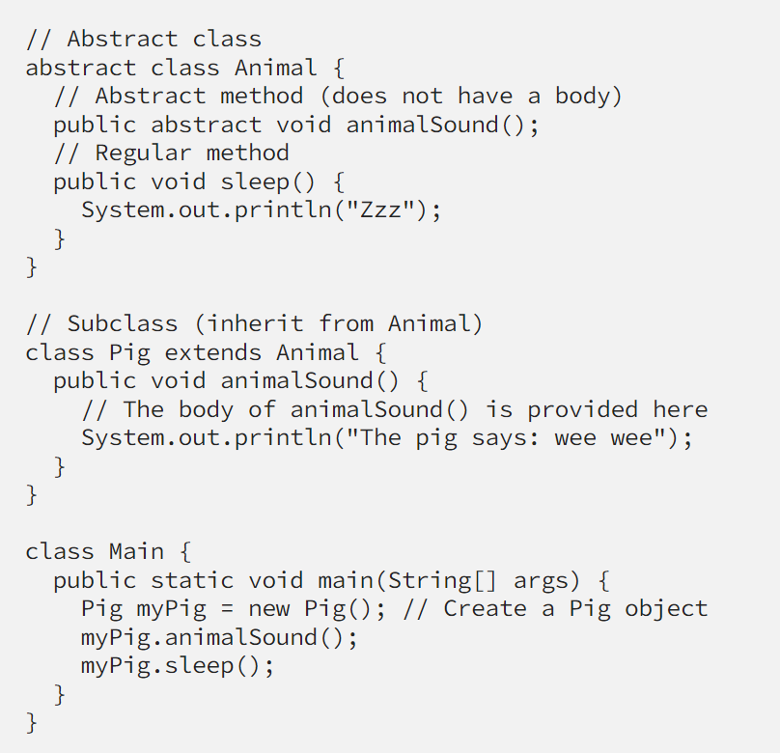
Topic 1 : Java Essentials: Abstraction
Abstraction
Hiding internal details and showing functionality is known as abstraction.
For example,
phone call, we don’t know the internal processing.
Any vehicle : Takes us from one place to other but hides internally how engine works and what its does internally.
In Java, we use abstract class and interface to achieve abstraction.

Slide 8
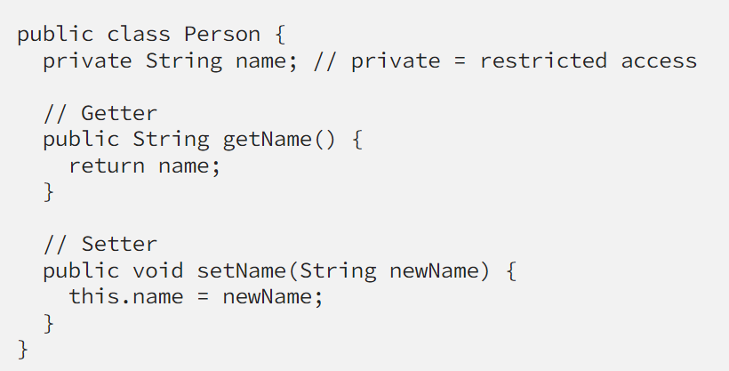
Topic 1 : Java Essentials : Encapsulation
Encapsulation
Binding (or wrapping) code and data together into a single unit are known as encapsulation. For example, a capsule, it is wrapped with different medicines.
A java class is the example of encapsulation. Java bean is the fully encapsulated class because all the data members are private here.

Slide 9
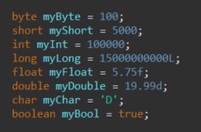

Topic 1 : Java Essentials : Java Data Types
Java Data Types are divided into two groups:
Primitive data types
Each data type takes up a certain amount of memory space, a certain number of bits. there are 8 different primitive data types
byte, short, integers, and long – Stores integers, such as 3
float, double – Stores decimal numbers, for example 3.14
boolean – Can only store true or false
char – Stores characters such as ‘C’
Non-Primitive Data Type or Reference Data Types
The Reference Data Types will contain a memory address of variable values because the reference types won’t store the variable value directly in memory. They are strings, objects, arrays, etc.

Slide 10
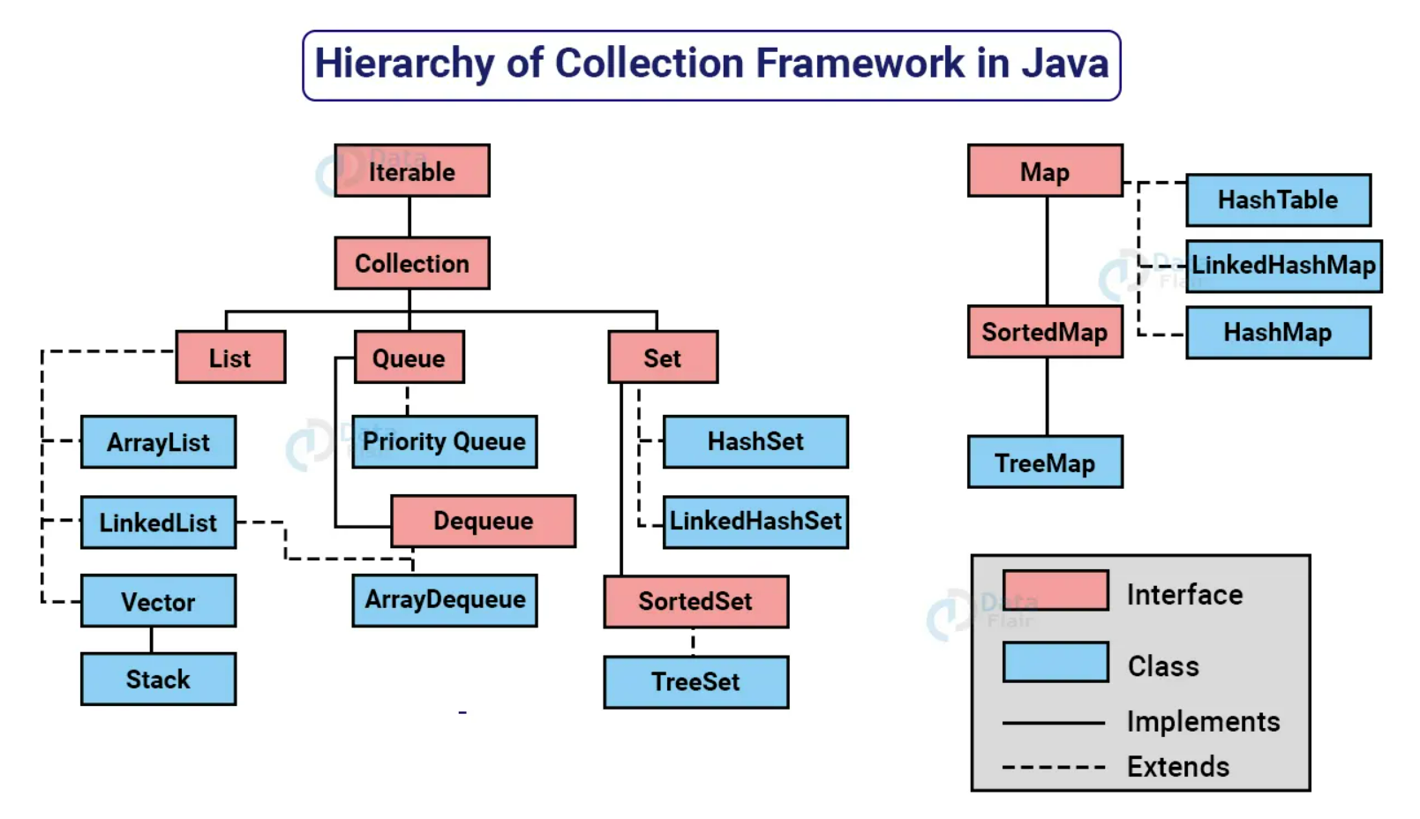
Topic 1 : Java Essentials:Java Collections

Slide 11
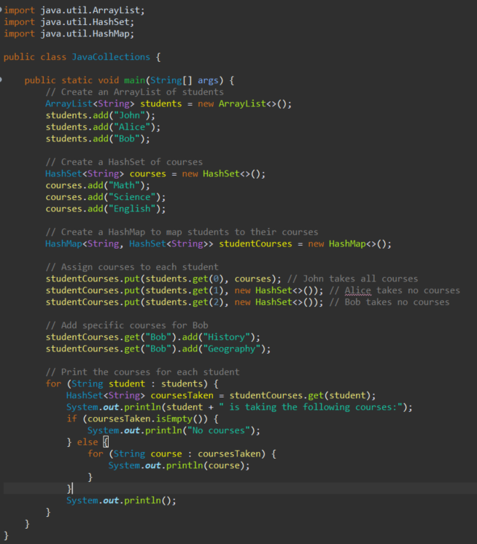
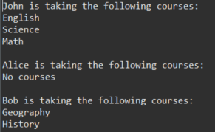
Topic 1 : Java Essentials:Java Collections
ArrayList, HashSet and HashMap are widely used collections.
ArrayList
An ArrayList is a resizable array that can store elements of any type. It provides dynamic size, easy insertion and deletion of elements, and random access to elements.
HashSet
A HashSet is an unordered collection that does not allow duplicate elements. It provides constant-time performance for basic operations like add, remove, and contains.
HashMap
A HashMap is a key-value pair collection that allows you to store and retrieve elements based on a unique key. It provides constant-time performance for basic operations like put, get, and remove.

Slide 12
Topic 1 : Java Essentials : Exception Handling
What is exceptional Handling?
statement 1;
statement 2;
statement 3;
statement 4;
statement 5;//exception occurs
statement 6;
statement 7;
statement 8;
statement 9;
statement 10;
What happens to statements after statement 5?
Does not execute
b. executes till statement 10.

Slide 13
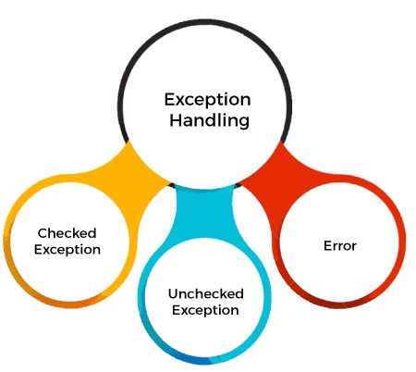
Topic 1 : Java Essentials : Exception Handling
Error
Exception
Exception indicates conditions that a reasonable application might try to catch.
An Error indicates a serious problem that a reasonable application should not try to catch.
Checked Exception
Unchecked Exception
Checked exceptions are called compile-time exceptions because these exceptions are checked at compile-time by the compiler.
The unchecked exceptions are just opposite to the checked exceptions. The compiler will not check these exceptions at compile time. In simple words, if a program throws an unchecked exception, and even if we didn’t handle or declare it, the program will not give a compilation error.

Slide 14
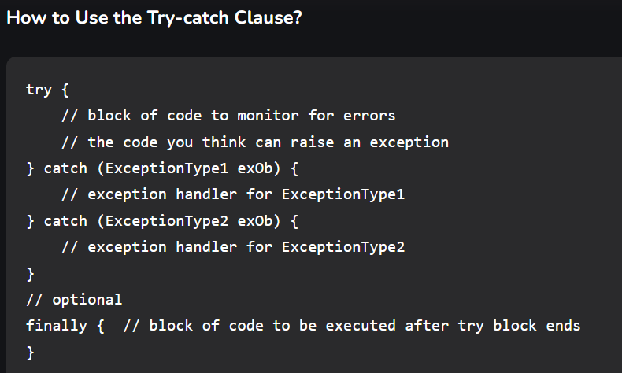
Topic 1 : Java Essentials : Exception Handling: Keywords
Keyword | Description
try | The "try" keyword is used to specify a block where we should place an exception code. It means we can't use try block alone. The try block must be followed by either catch or finally.
catch | The "catch" block is used to handle the exception. It must be preceded by try block which means we can't use catch block alone. It can be followed by finally block later.
finally | The "finally" block is used to execute the necessary code of the program. It is executed whether an exception is handled or not.
throw | The "throw" keyword is used to throw an exception.
throws | The "throws" keyword is used to declare exceptions. It specifies that there may occur an exception in the method. It doesn't throw an exception. It is always used with method signature.

Slide 15
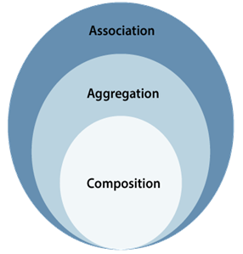
Topic 2 : Java Design Principles : Association
If two classes in a model need to communicate with each other, there must be a link between them, and that can be represented by an association.
In object-oriented programming, association is the common term used for both the has-a and part-of relationships but is not limited to these. When we say that two objects are in an association relationship, this is a generic statement which means that we don’t worry about the lifetime dependency between the objects.
The composition and aggregation are two subsets of association. In both cases, the object of one class is owned by the object of another class; the only difference is that in composition, the child does not exist independently of its parent, whereas in aggregation, the child is not dependent on its parent i.e., standalone.
An aggregation is a special form of association, and composition is the special form of aggregation.

Slide 16
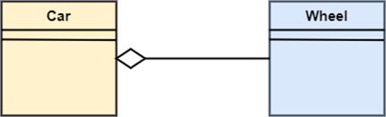
Topic 2 : Java Design Principles : Aggregation
It represents has a relationship. It is more specific than an association. It describes a part-whole or part-of relationship. It is a binary association, i.e., it only involves two classes. It is a kind of relationship in which the child is independent of its parent.
Example:
Here we are considering a car and a wheel example. A car cannot move without a wheel. But the wheel can be independently used with the bike, scooter, cycle, or any other vehicle. The wheel object can exist without the car object, which proves to be an aggregation relationship.

Slide 17
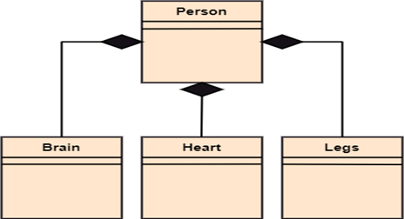
Topic 2 : Java Design Principles : Composition
The composition is a part of aggregation, and it portrays the whole-part relationship. It depicts dependency between a composite (parent) and its parts (children), which means that if the composite is discarded, so will its parts get deleted. It exists between similar objects.
Example:
The composition association relationship connects the Person class with Brain class, Heart class, and Legs class. If the person is destroyed, the brain, heart, and legs will also get discarded.

Slide 18
Topic 2 : Java Design Principles: SOLID PRINCIPLES
Principle | Description
Single Responsibility Principle | Each class should be responsible for a single part or functionality of the system.
Open-Closed Principle | Software components should be open for extension, but not for modification.
Liskov Substitution Principle | Objects of a superclass should be replaceable with objects of its subclasses without breaking the system.
Interface Segregation Principle | No client should be forced to depend on methods that it does not use.
Dependency Inversion Principle | High-level modules should not depend on low-level modules, both should depend on abstractions.

Slide 19
Topic 2 : Java Design Principles: Design Patterns
A design patterns are well-proved solution for solving the specific problem/task.
Structural Design Pattern
Behavioral Design Pattern
Creational design patterns are concerned with the way of creating objects. These design patterns are used when a decision must be made at the time of instantiation of a class (i.e., creating an object of a class).
The structural design patterns simplify the structure by identifying the relationships.
These patterns focus on, how the classes inherit from each other and how they are composed from other classes.
the interaction between the objects should be in such a way that they can easily talk to each other and still should be loosely coupled.
That means the implementation and the client should be loosely coupled in order to avoid hard coding and dependencies.
Creational Design Pattern
Advantages
They are reusable in multiple projects.
They provide the solutions that help to define the system architecture.
They capture the software engineering experiences.
They provide transparency to the design of an application.
They are well-proved and testified solutions since they have been built upon the knowledge and experience of expert software developers.

Slide 20
Agenda Week 2
What is Web Application and Visual example.
Web application Evolution.
REST API and Http methods.
First Spring.io project download.
REST services Testing
Spring Boot Essentials – Dependency Injection, Component Scan

Slide 21
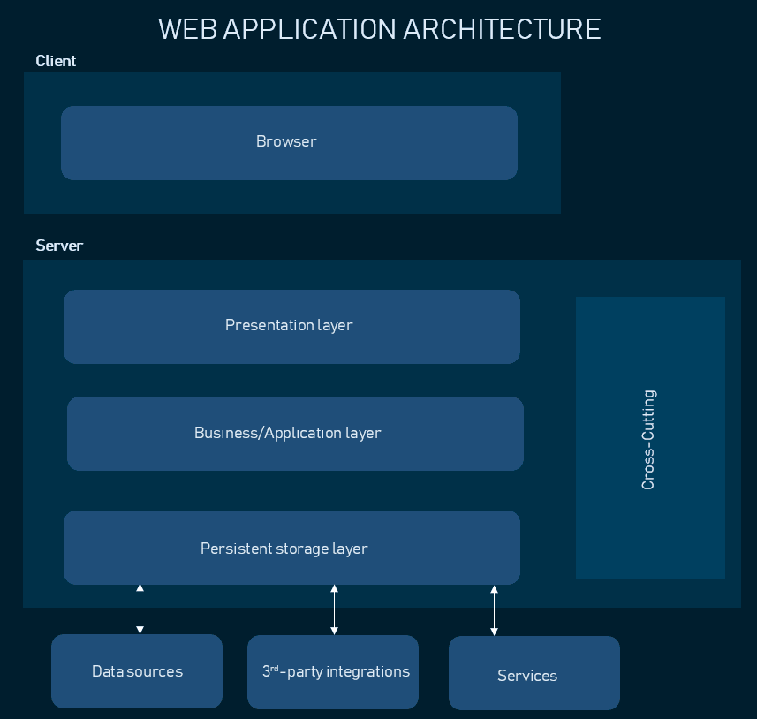
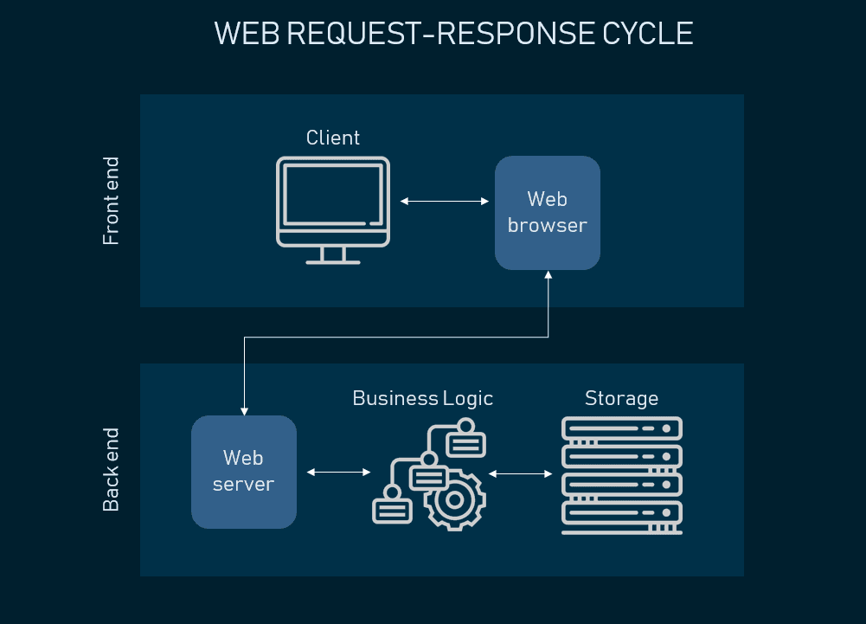
What is web application and how it works with real time example.
Multiple users can access one application at same time using java Multi-threading concept

Slide 22
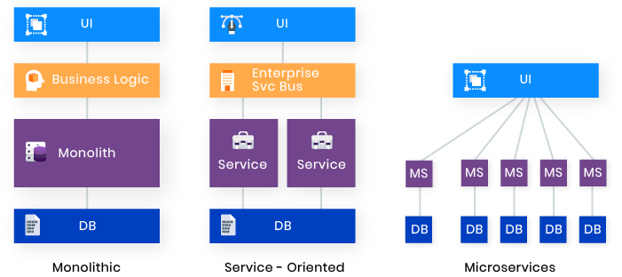
Web Application evolution

Slide 23
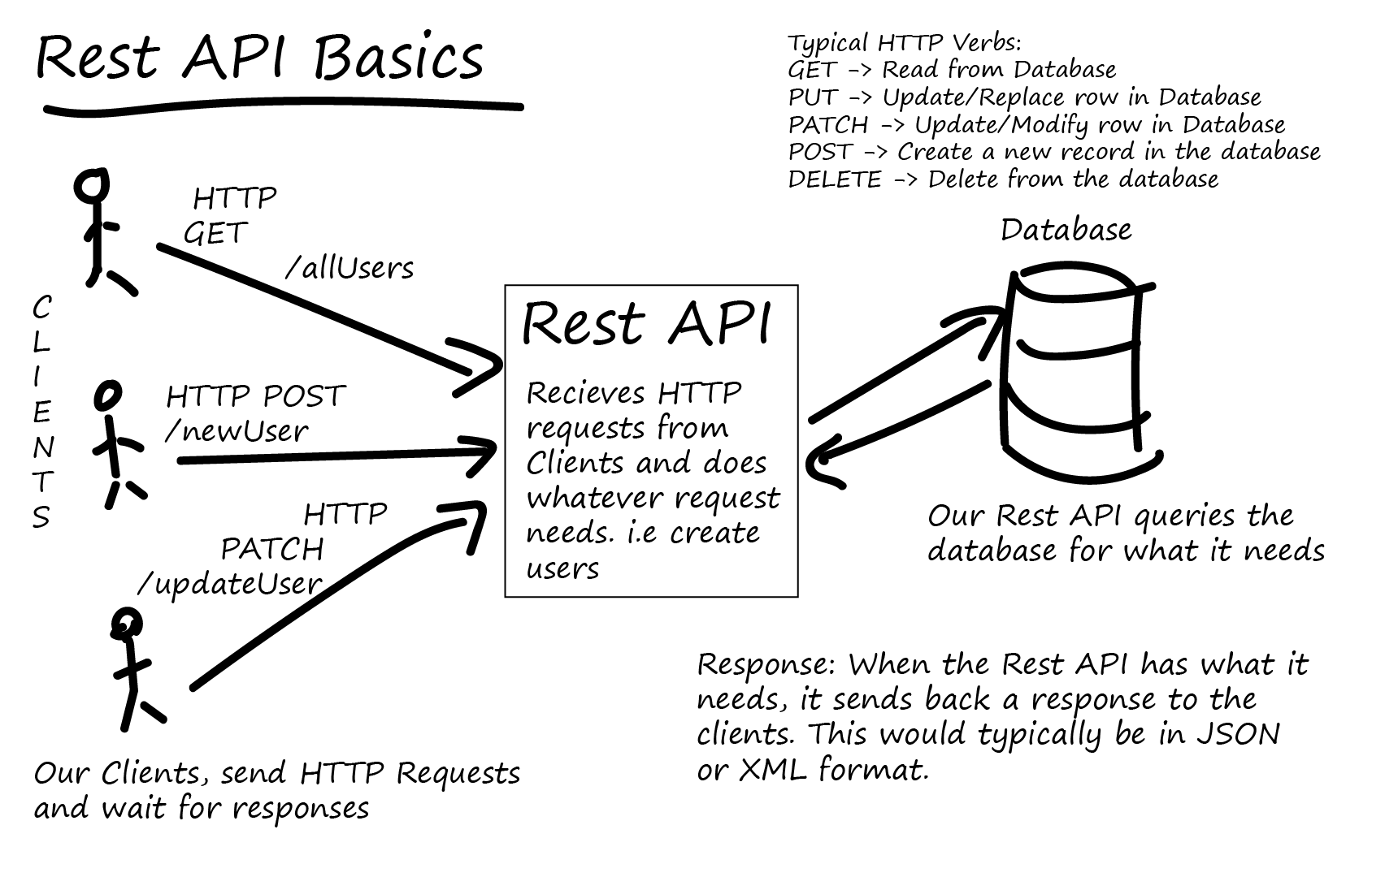
Topic 2 : REST API and Http methods.

Slide 24
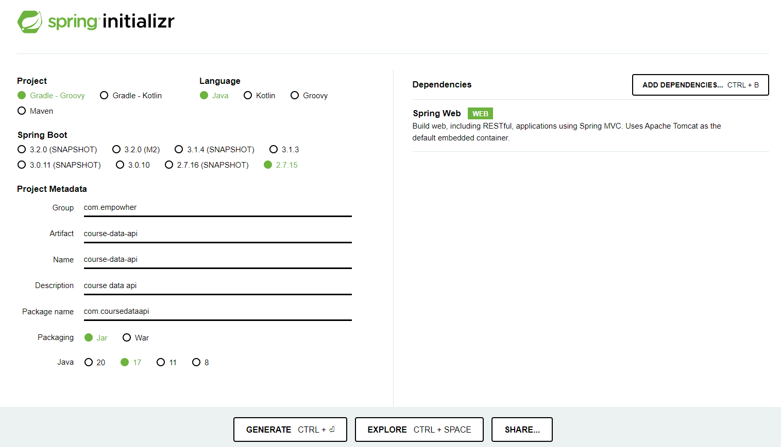
Topic 2: Introduction to Spring Boot Micro Services app – Spring boot initializer
Create first sprint boot Build and run first app.
https://start.spring.io/

Slide 25
COURSEMALL API
In this we are considering two objects , candidate and course.
Database schema : wiki

Slide 26
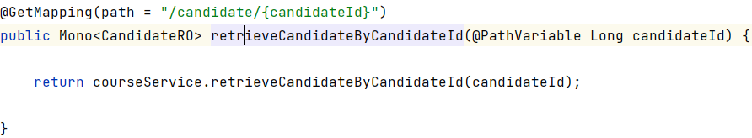
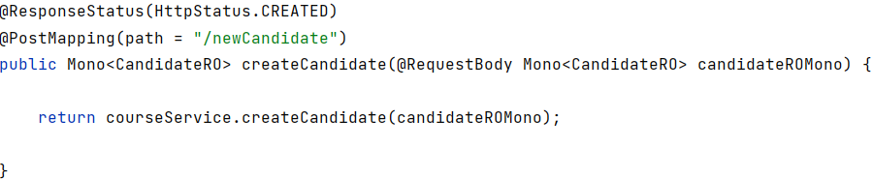
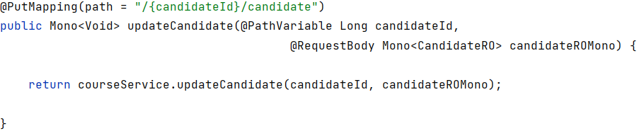
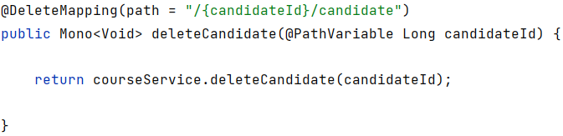

Slide 27
Topic 2 continued: REST services Testing
Unit Testing is a level of software testing where individual parts (or units) of a software are tested. A unit is the smallest testable part of any software, often a function or method within a class.
Testing RESTful APIs/endpoints/URLs : Tools like Postman and Rest-Assured.
The Methods(endpoints) in controller can be tested from POSTMAN by passing respective endpoint url and request.

Slide 28
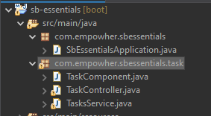

Topic 3: Spring boot essentials: component scan
Spring Boot is a powerful framework used to simplify the bootstrapping and development of new Spring applications. Two essential features of Spring Boot are Component Scanning and Bean Scope.
Component Scan
This is a mechanism provided by Spring Framework where it automatically scans the specified package in your application and registers the classes annotated with @Component, @Controller, @Service, @Repository, etc.
This feature is very handy as it saves the developer from manually defining and wiring beans in the application context.
It simplifies auto-wiring of beans by matching by type, by name, or by qualifiers.
It's important to properly structure your packages since Spring Boot, by default, scans sub-packages of the class that declares the @SpringBootApplication annotation.

Slide 29
Topic 3: Spring boot essentials: Annotations
Syntax | usage
@SpringBootApplication | This is a convenience annotation that adds all of the following: @Configuration, @EnableAutoConfiguration, and @ComponentScan. It's used to mark a configuration class that declares one or more @Bean methods and also triggers auto-configuration and component scanning.
@RestController | This annotation is applied to a class to mark it as a request handler. @RequestMapping - Annotation for mapping web requests onto methods in request-handling classes with flexible method signatures. It's a convenience annotation that combines @Controller and @ResponseBody.
@GetMapping("/path") [@PostMapping, @PutMapping, @DeleteMapping] | These are composed annotations that act as a shortcut for @RequestMapping(value = "/path“,method = RequestMethod.XXX).
@PathVariable("variableName") | This annotation indicates that a method parameter should be bound to a URI template variable.
@RequestBody | This annotation indicates a method parameter should be bound to the body of the web request. The body of the request is passed through an HttpMessageConverter to resolve the method argument depending on the content type of the request.
@Autowired | This annotation provides control over where and how autowiring should be accomplished. It can be used to autowire bean on the setter method, constructor, a property or methods with arbitrary names and/or multiple arguments.
@Component | This annotation indicates that an annotated class is a "component". Such classes are considered as candidates for auto-detection when using annotation-based configuration and classpath scanning.
@Service | This annotation is a specialization of the component annotation. It does not currently provide any additional behavior over the @Component annotation, but it's a good idea to use @Service over @Component in service-layer classes because it specifies intent better.
@Repository | This annotation is a marker for any class that fulfills the role of repository or Data Access Object. This annotation also translates any unchecked exceptions thrown from your DAO to Spring's DataAccessException.
@Qualifier("beanName") | This annotation is used to resolve the autowiring conflict, when there are multiple beans of the same type.
@Value("${property.name}") | @Value("${property.name}")@Value: This annotation indicates a default value expression for the field or parameter to initialize the property with.
Notes:
@ComponentScan: This annotation is used with @Configuration to tell Spring the packages to scan for annotated components. @ComponentScan is also used to specify base packages and/or base package classes to scan.
@EnableAutoConfiguration: This annotation tells Spring Boot to start adding beans based on classpath settings, other beans, and various property settings. It is generally placed on the main application class.
@Configuration: This annotation indicates that a class declares one or more @Bean methods and may be processed by the Spring container to generate bean definitions and service requests for those beans at runtime.
@ResponseBody: This annotation indicates a method return value should be bound to the web response body
@Component: This annotation indicates that an annotated class is a "component". Such classes are considered as candidates for auto-detection when using annotation-based configuration and classpath scanning.

Slide 30
Agenda Week 3
SPRING JDBC
Learn about the Spring JDBC and JdbcTemplate.
Learn about the in-memory database.
Learn to perform queries on the database such as SELECT, INSERT, UPDATE, and DELETE.
Master the concepts of DDL queries.
Learn about the RowMapper interface and related concepts.
Spring Data Java Persistent API
Learn about JPA, its annotations, and how to implement it.
Learn to manage entities using a repository.
Master the concepts of performing CRUD operations offered by the EntityManager.
Learn to write named queries.
Learn to connect to other databases.

Slide 31
Spring JDBC Overview
Spring Boot simplifies development and makes JDBC programming easy. It eliminates the need for establishing connection, handling expectations, and closing connections.
All the required boiler plate code is executed behind the scenes so the developer can concentrate on writing queries.

Slide 32
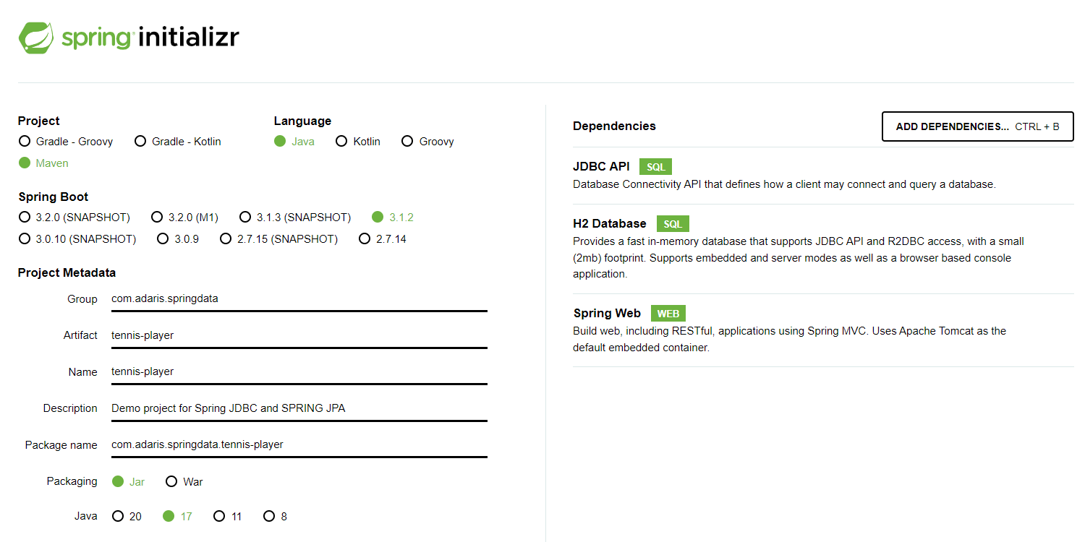
Creating a JDBC Starter Project
Spring JDBC makes talking to databases easy by eliminating the need for establishing a connection, handling expectations, and closing connections. Spring provides a template class called JdbcTemplate to interact with databases which offers a wide array of methods to perform storage and retrieval of data. The JdbcTemplate class hides all the boilerplate code for connection management and error handling whereby the developer can focus on the SQL query.
To set up a starter project for JDBC, go to Spring Initializr. The Group Id of the project is springdata and the Artifact Id is tennis-player. We will add the following dependencies:
JDBC API for querying the database
H2 Database that supports JDBC API access
Spring Web for the web console offered by H2

Slide 33
Setting up the H2 Database
Step 1
Configuring database
spring.datasource.url=jdbc:h2:mem:testdb
spring.h2.console.enabled=true
spring.h2.console.settings.web-allow-others=true
Step 2
Creating a table
CREATE TABLE Player (
ID INTEGER NOT NULL,
Name VARCHAR(255) NOT NULL,
Nationality VARCHAR(255) NOT NULL,
Birth_date TIMESTAMP,
Titles INTEGER,
PRIMARY KEY (ID)
);
Step 3
Inserting data
INSERT INTO Player (ID, Name,Nationality, Birth_date, Titles)
VALUES(1, 'Djokovic', 'Serbia', '1987-05-22', 81);
INSERT INTO Player (ID, Name,Nationality, Birth_date, Titles)
VALUES(2, 'Monfils', 'France', '1986-09-01', 10);
INSERT INTO Player (ID, Name,Nationality, Birth_date, Titles)
VALUES(3, 'Isner', 'USA', '1985-04-26', 15);

Slide 34
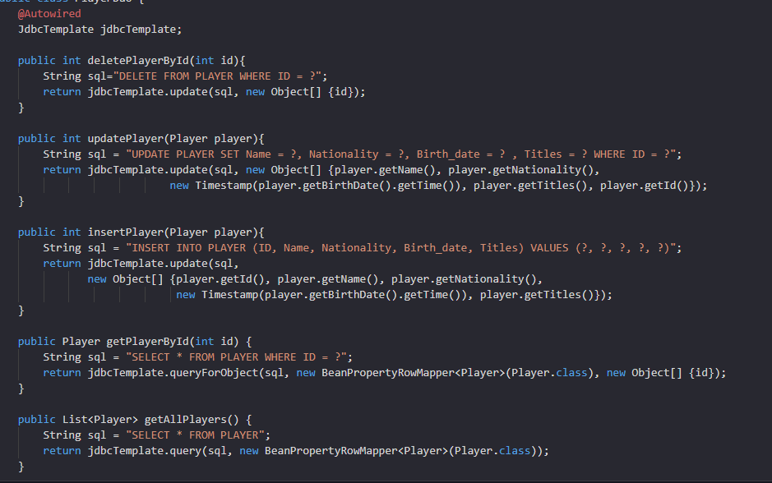
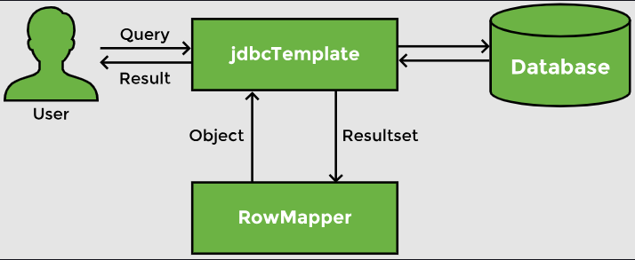
CRUD Operations
Spring data support makes interacting with databases easy. Since we are using Spring Boot, the connection part is automatically taken care of and the data source is automatically configured. Likewise, the connection is automatically closed. Spring provides JdbcTemplate, which makes it easy to write and execute a query. It also provides the BeanPropertyRowMapper which maps rows of a table to a bean.

Slide 35
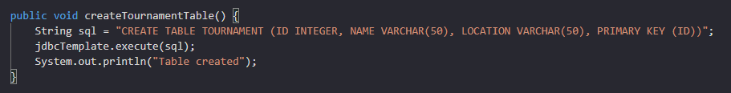
DDL Queries
Data Manipulation Language (DML) queries are the one where we manipulate the data in the table. In a rare scenario, we might want to create a table which is a Data Definition Language (DDL). In that case, we can use the execute method of the JdbcTemplate
we want to create a Tournament table to store details of a tennis tournament. We will create a method called createTournamentTable with a CREATE TABLE query.

Slide 36
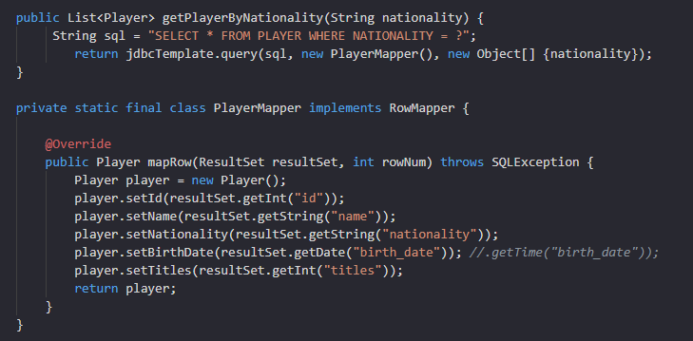
Custom RowMapper
The BeanPropertyRowMapper can be used to map the results of the query to our bean. If the database table has a different structure or column names, we need to define our custom mapping.
Define our own row mapper by implementing the RowMapper interface and providing the bean onto which the rows will be mapped.
Write custom implementation of mapRowMethod to initialize an object for each row
To use custom mapper, we can simply pass it in any method instead of the BeanPropertyRowMapper

Slide 37
Spring Data JPA Overview
Java Persistence API (JPA) is used to write, maintain, and manage hundreds of queries in large applications.
It is a simpler, cleaner, and less labor-intensive approach that helps developers to ease this task.
It eliminates the boilerplate code that has to be written to execute simple queries.
JPA helps to write more understandable and cleaner code and become more skilled and proficient as a Spring Boot developer.

Slide 38
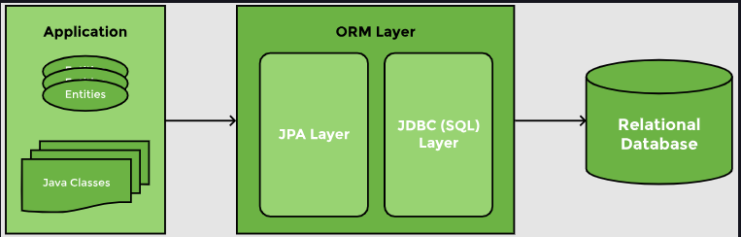
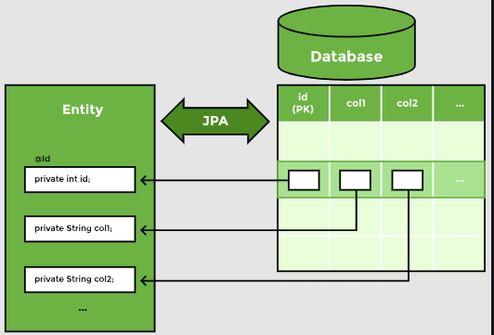
What is JPA?
Java Persistence API (JPA) is designed to ease writing and maintaining sql queries.
Using JPA, we can map a Java class or bean to a table. The members of the class map columns in the table. When this mapping is defined, JPA can write queries on its own. It takes the responsibility of creating and executing queries for CRUD operations.
There are numerous implementations of the JPA interface like Hibernate, EclipseLink, Apache OpenJPA, etc. Hibernate is by far the most popular implementation of JPA. It is a lightweight framework and can easily be integrated with Spring.
ORM maps Java objects to table rows
Class members are mapped to columns in a database table

Slide 39
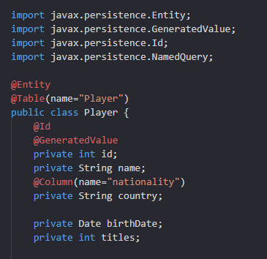
Defining an Entity
To use Spring Data JPA, add the starter JPA dependency, spring-boot-starter-data-jpa to the pom.xml
We will use the @Entity annotation to map this class to the Player table.
In case we want to map this class to a table with a different name, we can use the @Table annotation and provide the name of the table to which the bean maps to.
The @Id annotation is used to indicate the primary key
The @GeneratedValue annotation will automatically generate Id values.
@Column annotation mentions the name of the column that matches an attribute of the class

Slide 40
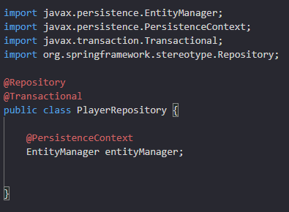
Creating a Repository
A repository class manages, stores, and retrieves entity data. It is created by marking it with the @Repository annotation.
Spring provides boilerplate code for transaction management, which can be integrated with JPA. This is done by using the @Transactional annotation on a method or class.
All operations on the entity, go through the EntityManager and are stored inside the PersistenceContext. EntityManager is the interface to the Persistence Context.

Slide 41
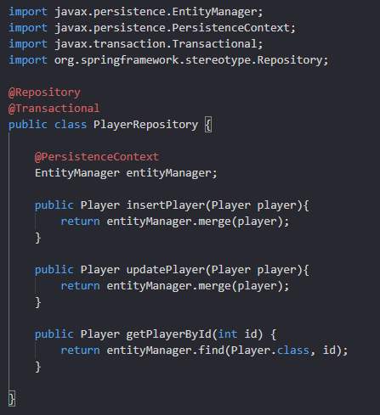
CRUD Operations
The EntityManager offers a merge method for both INSERT and UPDATE operations. merge checks if the primary key value is being passed to it or not. If it finds the primary key, it updates the corresponding record. If the primary key is not passed, it generates a value and inserts a new record in the table. The merge method returns a Entity object.
EntityManager offers a number of find methods.For example fine method can be used to return a player based on the primary key value.
merge and find methods creates the SQL query and maps values to it on its own. It also converts the row returned to a Player object.
To see the queries that Hibernate has generated, we can enable the show-sql property in the application.properties

Slide 42
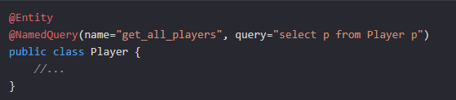
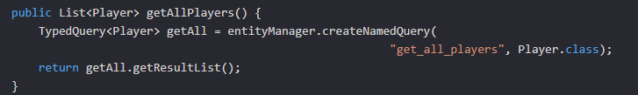
JPQL Named Query
To create a named query, we will use the @NamedQuery annotation on the Entity class. This annotation requires two parameters: the name of the query and the query itself.
In repository class,we will use the createNamedQuery method. We need to pass the name of the query and specify what the query will return.The createNamedQuery returns a TypedQuery. Then, we can use the getResultList method to return a list of Entities.

Slide 43
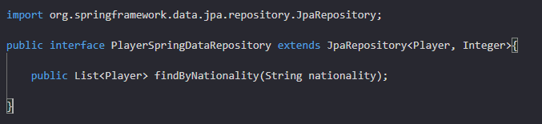
Spring Data JPA
Spring Data identified this duplication of code when writing repositories and created some predefined repositories. The developer provides the entity type and its primary key and Spring Data comes up with the CRUD methods for the entity. Spring Data JPA adds a layer of abstraction over the JPA provider.
The JpaRepository interface extends the Repository interface. It contains the API provided by CrudRespository as well as the PagingAndSortingRepository for CRUD operations along with pagination and sorting of records.
We will create an interface that extends the JpaRepository.We need to specify the entity that will be managed by this repository, as well as the primary key of the entity.Simply by extending the JpaRepository, we get all basic CRUD operations without having to write any implementation.

Slide 44
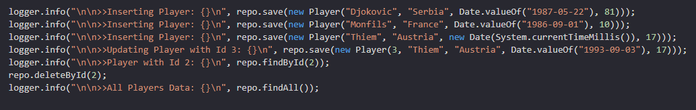
Spring Data JPA
To insert and update an object, Spring Data has a save method that works in the same manner as the merge method of the EntityManager.
Spring Data has a method called findById, which takes in the primary key and returns an object.
findAll method will returns all entity objects.
For deletion, Spring Data has a deleteById method that takes the primary key of the record to be deleted.
Spring Data can parse a method name and create a query from it. A method findByNationality even without any implementation, is converted to the following JPQL query using the JPA Criteria API:
select p from Player p where p.nationality = ?1
We can use keywords such as And, Or, GreaterThan, LessThan, Like, IsNull, Not etc., in the method name and OrderBy clause can be used to sort the results.

Slide 45

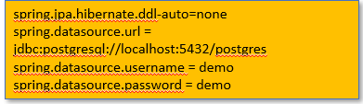
Connecting to Other Databases
In real-life applications, we might want to connect to Oracle, MySql, or postgresql server databases. Using Spring Boot, switching databases is very straightforward. We just need to perform following steps
Replace H2 dependency with dependency of Database we wish to connect to.
Update application.properties file with DB details. Since we already have a schema and do not want Hibernate to create it for us, we have set spring.jpa.hibernate.ddl-auto setting to none.
After making these changes, restart the application and Spring Boot will connect to the database of your choice.

Slide 46
Agenda Week 4
Spring Web(Spring REST - REST methods/Action that we perform on objects. How to choose end-point. When to use PUT and When to use Patch), resource, rest endpoint. ( architecture which is of type MVC, 4 layered ).
Spring Test ( Controller Test case)
Lombok
spring AOP (logging and exceptional handling)
High Level on below :
Spring Batch
Spring Kafka(Just introduce names and tell what are used for) - Site couple of examples where these are used.

Slide 47
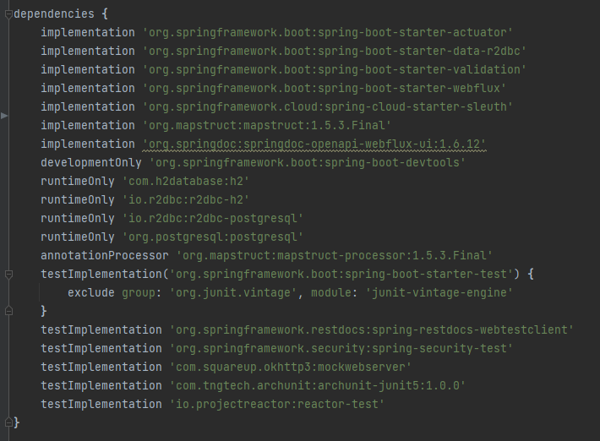
Code Snippet for Dependency Injection of topics of this class.

Slide 48
Topic 1: Spring Boot + REST API : GET
RequestMapping Annotation:
1. Used to map HTTP requests to handler methods of MVC and REST controllers
For Eg:
@RequestMapping("/courseMall")
GET method:
1. Used to retrieve data from the server.
2. A read-only method, so it has no risk of mutating or corrupting the data.
For Eg:
@GetMapping(path = "/candidates")
@GetMapping(path = "/candidate/{candidateId}")
@GetMapping(path = "/courses")
@GetMapping(path = "/course/{courseId}")

Slide 49
Topic 1: Spring Boot + REST API : POST and PUT
POST method:
1. Sends data to the server and creates a new resource.
2. Used to create a new data entry.
For Eg:
@PostMapping(path = "/newCandidate")
@PostMapping(path = "/newCourse")
PUT method:
1. Used to update but by replacing an existing resource.
For Eg:
@PutMapping(path = "/{candidateId}/candidate")
@PutMapping(path = "/{courseId}/course")

Slide 50
Topic 1: Spring Boot + REST API : DELETE
DELETE method is:
1. Used to delete a resource specified by its URI.
For Eg:
@DeleteMapping(path = "/{candidateId}/candidate")
@DeleteMapping(path = "/{courseId}/course")
Below two Tables has been used with REST API:
1. candidate
2. course

Slide 51
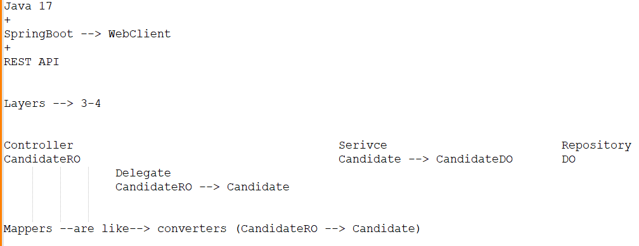
Topic 2: Layered Architecture
3 and 4 Layered Architecture:

Slide 52
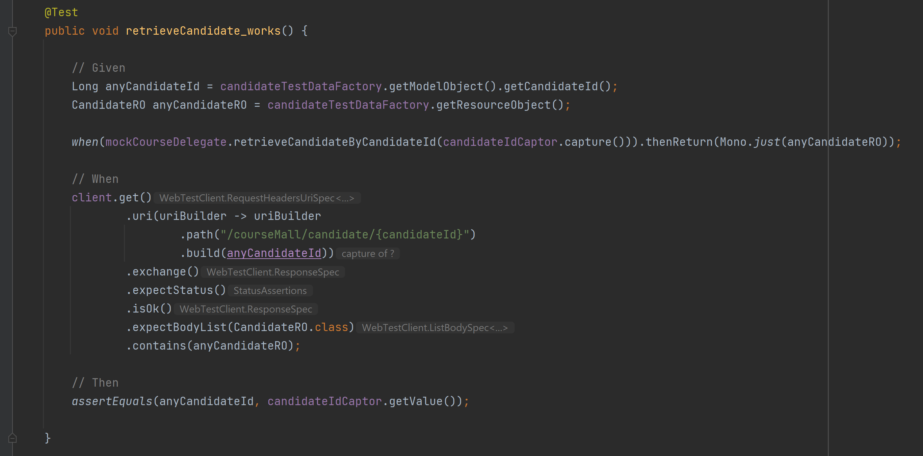
Topic 3: Spring Test ( Controller Test case)

Slide 53
Topic 4: Lombok
Project Lombok is a Java library tool that:
1. Generates code for minimizing boilerplate code.
2. Replaces boilerplate code with easy-to-use annotations.
For Eg:
By adding a couple of annotations, we get rid of code clutters, such as getters and setters methods, constructors, hashcode, equals, and toString methods, and so on.
Few Lombok constructs are:
@Getter, @Setter
@NoArgsConstructor, @AllArgsConstructor
@Data
@NotNull

Slide 54
Topic 5: Global Exception Handling with @ControllerAdvice
Spring AOP enables a mechanism to handle exceptions globally via:
@ControllerAdvice
@ExceptionHandler

Slide 55
Topic 6: Spring Batch
A lightweight, comprehensive batch framework designed to enable the development of robust batch applications vital for the daily operations of enterprise systems.
Spring Batch provides reusable functions that are essential in processing large volumes of records, including logging/tracing, transaction management, job processing statistics, job restart, skip, and resource management.
It also provides more advanced technical services and features that will enable extremely high-volume and high performance batch jobs through optimization and partitioning techniques. Simple as well as complex, high-volume batch jobs can leverage the framework in a highly scalable manner to process significant volumes of information.

Slide 56
Topic 7: Spring for Apache Kafka
The Spring for Apache Kafka (spring-kafka) project applies core Spring concepts to the development of Kafka-based messaging solutions.
It provides a "template" as a high-level abstraction for sending messages. It also provides support for Message-driven POJOs with @KafkaListener annotations and a "listener container". These libraries promote the use of dependency injection and declarative.
In all of these cases, you will see similarities to the JMS support in the Spring Framework and RabbitMQ support in Spring AMQP.

Slide 57
Agenda Week 5
Debugging
When is it required to debug?
How to put a debug point?
What is output before debug line?
How to disable breakpoint and run through?
Introduction to JUnits

Slide 58
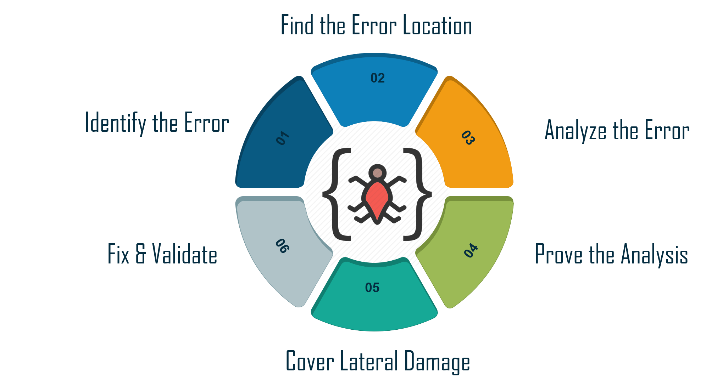
Topic 1 : What is Debugging

Slide 59
Topic 2 : Junits
JUnit framework provides annotations to identify test methods and gives assertions for testing expected results.
import org.junit.Test;
import static org.junit.Assert.assertEquals;
public class TestJunit {
@Test
public void testAdd() {
String str = "Junit is working fine";
assertEquals("Junit is working fine",str);
}
}

Slide 60
Agenda Week 6
What is application integration?
What is most important to integrate? With example...

Slide 61
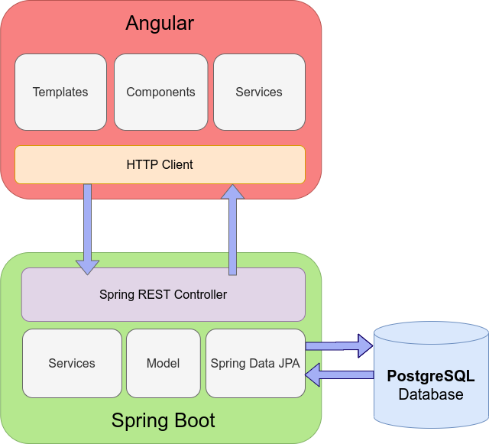
Topic 1 : Application Integration

Slide 62
Agenda Week 7
Work on case study

Slide 63
Agenda Week 8
Work on case study

Slide 64
Agenda Week 9
Work on case study

Slide 65
Agenda Week 10
DEMO and evaluation

Slide 66
Thank You!

Slide 67
Appendix
Add Links or permissible Images as needed

Slide 68
Topic 1 : Web Application and its evolution
Web applications, commonly referred to as web apps, are computer programs that use web browsers and web technology to perform tasks over the Internet. They run on a web server and can be accessed through a web browser on any device connected to the internet.
Static Web Pages (Early 1990s) : HTMLs and no interaction with user or server.
Dynamic Web Pages (Mid-1990s): CGI , dynamic content creation and database interactions.
Web 2.0 (Early 2000s): Interactive web applications, enabling features like real-time updates and rich user interfaces.
Single Page Applications (Late 2000s): JavaScript frameworks like AngularJS and ReactJS, web applications started to mimic the behaviour of desktop applications.
Progressive Web Apps (Mid-2010s): These are web applications that can be installed on a user's device and run offline.
Serverless and Microservices (Late 2010s - Present): The latest trend in web application development is the move towards serverless architectures and microservices. This allows for greater scalability and flexibility, as each part of the application can be developed and deployed independently.

