Slide 1
Week-4 Agenda
Routing, Router Link usage in HTML
Angular Forms
Template driven Forms
Reactive Forms

Slide 2
Angular Routing
Routing in Angular is a fundamental concept that allows you to build single-page applications (SPAs) with multiple views or pages, all within a single HTML page. It enables navigation between different components or views while maintaining the application state.
Routing in Angular typically involves the following components:
Routes: Routes define the mapping between the URL path and the corresponding components to be rendered.
Router: The router is responsible for interpreting the current URL and loading the appropriate components based on the defined routes.
Router Outlet: The router outlet is a placeholder in the application’s template where the content of the current route is rendered.
Router Links and Navigation: Links and navigation elements, such as anchor tags (<a>) or buttons, are used to trigger navigation to different routes within the application.

Slide 3
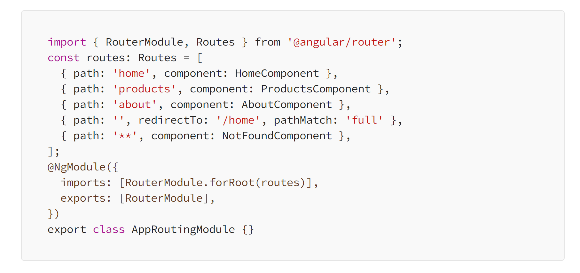
Setting Up Routes
RouterModule:
To enable routing in your Angular application, you need to import the RouterModule and configure it in your main app module.
In this example, an array of route configurations is defined. Each configuration specifies a route path and the component to display when the route is activated. You can also define redirects and a wildcard route for handling unknown paths

Slide 4
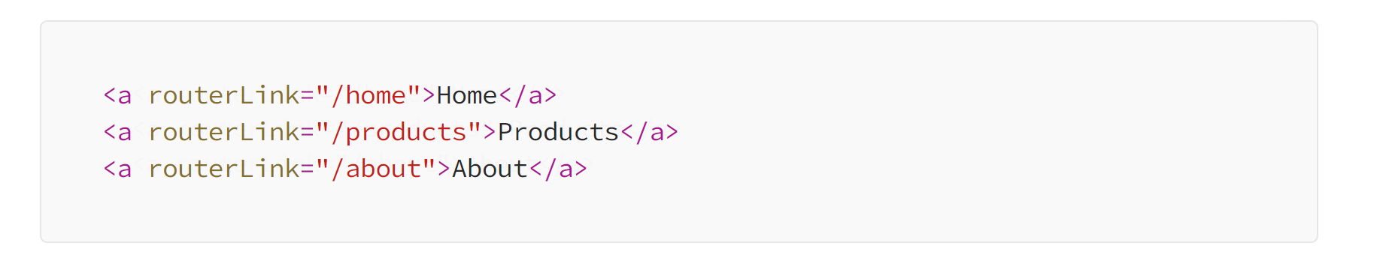
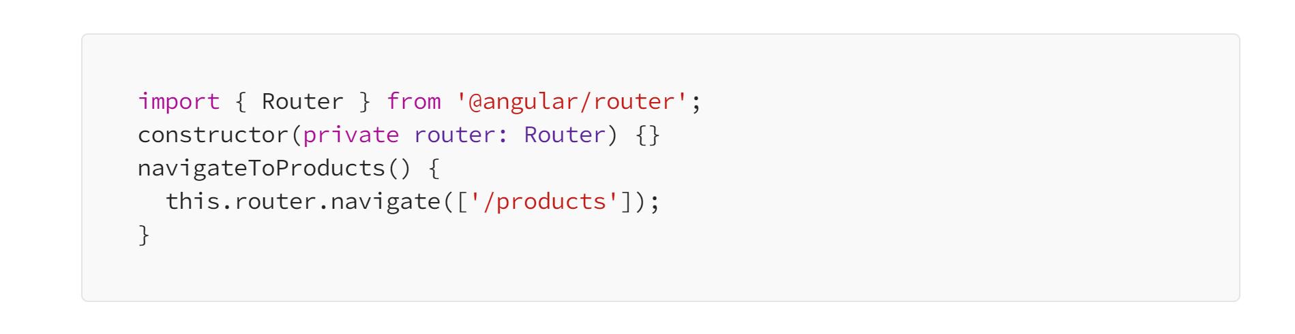
Setting Up Routes
Router Outlet:
To render components associated with routes, you need to add a <router-outlet></router-outlet> element in your main app component's template. This is where the activated component will be displayed.
Navigating Between Routes:
You can navigate to different routes using the RouterLink directive in your templates.
Programmatically, you can use the Router service for navigation in component code.

Slide 5
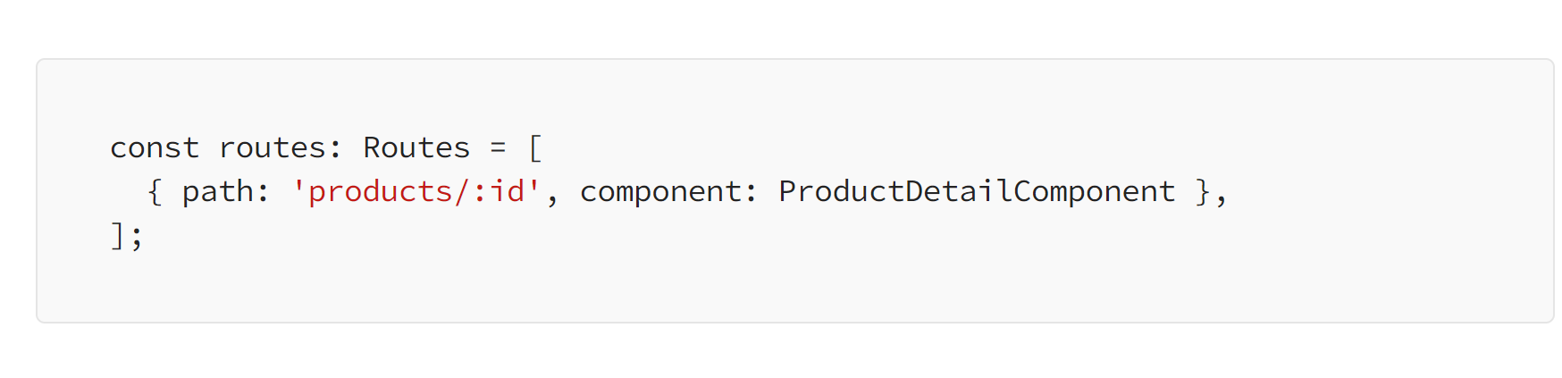
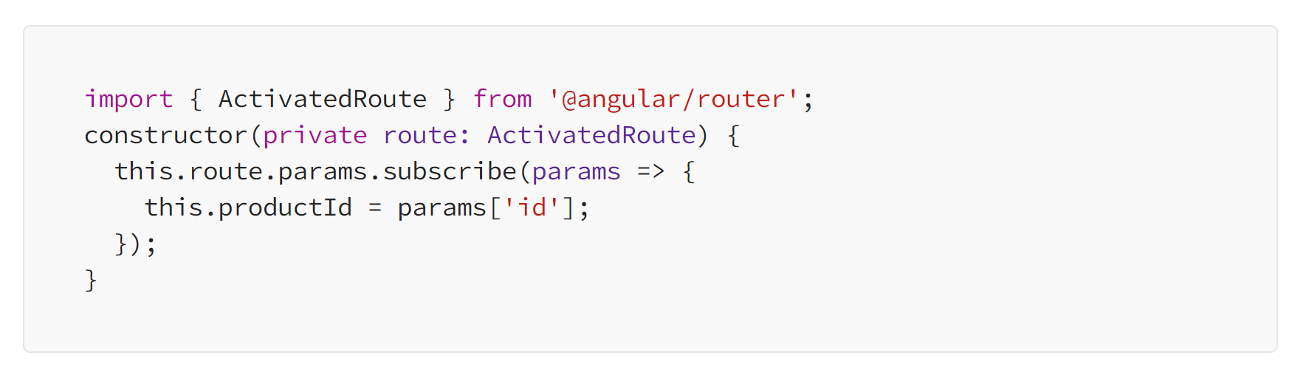
Setting Up Routes
Route Parameters
Routes can have parameters to pass data between components. You define route parameters in the route configuration.
Access route parameters in a component using ActivatedRoute.

Slide 6
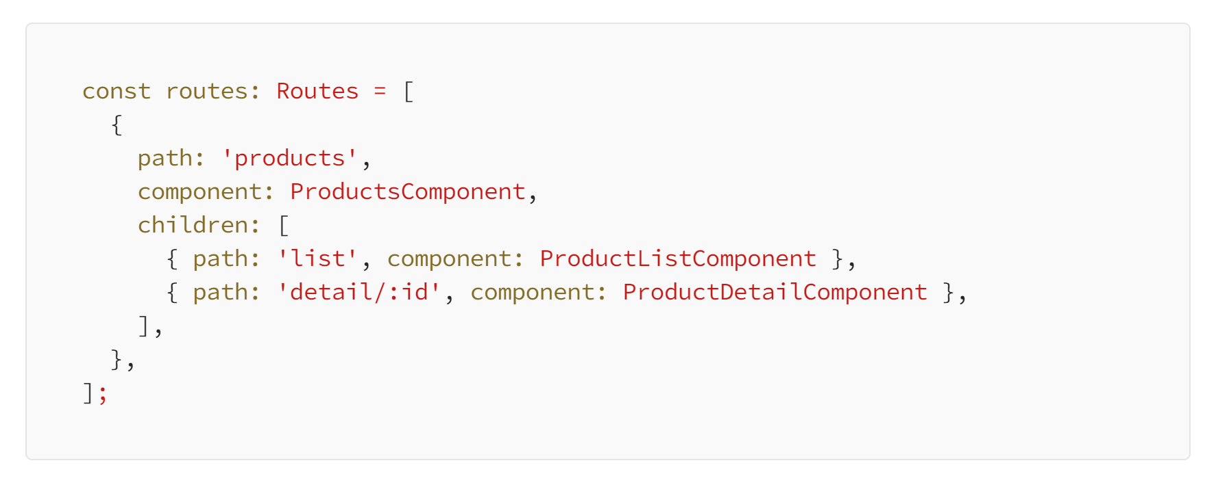
Setting Up Routes
Child Routes
You can create nested or child routes to organize your application’s routes hierarchically.

Slide 7
Angular Forms
Angular Forms are a key aspect of front-end web development with Angular, enabling developers to handle user input and validation in a robust, scalable manner.
Two Types of Forms in Angular:
Template Driven Forms
Reactive Forms

Slide 8
Template Driven Forms
Template-driven forms in Angular are a method to create and manage forms directly within the component's template.
This approach is particularly suitable for simpler scenarios where the form is not too complex, and the ease of use is a priority.
Template-driven forms rely on directives from the FormsModule to work.

Slide 9
Template Driven Forms
Key Features
Two-Way Data Binding: Utilizes Angular's ngModel directive for two-way data binding. This means any input field can be bound to a property in the component class, allowing for an automatic sync of data between the view and the model.
Directives: Template-driven forms make heavy use of directives such as ngModel, ngForm, and validation directives like required, minlength, etc., to create a link between the HTML elements and the Angular form model.
Automatic Form Tracking: Angular automatically tracks the form and input element states (valid, dirty, touched, etc.), making it easier to provide feedback to the user or disable/enable form controls based on the form's validity.
Simple Validation: Validation is straightforward, leveraging HTML5 validation attributes and Angular-specific directives. You can easily show validation errors with simple conditional expressions in your template.

Slide 10
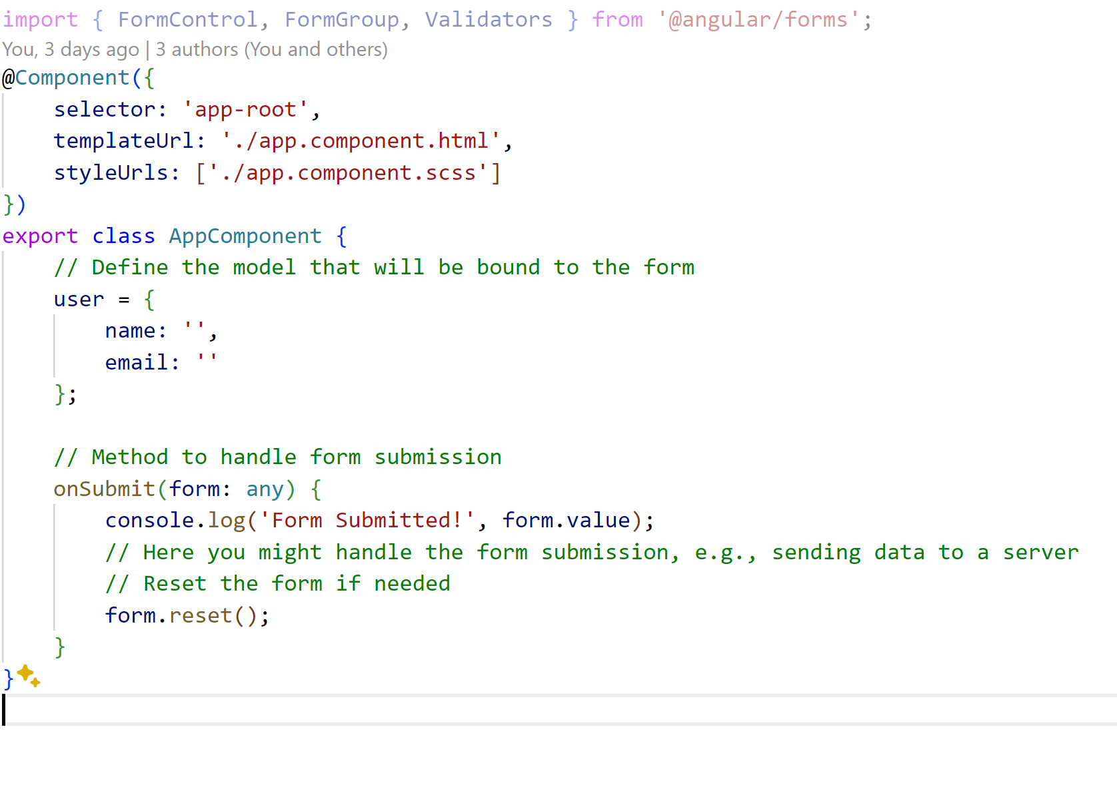
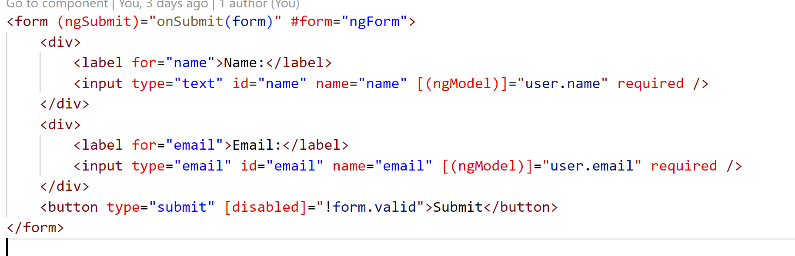
Template Driven Form

Slide 11
Reactive Forms
Reactive Forms in Angular provide a model-driven approach to handling form inputs and validation, offering an alternative to the template-driven method.
This approach gives developers more control and flexibility over form operations, making it well-suited for complex scenarios and dynamic form requirements.
Reactive Forms are part of Angular's ReactiveFormsModule and rely on creating a form model in the component class.
This form model is structured around observable-based form control objects, which include FormControl , FormGroup , and FormArray .
These objects provide a direct representation of the form's structure and state and can be manipulated programmatically to dynamically update the UI.

Slide 12
Reactive Forms
Key Features
FormControl: Represents a single input field. It tracks the value and validation status of an individual form control.
FormGroup: Groups multiple FormControl objects into one unit. It can be nested to create complex form structures, allowing for hierarchical form data.
FormArray: Manages a dynamic array of FormControl, FormGroup, or even other FormArray instances. It's useful for forms where the number of inputs is not fixed, like a dynamic list of hobbies or skills.
FormBuilder: A service that provides a more concise way to create forms programmatically. It's a helper class that simplifies the instantiation of form controls, groups, and arrays.
Validation: Reactive Forms support both synchronous and asynchronous validation. Validators are functions that are attached to form controls or groups and can be custom or built-in.
Value Changes and Status Changes: Observables are provided for both the value changes and the validation status changes of the form or individual controls, making it easy to react dynamically to changes.

Slide 13
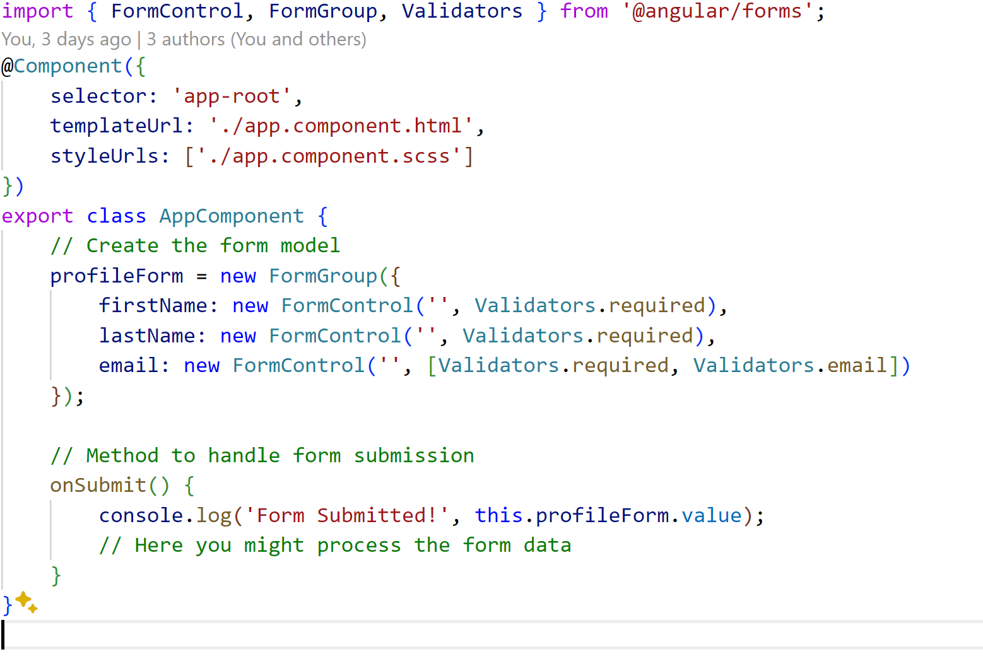
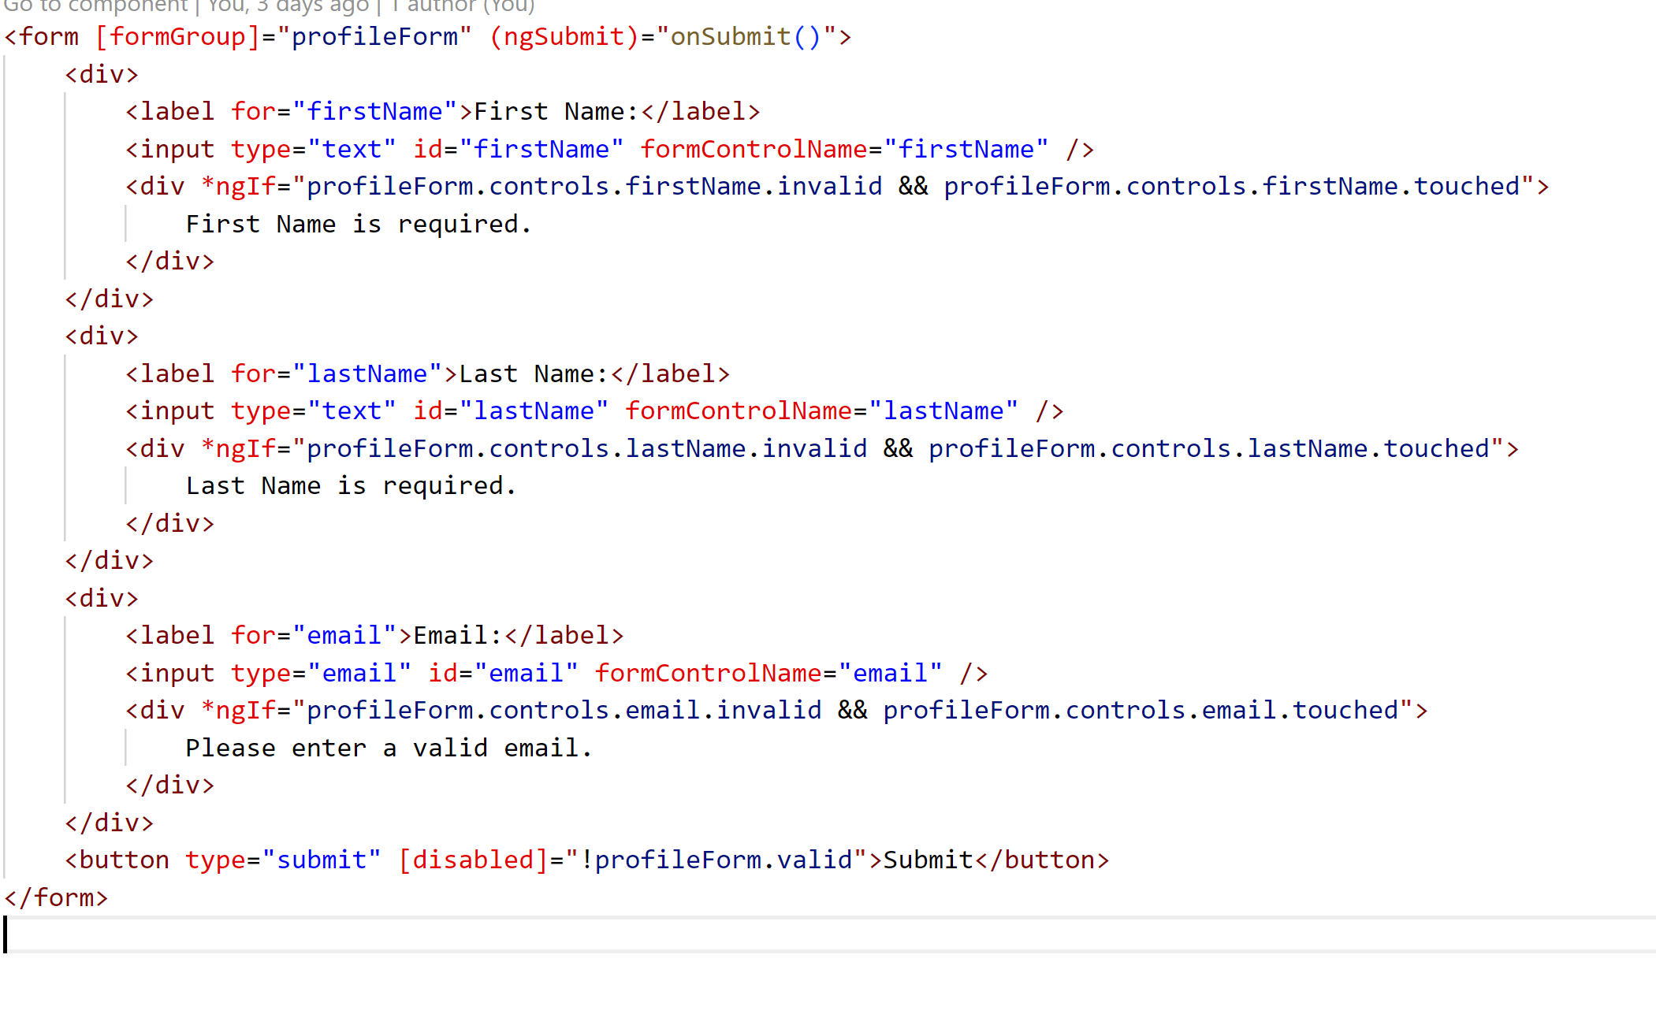
Reactive Forms

Slide 14
Thank you

