Slide 1
BASIC CHATBOT USING PYTHON
D.SPOORTHI
ECE
MallaReddy Engineering College For Women

Slide 2
INTRODUCTION
This project is a simple chatbot developed using Python. The chatbot responds to basic user messages like greetings and simple questions using predefined replies. This project helps in understanding basic Python concepts such as loops, conditions and user input handling.

Slide 3
OBJECTIVE
To create a simple chatbot using Python.
To understand conditional statements and loops.
To simulate basic human conversation using predefined responses.

Slide 4
TOOLS AND TECHNOLOGIES
Python Programming Language
Python IDLE / VS Code

Slide 5
REQUIREMENTS
Python installation on system
Basic knowledge of Python

Slide 6
WORKING
The chatbot accepts input from the user and checks the entered text using if-elif conditions.
Based on the input:
If user types “hello”, chatbot replies “Hi!”
If user types “how are you”, chatbot replies “I’m fine, thanks!”
If user types “bye”, chatbot exits the program.
The loop continues until the user enters “bye”.

Slide 7
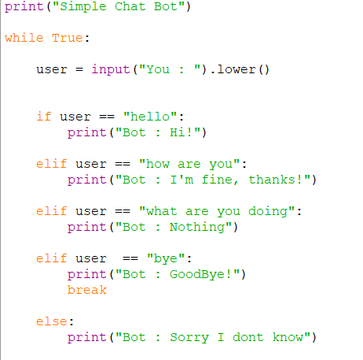
SOURCE CODE

Slide 8
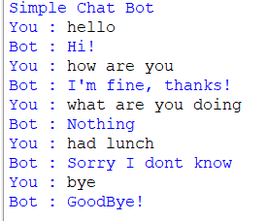
OUTPUT

Slide 9
ADVANTAGES
Simple and easy to understand
Beginner friendly
Helps understand chatbot basics
Improves Python programming skills

Slide 10
LIMITATIONS
Responds only to predefined inputs
Cannot understand complex sentences
No artificial intelligence used

Slide 11
CONCLUSION
The Basic Chatbot project successfully demonstrates simple interaction between user and computer using Python programming. This project helped in understanding loops, conditional statements and user input handling.

Slide 12
FUTURE ENHANCEMENTS
Add voice support
Add more responses
Use AI and machine learning
Create graphical interface

