Slide 1
HANGMAN GAME USING PYTHON
D . Spoorthi
ECE
Malla Reddy Engineering College For Women

Slide 2
INTRODUCTION
Hangman is a simple word guessing game. The player guesses letters one by one. The player has limited attempts to guess the word.

Slide 3
OBJECTIVE
To create a simple game using Python.
To understand loops and conditions.
To improve programming skills.

Slide 4
TOOLS
Python
Python IDLE / VS Code

Slide 5
REQUIREMENTS
Python installed on system
Basic knowledge of Python

Slide 6
WORKING
Program selects a random word.
User guesses letters.
Correct letters are displayed.
Wrong guesses reduce attempts.
Game ends when word is guessed or attempts become zero.

Slide 7
SOURCE CODE
import random
words = ["apple", "tiger", "phone"]
word = random.choice(words)
guessed = ""
attempts = 6
print("Welcome to Hangman Game")
while attempts > 0:
display = "“
for letter in word:
if letter in guessed:
display += letter

Slide 8
SOURCE CODE
else:
display += "_"
print(display)
if display == word:
print("You Won!")
break
guess = input("Guess a letter: ")
if guess in word:
guessed += guess

Slide 9
SOURCE CODE
print("Correct!")
else:
attempts -= 1
print("Wrong!")
print("Attempts left:", attempts)
if attempts == 0:
print("Game Over!")
print("The word was:", word)

Slide 10
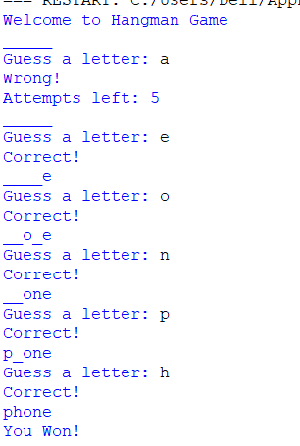
OUTPUT

Slide 11
ADVANTAGES
Easy to understand
Beginner friendly
Improves logical thinking
Helps learn Python basics

Slide 12
LIMITATIONS
The game uses only predefined words.
No graphics or animations are included.
The player can guess only single letters.
The game runs only in text mode.

Slide 13
CONCLUSION
The Hangman Game project was successfully developed using Python.
This project helped in understanding loops, conditions and strings in Python.

Slide 14
FUTURE ENHANCEMENTS
Add more words to the game.
Add difficulty levels.
Add sound effects and animations.

