Slide 1
Cyclone Detection & Early Warning System — Agentic AI for Disaster Management & Climate Resilience — IBM Bob + IBM Granite LLM + IBM Cloud

Slide 2
TEAM : CYCLONE GUARD AI
DOMAIN: DISASTER MANAGEMENT & CLIMATE RESILIENCE
Project: Cyclone Detection & Early Warning System
Need of Project: India faces 5–6 cyclones annually along the Bay of Bengal and Arabian Sea. Cyclone Biparjoy (2023) affected 1M+ people; Cyclone Fani (2019) caused $8.1B in damage. Delayed identification of cyclone formation and limited early warnings cost lives, displace communities, and damage critical infrastructure. This AI system detects cyclone formation 72+ hours in advance, predicts landfall with uncertainty cone, and generates location-specific preparedness alerts for NDMA, state DMA authorities, and coastal communities.
Team Lead
Methodology
Analyze meteorological data (atmospheric pressure, wind speed, SST, humidity) for cyclogenesis signatures. Process INSAT-3D/3DR satellite imagery for spiral band patterns and eye formation. IBM Granite LLM via watsonx.ai generates real-time threat assessments and actionable alerts.
Use AI/ML to detect anomalies and predict salinity risk. IBM Granite explains risks and generates farm-specific recommendations. Continuous monitoring enables early intervention and decision support.
IBM TOOLS USED
IBM Granite / LLaMA 3-70B – Cyclone analysis, intensity prediction & alert generation
IBM Bob – Full-stack agentic AI development & code generation
IBM Cloud (watsonx.ai, eu-gb) – LLM inference & cloud infrastructure
Agentic AI – 7-agent supervised pipeline with ReAct loop, memory & MCP tools
.
Conclusion and Demonstration
Impact of the Project Implimentation for example (" If farmers used my project the ratio of Farmers will decrease up to 20%.): The system delivers 72-hour animated cyclone track forecasts, automated RED/ORANGE/YELLOW district alerts, NDRF deployment recommendations, and evacuation planning — protecting 1.95M+ coastal residents. The prototype demonstrates Mission Control Dashboard with animated cyclone map, 7 AI agent detail pages, LLM comparison benchmarks, observability traces, and a full AI governance dashboard aligned with NDMA and DMA 2005 guidelines.
Sushmitha MG
Spoorthi T J

Slide 3
Development with IBM Bob
1 REQUIREMENTS
2 BOB CREATES PLAN
3 REVIEW & REFINE
Capture and clarify project goals, constraints, and acceptance criteria with Bob.
Bob generates a structured, step-by-step development plan with file structure and dependencies.
Team reviews, adjusts, and approves the plan before any code is generated.
4 CODE GENERATION
5 REVIEW OUTPUT
6 RUN & VALIDATE
Bob generates 7 AI agents, Streamlit UI, gateway/LLM router, ChromaDB memory, MCP tool registry, 9-category guardrails, and governance framework.
Team reviews generated code for correctness, style, and completeness.
Run the application end-to-end and validate against the original requirements.
7 BOB EXPLAINS
8 QUALITY & TESTS
9 DOCUMENTATION
Bob explains the implementation decisions and guides the team through the codebase.
Bob generates tests, identifies edge cases, and suggests quality improvements.
Bob auto-generates README, API docs, and inline code documentation.

Slide 4
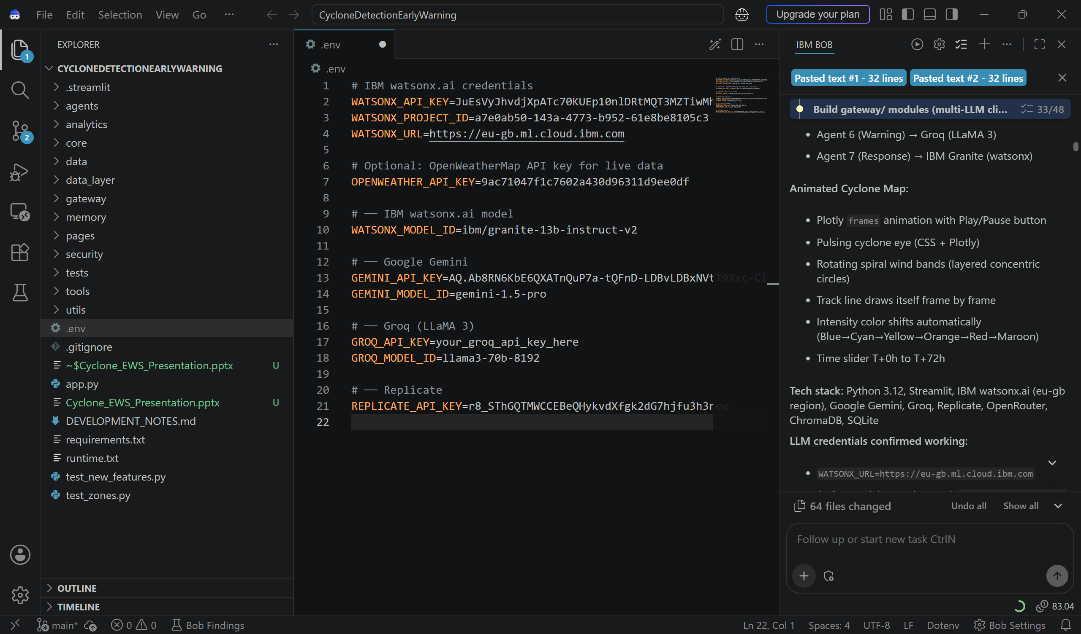
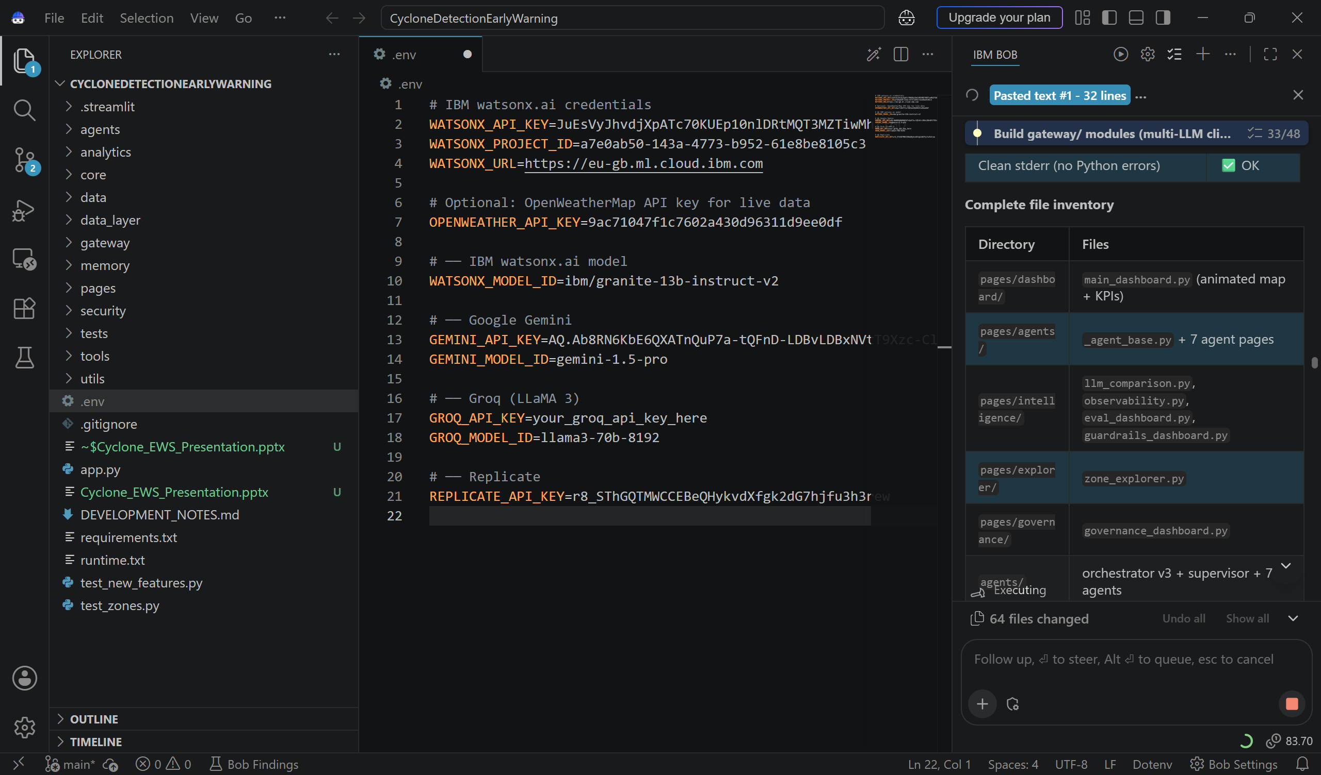
IBM Bob — Files & Code Generated
IBM Bob — Cyclone EWS Project File Structure
IBM Bob — Code Generation Session
[Screenshot: Bob-generated project — agents/, gateway/, core/, memory/, tools/, analytics/, security/, pages/ with 60 Python files]

Slide 5
Features of the Project
7-AGENT AI PIPELINE
ANIMATED 72H CYCLONE MAP
9-CATEGORY GUARDRAILS
8 specialized agents collaborate through an orchestrator to simultaneously tackle groundwater, drought, crop, recharge, water budgeting, and reporting challenges.
Plotly frames animation — cyclone eye pulses, spiral wind bands rotate, track draws frame-by-frame. Intensity auto-shifts Green→Yellow→Orange→Red (Cat 1→4). Time slider T+0h to T+72h with Play/Pause controls.
Input injection, hallucination detection, toxicity, PII masking, jailbreak prevention, token budget, HITL escalation, loop detection, and bias scoring — 40+ safety checks across all 7 agents.
No other system combines multi-agent AI with village-level explainable recommendations.
MULTI-LLM ARCHITECTURE
DISTRICT-LEVEL IMPACT ASSESSMENT
IBM watsonx (Weather, Detection, Response), Google Gemini (Tracking, Impact), Groq (Intensity, Warning). Per-agent LLM routing via core/llm_router.py with automatic fallback chain. 60+ Python files generated by IBM Bob.
Assesses risks to population (1.95M+), infrastructure, agriculture, and essential services across 5 coastal states. Generates RED/ORANGE/YELLOW alerts with evacuation routes and NDRF deployment coordinates.

Slide 6
Novelty & Future Scope
NOVELTY & UNIQUENESS
FUTURE SCOPE
72-Hour Animated Track Forecast
Advanced Prediction
First system to combine Plotly frame animation with pulsing cyclone eye, rotating spiral bands, and frame-by-frame track drawing — all inside Streamlit, no external player needed.
Improve drought and groundwater forecasting using richer historical datasets and ML models.
Multi-LLM Per-Agent Routing
SMS & Mobile Alert Integration
Each agent is paired with the best LLM for its task — watsonx for structured analysis, Gemini for spatial prediction, Groq for ultra-low latency alerts — with automatic fallback chain.
Direct SMS broadcast to 3M+ coastal residents via Common Alert Protocol (CAP) and NDMA national alert relay system.
Full Observability & Governance
GIS & Satellite Integration
ReAct execution traces, SQLite metrics, 15 named governance policies, immutable audit trail, and regulatory alignment with NDMA, DMA 2005, and IMD SOP — all visible in the dashboard.
Live INSAT-3DR imagery processing with ML-based cloud pattern classification and coastal DEM-based storm surge modelling.
Coastal Zone Intelligence
Regional & Global Scale-Up
5 Indian coastal divisions (Bay of Bengal N/S, Arabian Sea, Andaman, Lakshadweep) with district-level risk scoring, flood-prone settlement mapping, and population vulnerability analysis.
Expand coverage to the Arabian Sea, South China Sea, and Bay of Bengal — covering cyclone-prone coastal regions across South and Southeast Asia.

