Slide 1
CYBER ASSURE
SECURE RISKS. SMARTER CLAIMS.
Presented By : Mudragada Spoorthy

Slide 2

THE RISING THREAT
Organizations are becoming more vulnerable to cyber attacks, which can cause serious financial and operational damage. However, many organizations do not have a clear and centralized system to manage cyber risks, report incidents, and handle claims. Without a single platform to manage these processes, recovery becomes slower and coordination between different stakeholders becomes difficult.

Slide 3

Where Security Meets Intelligence
CyberAssure is a centralized digital platform that helps organizations manage cyber risk protection through streamlined policy management, efficient incident reporting, and structured claim processing. It connects administrators, underwriters, claims officers, and customers on a single platform to ensure transparent risk evaluation and faster claim assessment.

Slide 4





Who Drives the System
Customer
Admin
Under writer
Claims Officer
Registers company details, requests and purchases policies, reports cyber incidents, and raises claim requests.
Manages sector-wise policies, oversees system operations, assigns underwriters and claims officers, and monitors claim analytics.
Evaluates policy requests, verifies organizational risk details, and approves or rejects policy applications.
Reviews incident reports, assesses claims using defined factors, and determines claim approval or rejection.

Slide 5
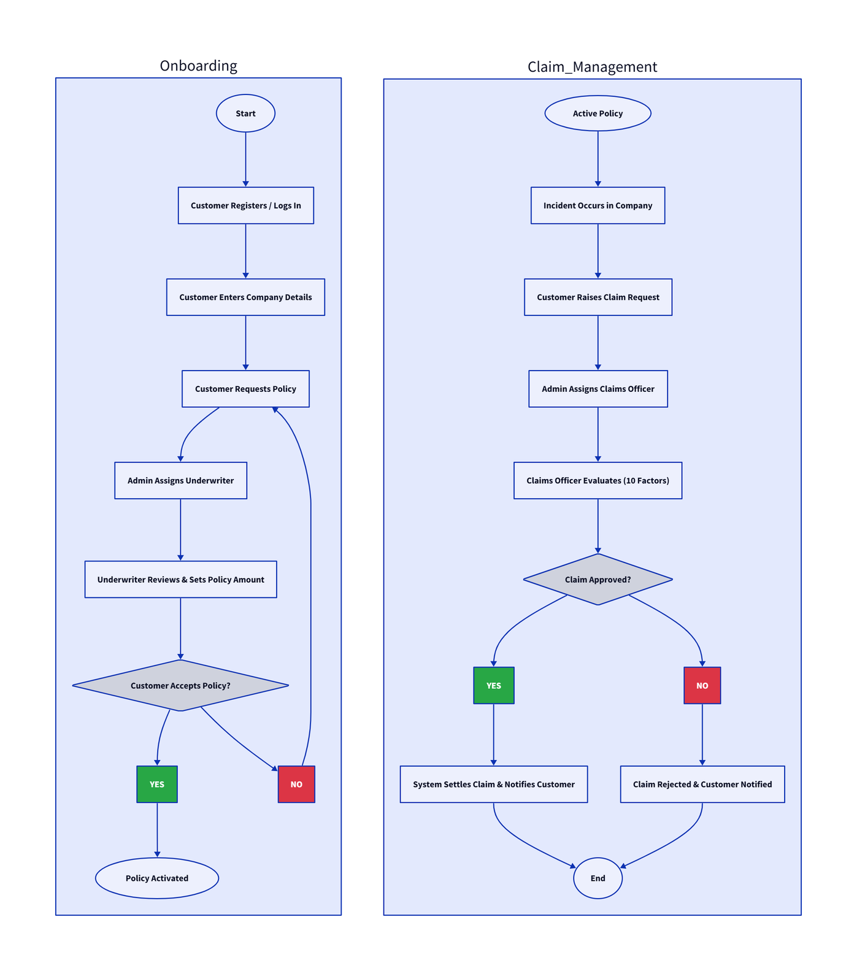
Application Process Flow

Slide 6
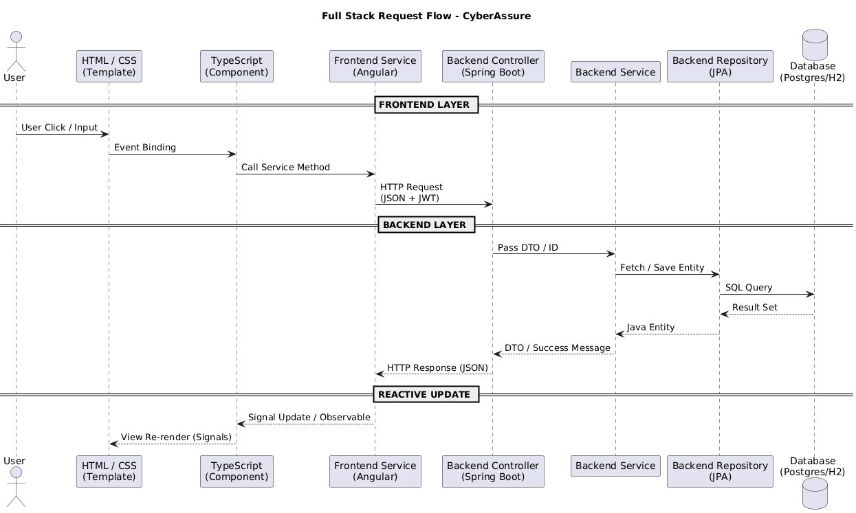
Architecture Workflow

Slide 7

The Decision Engine
Coverage & Remaining Limit: Ensures the claim amount does not exceed the policy’s vested coverage and remaining benefits.
Policy Validity Check: Verifies that the incident occurred within the active policy period.
Covered Incident Type: Confirms that the reported cyber incident is included in the policy benefits.
4. Deductible Rule: Applies the policy’s deductible amount that the policyholder must bear before insurance payout.
Timely Reporting (30-Day Rule): Checks whether the claim was filed within 30 days of the incident occurrence.
Evidence Verification: Validates supporting proof such as uploaded documents or police reports.
Sub-Limit Threshold Check: Flags claims exceeding 50% of policy coverage for additional review.
Claim Frequency Analysis: Evaluates previous settled claims to detect unusually frequent claim patterns.
Fraud Suspicion Detection: Identifies suspicious claims based on missing evidence or abnormal claim behaviour.
Recommended Payout Calculation: Determines the final payable amount considering policy limits, remaining coverage,and deductible.

Slide 8





Impact That Matters!
Financial Recovery
Automated Insurance
Faster financial recovery after cyber incidents
Streamlines the entire process, reducing manual work.
Efficient Policy Management
Data-Driven Objectivity
Replaces manual bias with automated, system-calculated settlements.
Enables sector-wise policy management

Slide 9

The Road Ahead..
CONCLUSION
AI-Driven Risk Intelligence- Leverage advanced machine learning models to predict cyber risks and enhance fraud detection accuracy.
Real-Time Threat Monitoring- Integrate with cybersecurity systems to enable continuous threat tracking and instant alerts.
Mobile Application Integration- Develop a user-friendly mobile app for seamless policy management, incident reporting, and claim tracking.
CyberAssure delivers a unified platform for managing cyber insurance operations, including policy administration, incident reporting, and claim processing.
By integrating stakeholders and leveraging a rule-based claim evaluation system, it enhances transparency, accelerates decision-making, and strengthens organizational response to cyber threats

Slide 10
THANK YOU !
Let’s Secure the Future Together

