Slide 1


AIR QUALITY INDEX(AQI) ANALYSIS IN INDIA
Presented By
Student Name: SPOORTHY LAKSHMI G
College Name:VCET PUTTUR
Department:COMPUTER SCIENCE
Email ID:SPOORTHYLAKSHMIG@GMAIL.COM

Slide 2
OUTLINE:
Problem Statement (Should not include solution)
Proposed System/Solution
System Development Approach (Technology Used)
Algorithm & Deployment
Result (Output Image)
Conclusion
Future Scope
References

Slide 3
Problem Statement:
Air pollution has become a major environmental and health concern in many regions of India. Monitoring air quality is important to understand pollution levels and identify the pollutants that contribute most to poor air quality. However, large volumes of air quality data collected from monitoring stations are difficult to interpret without proper analysis and visualization. Therefore, there is a need for a system that can analyze air quality data and present meaningful insights through interactive visualizations to help understand pollution patterns and support environmental decision-making.

Slide 4
Proposed Solution:
The proposed system is an interactive Air Quality Index (AQI) dashboard developed using Microsoft Power BI to analyze and visualize air pollution data across India.
The system collects air quality data containing information about different pollutants such as PM2.5, PM10, NO2, CO, OZONE, and SO2 along with geographical coordinates.
The solution processes and visualizes the data through interactive charts and maps that allow users to explore pollution levels across different locations. The dashboard includes key visualizations such as:
Average AQI indicator to show overall air quality level
Map visualization to display pollution distribution across India
Bar chart to compare pollution levels by pollutant type
Pie chart to identify dominant pollutants
Interactive slicer to filter data based on pollutant type
This solution helps users quickly understand pollution patterns and identify the most harmful pollutants affecting air quality.

Slide 5
System Approach:
The system was developed using a data analytics and visualization approach.
Technologies Used:
• Microsoft Power BI – For data visualization and dashboard creation
• Power Query – For data cleaning and transformation
• Data Modeling – To organize and structure the dataset
• Interactive Visualizations – To display insights through charts and maps
System Requirements:
Hardware Requirements:
• Computer/Laptop with minimum 8GB RAM
• Internet connection
Software Requirements:
• Microsoft Power BI Desktop
• Windows Operating System
Dataset:
Air Quality Index dataset containing pollutant values, geographic coordinates, and AQI measurements.

Slide 6
Algorithm & Deployment:
The system uses a data analysis and visualization approach rather than traditional machine learning algorithms.
Data Input:
The system takes air quality data containing pollutant values such as PM2.5, PM10, NO2, CO, OZONE, and SO2 along with latitude and longitude coordinates.
Data Processing:
• Data cleaning using Power Query
• Handling missing values and formatting columns
• Structuring the dataset for analysis
Data Visualization:
The processed data is visualized using Power BI visualizations such as:
• Card visual for Average AQI
• Map visualization for pollution distribution
• Bar chart for pollutant comparison
• Pie chart for dominant pollutant analysis
Deployment:
The dashboard can be deployed using Power BI Service, allowing users to access and interact with the report online.

Slide 7
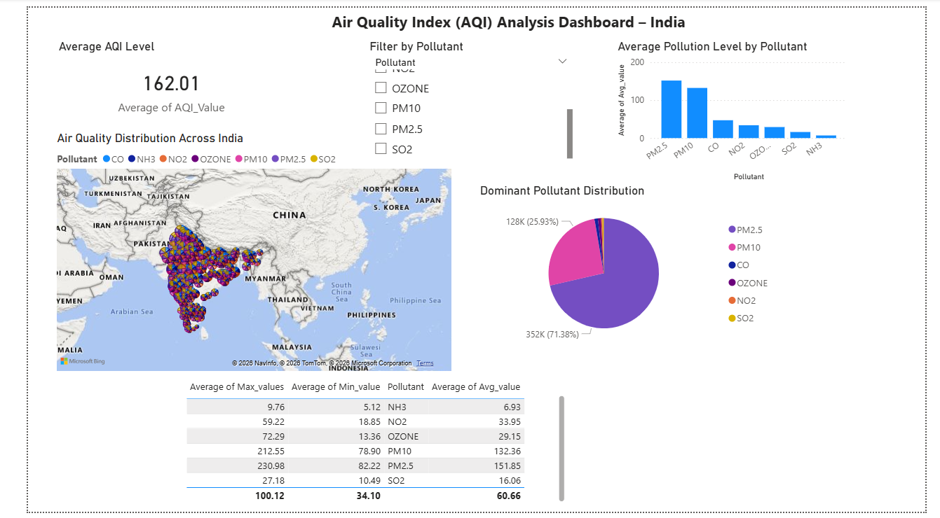
Result:
The developed Power BI dashboard successfully analyzes
air quality data and provides meaningful insights through
interactive visualizations.
The dashboard displays:
• Average AQI level across the dataset
• Geographic distribution of pollution across India
• Comparison of different pollutants
• Identification of dominant pollutants affecting air quality
Users can interact with the dashboard by applying
filters and exploring pollution levels across different locations.

Slide 8
Conclusion:
The Air Quality Index Analysis Dashboard effectively transforms raw air quality data into meaningful visual insights using Microsoft Power BI. By presenting pollution levels through maps, charts, and interactive filters, the system helps users understand pollution distribution and identify dominant pollutants affecting air quality. This approach demonstrates how data analytics and visualization tools can support better understanding and monitoring of environmental conditions.

Slide 9
Future scope:
The system can be further enhanced by integrating real-time air quality data from environmental monitoring stations and incorporating machine learning models to predict future AQI levels. Additional features such as city-wise analysis, automated pollution alerts, and integration with web or mobile applications can improve accessibility and provide more detailed insights into air quality trends.

Slide 10
References:
1. Microsoft Power BI Documentation
https://learn.microsoft.com/power-bi/
2. Central Pollution Control Board (CPCB) – Air Quality Data
https://cpcb.nic.in
3. Air Quality Index (AQI) Guidelines – Government of India
4. Data Visualization Best Practices – Microsoft Power BI
GitHub Link: Link

Slide 11
Thank You

