Slide 1

Data Structures & Algorithms
y
Online Shopping
🛒
(E-Commerce) System
E-Commerce
System
Guided by : Dr .MAHESH BABU ARRAMA SIR
Team Members:
Sirisha Atavali | Roll No: 2510030217
Spoorthy Reddy | Roll No: 2510030107 Chandana Reddy | Roll No: 2510030376
Guided by: Department of Computer Science & Engineering, KL University

Slide 2
Project Overview
What is this Project?
Products
Managed with Arrays
An Online Shopping System is a real-time application used to manage products, customers, orders, payments, and deliveries. E-commerce platforms handle millions of users and transactions daily, making efficient data management extremely important. This project illustrates how Data Structures and Algorithms are used to design a scalable and efficient e-commerce system.
Cart Items
Linked Lists
Orders
Queue System
Undo/Redo
Stack Operations

Slide 3
KL nivrsity
Data Structures & Algorithms Used
Arrays
Queue
Store product IDs, prices, category codes, discount %
Order processing, delivery requests, complaint handling
Linked Lists
Binary Search
Shopping cart items, order history, browsing history
Find products by name or ID efficiently (O log n)
Stack
Sorting
Undo/Redo cart operations, backtracking in checkout
Sort products by price/rating, orders by delivery date

Slide 4
iy
System Architecture & Workflow
Customer
Registration
→
Product
Browse & Search
→
Add to Cart
(Linked List)
→
Checkout
(Stack)
→
Order Queue
& Delivery
How DSA Powers Each Step
Operation | Data Structure | Algorithm Used
Product Storage | Arrays | Linear / Binary Search
Shopping Cart | Doubly Linked List | Insertion at Head/Tail
Undo Cart Changes | Stack (LIFO) | Push / Pop
Order Processing | Queue (FIFO) | Enqueue / Dequeue
Sort by Price | Array | Bubble / Selection Sort

Slide 5
Team Work
Sirisha Atavali | Chandana Reddy | Spoorthy Reddy
Arrays – Product Storage (id, name, price, quantity) | Stack – Undo last cart item (LIFO) | Linked List – Shopping Cart & Order History
File Handling – Load & Save products from file | Queue – Order processing system (FIFO) | Add / Remove Products – Stock update & new product
Overall System Integration – Main method & menu | Order Processing – Place & process orders | Exception Handling – Invalid inputs & error handling

Slide 6
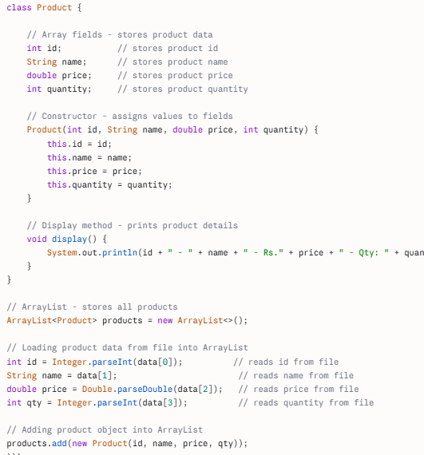
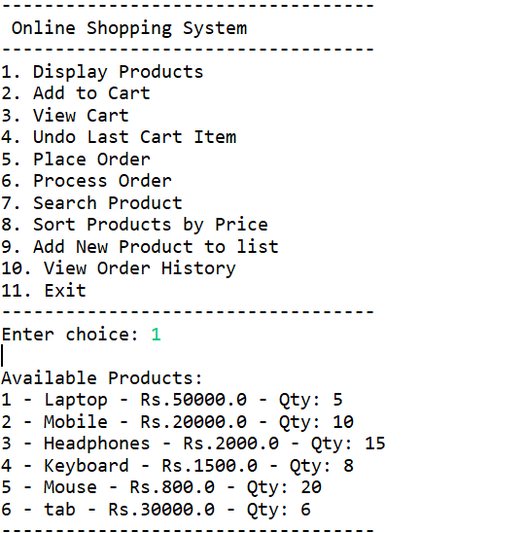
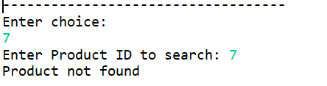
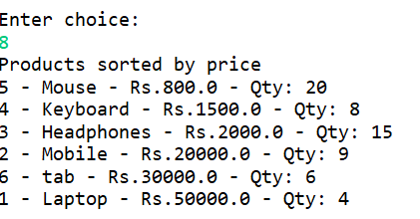
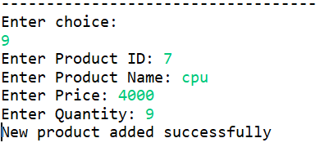
Operation 1 — Arrays
Purpose: Store product IDs, price lists, category codes and discount percentages. Arrays provide O(1) index-based access.
Code Screenshot
Output Screenshot

Slide 7
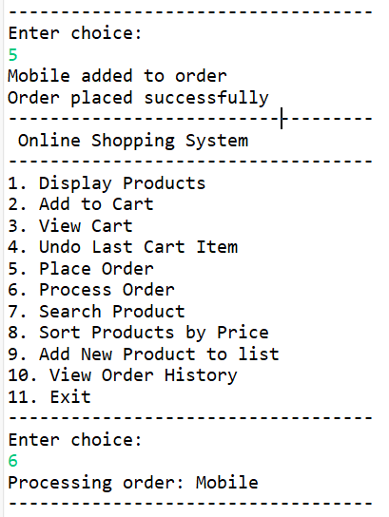
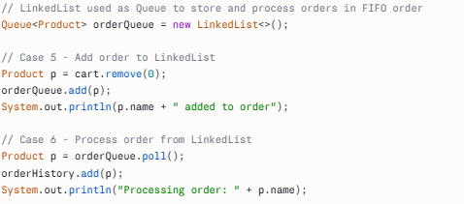
Operation 2 — Linked Lists (Shopping Cart)
KL University
Purpose: Dynamic cart management — add/remove items without shifting. Order history and browsing history stored as linked nodes.
Code Screenshot
Output Screenshot

Slide 8
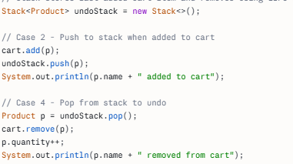

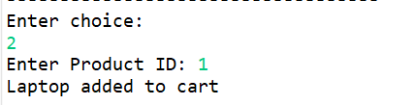
Operation 3 — Stack (Undo/Redo Cart)
KL University
Purpose: Stack (LIFO) allows users to undo cart modifications and backtrack during the checkout process, recovering from mistakes.
Code Screenshot
Output Screenshot

Slide 9
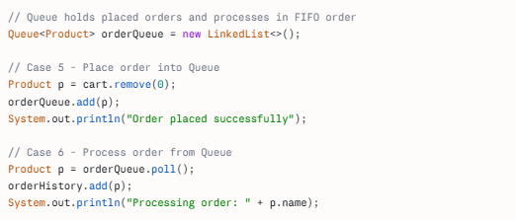
Operation 4 — Queue (Order Processing)
KL
Purpose: Queue (FIFO) ensures orders, delivery requests, and customer complaints are processed in arrival order — fair and systematic.
Code Screenshot
Output Screenshot
]

Slide 10
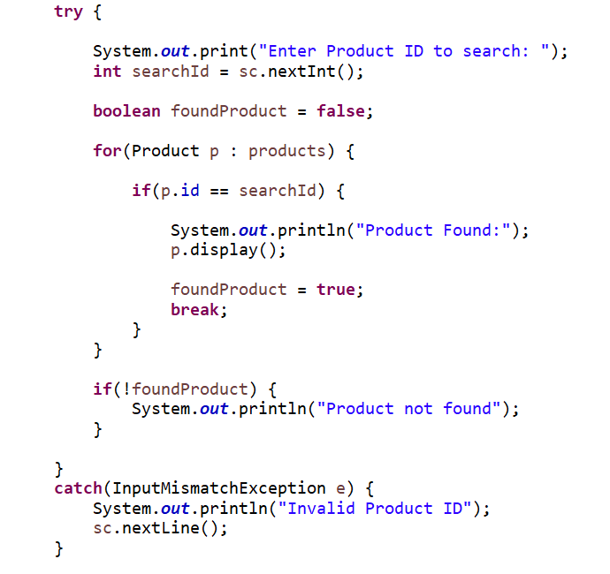
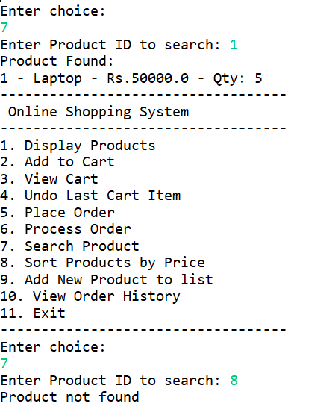
Operation 5 — Searching Algorithms
vrsity
Purpose: Linear Search scans unsorted data. Binary Search (O log n) locates products by name/ID in sorted arrays — much faster.
Code Screenshot
Output Screenshot

Slide 11
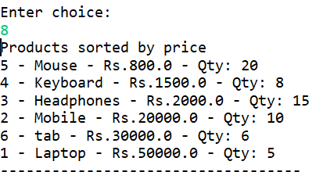
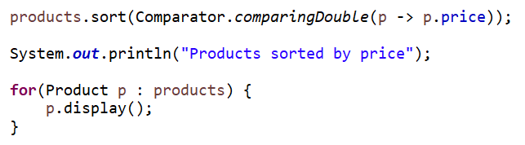
Operation 6 — Sorting Algorithms
KL University
Purpose: Bubble Sort & Selection Sort arrange products by price/rating and orders by delivery date, improving the user experience.
Code Screenshot
Output Screenshot

Slide 12
KL University
Conclusion
Arrays enable O(1) product retrieval by index — fast and memory efficient.
Linked Lists provide flexible cart management with efficient insertions and deletions.
Stack implements Undo/Redo, making the checkout experience user-friendly.
Queue ensures fair and ordered processing of deliveries and complaints.
Binary Search dramatically speeds up product lookup in large catalogs.
Sorting algorithms enhance the shopping experience through organized product listings.
KL University — Department of CSE | Data Structures & Algorithms

