Slide 1
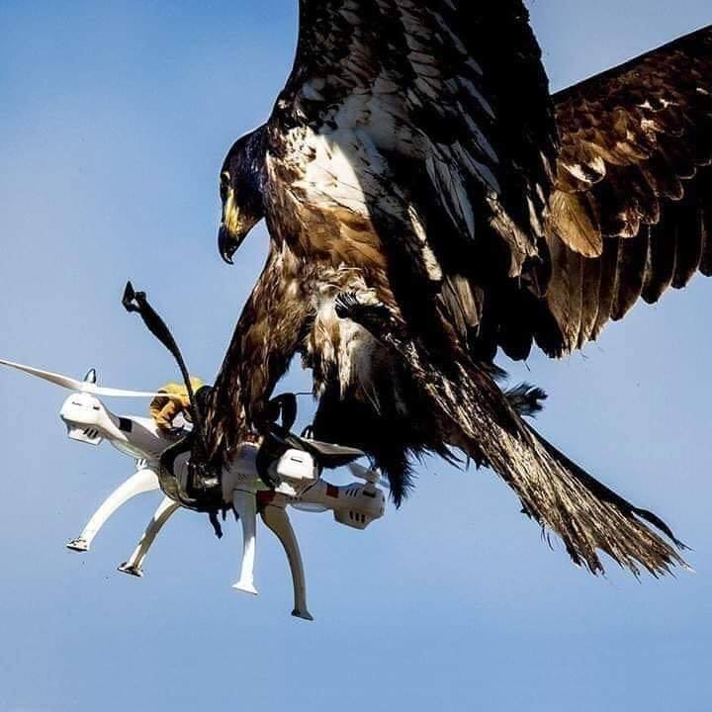
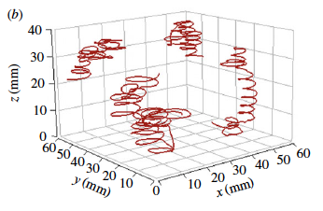
Food web and ecomechanics
Bianco et al (2014)
Leipzig, workshop on mechanics of food webs

Slide 2
So far:
Motivations for ecomechanical approach:
Generality, predictability (topology emerging rather than assumed or measured)
Objectives:
Improve reliability and generality of feasibility predictions (extend and improve ecomechanical model)
Better predict food webs (integration with food web models); test predictions with GateWays database.
Test model assumptions and restricted predictions with smaller, adapted databases with biomechanical traits.
Improvements:
Capture process, detection (at low viscosity) , dimensionality, prey population density, shape
Additional traits:
Predator metabolic type; Prey defense; Predator strategies
Mechanistic models for integration:
ADBM (Allometric Diet Breadth Model), Ecomechanical model; Vacuum-cleaner model, dimensionality model; bioenergetic population model?
Databases
GATEWAYs, Biotraits?
Longer term perspective
Integrate other types of interactions beyond pure predation (parasites…).

Slide 3
To do:
Motivations for ecomechanical approach:
Still some convincing: what can an ecomechanical (more generally mechanistic) food web approach do that other approaches can’t?
Objectives:
ø
Improvements:
turbulence, solid surfaces/complex landscapes/refuges
Additional traits:
Temperature
Mechanistic models for integration:
Define the set of models to integrate
Databases
Biomechanical databases?
Longer term perspective
Predict the size structure/traits of species as a function of the physical properties of the habitat.

