Slide 1


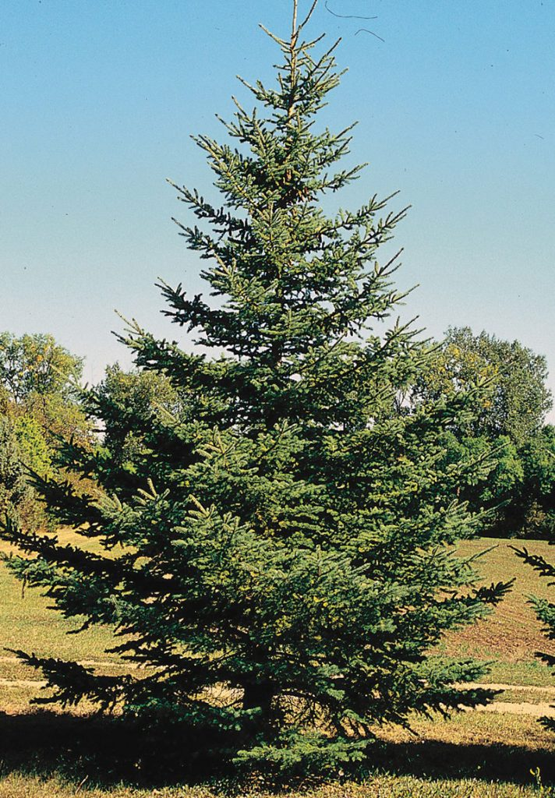
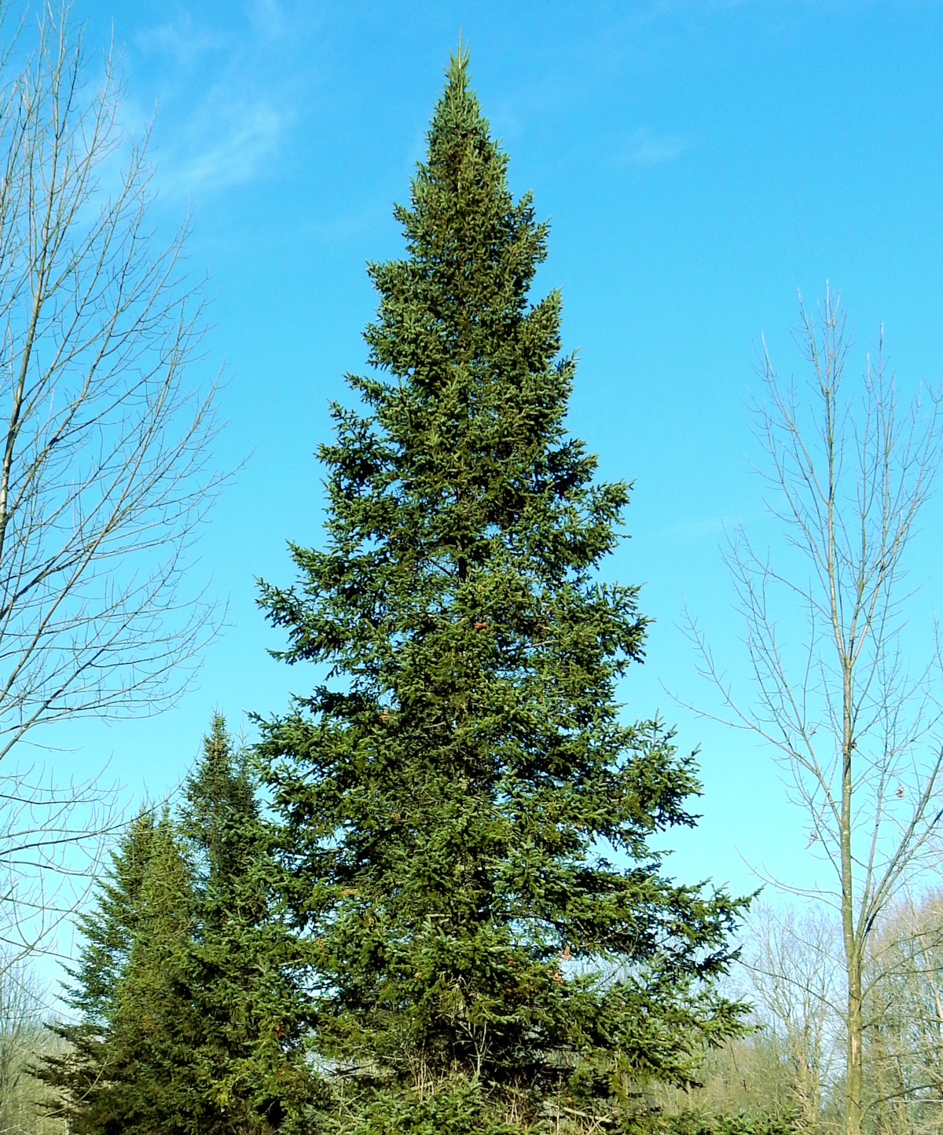
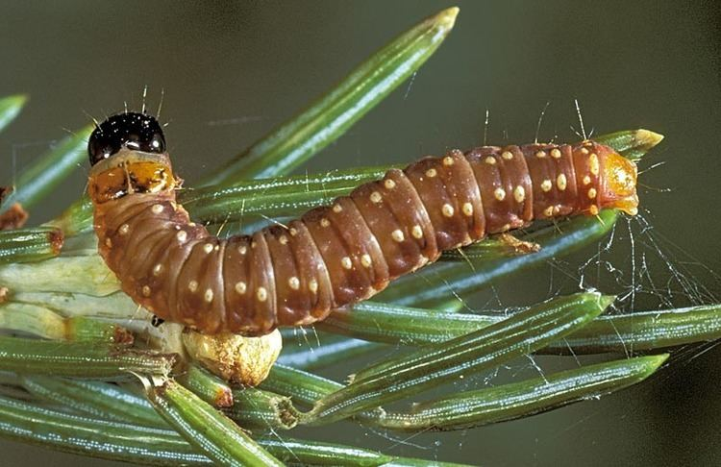
Modelling SBW phenology in a changing climate
Frithjof Lutscher
Sebastien Portalier
University of Ottawa

Slide 2
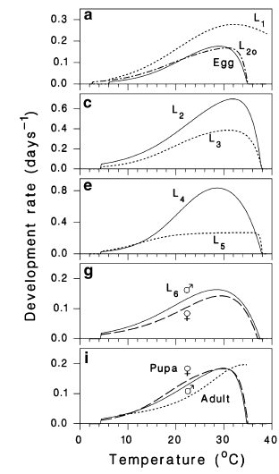
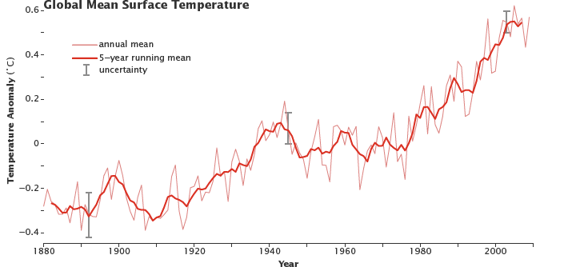
SBW development is temperature-dependent
Regniere et al., 2010
Shift in temperature occurs

Slide 3
Phenology mismatch?
Shift in temperature may affect SBW phenology
Host phenology may also shift
Consequences?
SBW may grow in regions where “traditional” hosts are not present
Survival depends on the ability to accomplish a full developmental cycle in synchrony with seasons (e.g. diapause during winter)

Slide 4
Objective
Approach
Evaluate impacts of phenology mismatch on long term population dynamics and spatial distribution of SBW
Dynamic model that integrates:
  Phenology
  SBW population dynamics
  Host population dynamics
  External drivers (e.g. temperature)

Slide 5
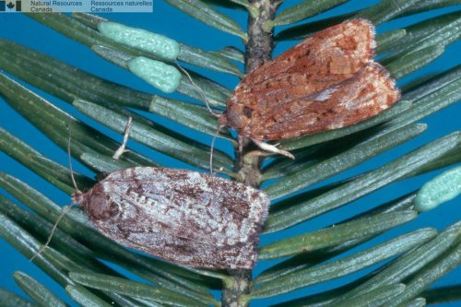
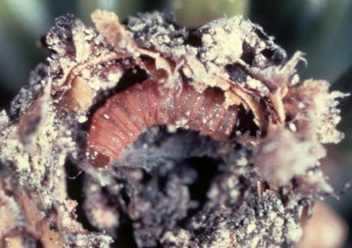
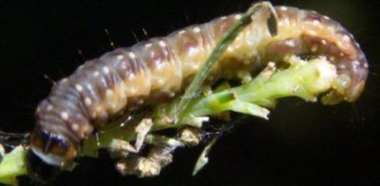
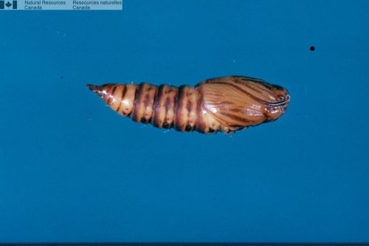
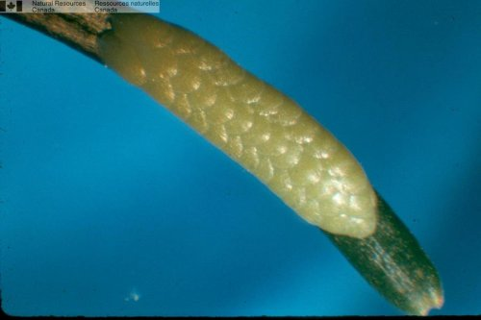
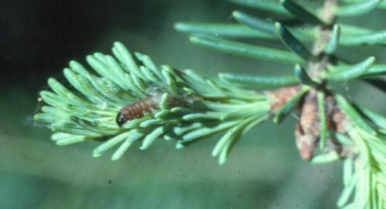
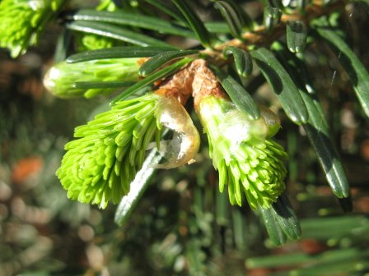
Model
eggs
L1
L2
diapause
L3
L4
L5
L6
pupa
adults
eggs
time
Bud burst

Slide 6
Model
Adult
Eggs
Pupa
L6
L1
L5
L2
L4
Bud burst
Diapause (L2)
L3

