Slide 1
Completely customizable user experience
Show or hide boxes/features
Skip steps or complete full and robust alignment
Utilize a variety of tools and graphics
Expandable
More tools and features added with time
User feedback produces more robust tool

Slide 2
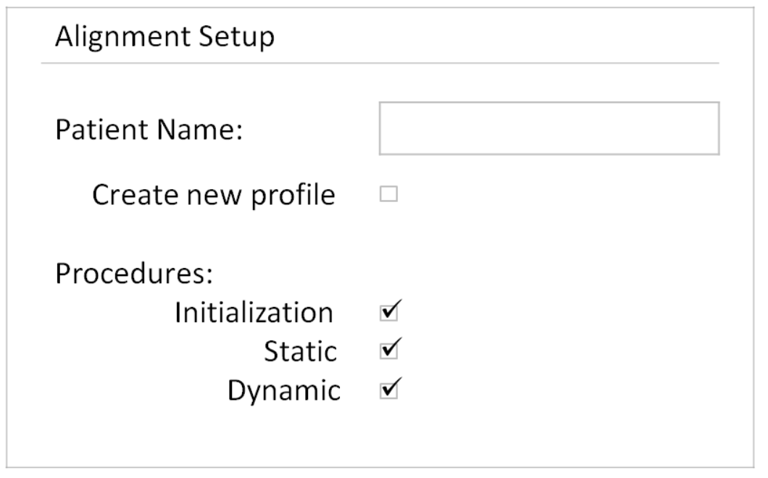


+ Begin New Alignment
Begin Alignment

Slide 3
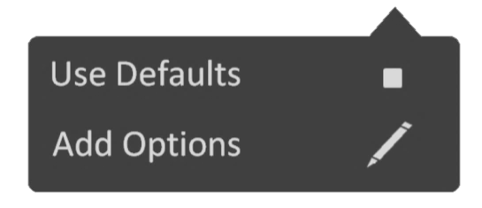
+ Begin New Alignment
Begin Alignment

Slide 4
Patient Profile
Proceed
help
 | Patient Profile
 | Patient Name: | Alan Mint
 | Injury type Date of Birth Weight Prosthetic Information: Manufacturer Length Position Liner Notes | Please Choose

Slide 5
Patient Profile
Proceed
help
 | Patient Profile
 | Patient Name: | Alan Mint
 | Injury type Date of Birth Weight Prosthetic Information: Manufacturer Length Position Liner Notes | Please Choose
Transtibial
Transfemoral
Dual Transtibial
Dual Transfemoral

Slide 6
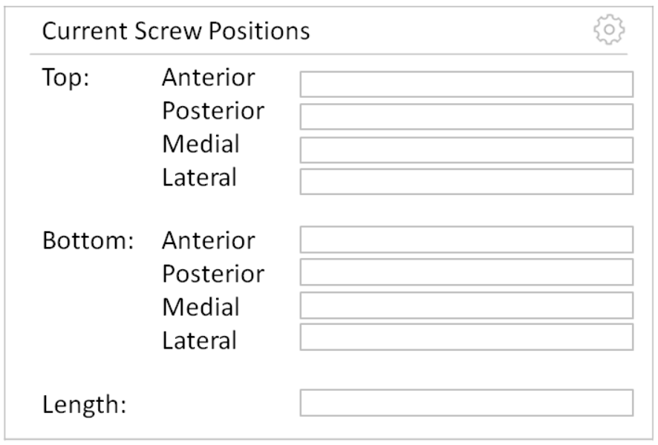
Patient Profile > Alignment Initialization
Proceed
help

Slide 7
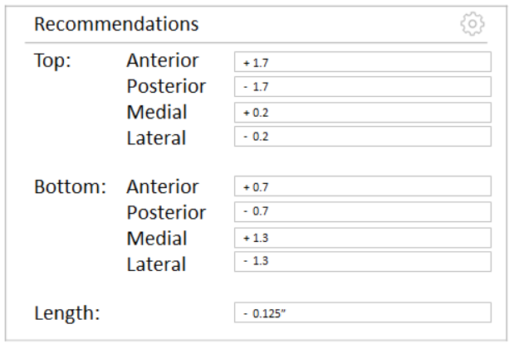
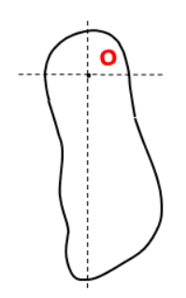

Patient Profile > Alignment Initialization > Static Alignment
Proceed
help
·
·
·
M/L
50% | 50%
26% | 74%
A/P
60% | 40%
47% | 53%
Change Tracker
Target
Actual
+ 0.2
+ 0.2
Knee Flexion
$$3.5°$$
$$1.5°$$
+ 1.2
T
- 1.2
+ 1.2
B
- 1.2
- 0.2
- 0.2

Slide 8
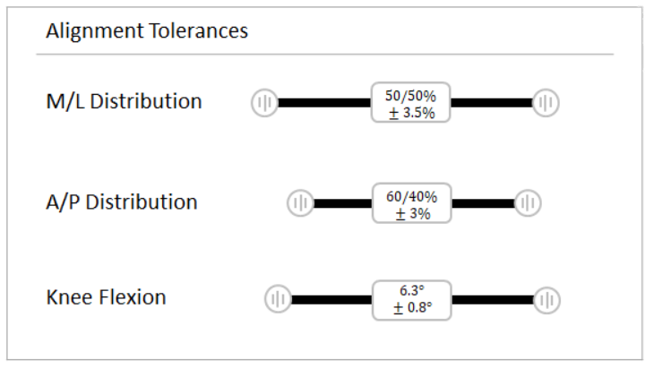
Patient Profile > Alignment Initialization > Static Alignment
Proceed
help
·
·
·
·
·
·
M/L
50% | 50%
26% | 74%
A/P
60% | 40%
47% | 53%
Change Tracker
Target
Actual
Target
Actual
+ 0.2
+ 0.2
Knee Flexion
$$3.5°$$
$$1.5°$$
+ 1.2
T
- 1.2
+ 1.2
B
- 1.2
- 0.2
- 0.2

Slide 9
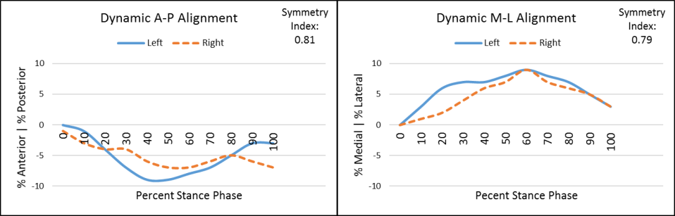

Patient Profile > Alignment Initialization > Static Alignment > Dynamic Alignment
Finish!
help
Scan 1:
A/P Symmetry Index
1
0.81
M/L Symmetry Index
1
0.79
Change Tracker
·
·
Toe Out
$$8.0°$$
$$2.5°$$
+ 0.2
+ 0.2
+ 1.2
T
- 1.2
+ 1.2
B
- 1.2
New Scan
- 0.2
- 0.2

Slide 10

Patient Profile > Alignment Initialization > Static Alignment > Dynamic Alignment
Finish!
help
Scan 1:
Add Options
Add Options
Hide
Show all scans
A/P Symmetry Index
1
0.81
M/L Symmetry Index
1
0.79
Change Tracker
·
·
Toe Out
$$8.0°$$
$$2.5°$$
Add Options
+ 0.2
+ 0.2
+ 1.2
T
- 1.2
+ 1.2
B
- 1.2
New Scan
Hide
- 0.2
- 0.2

Slide 11
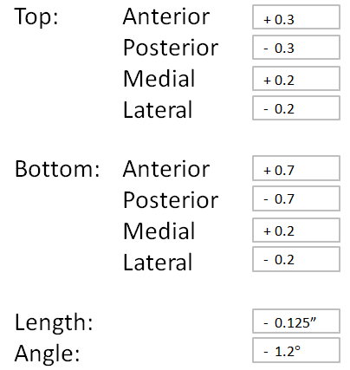




Before
Changes
After
M/L
50% | 50%
26% | 74%
A/P Symmetry Index
1
0.81
M/L
50% | 50%
49% | 51%
A/P Symmetry Index
1
0.98
A/P
60% | 40%
47% | 53%
M/L Symmetry Index
1
0.79
A/P
60% | 40%
61% | 39%
M/L Symmetry Index
1
0.99
Knee Flexion
$$3.5°$$
$$1.5°$$
Toe Out
$$8.0°$$
$$2.5°$$
Knee Flexion
$$3.5°$$
$$3.4°$$
Toe Out
$$8.0°$$
$$8.0°$$

Slide 12
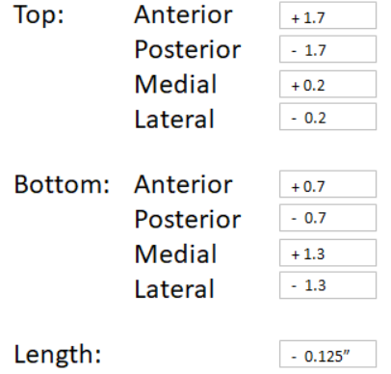


Before
Changes
After
M/L
50% | 50%
26% | 74%
M/L
50% | 50%
49% | 51%
ᴏ
·
·
ᴏ
A/P
60% | 40%
47% | 53%
A/P
60% | 40%
61% | 39%
Knee Flexion
$$3.5°$$
$$1.5°$$
Knee Flexion
$$3.5°$$
$$3.4°$$

Slide 13

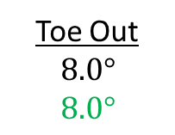
Before
Changes
After
A/P Symmetry Index
1
0.81
M/L Symmetry Index
1
0.79
A/P Symmetry Index
1
0.98
M/L Symmetry Index
1
0.99
·
·
Toe Out
$$8.0°$$
$$8.0°$$
·
·
Toe Out
$$8.0°$$
$$2.5°$$

Slide 14
 | Report Options
 | Patient Profile:
 | Alignment Data: Overview Static Dynamic Include all trials
Generate Report

