Slide 1


#DPL2026
DATA PREMIER LEAGUE 2026
Decode the Game. Build the Analytics.
PRELIMINARY ROUND — SUBMISSION
TEAM / PARTICIPANT NAME
Faizan Khan
QUESTION ATTEMPTED
Question 1 — Franchise Report
SELECTED IPL TEAM(S) / SEASONS
Royal Challengers Bengaluru · IPL 2023 and 2024 · chosen by a screen of all ten teams, then audited decision by decision
SUBMISSION DATE
16 / 10 / 2026
Data Premier League · An INSMA Hackathon · info@insma.in

Slide 2

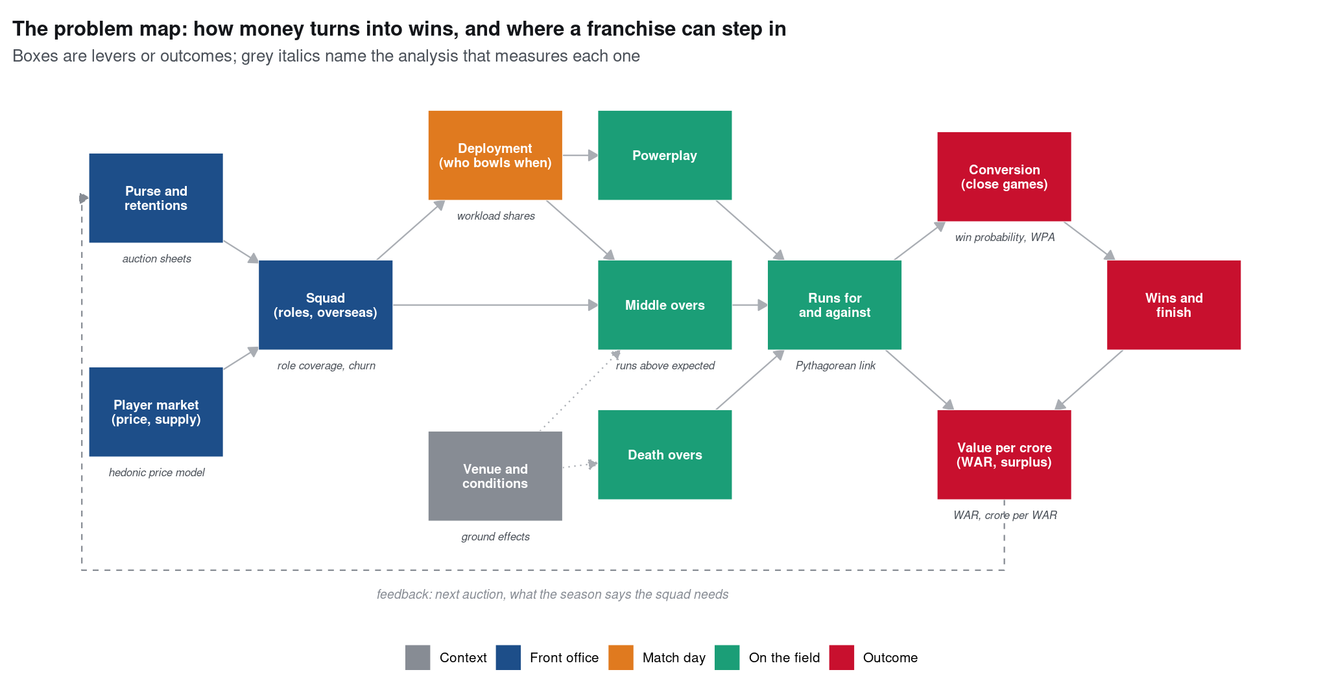

SECTION 1
REQUIRED
Context & Analytical Objective
Two problems inside one question
Problem A, which team? Every team went through three gates fixed in advance: under-converted in both seasons, a weakness that survives three hurdles, and a money problem. Only RCB passes all three.
Problem B, that team. What is wrong, what the franchise did about it at the auction, how that turned out, and what to do next.
Key question. Which part of RCB's cricket was persistently below par, did the December 2023 auction fix it, and what is the cheapest fix now?
Approach. Situation, search, obvious gap, representation, hypotheses, key question, run once for each problem.
The problem map: money buys a squad, the squad is deployed into phases, phases produce runs, runs become wins, and value per crore feeds the next auction. Every analysis measures one link.
DATA PREMIER LEAGUE 2026 · PRELIMINARY ROUND
2

Slide 3
SECTION 2
REQUIRED
Data & Methodology
Data Sources
Cleaning & Prep
Analytical Methods
DPL ball-by-ball, 2023–24: 34,967 rows × 61 fields, 145 matches, 14 venues
Ball tracking: line, length, shot, control, wagon wheel
Auction sheets for both seasons: retained, sold, traded, unsold (399 priced player-seasons)
Mentor sessions and published work: cricWAR, T20 Basics, Runs Above Expected, Malhotra
bat_out is TRUE on 99.9% of rows: dismissals rebuilt; 1,797 true wickets
Retired hurt is not a wicket; wagon zones decoded (99.2% agreement)
All game state rebuilt as it stood before each ball; a guard blocks post-ball features
Every comparison made within season (2024 scoring jumped under the impact-player rule)
League EDA: 22 views by over, phase, ground, line/length, shot, matchup, team and price
Problem A: Pythagorean gate, 12-cell scan with BH, ground fixed effects and replication, money gate
Tools: expected runs M0→M4, win probability W0→W4, WAR, crore per WAR, hedonic prices, pressure
Problem B: eight written hypotheses; decision audit 2023 → auction → 2024, foresight vs hindsight
Code: github.com/sportsanalystf/data-premier-league-26/tree/main/01-team-diagnostics · Rscript run_all.R rebuilds every number (seed 2026) · Rscript build.R rebuilds the reports, paper, dashboard and deck
DATA PREMIER LEAGUE 2026 · PRELIMINARY ROUND
3

Slide 4
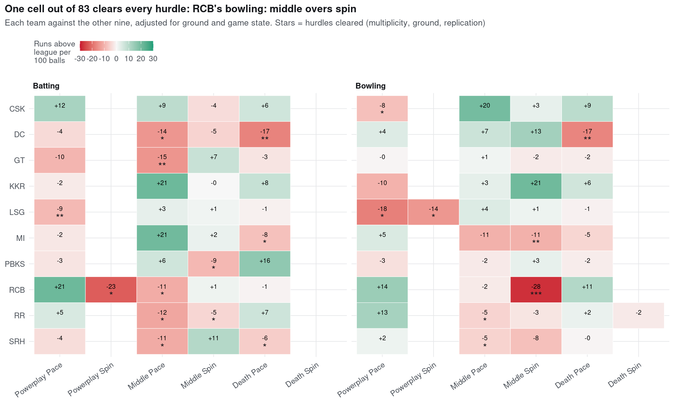
SECTION 3
Performance Overview
1 of 10
Teams passing all three gates: RCB only
−27.9
Middle-overs spin, runs per 100 balls vs the rest: −26.8 in 2023, −29.0 in 2024
₹36 : ₹2 cr
New auction money for 2024 on pace against spin
Every team, every cell: runs above the rest of the league per 100 balls, ground and game state held fixed. Stars count hurdles cleared.
DATA PREMIER LEAGUE 2026 · PRELIMINARY ROUND
4

Slide 5
SECTION 4
REQUIRED
Detailed Analytical Findings
1
RCB was chosen by the data, on three separate gates
Below Pythagorean expectation in both seasons (−5.4 and −10.9 points); the only one of 83 team-cells to clear BH (q = 0.061), ground fixed effects (p = 0.0014) and replication; and the league's most negative surplus (−₹11.7 cr). Punjab passed two gates; nobody else more than one.
2
The leak is middle-overs spin, not bowling in general
With the ground held fixed the bowling gap falls from +5.3 to −0.6 per 100 balls, and powerplay and death bowling both rank first in the league. Middle-overs spin is −27.9 against the rest, costing 105 runs (1.2 wins) in 2023 and 103 in 2024. No frontline spinner was above the league median.
3
The auction went the other way, and 2024 turned elsewhere
Both main spinners were released; ₹36.2 cr of new money went on pace, ₹2.0 cr on spin. The 2024 turn (1/7 to 6/7) came from the powerplay (wickets 4 → 18); middle-overs spin stayed the league's worst. Clutch does not repeat (r = −0.28).
DATA PREMIER LEAGUE 2026 · PRELIMINARY ROUND
5

Slide 6
SECTION 5
Strengths & Weaknesses of Chosen Methodology
STRENGTHS
LIMITATIONS
Fair choice of team. Three gates, fixed in advance, every team treated the same; nothing added up into one score.
Like-for-like. Ground, over, wickets, bowler type and set-ness held fixed; ground also tested with fixed effects.
Honest validation. Train 2023, test 2024. The simplest well-calibrated models won (M2 slope 1.004; W1 log-loss 0.508).
Decisions in order. The audit separates what was knowable at the time (foresight) from what we know now (hindsight).
Checked against results. Squad WAR tracks wins (r = 0.70) without seeing a result.
Two seasons. Gate 1 holds in only 58% of match resamples; BH q for the cell is 0.061, so at a 5% level no team clears gate 2.
Heavy shrinkage. k ≈ 585 balls for bowlers: projected gains (+0.24 wins) are far below the measured cost.
Thin foresight market. Only 6 spinners in the Dec 2023 pool had 2023 middle-overs evidence.
Not causal. A released player doing well elsewhere mixes skill with a new team, role and ground.
Incomplete prices. Some replacement signings are not on the auction sheets.
DATA PREMIER LEAGUE 2026 · PRELIMINARY ROUND
6

Slide 7
SECTION 6
REQUIRED
Interpretation & Practical Significance
Cricket interpretation
Practical relevance to the franchise
At Chinnaswamy raw economy punishes every bowler; adjusted, the new-ball and death attack were assets.
Overs 7–15 decide whether a side reaches the death with wickets in hand. Middle-overs wickets go with winning more than anything else (r = 0.69).
RCB's spinners in that phase were the league's worst two seasons running; Karn Sharma still bowled 39% of the overs in 2024.
Close games went 0–3: variance, not character. Clutch does not repeat.
Overseas players cost about +170% for the same role; Indian bowlers are the cheapest wins.
The proven middle-overs spinners were all retained elsewhere: the route is a trade, the route used for Cameron Green (₹17.5 cr).
In hindsight an established spinner in RCB's 2024 overs was worth about a win; Axar Patel 1.5 (₹9.0 cr).
Build around Yash Dayal, Mohammed Siraj, Dinesh Karthik and Rajat Patidar; review Glenn Maxwell and Alzarri Joseph on price.
DATA PREMIER LEAGUE 2026 · PRELIMINARY ROUND
7

Slide 8
SECTION 7
Conclusion & Key Takeaways
Buy one Indian middle-overs spinner, on more than one season
Top-quarter shrunk rate (≥ +5.7 per 100); bid ceiling = projected WAR × ~₹6.0 cr. Archetype: Varun Chakravarthy, Axar Patel, Krunal Pandya, Harpreet Brar. Trade if the pool is thin.
Move the middle overs now, for free
More for Cameron Green, Mohammed Siraj and Glenn Maxwell, fewer for the bottom of the list; track middle-overs spin every five matches.
Don't buy ‘bowling’ or ‘clutch’
The new ball and the death are already strong once the ground is removed, and clutch does not repeat. Keep the big bids and overseas slots for proven overall rate.
DATA PREMIER LEAGUE 2026 · PRELIMINARY ROUND
8

Slide 9
APPENDIX — NOT COUNTED IN SLIDE LIMIT
References & Code Repository
References
Bandyopadhyay, Runs Above Expected, arXiv:2608.18020 · Ganjoo, T20 Basics · Rafique, cricWAR (CMSAC 2022)
Malhotra, J. Sports Analytics 8(3) 2022 · Date, A Cricketing View · Nielsen, Cricket Sims · Weston, IPL Auctions
Benjamini & Hochberg (1995) · DPL 2026 mentor sessions: A. Desai, O. Walunj, S. Gupta, H. Ganjoo
Epilogue (outside the data): Sportskeeda and Onmanorama on the 2025 auction; cricket.com on the 2025 final
Code, Reproducibility & Video Explanation Links
Repository: github.com/sportsanalystf/data-premier-league-26/tree/main/01-team-diagnostics
Rebuild: Rscript build.R (run_all.R → figures → numbers → three reports → paper → dashboard → deck); R 4.3, Quarto; seed 2026
Deliverables: report/01–03 (EDA, team review, player appendix), paper/paper.pdf, appendix/dashboard.html, data/, this deck
Video explanation: video/DPL2026_Q1_FaizanKhan_video.mp4 in the repository (7 min, subtitled)
DATA PREMIER LEAGUE 2026 · PRELIMINARY ROUND
9

Slide 10
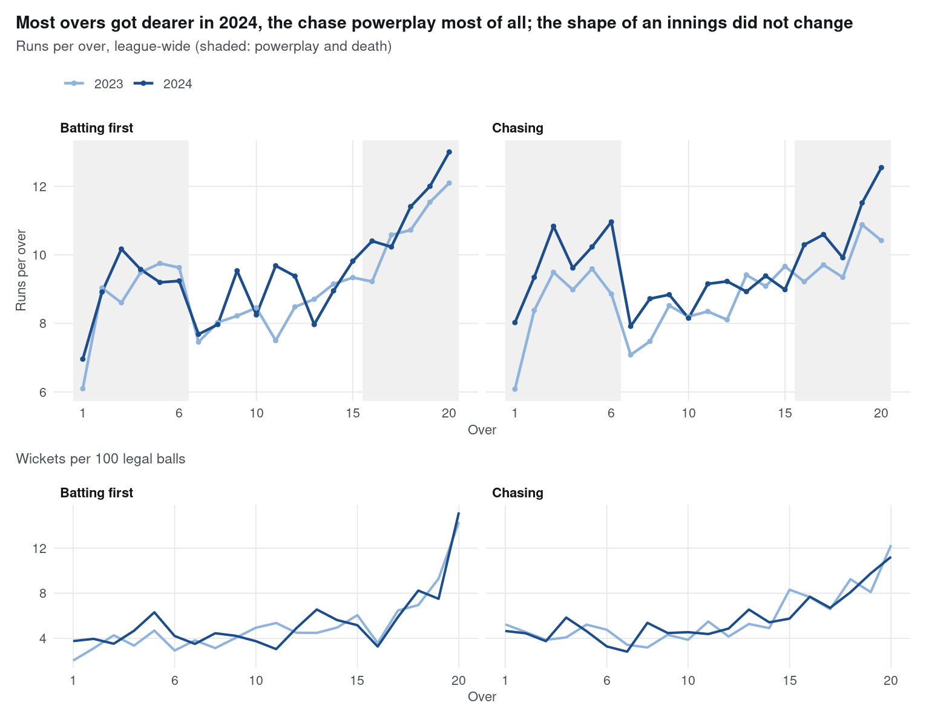
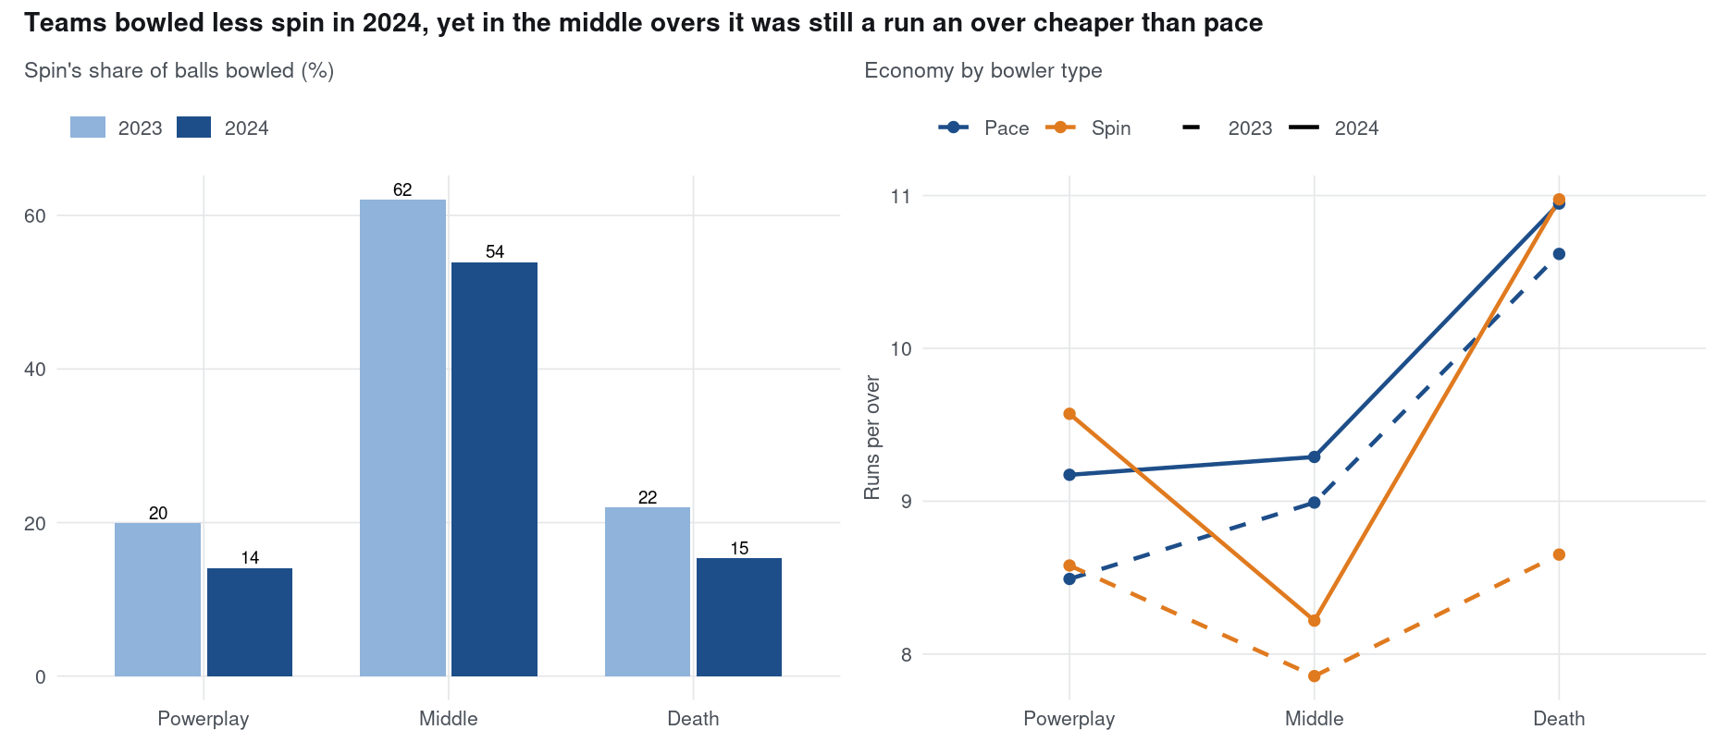
APPENDIX — NOT COUNTED IN SLIDE LIMIT
A1 · The league: how an innings is shaped
Scoring rose from 8.94 to 9.52 an over, mostly in the powerplay and at the death (middle overs +0.41). Spin is the middle-overs tool and stayed cheaper than pace there in 2024.
DATA PREMIER LEAGUE 2026 · PRELIMINARY ROUND
10

Slide 11
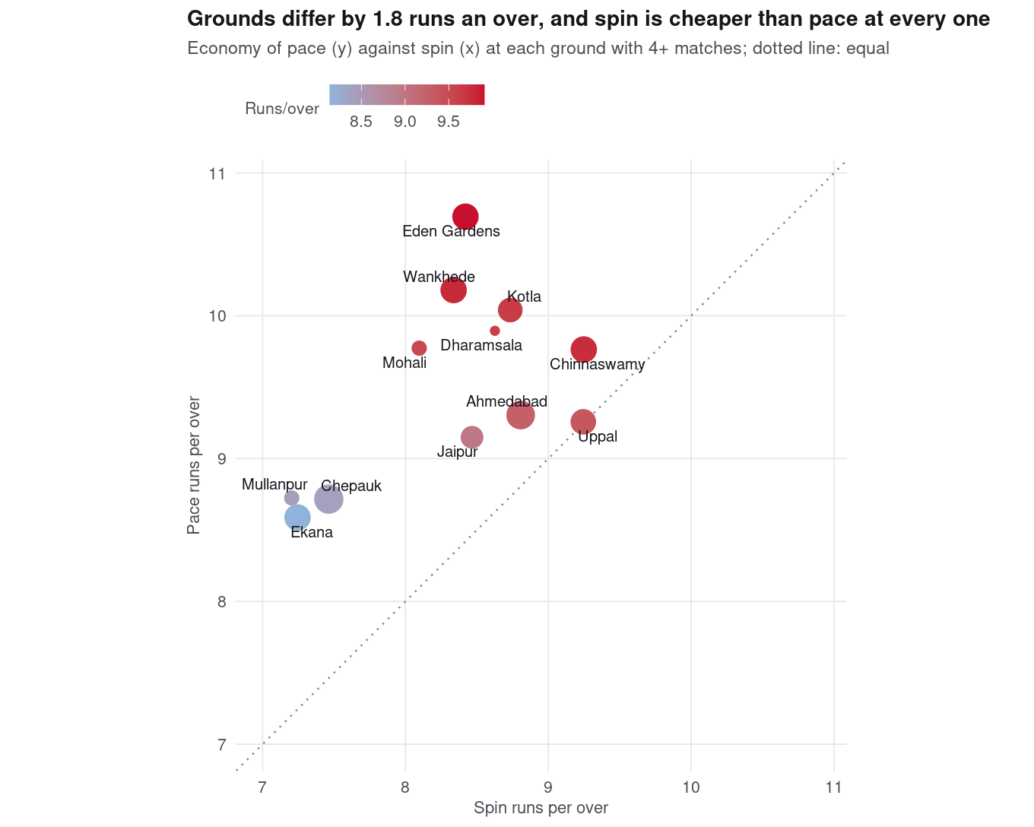
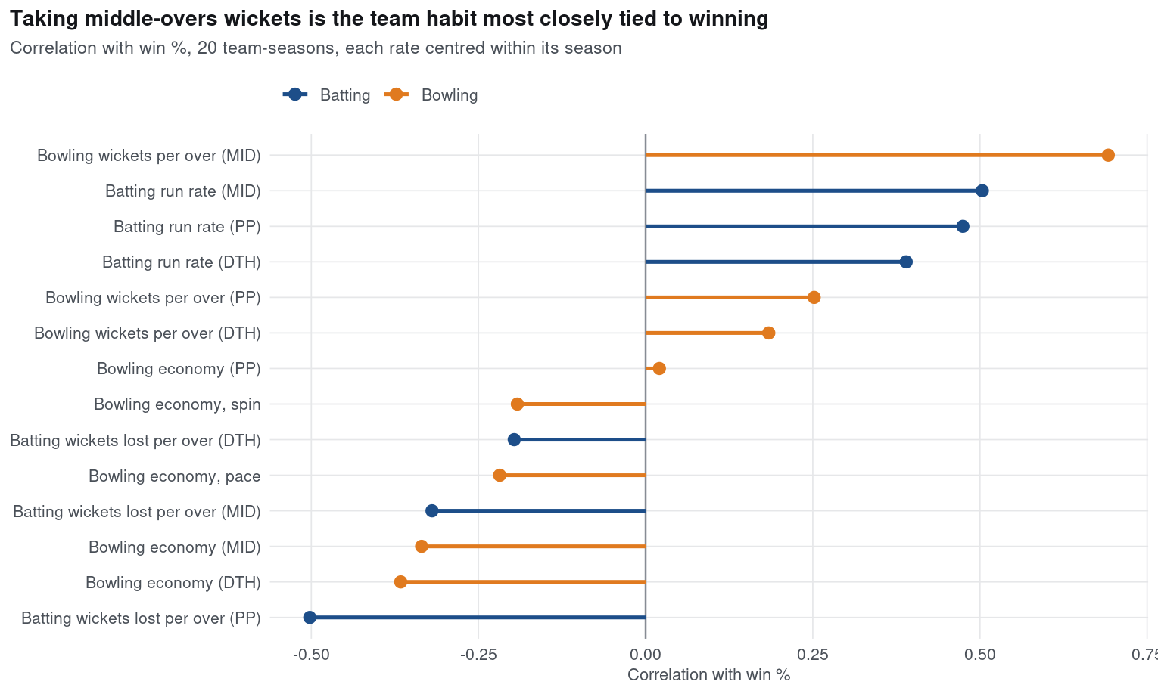
APPENDIX — NOT COUNTED IN SLIDE LIMIT
A2 · The league: what goes with winning, and where
Middle-overs wickets are the team habit most tied to winning (r = 0.69, 20 team-seasons). Grounds differ by 1.8 runs an over, so every comparison holds venue fixed.
DATA PREMIER LEAGUE 2026 · PRELIMINARY ROUND
11

Slide 12
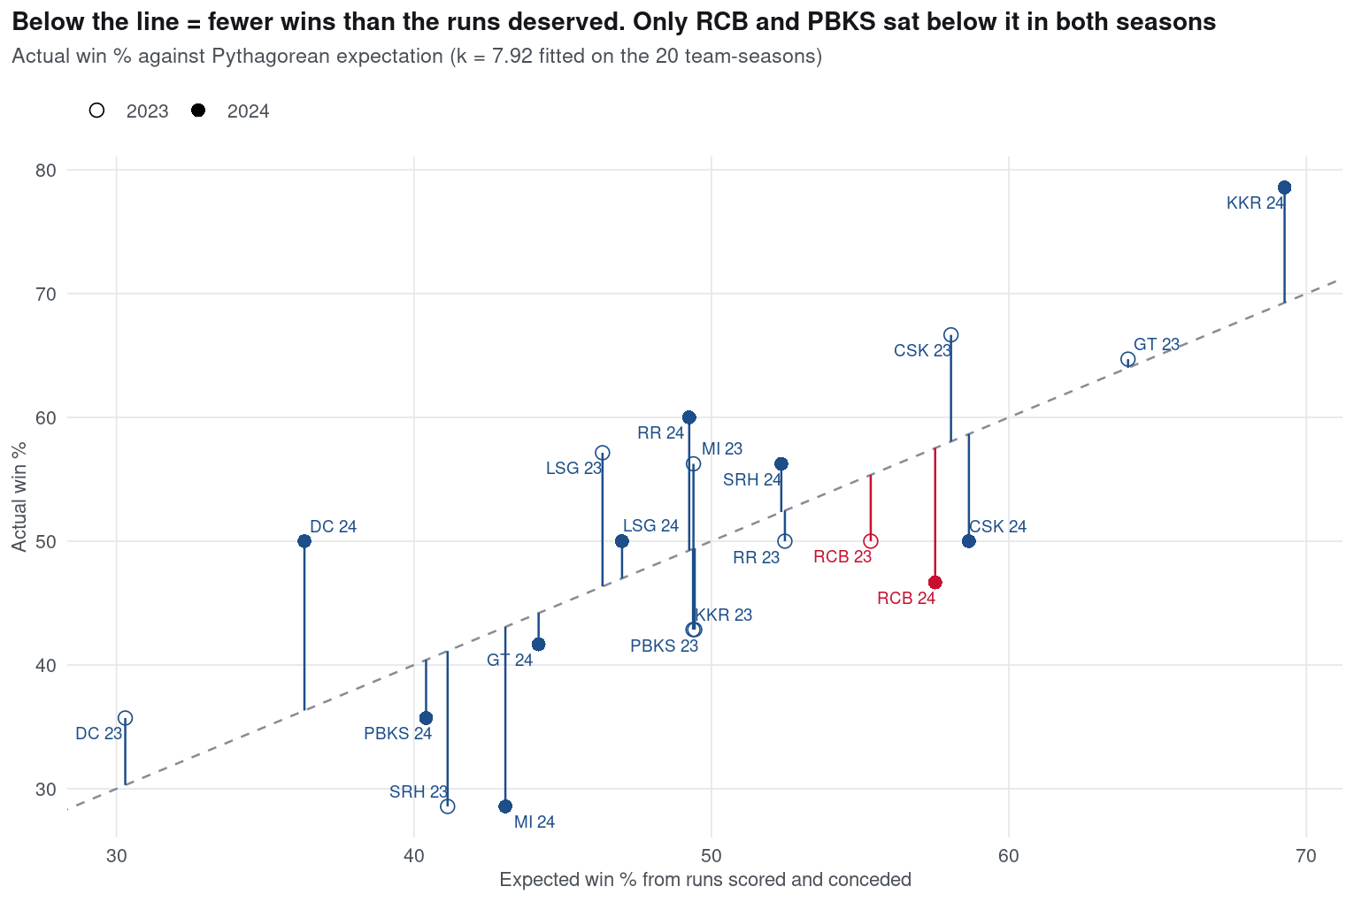
APPENDIX — NOT COUNTED IN SLIDE LIMIT
A3 · Problem A: results and the cell scan
Left: only RCB and PBKS won fewer games than their runs deserved in both seasons. Right: one cell of 83 clears all three hurdles, RCB's middle-overs spin.
DATA PREMIER LEAGUE 2026 · PRELIMINARY ROUND
12

Slide 13
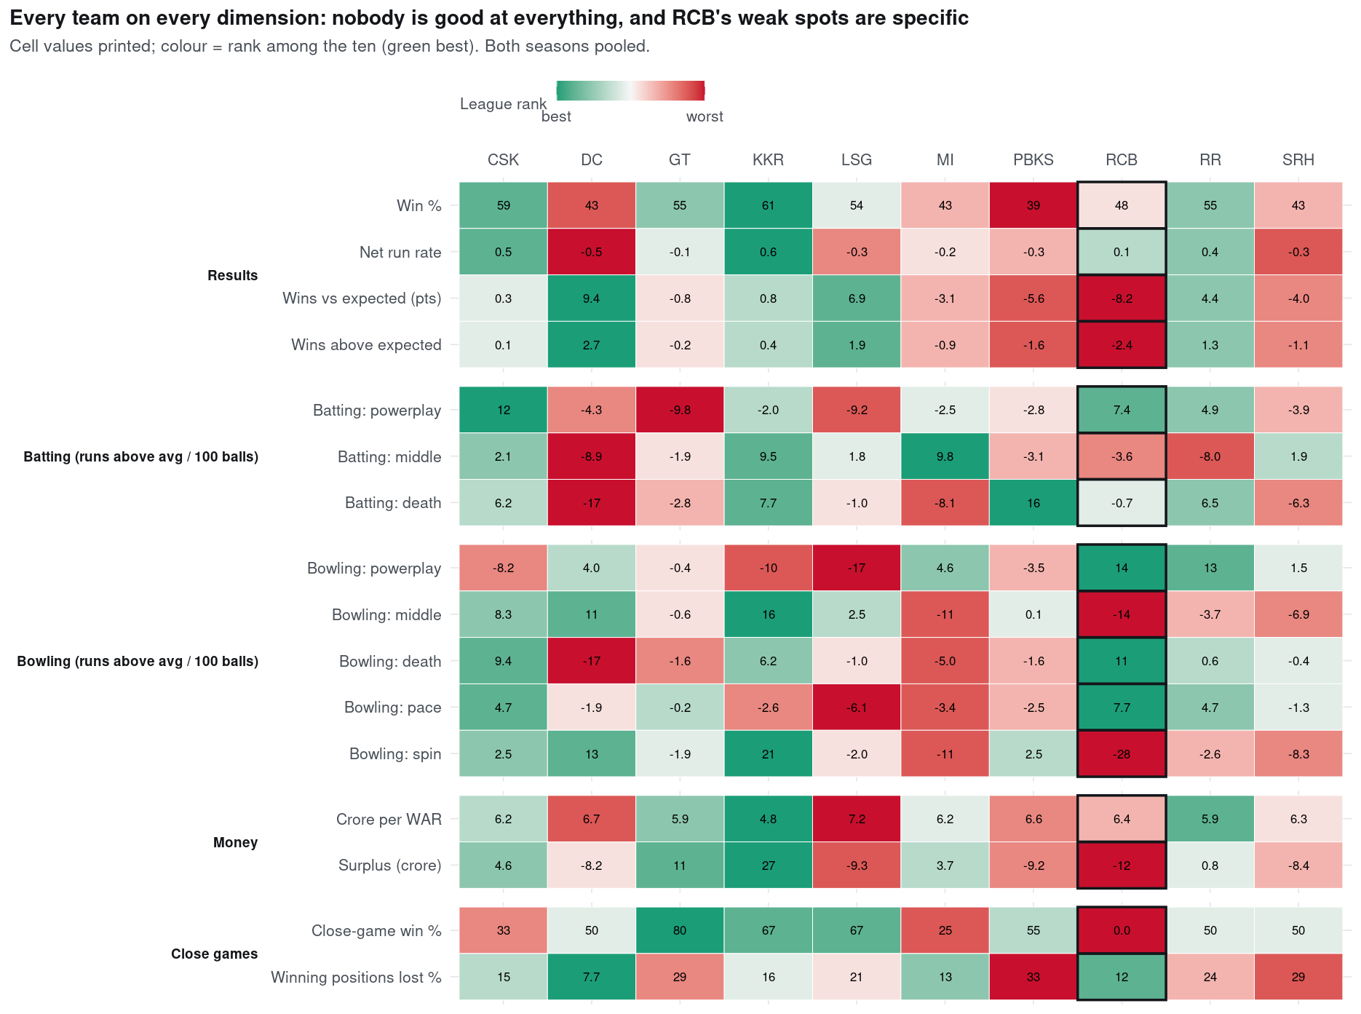
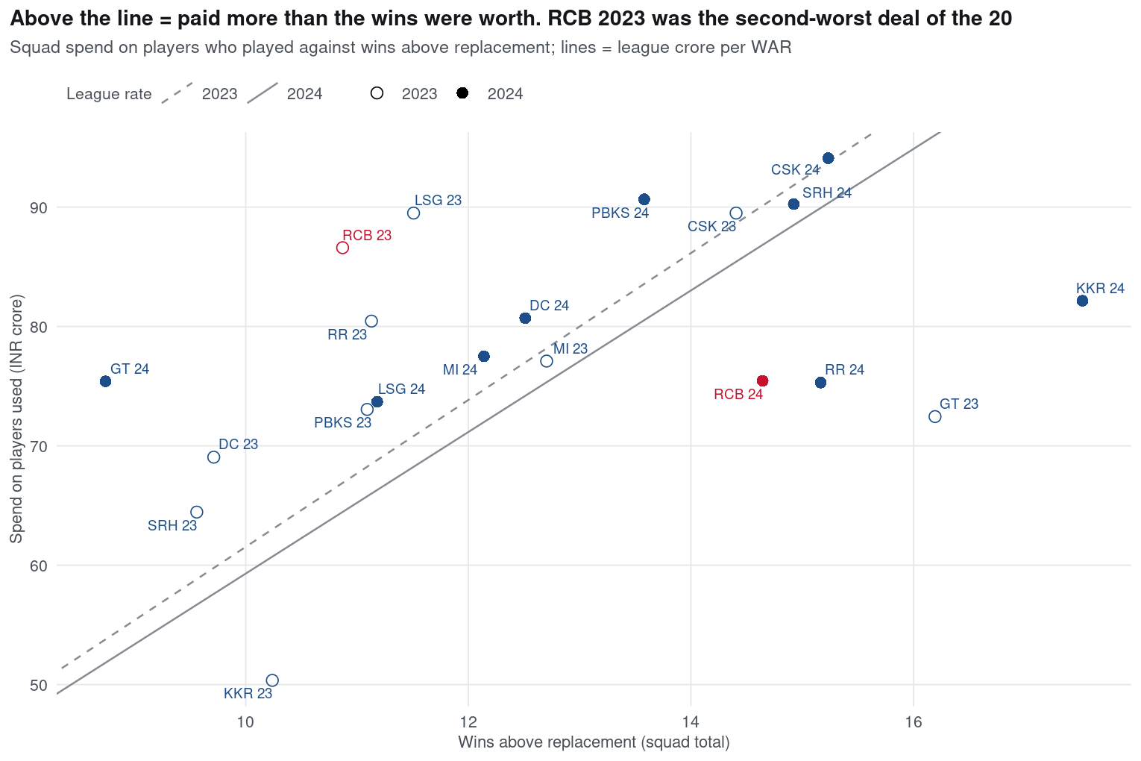
APPENDIX — NOT COUNTED IN SLIDE LIMIT
A4 · Problem A: money, and every dimension
RCB had the most negative surplus (−₹11.7 cr) over two seasons. The scorecard: powerplay and death bowling both rank first; middle-overs bowling 10; spin 10.
DATA PREMIER LEAGUE 2026 · PRELIMINARY ROUND
13

Slide 14
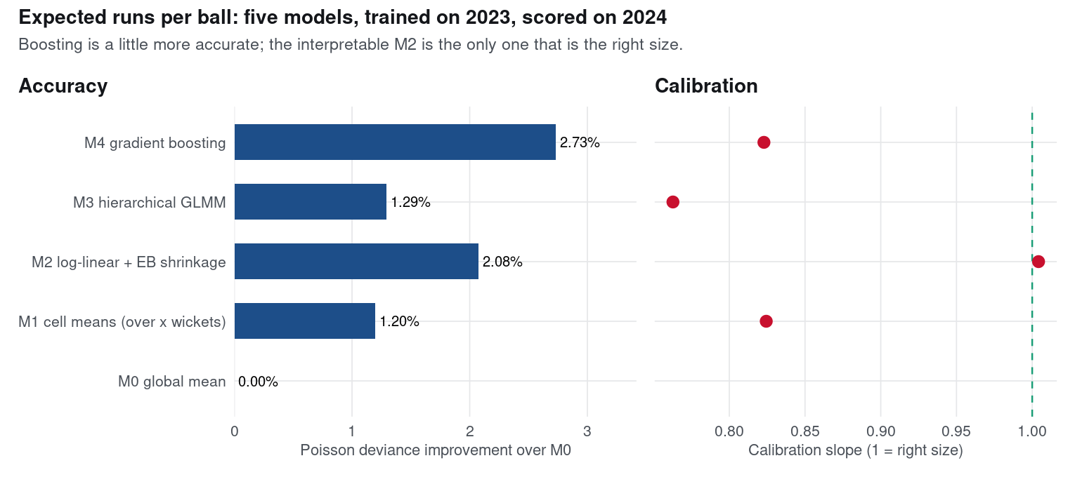
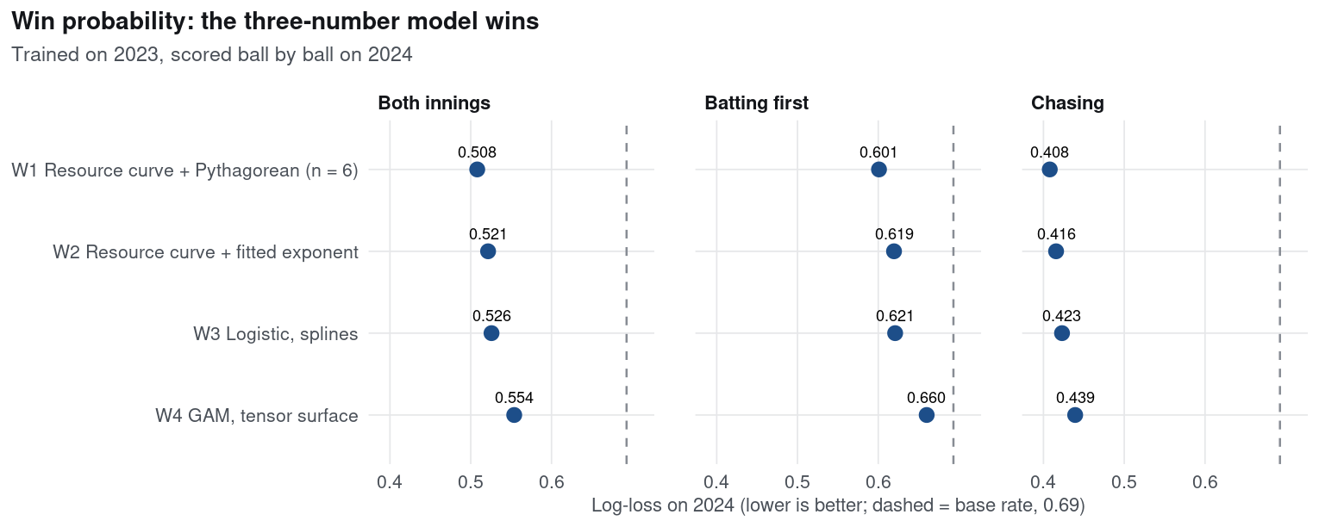
APPENDIX — NOT COUNTED IN SLIDE LIMIT
A5 · The measuring tools: two model ladders
Trained on 2023, scored on 2024. Boosting is most accurate (+2.7%) but only M2 is well calibrated (slope 1.004). The three-parameter win model W1 beats logistic and GAM (log-loss 0.508).
DATA PREMIER LEAGUE 2026 · PRELIMINARY ROUND
14

Slide 15
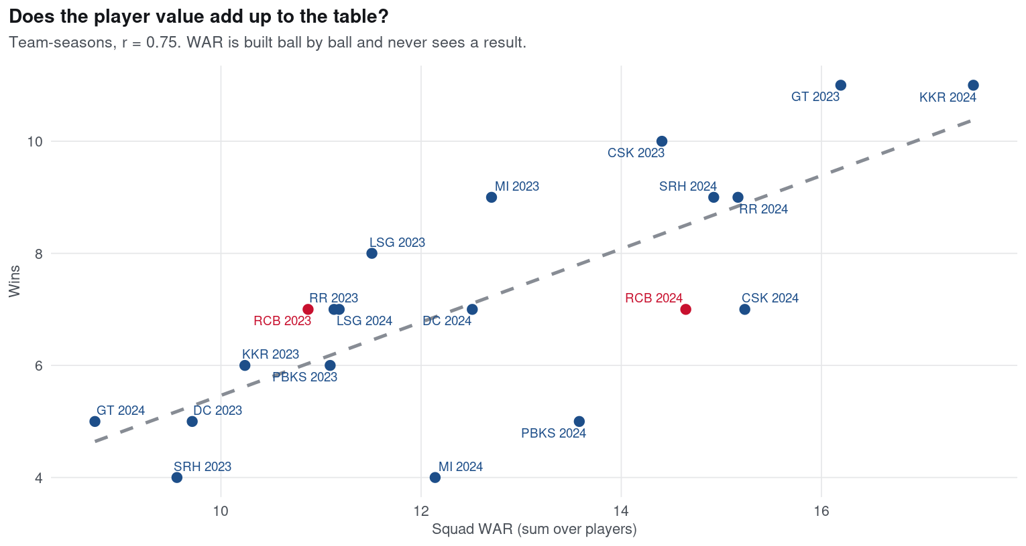
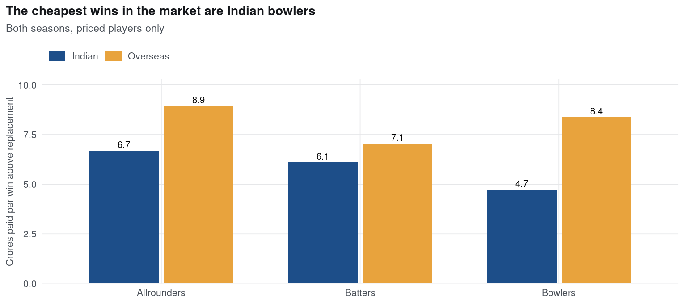
APPENDIX — NOT COUNTED IN SLIDE LIMIT
A6 · From runs to wins to crore
Squad WAR, built ball by ball, tracks wins (r = 0.75); 90 runs per win. Indian bowlers are the cheapest wins in the market.
DATA PREMIER LEAGUE 2026 · PRELIMINARY ROUND
15

Slide 16
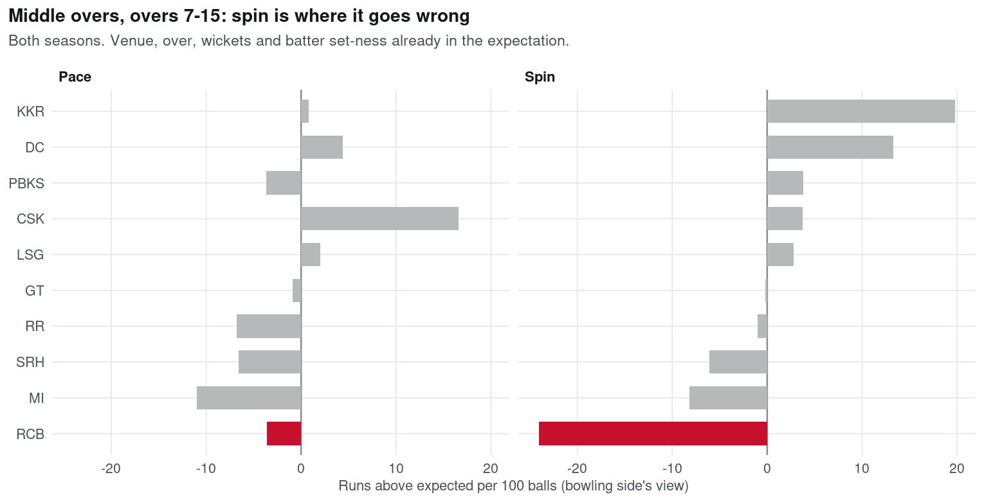
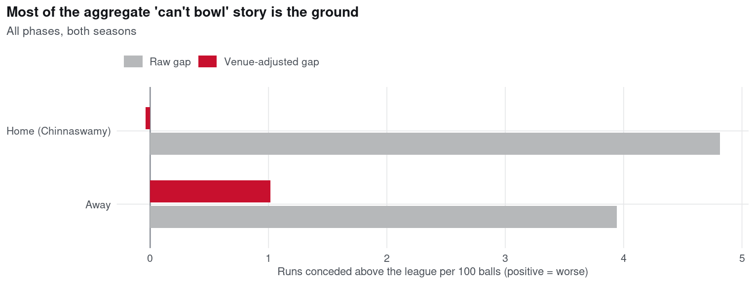
APPENDIX — NOT COUNTED IN SLIDE LIMIT
A7 · Problem B: the ground, and the middle overs
Bowling effect +5.3 → −0.6 per 100 balls with ground fixed effects. Middle-overs spin −24.1 against expectation; every other side +3.8.
DATA PREMIER LEAGUE 2026 · PRELIMINARY ROUND
16

Slide 17
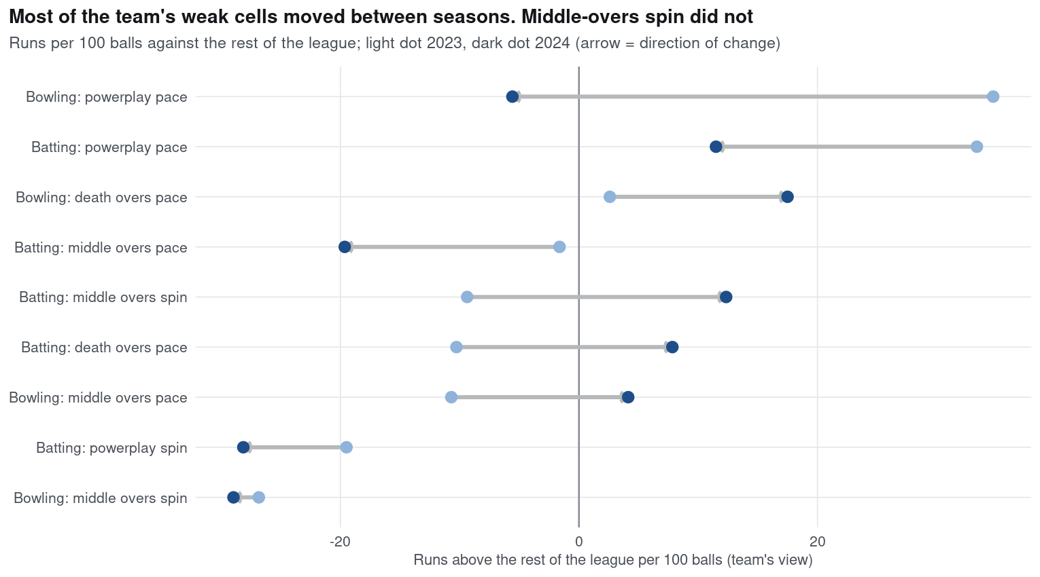
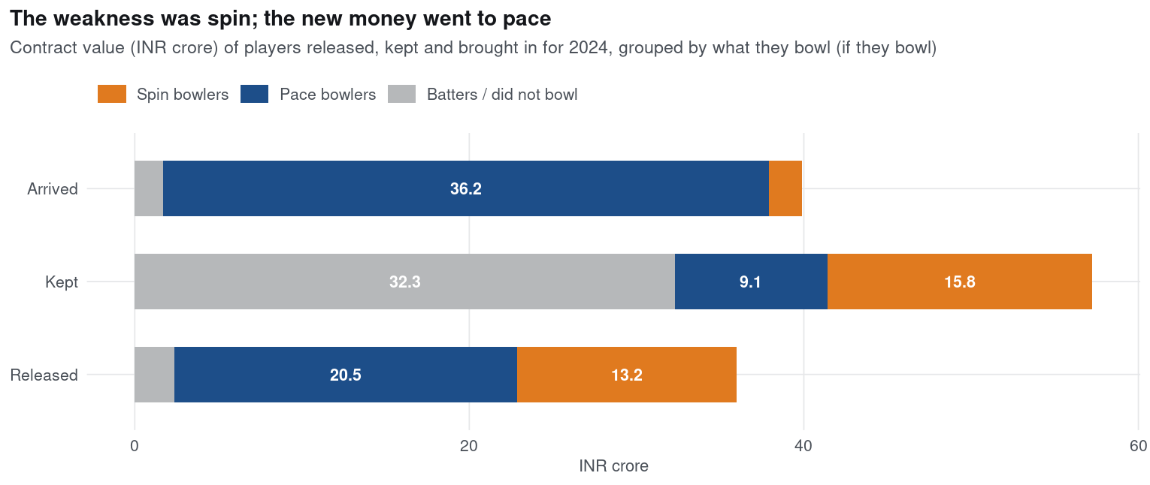
APPENDIX — NOT COUNTED IN SLIDE LIMIT
A8 · What 2023 said, and where the money went
Most weak cells moved between seasons; middle-overs spin did not (−26.8 then −29.0). New money: ₹36.2 cr on pace, ₹2.0 cr on spin.
DATA PREMIER LEAGUE 2026 · PRELIMINARY ROUND
17

Slide 18
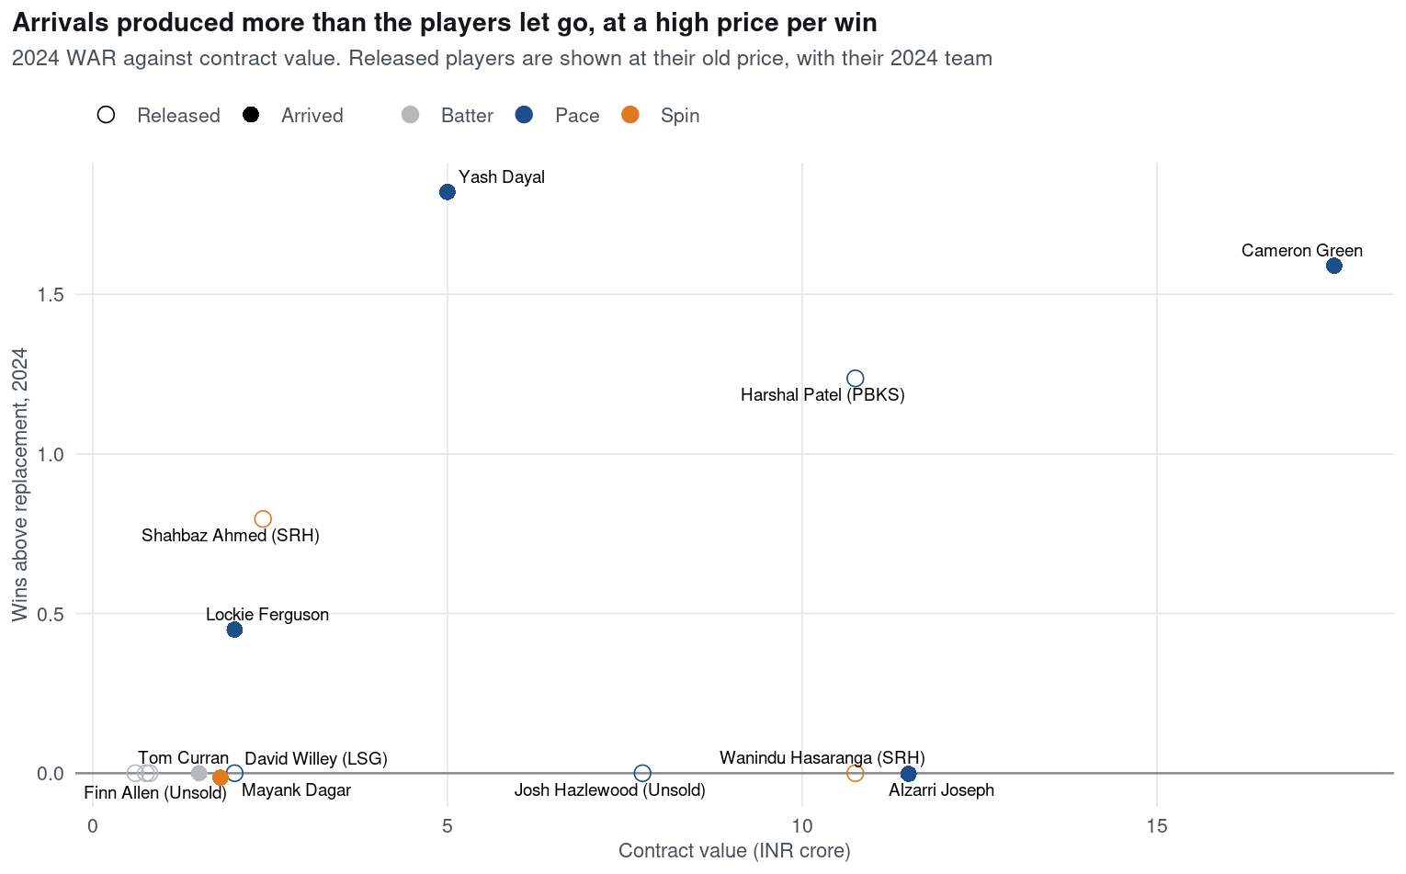
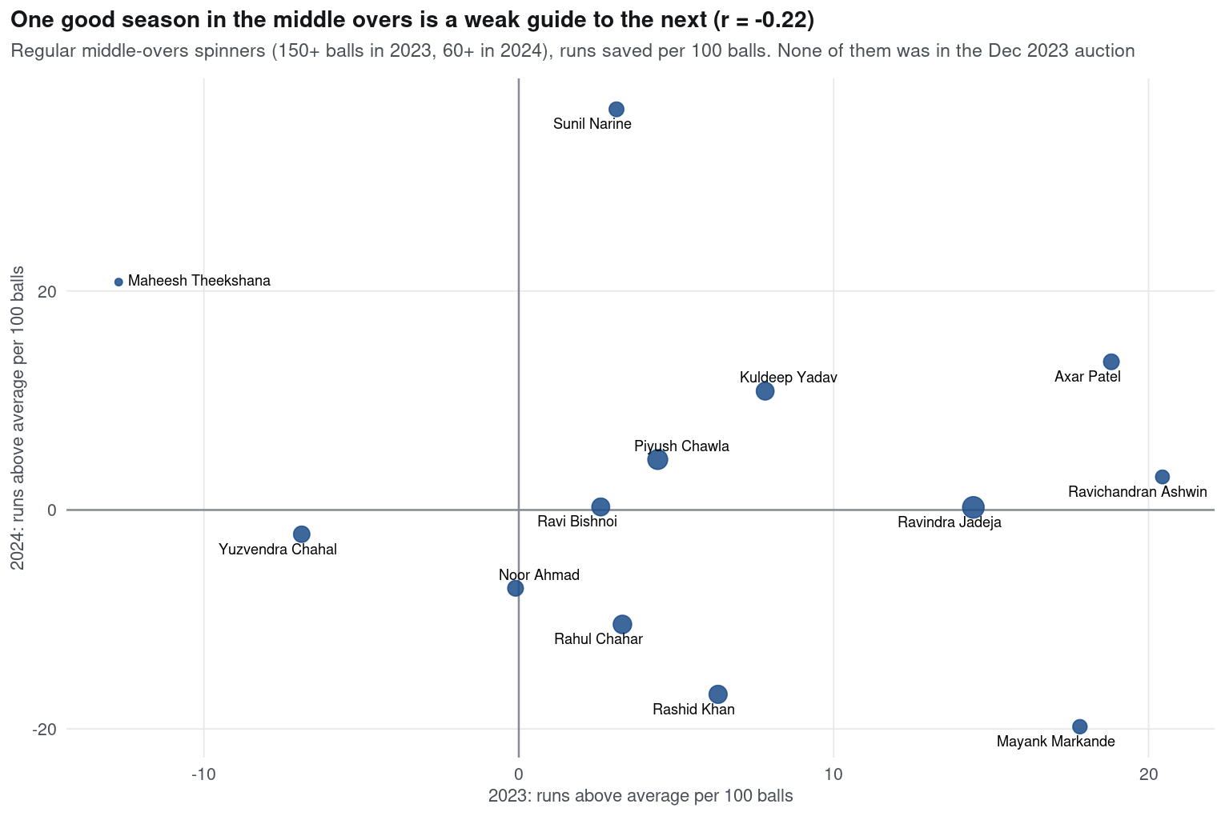
APPENDIX — NOT COUNTED IN SLIDE LIMIT
A9 · The decision audit: outcomes and the market
Arrivals: 4.6 WAR at ₹8.72 cr per WAR. None of 2023's regular middle-overs spinners was in the auction; the route was a trade. Axar Patel would have been worth 1.5 wins (hindsight).
DATA PREMIER LEAGUE 2026 · PRELIMINARY ROUND
18

Slide 19
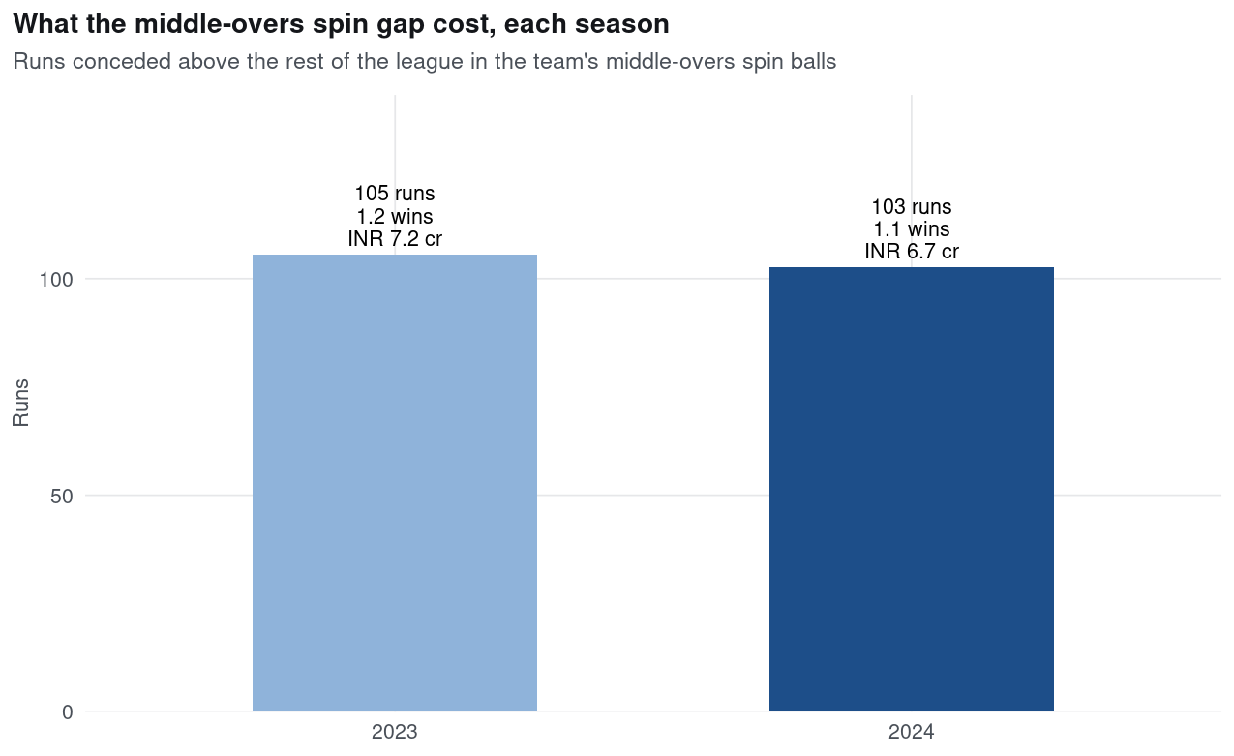
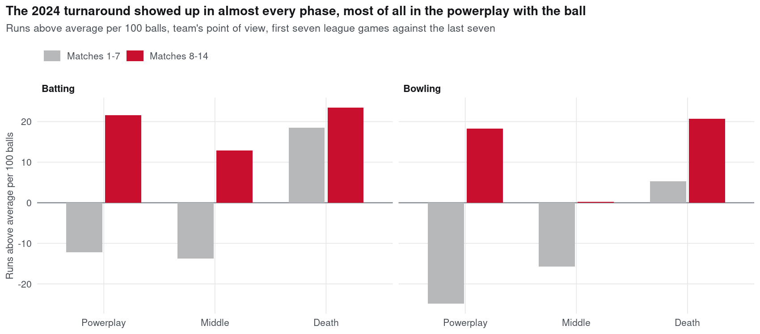
APPENDIX — NOT COUNTED IN SLIDE LIMIT
A10 · Inside 2024, and what the gap cost
1 win in 7, then 6 in 7: the turn came in the powerplay (wickets 4 → 18). The spin gap cost 105 and 103 runs.
DATA PREMIER LEAGUE 2026 · PRELIMINARY ROUND
19

Slide 20
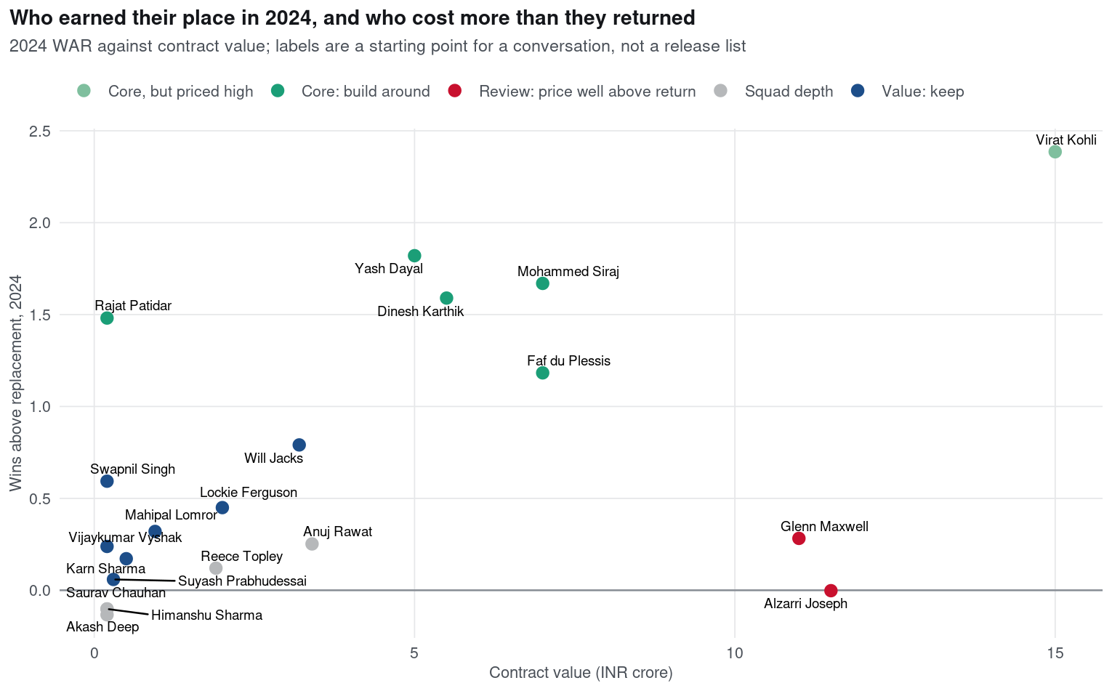
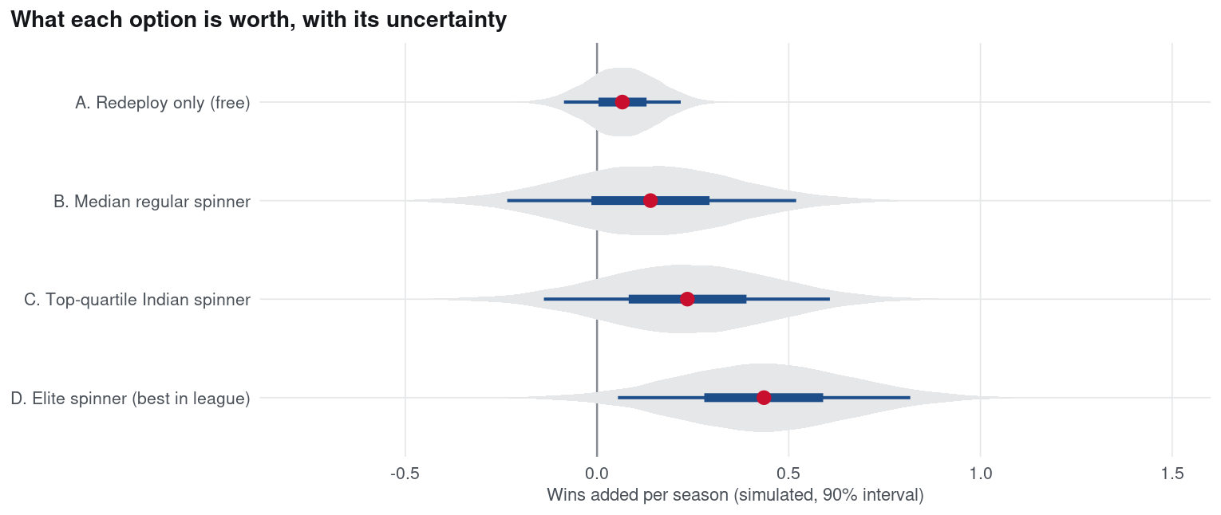
APPENDIX — NOT COUNTED IN SLIDE LIMIT
A11 · What next: options and the squad
On shrunk projections a top-quartile Indian spinner adds 0.24 wins (85% chance positive); up to 0.8 if the gap repeated. Right: 2024 WAR against price.
DATA PREMIER LEAGUE 2026 · PRELIMINARY ROUND
20

