Slide 1
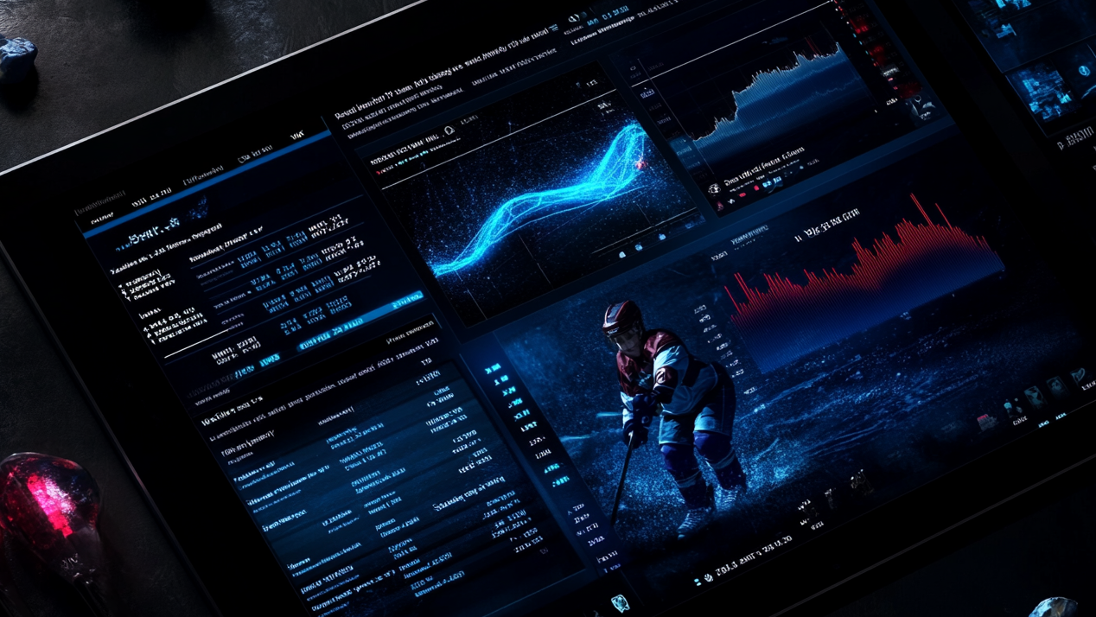
Team Balance
Where are we? What do we do about it?

Slide 2
Team Balance – Where Are We? What are the Implications?
TEAM | OFF | DEF | GOAL | GRIT | BALANCE | WIN PROB
Colorado Avalanche | 69.41 | 80.19 | 82.73 | 23.39 | 63.93 | 71.00
Tampa Bay Lightning | 68.69 | 72.33 | 76.39 | 57.79 | 68.80 | 67.00
Dallas Stars | 69.00 | 64.50 | 65.52 | 38.25 | 59.32 | 61.00
Carolina Hurricanes | 65.26 | 61.98 | 63.01 | 46.46 | 59.18 | 60.00
Pittsburgh Penguins | 66.12 | 69.21 | 65.73 | 29.77 | 57.71 | 59.00
Minnesota Wild | 65.12 | 56.43 | 59.57 | 45.89 | 56.75 | 58.00
Utah Mammoth | 47.78 | 64.06 | 61.41 | 44.88 | 54.53 | 58.00
Buffalo Sabres | 57.54 | 60.42 | 57.74 | 47.41 | 55.78 | 56.00
Boston Bruins | 66.35 | 34.07 | 37.71 | 73.04 | 52.79 | 55.00
Vegas Golden Knights | 64.00 | 57.99 | 58.31 | 41.74 | 55.51 | 55.00
Washington Capitals | 47.32 | 54.86 | 56.28 | 43.85 | 50.58 | 55.00
Montreal Canadiens | 65.72 | 38.30 | 37.79 | 62.86 | 51.17 | 54.00
New York Islanders | 38.01 | 68.37 | 69.92 | 46.52 | 55.70 | 54.00
Edmonton Oilers | 77.20 | 38.25 | 39.63 | 36.03 | 47.78 | 53.00
Ottawa Senators | 59.59 | 30.63 | 36.77 | 67.77 | 48.69 | 52.00
Detroit Red Wings | 48.61 | 56.92 | 59.15 | 27.10 | 47.95 | 51.00
Columbus Blue Jackets | 50.86 | 47.64 | 44.92 | 44.09 | 46.88 | 50.00
Anaheim Ducks | 56.48 | 33.48 | 27.21 | 60.99 | 44.54 | 48.00
Seattle Kraken | 40.38 | 35.60 | 48.67 | 29.50 | 38.54 | 48.00
Florida Panthers | 48.49 | 43.68 | 40.32 | 86.97 | 54.86 | 47.00
Philadelphia Flyers | 37.63 | 45.93 | 46.96 | 65.62 | 49.04 | 47.00
Toronto Maple Leafs | 51.04 | 49.22 | 44.01 | 53.04 | 49.33 | 47.00
Winnipeg Jets | 38.79 | 51.16 | 48.66 | 58.17 | 49.19 | 46.00
Los Angeles Kings | 27.24 | 47.49 | 49.52 | 45.29 | 42.38 | 44.00
Calgary Flames | 26.94 | 60.03 | 59.71 | 70.35 | 54.26 | 43.00
Nashville Predators | 47.05 | 42.52 | 34.51 | 43.41 | 41.87 | 43.00
San Jose Sharks | 47.00 | 32.03 | 29.99 | 46.89 | 38.98 | 43.00
Chicago Blackhawks | 32.01 | 61.55 | 52.89 | 35.42 | 45.47 | 42.00
New York Rangers | 33.46 | 44.57 | 46.83 | 72.38 | 49.31 | 41.00
New Jersey Devils | 29.18 | 56.07 | 53.92 | 38.88 | 44.51 | 40.00
St. Louis Blues | 28.35 | 28.03 | 28.61 | 61.72 | 36.68 | 36.00
Vancouver Canucks | 29.38 | 12.51 | 15.62 | 54.52 | 28.01 | 34.00
Lower physicality will have higher impact in playoffs
Two areas to assess and improve: defensive play and goaltending
Teams below this line need to think carefully about:
Talent acquisition
Intelligent approach to salary cap
Potential rebuild

