Slide 1
Clustering VCD dump and Report Functional coverage.
Shivam Porwal

Slide 2
Content
Understand the problem
Input Data
Intent and process
Data preprocessing
ML Process
Post processing
Proof of concept
Challanges
Future Scope

Slide 3
Let’s understand the problem
Functional coverage-
In VLSI, "functional coverage" refers to a metric that measures how much of a design's intended functionality has been exercised by the verification process.
Existing EDA tools does not report functional coverage.
Inadequate or Missing Functional Coverage Bins

Slide 4
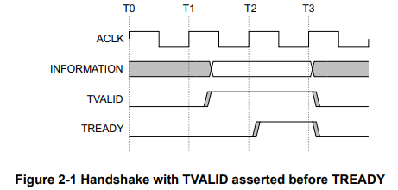
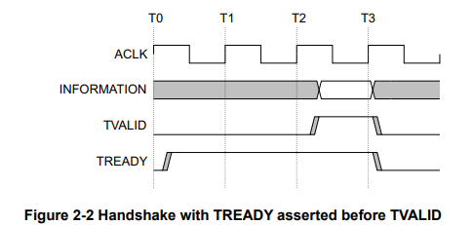
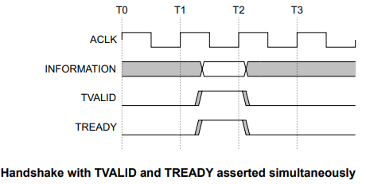
Let’s understand this Example

Slide 5
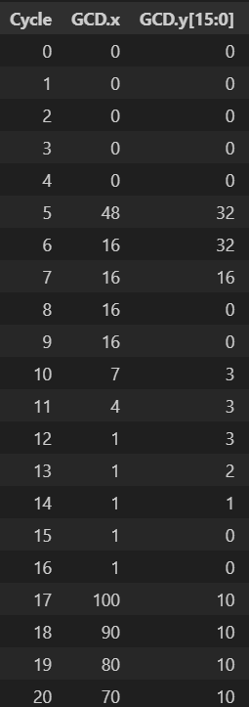
How does Data look like
VCD dump or value change dump is an o/p file generate by any EDA logic simulation tool.
This file consist signal from the design and captures the transitions of those signals over a time duration or clock.

Slide 6
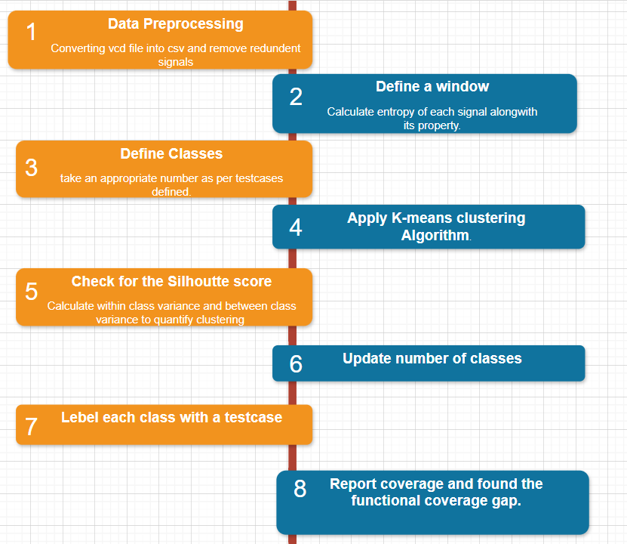
Process

Slide 7
Dataset/ Preprocessing
Converts vcd file into a csv file, where we can have multiple columns with signal names, and populate these columns with the binary and asci values over each clock period.
Eliminate signals which toggles over a test case rather over a transaction for example reset, test_done , start etc.
Calculate entropy for all these filtered signals and choose a signal having least entropy. Lets call it window signal.
Define a window size using this window signal and create a matrix of window size * No. filtered signals.
Flatten these all matrix before giving it to k-means algorithm for clustering
Now this data is preprocessed and ready for a clustering algorithm.

Slide 8
ML Process
Lets start with initial K value which is number of testcases defined.
Select Initial centroids and apply k-means to assign data points to the clusters.
Calculate within class variance and between class variance to quantify the clustering.
Update value of k if silhouette score is beyond threshold boundary.
Redo the clustering and keep updating no of classes to reach an optimal value.

Slide 9
Post Processing
Calculate the variance matrices with in a cluster.
Pick up few samples with higher variance and draw timing diagram.
Label each classes as per the timing diagram of sample matrices.
Compare these labels with the test cases defined.
Report the coverage with existing test bench.
Determine the coverage gap

Slide 10
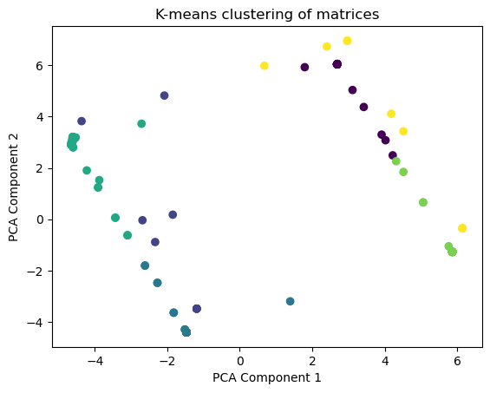
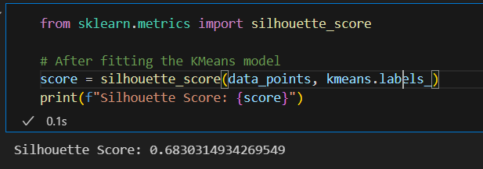
Proof of concept
Input – Total no of matrices are 191 each of 64 clock samples.
Output- Clustered these matrices into 6 classes.

Slide 11
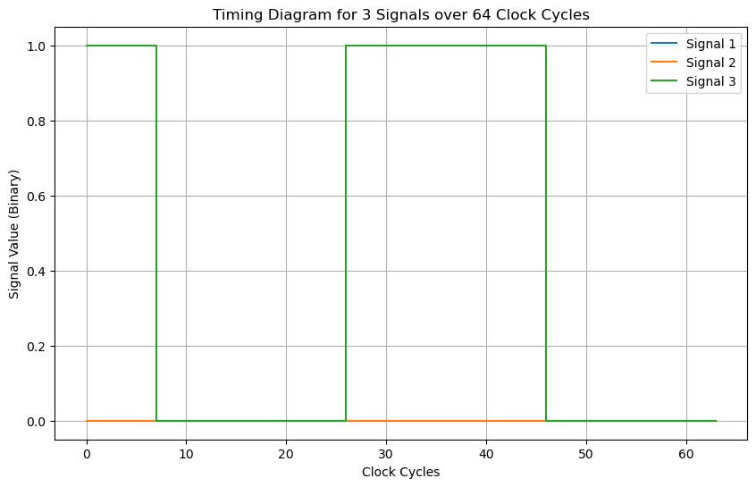
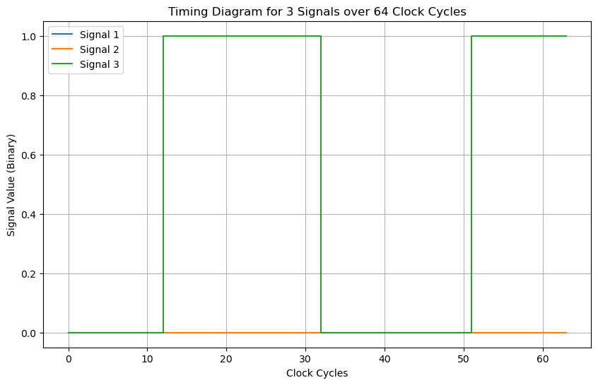
Post processing
These are 2 matrices of same class, which covers one IDLE test case of axi stream protocol where ready is toggling but tvalid and tlast are low.

Slide 12
Challenges
VCD is a complicated format and converting it into csv was a challenge.
Deciding optimal window size requires understanding of data sample behaviour.
Defining threshold to quantify clustering.
Labelling of data requires manual effort.

Slide 13
Usecase
Functional coverage gaps are hard to find in large data set.
Determine the cases covered with in a test case by just randomizing the input signals.
Can eliminate the need of writing coverpoints to some extent.
Reduces manual intervention and improves the quality of product.

Slide 14
Future Scope for Next year
Enable dynamic and auto window detection.
Using it for custom logic.
Working with multi bit signals.
Working with complex designs having multiple levels/instances.
Improve the quality of classification.
Reducing manual efforts in labelling the classes.

Slide 15
Thank You

