Slide 1
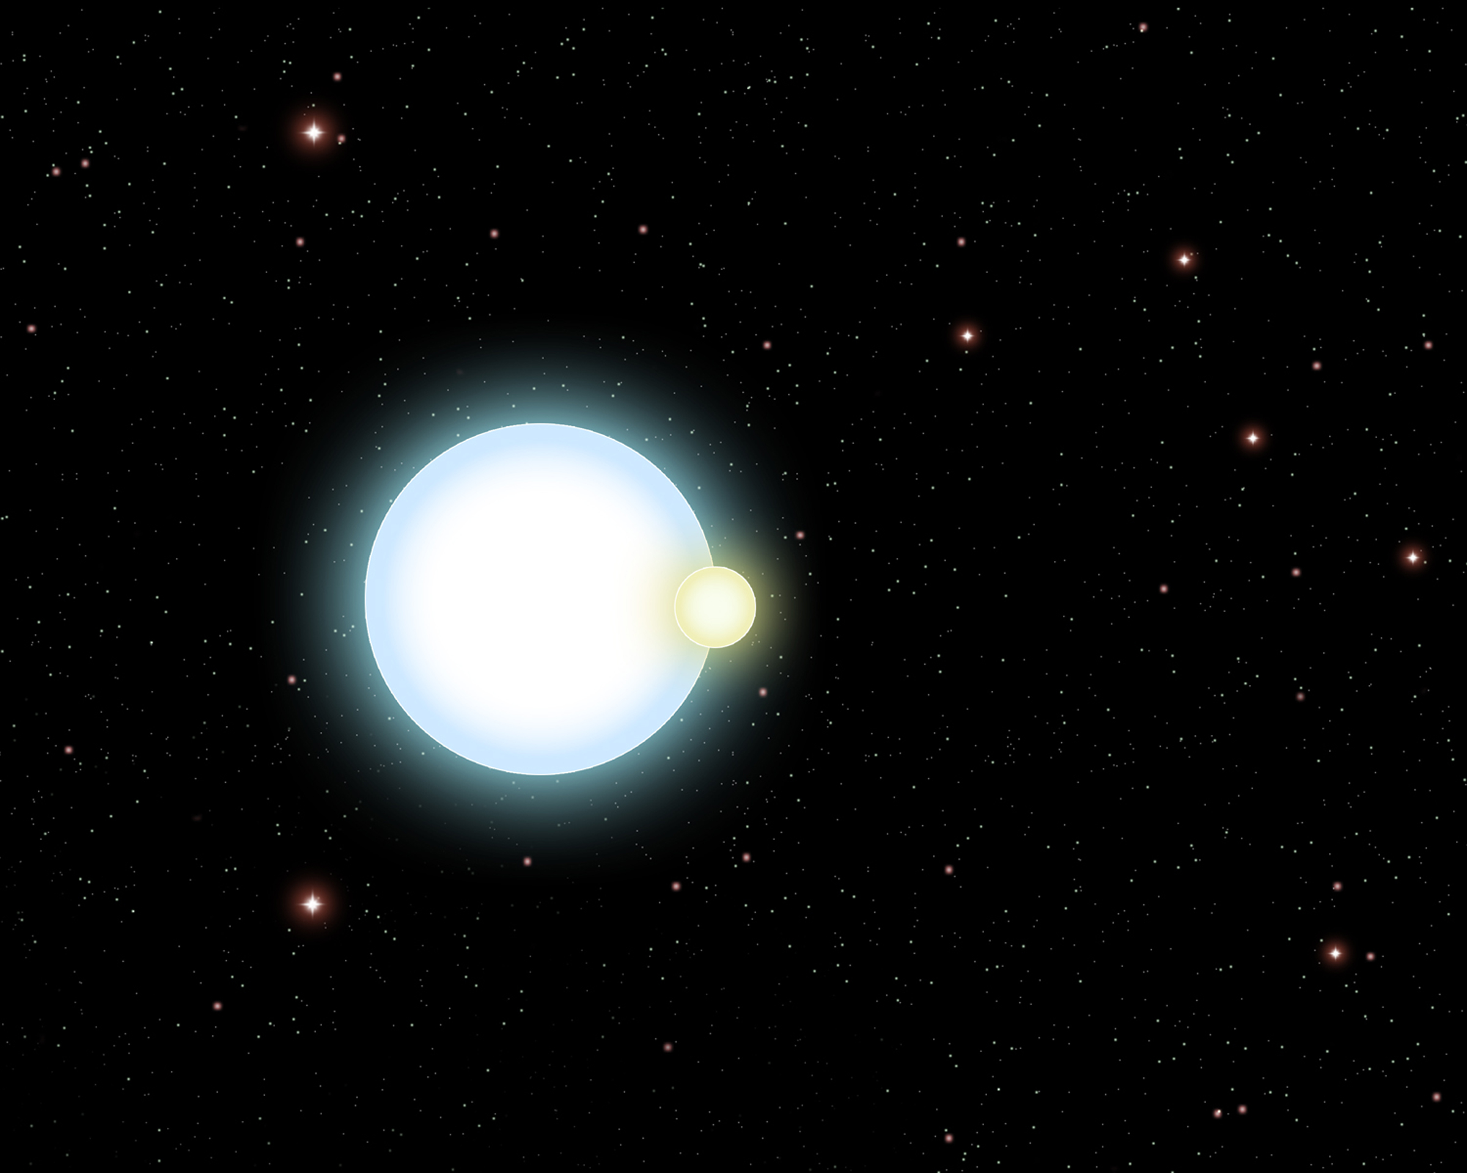

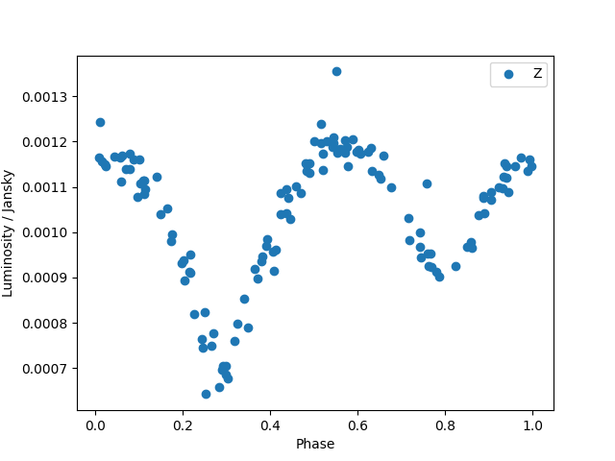
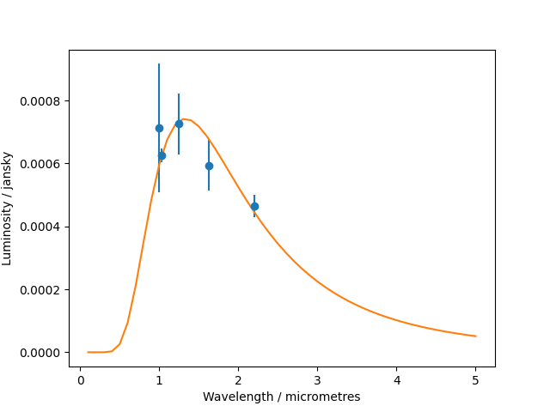
Eclipsing Binary Properties
Supervisor: Dr. Nicholas Cross
Conclusions
Described a method for determining various physical properties of stars in an eclipsing binary system.
Encountered the issue of limitations of only using infrared data.
Better results can be obtained by using optical data too.
Introduction
Binary Stars: Systems with two stars that revolve around a common centre of mass
Eclipsing Binaries: Those systems where periodically, one of the two stars passes in front of the other(from our perspective).
^{Why Eclipsing Binaries?}
Insight into properties of stars:
^{How big, How hot, How far}
The structure of the galaxy: Distance measurements to these, helps map the galaxy
^{What was the project about?}
^{Method to determine physical}
Properties(temperature, distance, size from
^{observational data}
^{Classify Star-types}
Sahaj Porwal
Results and Discussion
Eclipsing Binary Plot
Two dips seen:
One larger, one smaller,
short constant part
between(non-eclipsing)
Black-body curve fitted to the
star above. This can be used to
Determine Temperature and
other physical properties
Data used had limitation:
Only infrared.
Same method can be used
with optical data for further study
Figure 1: Distribution of comment codes.
References
Background image: https://www.news.ucsb.edu/file/3927/download?token=5b43ABw8
Method
Brightness Measurements in 5 wavelengths
Find Temperatures from these Measurements by fitting black-body curve
Find distances and actual brightness's
Classify stars
Acknowledgements
Thanks to my supervisor, Dr. Nicholas Cross for his guidance and support during the undertaking of this project.
Notes:
Copyright Colin Purrington (http://colinpurrington.com/tips/academic/posterdesign).

