Slide 1

Presents

Slide 2

+GOBLINSRPG3+
Click here to start

Slide 3

100 to 150 years ago…
It was a long lived peace in the land
Until….

Slide 4

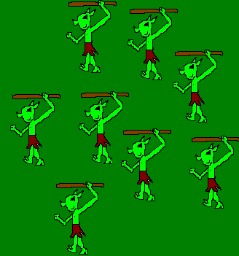
And then the goblins invaded…

Slide 5
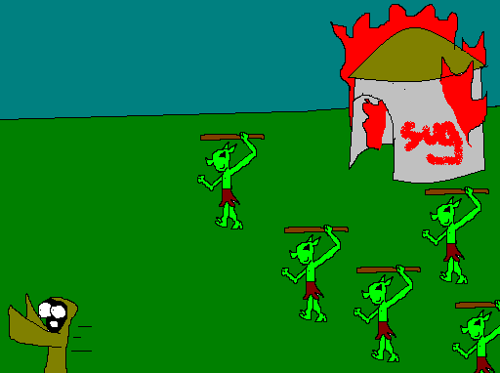
They Burned an pillaged the countryside…
And there seemed no end

Slide 6
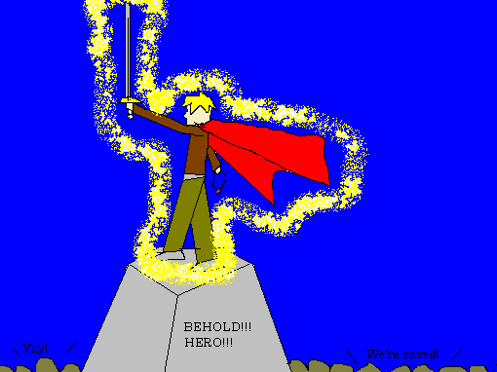
Until the “hero of time” appeared.

Slide 7
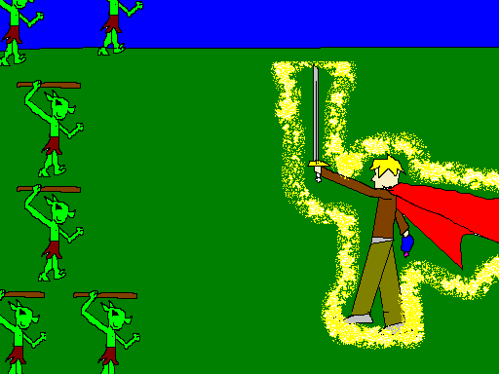
The hero of time ded them all with fell run of his spear.
(don’t ask)

Slide 8
Peace was restored once more.
This is 100 to 150 years later…

Slide 9
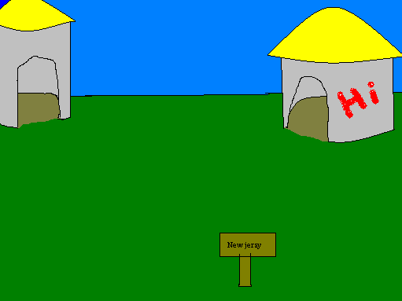

You live in the small, quiet village of New Jersey.
HINT: Click on something to talk/examine

Slide 10
Hello! Uh, I mean… RUFF RUFF!!
Click here to continue

Slide 12
I’ll give you this if you leave me alone.
Okay, Okay. I give. I’m a talking dog.

Slide 13
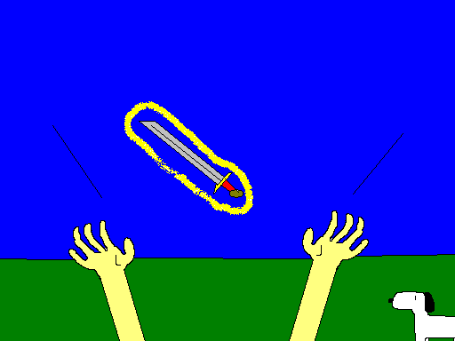
Got the sword!

Slide 14

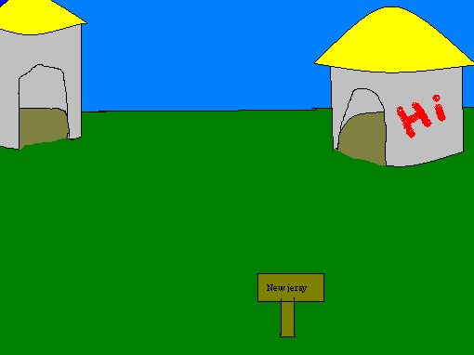


Yip!
(Darn strait)
AAA!!! The goblins are attacking!!

Slide 15
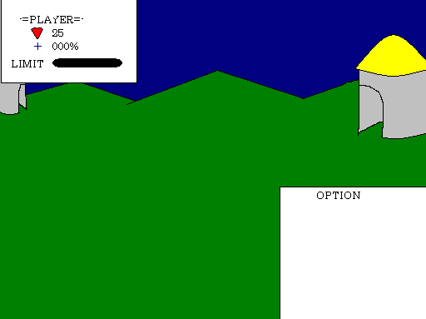
Goblin x3 attacked!
I’m bored…
-Attack
-flee

Slide 16
Goblin fled of boredom…
-Attack
-flee

Slide 17




CAN’T ESCAPE!!!
Click here to continue…

Slide 18


CAN’T ESCAPE!!
Click here to continue…

Slide 19


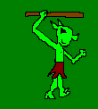

Felled goblin!!!
Click here to continue…

Slide 20
Felled goblin!!
Click here to continue…

Slide 21
15
-Attack
-flee

Slide 22
15
-Attack
-flee

Slide 23


Goblin x3 Attacks!
Player takes 15 damage!
Click here to continue…

Slide 24
10
-Attack
-flee

Slide 25
Goblin x2 Attacks!
Player takes 10 damage!
Click here to continue…

Slide 26
Goblin x1 Attacks!
Player takes 5 damage!
Click here to continue…

Slide 27
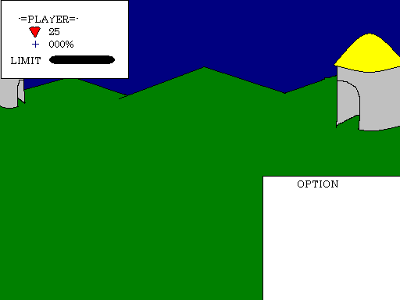
10
-attack
-flee

Slide 28
Can’t escape!
Click here to continue….

Slide 29
Goblin releases Fury!!
Player takes 10 damage.
Click here to continue…

Slide 30
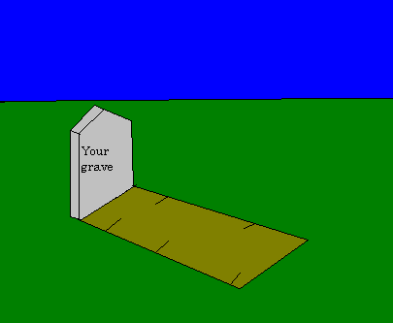
DED!!
You ded.
Press esc to exit.

Slide 31
Goblin x3 Attacks!
Player takes 15 damage!
Click here to continue…

Slide 32
Goblin x2 Attacks!
Player takes 10 damage!
Click here to continue…

Slide 33
Felled goblin!!
Click here to continue…

Slide 34
Goblin x1 Attacks!
Player takes 5 damage!
Click here to continue…

Slide 35
Felled goblin!
Click here to continue…

Slide 36
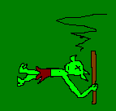

HAHAHAHA!!
YAH!! TAKE THAT STUPID GOBLINS!!!
Click here to continue….

Slide 37
Can’t escape!
Click here to continue….

Slide 38
Goblin x1 Attacks!
Player takes 5 damage!
Click here to continue…

Slide 39
20
-attack
-flee

Slide 40
Felled goblin!
Click here to continue…

Slide 41
Can’t escape!
Click here to continue….

Slide 42
Goblin x1 Attacks!
Player takes 5 damage!
Click here to continue…

Slide 43
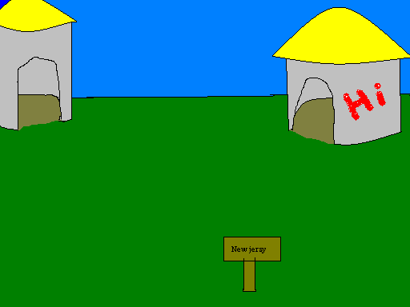

So you flee like crazy

Slide 44
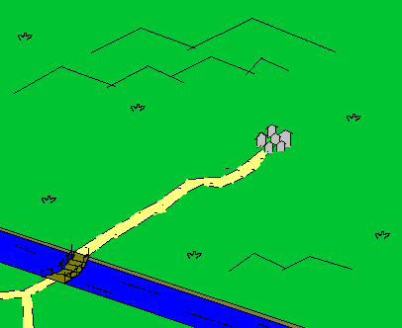
“You are here”

Slide 46
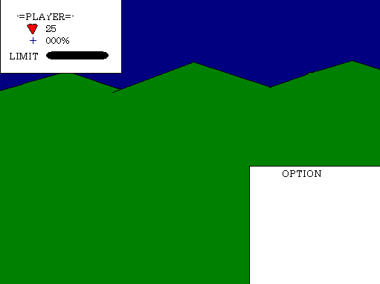

Ubergoblin attacks!
5
-attack
-LIMIT
-flee

Slide 47



Ubergoblin attacks!
Player takes 15 damage.
Player is dead……………..

Slide 48
………
Am I dead?
“We need to talk, come to my room. It’s the one to the left.”
Huh what the heck?

Slide 49
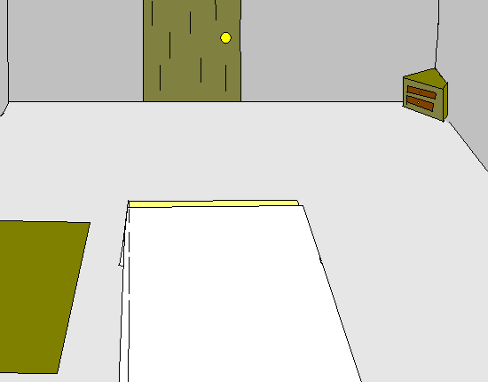

Slide 50
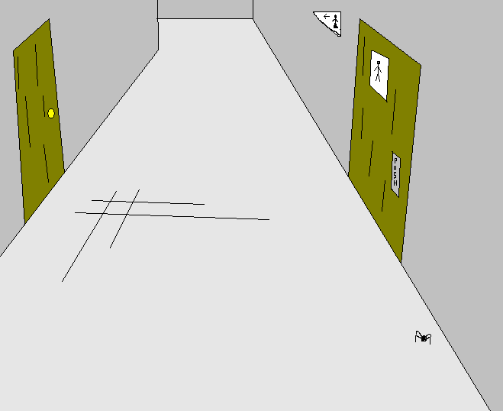

Slide 51
ELVIS FOREVER!!!
Click here to continue

Slide 52
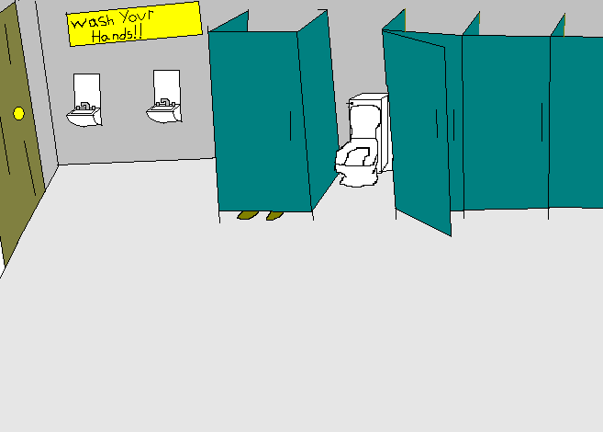

Slide 53
OCCUPIED!!
(back)

Slide 54
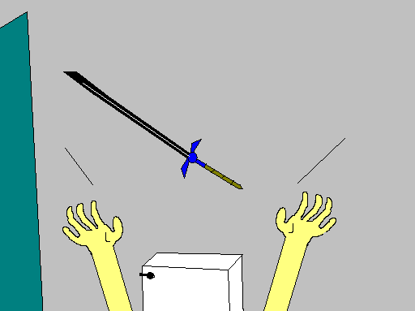
Got the Magic sword!
(Back)
You trash digger….

Slide 55
So you’ve come…
Huh?

Slide 56
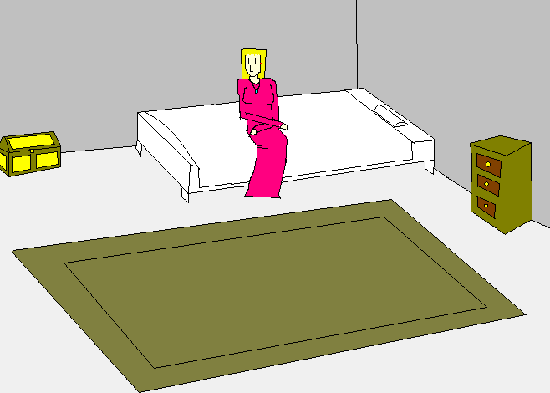
I’ve been waiting.
Don’t just stand there…

Slide 57
Who are you?
Don’t you know?
Uhhhhh………..Not really…
………

Slide 58
Okay, well, that doesn’t really matter
I’ve actually called you here for a reason…
You’re really special…
And what would that be?

Slide 59
We believe you’re the
“Hero of time”

Slide 60
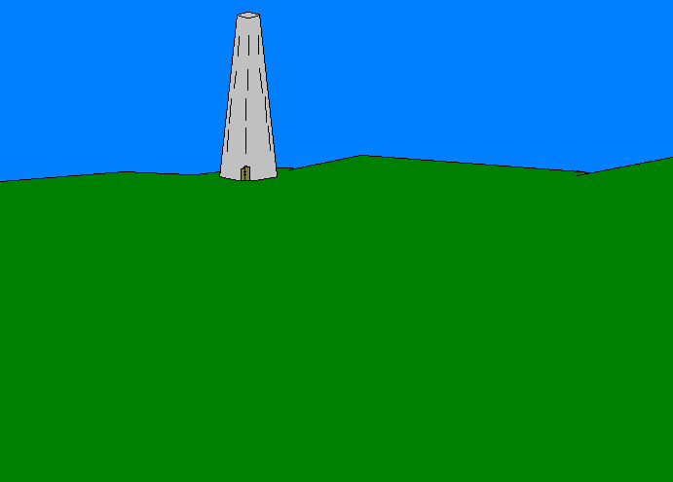
Far, Far to the south, There is a tower,
Which is believed to be the tomb of the last hero.
There you will find your destiny…

Slide 61
Why does this draw so heavily from Zelda…?
NOTE FROM SHINY: LETS SEE YOU COME UP WITH ANYTHING BETTER!!

Slide 62
You must defeat them before they take over the world!!!

Slide 63

Take over the world!!!!!!!!!!

Slide 64
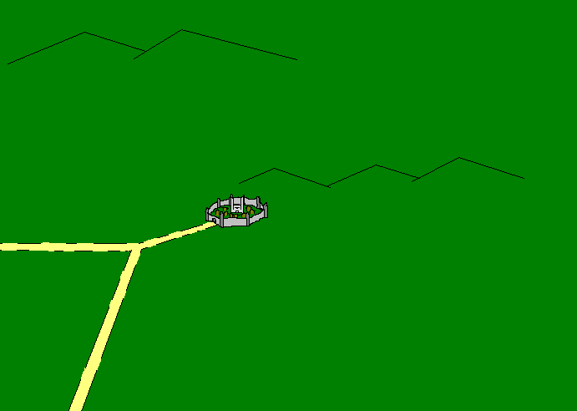
She sure gets her point made…

Slide 66
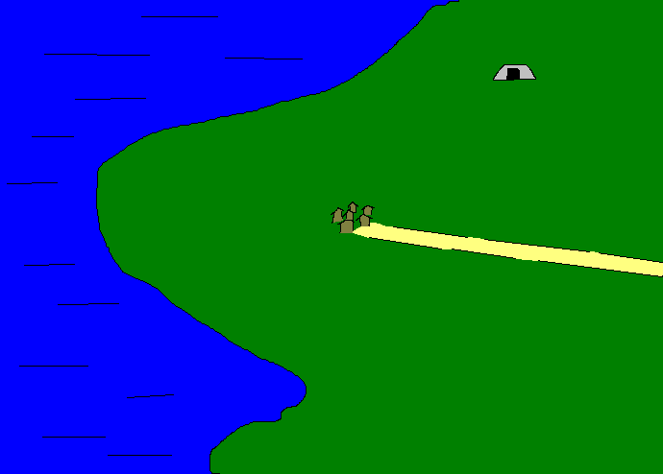

Slide 67
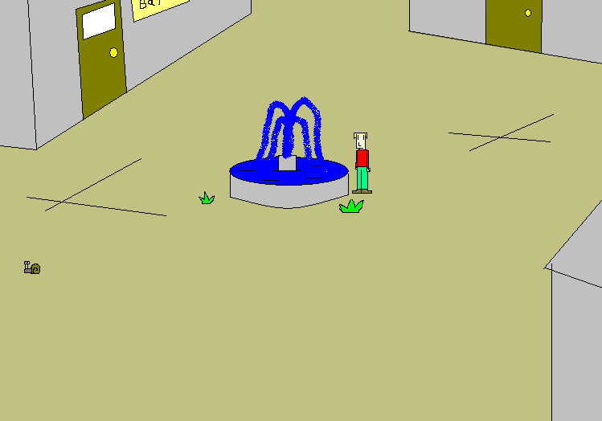
out

Slide 68
…

Slide 69
out

Slide 70
Hey ,can I have some money mister?
(back…)

Slide 71
Hey ,can I have some money, mister?
(back…)

Slide 72
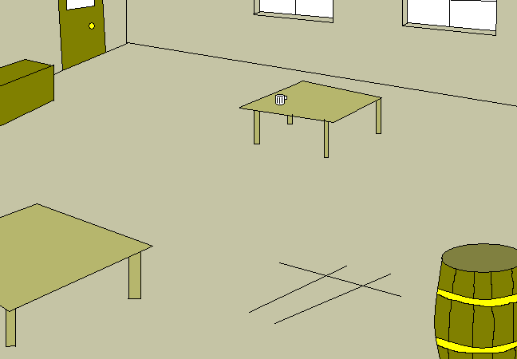

Slide 73
Help me!!
(back)

Slide 74
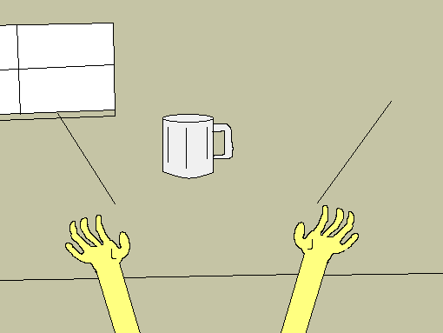
Got the glass!!
(back)

Slide 78


Slide 79
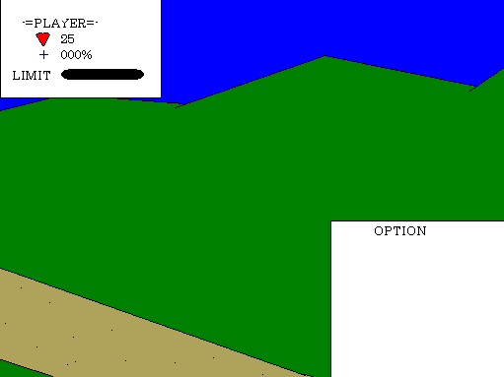

Mr. T attacks!
-attack
-LIMIT
-flee

Slide 80


Player charges LIMIT!
Felled Mr. T!

Slide 81

Gained a level!
Gained a level
-Hp +10
-Mp +10
Click here to continue

Slide 82
Fled successfully!
I pity the foo..
Click to continue…

Slide 83
Mr. T takes 7 damage!
Click here to continue

Slide 85
BAM!!

Slide 86

Player takes 15 damage!
Click here to continue.

Slide 87
10
-attack
-LIMIT
-flee

Slide 88
Mr. T takes 10 damage!
Click here to continue

Slide 89
BAM!!

Slide 90
Player takes 15 damage!
Click here to continue.

Slide 91


Slide 92
Slug attacks!
-Attack
-LIMIT
-Flee

Slide 94
You can’t run from a slug! That’s just not cool!
-Attack
-LIMIT

Slide 95
Slug takes 14 damage!
Felled slug!
Click here to continue

Slide 96
Gained a level!
New level up
-Hp +10
-Mp +10
Click here to continue

Slide 97
Player charges LIMIT!
Felled Slug!
Click here to continue

Slide 99


Slide 102
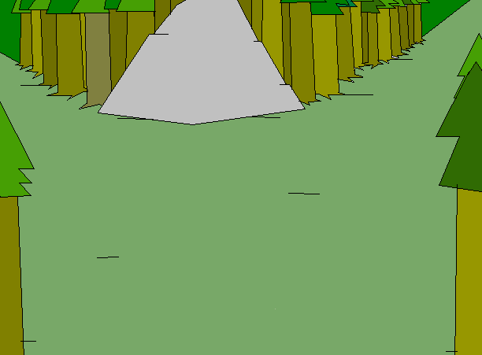

Slide 103
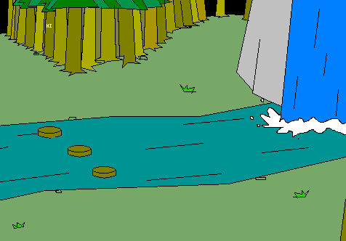

Slide 105


Slide 106


Slide 107


Slide 108



Slide 109


Slide 110


Slide 111


Slide 112
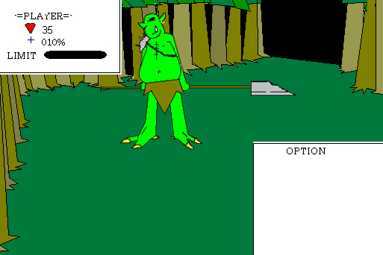
Goblin commander attacks!
-attack
-magic
-limit
-flee

Slide 113
-attack
You can’t flee from a boss! Duhh….
Why did I even include that?
-magic
-limit

Slide 114
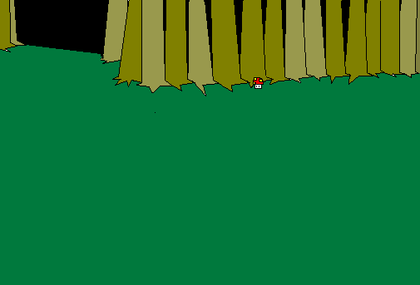
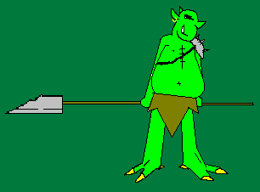

Player casts shield!
Defense raised by 20%!
Click here to continue

Slide 115



Goblin commander takes 15 damage!

Slide 116
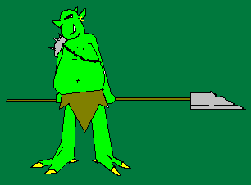
Player takes 15 damage!
Click here to continue…

Slide 117

Player charges LIMIT!
Goblin commander takes 25 damage!

Slide 118
Player takes 15 damage!
Click here to continue…

Slide 119
20
-attack
-magic
-limit

Slide 120
20
-attack
-magic

Slide 121
Goblin commander takes 15 damage!

Slide 122
Player takes 15 damage!

Slide 123
5
-attack
-magic
-limit

Slide 124
Goblin commander takes 15 damage!

Slide 125
Player takes 15 damage!
Click here to continue

Slide 126
Player charges LIMIT!
Felled goblin commander!
Click here to continue

Slide 127
WIN

Slide 128
Player casts shield!
Defense raised by 20%!

Slide 129
Player takes 10 damage!
Click here to continue

Slide 130
Player casts shield!
Defense raised by 20%!

Slide 131
Player takes 10 damage!

Slide 132
10
00%
-attack

Slide 133
Goblin commander takes 15 damage!

Slide 134
Player takes 10 damage!
Click here to continue

Slide 135
5
00%
-attack

Slide 136
Goblin commander takes 15 damage!
Felled goblin commander!
Click here to continue

Slide 137
5
10%
-attack
-magic

Slide 138
Goblin commander takes 15 damage!
Click here to continue

Slide 140
Player casts shield!
Defense raised by 20%!

Slide 141
Player takes 10 damage!
Click here to continue

Slide 142
10
00%
-attack
-limit

Slide 143
Player charges LIMIT!
Goblin commander takes 25 damage!

Slide 144
Player takes 10 damage!
Click here to continue

Slide 146
Player charges LIMIT!
Goblin commander takes 25 damage!

Slide 147
Player takes 10 damage!
Click here to continue

Slide 148
Magic’ed battle.

Slide 149
Player takes 4 damage!

Slide 150
31
00%
-attack
-limit
Round2.aftermagic

Slide 151
Goblin commander takes 15 damage!

Slide 152
Player takes 10 damage!
Click here to continue

Slide 153
21
00%
-attack
-limit
Round3.magic.attack

Slide 154
Goblin commander takes 15 damage!

Slide 155
Player takes 10 damage!
Click here to continue

Slide 156
11
00%
-attack
-limit
Round4.magic.attack.attack

Slide 157
Goblin commander takes 15 damage!

Slide 158
Player takes 10 damage!
Click here to continue

Slide 159
1
00%
-attack
-limit
Round5.magic.attack.attack.attack

Slide 160
Goblin commander takes 15 damage!

Slide 161
Player takes 10 damage!
Click here to continue

Slide 162
Player charges LIMIT!
Goblin commander takes 25 damage!

Slide 163
Player takes 10 damage!
Click here to continue

Slide 164
11
00%
-attack
Round4.magic.attack.limit

Slide 165
Goblin commander takes 15 damage!
Felled goblin commander!
Click here to continue

Slide 166
If magic/limit

Slide 167
Player charges LIMIT!
Goblin commander takes 25 damage!

Slide 168
Player takes 10 damage!
Click here to continue

Slide 169
21
00%
-attack

Slide 170
Goblin commander takes 15 damage!
Felled goblin commander!
Click here to continue

Slide 171
After Battle

Slide 172
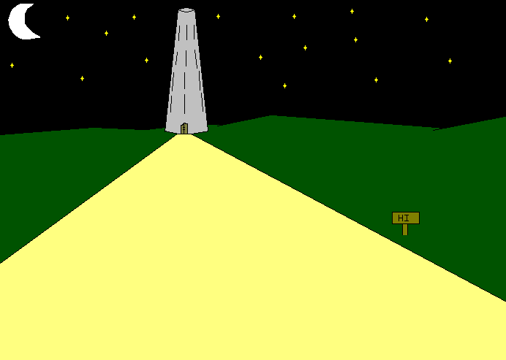

Slide 173
Tis’ here ye shall find th’art destiny.
(back)

Slide 174
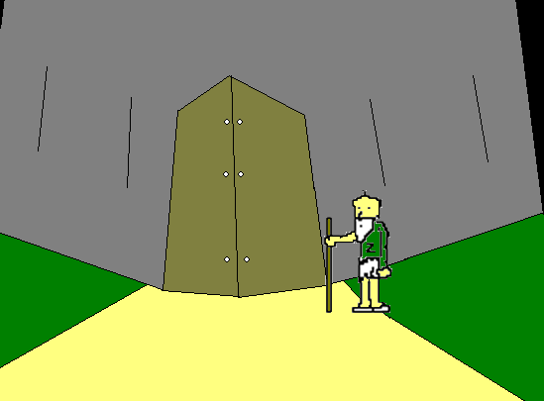

Slide 175
What up Holmes?
(BACK!!!)

Slide 176
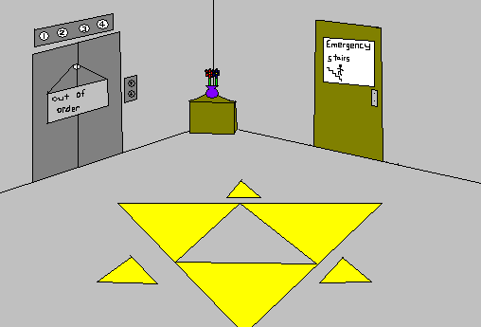

Slide 177
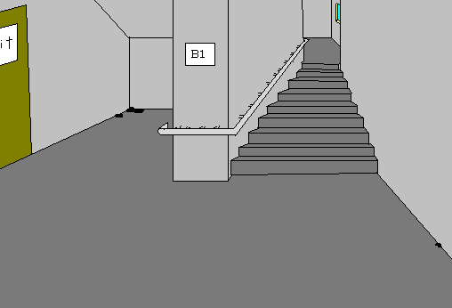

Slide 178
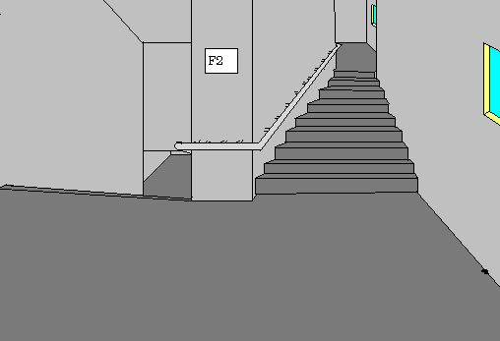

Slide 179


Slide 180


Slide 181


Slide 182
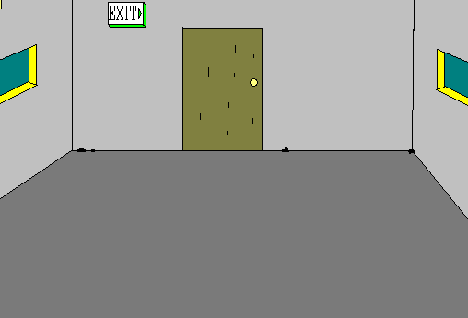

Slide 183
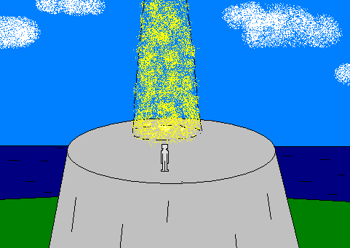
Step into the light… if th’art worthy…

Slide 185


Slide 186


Slide 187


Slide 188


Slide 189

Who dares step into the light?

Slide 190
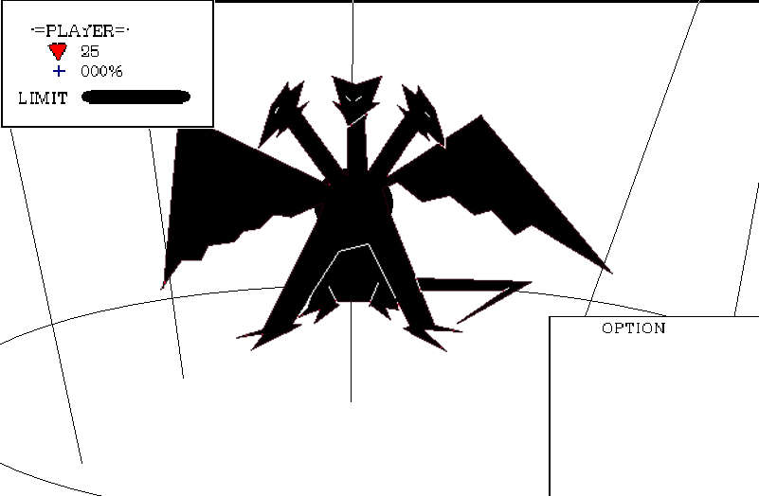
Guardian Askook Attacks!
45
-attack
-limit
-flee

Slide 191
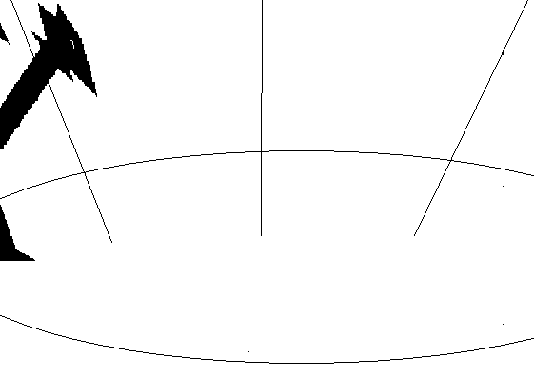

Ow…

Slide 192



Slide 193
Click here to continue…

Slide 195

Can’t flee!
Click here to continue…

Slide 196
Guardian Askook Unleashes INFINITY
Player takes 4,326,105 Damage.
+12

Slide 197
DED!!
You ded.
Press esc to exit.

Slide 198
So the legends are true…You are the Hero of time™… it is, now your destiny to kill every stinkin’ goblin.
Aww, shiz…
Don’t worry… if you die now, your stuff will end up in some museum.
Huh?

Slide 199
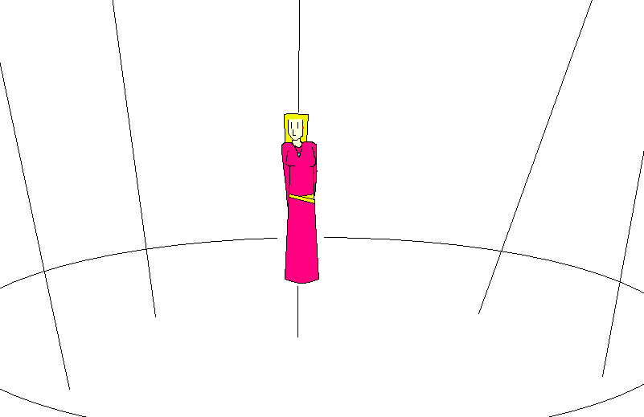
Hi

Slide 200
The End.
(press ESC to exit…)

Slide 201
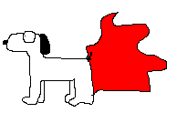

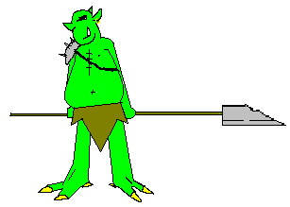





Credits—
Executive Producer-Shiny Yang
Main programmer- Shiny Yang
Art director- Shiny Yang
Monster Design- Shiny Yang
Ethics Director- Brian Goddard
Battle Programmer- Shiny Yang
-Music-
Theme song- “Jesu, joy of man’s desire” by Baby Einstein
Rock’s song- “Trogdor” by Strong Bad.
Victory song- “FF1 fanfare by anonymous at Vgmusic.com
Special thanks-
David, Brian and Mr. Mullins.
May 20^{th,} 2005, SPOTCO
-=Thanks 4 Playing=-
Bye.

