Slide 1
EXECUTIVE SUMMARY · AUGUST 2026
Tech Drawdown
A live market-drawdown dashboard, private-portfolio tracker, retirement planner and equity-valuation workbench — designed, built, tested and documented through conversation with IBM Bob.
One self-contained Dashboard · ~1,100 securities · zero-touch daily refresh
Sailaja Pudota
Sunil Pothakamuri
Suresh Pudota
Rules-based analytics — not financial advice.

Slide 2
WHY THIS MATTERS FOR AI ADOPTION
One real, production-grade application — built end to end in conversation.
~1,100
Zero-touch
1 file
securities monitored across six market universes
daily refresh — fully unattended automation
self-contained web page; opens anywhere, nothing to install
No dev team spun up. No infrastructure stood up. A spreadsheet-and-manual-lookup problem became a self-updating system — the same pattern you can bring to client workflows.
Tech Drawdown · Executive Showcase
2

Slide 3
THE PROBLEM IT REPLACES
Spreadsheets couldn't keep up
Stale, error-prone data
No single view
High manual effort
Values and drawdowns were only as fresh as the last manual refresh; off-index holdings were mis-valued from outdated figures.
Market context, personal holdings, and retirement projections lived in separate files — hard to see the whole picture or act quickly.
Keeping everything current consumed hours every week and was easy to forget or get wrong.
Hours of upkeep,
every week.
Manual, fragmented, and always a little out of date.
Tech Drawdown · Executive Showcase
3

Slide 4
THE SOLUTION
One always-current view
A single, self-updating web page that unifies three things at a glance:
• Which stocks and funds are in a drawdown — and how deep
• What every holding is worth at today's live prices
• Whether the household is on track for retirement income
…and now: how it performs against the market, what changed overnight, and what it will pay in dividends.
Market drawdown & trend
Live private portfolios
Retirement & income
Fundamentals + factsheet
Tech Drawdown · Executive Showcase
4

Slide 5
AT A GLANCE
What it delivers
Coverage
~1,100 securities — S&P 500, Nasdaq-100, Dow, Top-100 ETFs, Thematic ETFs, Mutual Funds
Private accounts
IRA (income focus) + Brokerage (growth focus) + a household retirement planner
Refresh
Automatic daily at 9am, plus an on-demand 'Load live prices' button
History & income
Rolling daily value history → benchmark vs Dow/Nasdaq/S&P, drawdown timeline, change alerts, and a forward 12-month dividend calendar
Delivery
Single self-contained web page — opens in any browser, works offline
Data privacy
Holdings stay local; only ticker symbols are sent, only for public market data
Reliability
Integrity-gated automation — always falls back to the last good state, never blanks a holding
Tech Drawdown · Executive Showcase
5

Slide 6
FEATURE · MARKET-CONTEXT OVERVIEW
A health spectrum, at a glance
The whole universe, de-duplicated and sorted into three color-coded columns — every ticker tagged with the index it belongs to.
Best performing
In correction
Worst drawdown
MRNA
S&P
MU
S&P·NDX
TTD
S&P·NDX
WCBR
THM
MCD
S&P·DOW
FISV
S&P
IVE
ETF
PBW
THM
MSTR
NDX
+ top-10 · click any ticker
+ top-10 · click any ticker
+ top-10 · click any ticker
Tech Drawdown · Executive Showcase
6

Slide 7
FEATURE · MARKET CONTEXT
One-year charts — indices & macro
US indices · 1-year
Macro & commodities · 1-year
Own-scale sparklines for the Dow, Nasdaq, S&P 500 and Russell 2000 — read each index directly, not rescaled against the others. Built once, embedded, no runtime calls.
Oil, gold, silver, copper, rare earths (ETF proxy), the US dollar vs four major currencies, and consumer sentiment — the wider backdrop behind the portfolio, in one card. Any series the data plan gates is simply omitted; the card shows the rest.
Tech Drawdown · Executive Showcase
7

Slide 8
FEATURE · PRIVATE PORTFOLIOS
Your holdings, valued live
• Market value = quantity × today's live price
• IRA (income) and Brokerage (growth) tabs, each with allocation and gain/loss
• A guarded pricing rule rejects a corrupt quote and falls back safely — one bad number can never mis-state the portfolio
• Off-index holdings priced individually, so nothing is valued from a stale figure
Edit a flat export — the next run re-imports it and prices new names automatically.
Holdings never leave the machine. Only ticker symbols go out.
Tech Drawdown · Executive Showcase
8

Slide 9
FEATURE · RETIREMENT & INCOME
Planned to a retirement date
Two-account model
Projections
Rebalance targets
IRA modeled for income, Brokerage for growth — roles baked into the projection.
Household balances and sustainable income projected to your target date.
See current plan vs. a rebalance plan, with the difference called out.
Tech Drawdown · Executive Showcase
9

Slide 10
FEATURE · INCOME
What will it pay me, and when?
A forward 12-month dividend calendar across every holding — the question an income portfolio exists to answer.
• Projected annual income, forward yield on market value, and income due in the next 30 days
• A month-by-month chart split by account — IRA (income engine) vs Brokerage
• An upcoming-payments list with exact ex-dividend, record and pay dates
Dividend income
Projected next 12 months
Honest by design. Declared payments show an exact date and render green. Where the data plan gates per-symbol dates (ETFs and funds), income is estimated from yield × value, placed at month level, and labelled estimated — never silently faked.
quarter-end months stack on the monthly ETFs
declared · exact date estimated · month level
Tech Drawdown · Executive Showcase
10

Slide 11
FEATURE · PERFORMANCE
Am I beating the market?
A rolling daily history turned a point-in-time snapshot into something that can answer 'versus what?' and 'since when?'.
Portfolio vs the market
Drawdown timeline
Household value indexed to 100 against the Dow, Nasdaq and S&P 500, with a live alpha readout. No fabricated back-cast — the comparison accrues honestly from the day it was switched on.
An underwater chart: how far the portfolio and each index sit below their own running peak over the past year, with the Correction (−10%) and Bear (−20%) bands shaded.
Tech Drawdown · Executive Showcase
11

Slide 12
FEATURE · SIGNAL
What changed since yesterday?
Stop re-scanning the whole board every morning to find the two things that moved.
• A daily diff of held names: entered Bear or Correction, Golden or Death Cross, recovered, or hit a new 52-week low
• Shown as a colour-coded icon beside the ticker — click it for the from→to detail and history
• Listed in the automated run report, so the change is in the record too
Changes since yesterday
SNOW
Golden Cross
NVO
Death Cross
ACHR
Death Cross
ASML
entered Correction
Zero new data calls. Every field it needs is already on hand. And it is guarded by the integrity check — a corrupt price can never fabricate a Death Cross. An alert system that cries wolf once is worse than none at all.
META
recovered to Correction
Tech Drawdown · Executive Showcase
12

Slide 13
FEATURE · CERTAINTY
One line implies a certainty that doesn't exist
A retirement projection is a distribution, not a forecast. So show the distribution.
• 10,000 simulated paths of household value — median plus 10th / 25th / 75th / 90th percentile bands, on a KPI tile that opens a fan chart
• User controls for horizon, annual contribution and return assumptions
• Seeded and reproducible — a projection that changes every time you open it is a slot machine, not a plan
Median @ year 10
No new data source. Volatility is estimated from the 52-week high/low already sitting in every row of the table. Look hard at what your data can already tell you before you go shopping for a new feed.
median path · bands = 25th–75th and 10th–90th percentile
Tech Drawdown · Executive Showcase
13

Slide 14
FEATURE · VALUATION
Is it actually worth what it costs?
The question the whole dashboard implies — and never answered until now.
• A three-stage DCF per held stock — analyst consensus, a 10-year fade, then a rebuilt steady state — shown as a fair-value strip beside the market price
• Every judgement input is a user control: capex intensity, fade, terminal growth, beta, risk-free rate, equity risk premium, consensus haircut
• A reverse DCF reports the discount rate the market is implicitly applying to consensus
• A Trefis-style segment sum-of-the-parts tab values each business line separately
Fair value
MSFT
$583
vs $600 independent
NVDA
$267
vs $280 independent
AMD
segment view refused
Benchmarked externally, or it doesn't ship. This model was built three times before it was right — each time ‘verified’ against the vendor's own model, which only ever proved a flawed model had been faithfully reproduced. Internal consistency is not correctness.
segments overstate revenue 12%
refusing to render, with a reason, is a feature
Tech Drawdown · Executive Showcase
14

Slide 15
FEATURE · X-RAY
What do I actually own?
Single-name risk arrives through funds, not just through shares — and the account tabs cannot see it.
• Every held ETF and mutual fund decomposed into its underlying companies, then combined with the directly held shares
• A duplicate-tracker check — three separate S&P 500 trackers held side by side is one bet, not three
• Explicit buckets for each fund's long tail, cash inside funds, and any fund not yet mapped — reconciled to the household total, to the dollar
True single-name exposure
NVDA
6.2%
AAPL
5.1%
MSFT
4.8%
AMZN
3.4%
A look-through that hides its gaps understates the exact concentration it exists to reveal. So while any fund is unmapped, every figure is presented as a floor — ‘at least’, never a total.
AVGO
2.2%
green = shares you hold · purple = reaching you through funds
Tech Drawdown · Executive Showcase
15

Slide 16
FEATURE · FUNDAMENTALS POPUP
Click any ticker — get the story
• Factsheet — a plain-English summary + a vitals grid (sector, HQ, founded, employees, market cap / issuer, expense, AUM, holdings)
• A data-derived “Did you know?” fun fact on every name
• An 8-factor risk summary (incl. supply-chain) and an advisor scorecard
• Cached locally, refreshed daily — fast on repeat opens
Apple Inc.
Technology · Consumer Electronics · Cupertino
Designs iPhone, Mac & iPad plus a fast-growing Services arm; among the world's most valuable companies.
Did you know? Founded in a garage in 1976 — now one of a handful of companies ever worth over $3 trillion.
Tech Drawdown · Executive Showcase
16

Slide 17
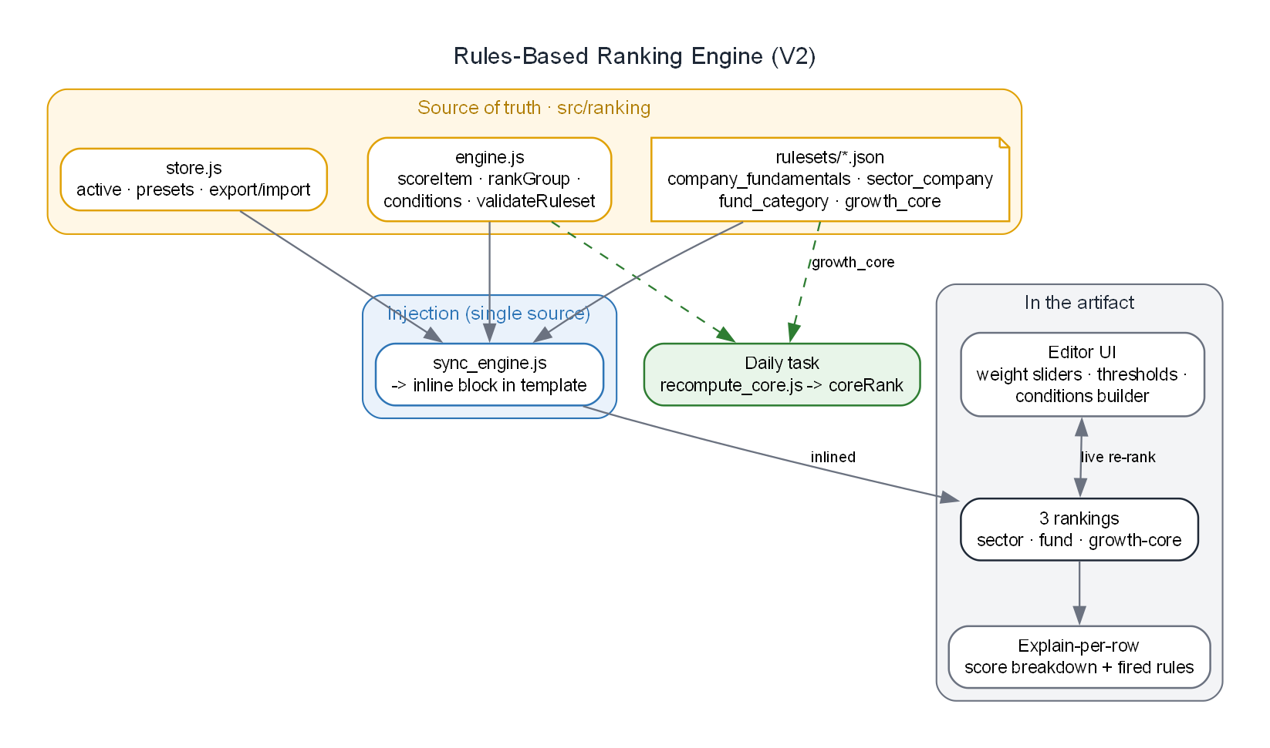
FEATURE · RULES-BASED RANKING
Rankings you can customize — and trust
• Sector, fund/category, and growth-core rankings on a declarative rules engine
• Tune weights, thresholds, and IF/THEN conditions live
• Every score traces to its rules — a per-row breakdown popover explains it
Tech Drawdown · Executive Showcase
17

Slide 18
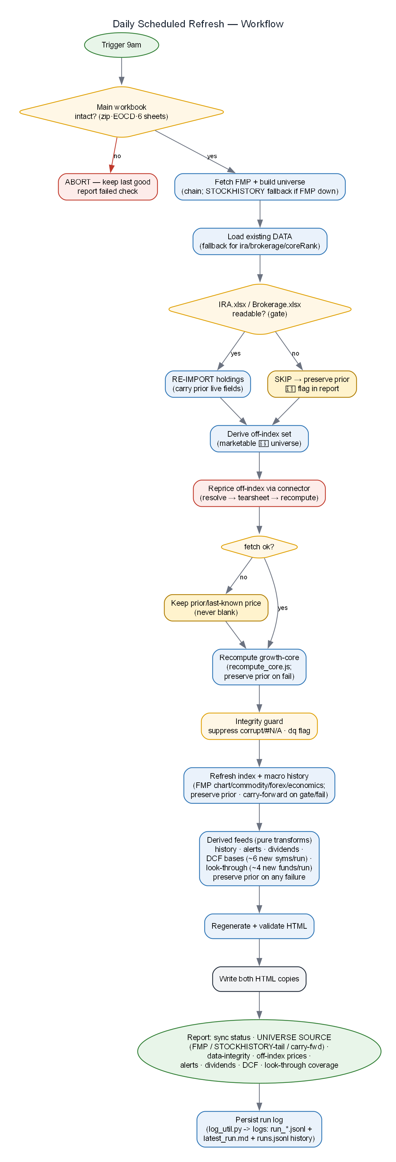
FEATURE · DAILY AUTOMATION
Zero-touch, every morning
Fetch → build → guard → import → reprice → recompute → alert → project income → regenerate → publish — with a safe fallback at every rung.
Tech Drawdown · Executive Showcase
18

Slide 19
FEATURE · RELIABILITY & DATA INTEGRITY
Built to be trusted
Integrity guard
Fallback ladder
Never blanks
Every row checked against its 52-week band; corrupt / #N/A values are suppressed and flagged with a ⚠ badge — and suppressed rows can never raise a false alert.
FMP live → workbook tail → carry-forward. A total outage degrades safely to the last good data.
Holdings, rankings, charts, history, alerts and the dividend calendar are all preserved on any failure — the dashboard never breaks.
Tech Drawdown · Executive Showcase
19

Slide 20
OBSERVABILITY
Logging & a debug view
Structured run logs
Opt-in debug panel
Every daily run writes a per-run event stream, a human-readable report, and an append-only history — auto-pruned. A failed run is diagnosable after the fact.
Enable with ?debug=1 or Shift+D (off by default). See connector calls, data provenance, cache state, and errors — with a one-click copy-report for support.
Tech Drawdown · Executive Showcase
20

Slide 21
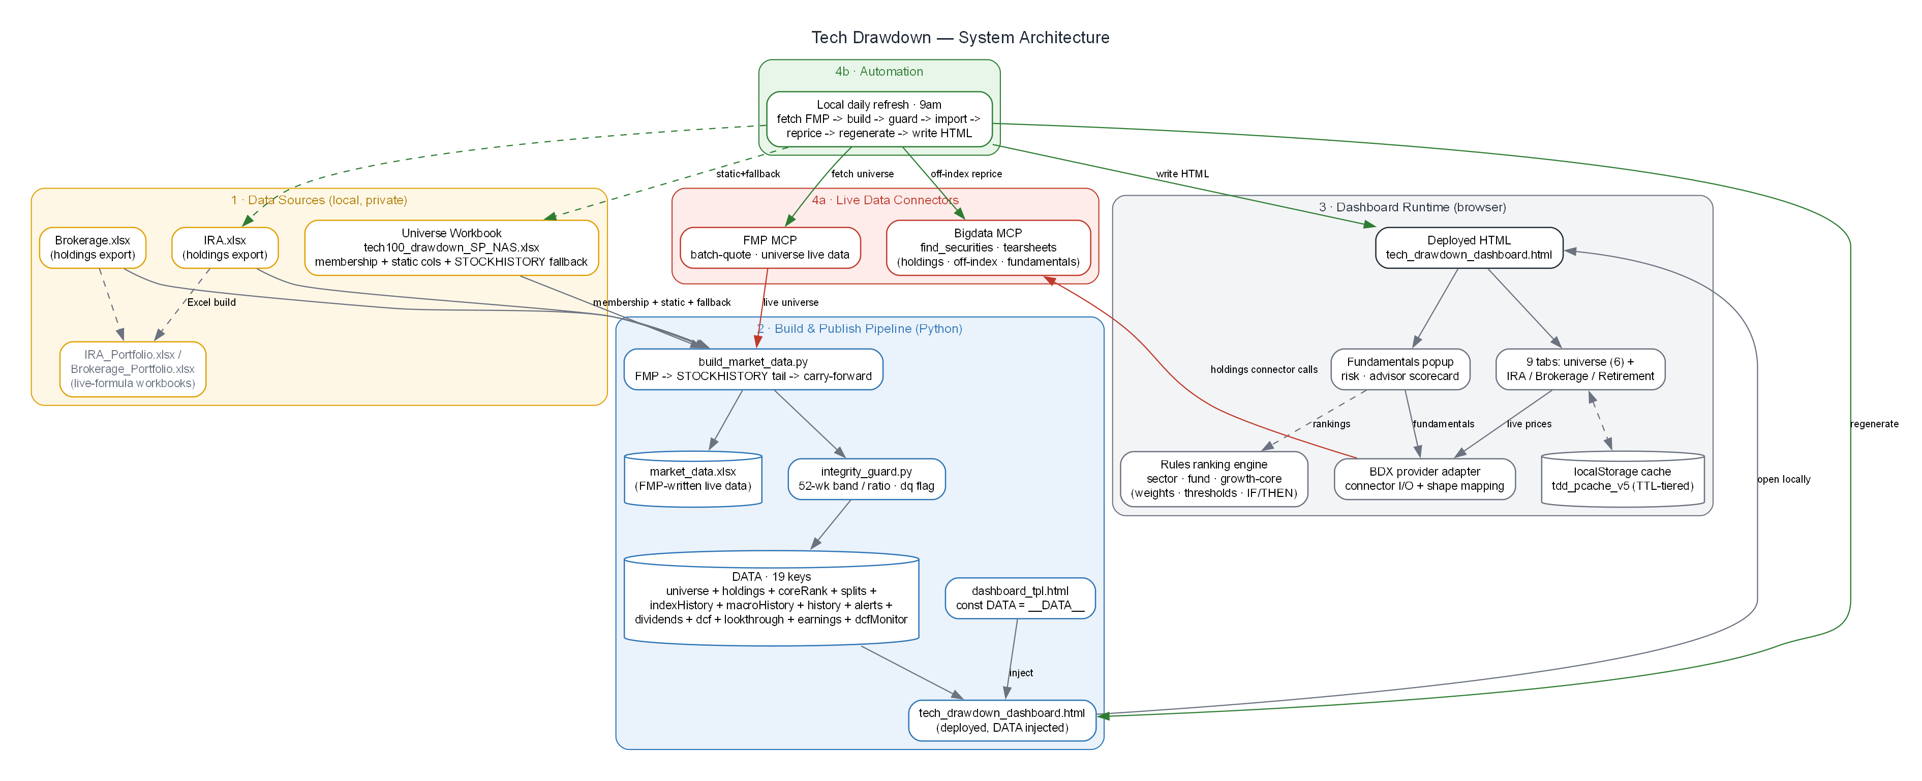
UNDER THE HOOD
System architecture
Tech Drawdown · Executive Showcase
21

Slide 22
WHY IT HOLDS UP
Engineering discipline the AI applied
Modular build
Verified changes
Provider adapter
Integrity gates
A single-file app assembled from 23 concern-based modules — with a byte-for-byte golden-master guard.
Edits validated in a stubbed-DOM harness, not just a syntax check — regressions caught before publish.
All connector I/O behind one boundary — a provider or shape change is a one-place edit.
Guards and safe fallbacks at every automated step — speed without fragility.
Tech Drawdown · Executive Showcase
22

Slide 23
THE AI-ADOPTION METHOD
How it was built
1
2
3
4
Clarify
Plan + mock
Small steps
Harden + doc
A couple of pointed questions before each step — build the right thing, not the wrong thing.
Show a plan and a visual mockup, agree, then build — no surprises.
One capability per prompt, validated, then the next — reversible and traceable.
Guards, tests, and living docs so it's production-grade, not a demo.
Tech Drawdown · Executive Showcase
23

Slide 24
DELIVERY TIMELINE
Baseline v1.0 is the starting point
v1.0
Next
Baseline
Backlog
9-tab dashboard, live portfolios, retirement, ranking, valuation, look-through, daily automation, docs
Tax-lot, PDF/email, corporate actions, saved scenarios, security/CI, Morningstar FVE
Tech Drawdown · Executive Showcase
24

Slide 25
BUSINESS VALUE
What it's worth
Hours → 0
100% local
1 file
Adaptable
weekly upkeep replaced by a zero-touch daily refresh
holdings never leave the machine — private by design
shareable, installs nothing, works offline
rules, universe, and features change by conversation
Tech Drawdown · Executive Showcase
25

Slide 26
FOR YOUR CLIENT ENGAGEMENTS
The repeatable pattern
Find the workflow
Build conversationally
Harden
Document & automate
A spreadsheet-and-manual-lookup process that's stale, fragmented, and high-effort.
Plan, mock, and build feature by feature — in the client's own language.
Guards, safe fallbacks, and tests so it runs unattended and never breaks.
Living docs, a scheduled refresh, and observability — hand off a system, not a script.
Tech Drawdown · Executive Showcase
26

Slide 27
AI AGENT INFRASTRUCTURE · BOB 2.0
MCP, Markdown & the agent configuration layer
Remote HTTP MCP
Markdown instruction files
Env vars & secrets
Both data connectors are fully-managed remote HTTP servers — no npm install, no local process to babysit. Bigdata connects automatically. FMP binds :8080 on startup.
Agent behaviour lives in plain Markdown: AGENTS.md (invariants, pipeline rules, provider constraints), daily_refresh.md (9-step playbook), and the .bob/ rules-ask layer.
API keys never live in code. FMP_ACCESS_TOKEN and BIGDATA_API_KEY are read from .env (gitignored). mcp.json carries only the transport URL and auto-approved tool list.
Bigdata
AGENTS.md
FMP_ACCESS_TOKEN
https://mcp.bigdata.com/
invariants · pipeline · data-provider rules
.env (gitignored)
FMP
daily_refresh.md
BIGDATA_API_KEY
http://localhost:8080/mcp
10-step daily playbook
.bob/mcp.json → x-api-key header
Tech Drawdown · Executive Showcase
27

Slide 28
CODE ANALYSIS · INIT & MIGRATION
Understanding and evolving an existing codebase
Bob 2.0 can read an entire repo on first open, reason about its structure, and guide migrations — not just write net-new code.
Init · first open
• GetSymbolsOverview and FindSymbol map every class, function, and module across the project in seconds — no manual spelunking
• FindReferencingSymbols traces all callers of any symbol, so a refactor's blast radius is known before the first edit
• Init flow: Bob reads AGENTS.md, inspects src/dash/, scripts/, tests/ and builds a mental model of the codebase before answering any question
• Migration: replace a provider, rename a constant, restructure a module — Bob proposes the diff, verifies it compiles in the stubbed-DOM harness, then ships both HTML copies in a single agent turn
Read
AGENTS.md + TASKS.md
Map
src/dash/ · scripts/ · tests/ · data/
Verify
golden-master + test suite green
Ready
can answer any question about the codebase
Migration · provider swap example
Identify
FindReferencingSymbols on the old provider
Diff
propose targeted apply_diff per file
Test
node --test + pytest in the same turn
Deploy
assemble + inject + write both HTML copies
Tech Drawdown · Executive Showcase
28

Slide 29
From spreadsheet to self-updating system —
conversationally.
Tech Drawdown · Version 1.0 · Rules-based analytics, not financial advice.

