Slide 1

Power and Pitfalls of Generic Smart Contracts
Andrea Benini, Mauro Gambini, Sara Migliorini, Fausto Spoto University of Verona, Italy

Slide 2
Outline
Smart contract languages
Limits of Solidity in source code type management
Use of high-level languages for smart contracts: Java
Java generics in smart contract implementation
Vulnerabilities due to the use of Java generics in smart contracts
Prevent vulnerabilities due to generic type erasure
Conclusion

Slide 3
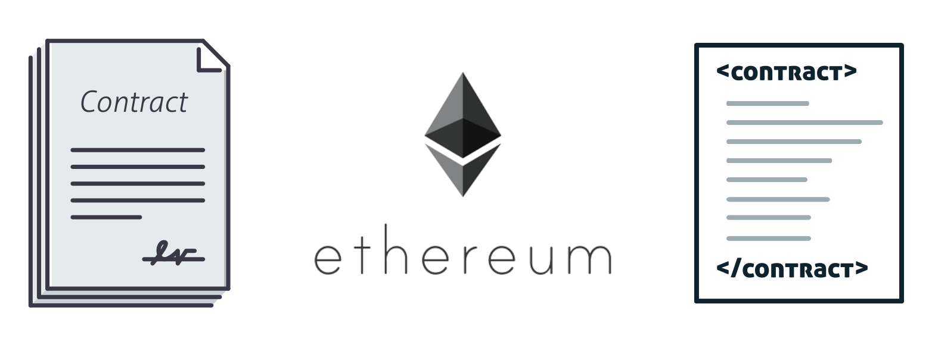
Blockchain-based smart contracts
A smart contract is a piece of code that can be automatically enforced when a particular event occurs, without the need for a trustworthy intermediary.
Through smart contracts, platforms like Ethereum can build a sort of world computer that persists the same objects inside the memory of all computers composing the blockchain network.

Slide 4
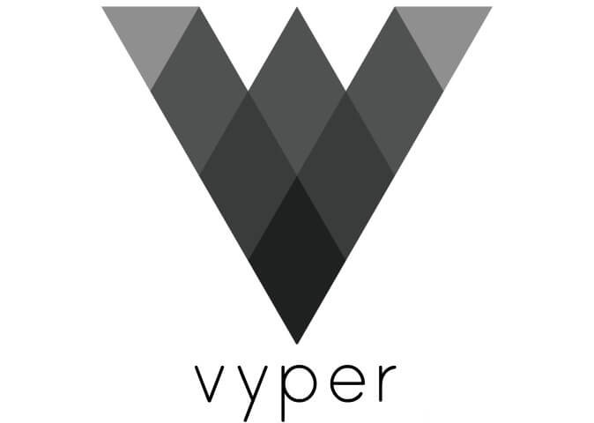
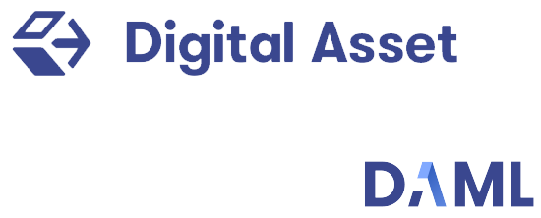
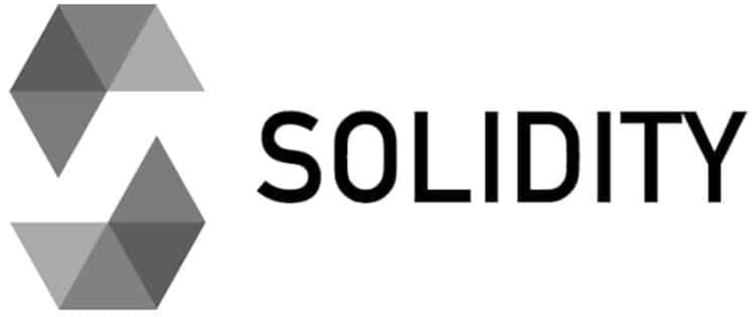
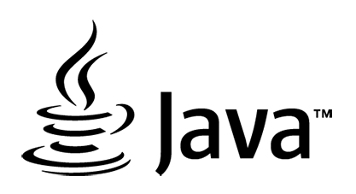

Languages for Smart Contracts

Slide 5
Languages for Smart Contracts

Slide 6
Solidity limitations
Solidity is not strongly typed.
In Solidity’s bytecode, non-primitive values are referenced through a general address type.
The compiler cannot enforce strong typing by generating defensive type instance checks and casts.
Values are unboxed: they have no attached type information at run-time, they are just numerical addresses.

Slide 7









Solidity limitations
At run-time, everything can be passed to p, not just a Person instance
child(Person p, uint256 n)
Bytecode publication on chain
The compiler cannot enforce strong typing.
Values are just numerical addresses.
Smart contract execution

Slide 8

Solidity limitations
At run-time, everything can be passed to p, not just a Person instance
child(Person p, uint256 n)
In Solidity it is discouraged to call methods of parameters passed to another method.
Bytecode publication on chain
The compiler cannot enforce strong.
Values are unboxed are just numerical addresses.
Smart contract execution
Notes:
,,,

Slide 9
Solidity limitations
Solidity misses many modern language feature, like generics.
Generics allows to personalize the behavior of smart contracts and partially overcome their inherent incompleteness.

Slide 10



Languages for Smart Contracts

Slide 11
Languages for Smart Contracts

Slide 12
Languages for Smart Contracts

Slide 13
Java Generics
Java generics are strongly typed in the source code.
Java generics are implemented through the erasure mechanism.
The erasure mechanism weakens the type information of the compiled code.
Java generics might have security issues at bytecode level.
The compiler guarantees type correctness of the Java code, not to the bytecode!

Slide 14
Java Generics
Heterogeneous implementation
The code is duplicated and specialized for each instance of the generic parameters.
Safest approach but rarely applied since the code size can dramatically increase.
In blockchain, it obliges one to reinstall all instantiations of generic code.
C++ templates.
Homogeneous implementation
Only one instance of the code is maintained and shared by all generic instances.
Erasure mechanism: a generic parameter is replaced by the upwards bound (e.g. Object)
It is less safe, but it requires a smaller consumption of resources.
Java, .Net.

Slide 15
Paper contribution
Demonstrating that a naïve use of Java generics in smart contracts can lead to security vulnerabilities at run-time.
Use of a real-world example of smart contract from the Takamaka library.
Proposing a fix to the issue through a code refactoring that forces the compiler to generate defensive checks.
Posing the basis for the definition of new smart contract languages, by learning from the weakness of the Java bytecode.

Slide 16


Example: Shared Entities
Shareholders
Who are the potential shareholders?
Shares
How offers for selling share work?
public interface SharedEntity <S extends PayableContract, O extends Offer<S>>
Shared Entity
Implementations can subclass Offer if they need more specific offers.
Who is the seller of the shares?
How many shares are being sold?
What is the requested price?
What is the expiration of the offer?
Notes:
Examples of shared entity: - A corporation, where shares represent unit of posses of the company
- A voting community, where shares represent the voting power
- Validator nodes of a proof-of-stake blockchain

Slide 17
Example: Shared Entities
Shareholders
Who are the potential shareholders?
Shares
How offers for selling share work?
public interface SharedEntity <S extends PayableContract, O extends Offer<S>>
Shared Entity
Consistency of Shareholders: If se is a SharedEntity<S,O> then the elements contained in the list se.getSharehoders() have type S.
Notes:
Examples of shared entity: - A corporation, where shares represent unit of posses of the company
- A voting community, where shares represent the voting power
- Validator nodes of a proof-of-stake blockchain

Slide 18
Example: Shared Entities
public class SimpleSharedEntity <S extends PayableContract, O extends Offer<S>>
extends Contract
implements SharedEntity<S,O>{ private final StorageTreeMap<S, BigInteger> shares = new StorageTreeMap<>();
…
@Override @FromContract(PayableContract.class) @Payable
public void accept( BigInteger amount, S buyer, O offer ){
require( caller() == buyer, “only the future owner can by the shares” );
….
addShares( buyer, offer.sharesOnSale );
}
}
The map shares holds only values of type S as keys
The consistency property requires the dummy parameter buyer. Alternative addShares( (S) caller(), offer.sharesOnSale ); Unchecked cast makes the code not strongly typed!

Slide 19
Example: Shared Entities – Problem
The absence of unchecked operations guarantees strong typing of Java source code.
What about the bytecode?
Malicious users might install in blockchain some manually crafted bytecode, not derived from the compilation of the provided Java source code.
The signature of the method accept() declares a parameter buyer of type S at source code level, but during the compilation S is erased in favor of its superclass PayableContract.
Any PayableContract can be passed to the method accept() and become shareholder!
The Consistency of Shareholder property could be easily violated at bytecode level.

Slide 20

Example: Shared Entities – Problem
public abstract class AbstractValidators<V extends Validator> extends SimpleSharedEntity<V, Offer<V>> {…} public class TendermintValidators extends AbstractValidators<TendermintED25519Validator>{…}
The shareholder are the validators of a Tendermint blockchain.
A validator can buy and sell voting power.
At block creation, Tendermint expects that the validators mine and vote the block validity.
What about the bytecode?
The Consistency of Shareholder property holds at source code level: we need that the shareholders is of type TendermintED25519Validator.

Slide 21

Example: Shared Entities – Problem
public void accept( BigInteger amount, S buyer, O offer )
source code
bytecode
public void accept( BigInteger amount, PayableContract buyer, O offer )
Any instance of PayableContract can be used as parameter of accept()
Any externally owned account can become a validator of the blockchain!

Slide 22
Example: Shared Entities – Solution
A possible solution is to oblige the compiler to generate a more restrictive signature for the method accept().
public class TendermintValidators
extends AbstractValidators<TendermintED25519Validator>{
…
@Override @FromContract(PayableContract.class) @Payable
public void accept( BigInteger amount, TendermintED25519Validator buyer, Offer< TendermintED25519Validator> offer ){ super.accept( amount, buyer, offer ); } }
The method accept() is redefined in the extended class to enforce the correct type for buyer.

Slide 23
Example: Shared Entities – Solution
Bytecode
public class TendermintValidators extends AbstractValidators{
…
public void accept(BigInteger, TendermintED25519Validator, offer){
…
invokespecial AbstractValidators.accept( BigInteger, PayableContract, Offer )
…
}
public void accept(BigInteger, PayableContract, offer){
…
invokevirtual AbstractValidators.accept( BigInteger, TendermintED25519Validator, Offer )
…
}
}
Method redefined in the sub-class: it delegates to the method of the superclass.
Method of the super-class Bridge method: all calls to the erased signatures are forwarded to the redefined accept method.

Slide 24
Conclusion
Solidity provides a very limited support in terms of source code type management: all types are translated into the address type in the bytecode.
Generic types can be useful in the definition of smart contracts.
Generic types can introduce some security risks due to the erasure mechanism.
We identify a method for preventing such security risk: redefinition of methods with specific types.
The solution forces the compiler to generate some kinds of checks in the bytecode.
A smarter compilers might recognize such additional code as unnecessary and remove it.
New compilers for smart contracts could be engineered, in order to automatically produce such additional checks and guaranteeing a safe type management also in the bytecode.

Slide 25

Thank you for your attention. Any question?

