Slide 1
Applets

Slide 2
An Example Applet with If-Statements
// Finding the minumum of three integers
import java.applet.Applet;
import java.awt.*;
import java.awt.event.*;
public class MinTestApplet extends Applet implements ActionListener {
TextField tNum1,tNum2,tNum3; // text fields for integers
Label lMinValue; // Area for the minimum number
int minValue,num1,num2,num3;
// Create fields and initialize the variables
public void init() {
// Initialize variables
minValue = 0; num1 = 0; num2 = 0; num3 = 0;
// Create input areas
add(new Label("First Number: ")); tNum1=new TextField("0",10); add(tNum1);
add(new Label("Second Number: ")); tNum2=new TextField("0",10); add(tNum2);
add(new Label("Third Number: ")); tNum3=new TextField("0",10); add(tNum3);
// create output area
add(new Label("Minimum Value: ")); lMinValue=new Label("0"); add(lMinValue);
// Listen three input areas
tNum1.addActionListener(this); tNum2.addActionListener(this);
tNum3.addActionListener(this);
}

Slide 3
An Example Applet with If-Statements (cont.)
// Respond to the events
public void actionPerformed(ActionEvent e) {
// Find the source if the event
if (e.getSource()==tNum1)
num1 = Integer.parseInt(tNum1.getText().trim());
else if (e.getSource()==tNum2)
num2 = Integer.parseInt(tNum2.getText().trim());
else
num3 = Integer.parseInt(tNum3.getText().trim());
// find the minumum
if (num1<num2)
minValue = num1;
else
minValue = num2;
if (num3<minValue)
minValue = num3;
// put the new minimum into the applet
lMinValue.setText(minValue + "");
} }

Slide 4
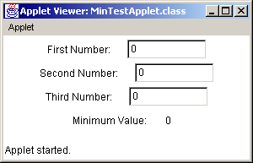
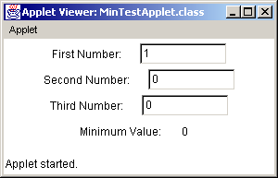

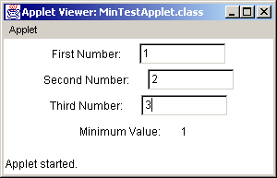

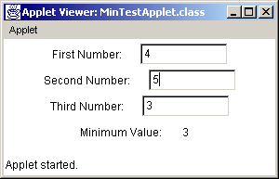
Output of The Applet
1
2
3
4
5
6

Slide 5



Output of The Applet (Problem)
What is wrong here?
I did not push the return key
I pushed the return key after 1;
but I did not push the return key after 0.

Slide 6
Another Version
// Finding the minumum of three integers
import java.applet.Applet;
import java.awt.*;
import java.awt.event.*;
public class MinTestApplet extends Applet implements ActionListener {
TextField tNum1,tNum2,tNum3; // text fields for indegers
Button b;
Label lMinValue; // Area for the minimum number
int minValue,num1,num2,num3;
// Create fields and initialize the variables
public void init() {
// Initialize variables
minValue = 0; num1 = 0; num2 = 0; num3 = 0;
// Create input areas
b = new Button("Find Minimum"); add(b);
add(new Label("First Number: ")); tNum1=new TextField("0",10); add(tNum1);
add(new Label("Second Number: ")); tNum2=new TextField("0",10); add(tNum2);
add(new Label("Third Number: ")); tNum3=new TextField("0",10); add(tNum3);
// create output area
add(new Label("Minimum Value: ")); lMinValue=new Label("0"); add(lMinValue);
// Listen the button
b.addActionListener(this);
}

Slide 7
Another Version
// Respond to the events
public void actionPerformed(ActionEvent e) {
// Find the source if the event
num1 = Integer.parseInt(tNum1.getText().trim());
num2 = Integer.parseInt(tNum2.getText().trim());
num3 = Integer.parseInt(tNum3.getText().trim());
// find the minumum
if (num1<num2)
minValue = num1;
else
minValue = num2;
if (num3<minValue)
minValue = num3;
// put the new minimum into the applet
lMinValue.setText(minValue + "");
} }

Slide 8
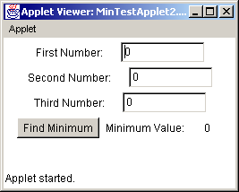
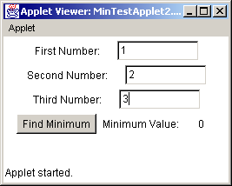

Another Version (output)
Before pushing
button
After pushing
button

Slide 9
An Example Applet
// This applet draw a ladder like shape
// The number of the steps is read from a TextField
import java.awt.*;
import java.applet.Applet;
import java.awt.event.*;
public class Ladder extends Applet implements ActionListener{
private final int MAXSTEPS = 30;
private int numOfSteps = 0;
private TextField input;
// Create components and put them into the applet
public void init() {
add(new Label("Number of Steps: "));
input = new TextField(10);
add(input);
input.addActionListener(this);
}

Slide 10
An Example Applet (cont.)
// Draw the ladder like shape
public void paint(Graphics g) {
int i;
int x=20, y=20;
for (i=0; i<numOfSteps; i=i+1) {
g.drawLine(x,y,x+20,y);
g.drawLine(x+20,y,x+20,y+20);
x=x+20;
y=y+20;
}
}
// Read the number of steps and activate paint method
public void actionPerformed(ActionEvent e) {
numOfSteps = Integer.parseInt(e.getActionCommand().trim());
if (numOfSteps>MAXSTEPS)
numOfSteps = MAXSTEPS;
else if (numOfSteps<0)
numOfSteps = 0;
repaint();
} }

Slide 11
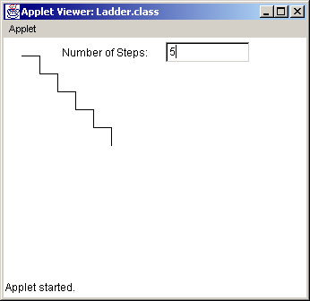
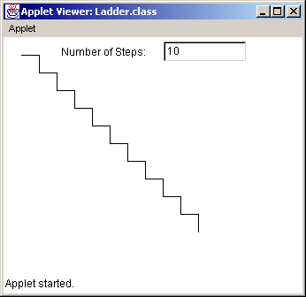
An Example Applet -- Output

Slide 12
Some methods defined in class Applet
public void init(){}
Called by the browser or appletviewer to inform this applet
that it has been loaded into
It is always called before the first time that the start method is called.
A subclass of Applet should override this method if it has
initialization to perform.
The implementation of this method provided by the Applet class
does nothing.

Slide 13
  public void start(){}
Called by the browser or appletviewer to inform this applet
that it should start its execution.
It is called after the init method and each time
the applet is revisited in a Web page.
A subclass of Applet should override this method
if it has any operation that it wants to perform each time
the Web page containing it is visited. For example, an applet
with animation might want to use the start method to resume
animation, and the stop method to suspend the animation.
The implementation of this method provided by the Applet class
does nothing.

Slide 14
  public void stop(){}
called when the Web page that contains this applet
has been replaced by another page, and also just before
the applet is to be destroyed.
a subclass of Applet should override this method
if it has any operation that it wants to perform each time
the Web page containing it is no longer visible. For example,
an applet with animation might want to use the start method
to resume animation, and the stop method to suspend the animation.
The implementation of this method provided by the Applet class
does nothing.

Slide 15
  public void destroy(){}
Called by the browser or appletviewer to inform this applet
that it is being reclaimed and that it should destroy any resources
that it has allocated. The stop method will always be called
before destroy.
A subclass of Applet should override this method
if it has any operation that it wants to perform before it is destroyed.
For example, an applet with threads would use the init method to create
the threads and the destroy method to kill them.
The implementation of this method provided by the Applet class
does nothing.

Slide 16
paint method in applets
paint method is automatically called after
calls to init and start methods.You need to override it,
otherwise it will do nothing.
paint method takes a Graphics page, an object
from java.awt.Graphics class. A Graphics object
cannot be instantiated, you simply request it from system.
If you need to call paint method repeatedly you can not
do it directly, you should call repaint() method (but you can
not override it).

Slide 17
Class Applet
java.lang.Object
|
+--java.awt.Component
|
+--java.awt.Container
|
+--java.awt.Panel
|
+--java.applet.Applet
void paint(Graphics g){}

