Slide 1
Graphics Class
Graphics class is a class in java.awt package.
  contains methods for creating line drawings, rectangles, ovals, arcs, polygons.
  control color and fonts
A Graphics object represents a particular drawing surface.
  We cannot directly call the constructor of Graphics class to create a Graphics object.
  A Graphics object is created indirectly. For example, each applet is associated with a Graphics object, and we can access this Graphics object.
  Any methods called with the Graphics object associated with an applet will affect that applet.
An object of Graphics class represents a particular drawing surface, and Graphics class contains methods for drawing shapes on that surface.

Slide 2
An Applet’s Graphics Context
An applet has a graphics context which is automatically passed to the paint method when it is invoked.
import java.applet.Applet;
import java.awt.*;
public class AnApplet extends Applet {
public void paint(Graphics g) {
… … // using this Graphics object g,
… … // we can draw shapes on this applet.
}
}

Slide 3
Coordinate System
0,0
width drawing surface of
an applet
height
width-1,height-1
Each point on the coordinate system represents a single pixel.
Anything drawn outside of this area will not be visible.

Slide 4
An Example
import java.applet.Applet;
import java.awt.*;
public class AnApplet extends Applet {
public void paint(Graphics g) {
g.drawRect(10,10,100,50);
top left corner width and height of the rectangle
g.drawLine(10,10,110,60);
source coordinate destination coordinate
g.drawString(“This a rectangle”,10,150);
}
} top left corner

Slide 5
Drawing Shapes
Graphics class directly supports the drawing of:
  lines
  ovals (circles are special forms of ovals)
  rectangles
  arcs
  polygons – triangles, hexagons, …
  polylines – a series of line segments
Most shapes (except polylines) can be drawn filled or unfilled.
      We can see the other graphics objects under an unfilled object
      The foreground color is used to fill shapes. The other graphics objects under a filled object cannot be seen.
Thickness cannot be specified (always 1 pixel). Thicker lines can be drawn by multiple lines.
  g.drawLine(10,10,200,10);
  g.drawLine(10,11,200,11);

Slide 6
Rectangles
drawRect(xsrc,ysrc,width,height)
fillRect(xsrc,ysrc,width,height)
top left corner

Slide 7
Ovals
A bounding rectangle is used to define the position of an oval.
drawRect(xsrc,ysrc,width,height)
fillRect(xsrc,ysrc,width,height)
top left corner of the bounding rectangle
bounding rectangle is not seen
if width and height are equal ➔ a circle

Slide 8
Some Other Rectangle Related Methods
clearRect(x,y,width,height)
draws a (filled) rectangle in the current background color.
cleans that rectangle area.
drawRoundRect(x,y,width,height,arcwidth,archeight)
fillRoundRect(x,y,width,height,arcwidth,archeight)
draws a rectangle with rounded corners.
archeight
arcwidth

Slide 9
Arcs
An arc is a segment of an oval.
The segment begins at a specific angle, and extends for a distance specified by the arc angle.
drawArc(x,y,width,height,startangle,arcangle)
fillArc(x,y,width,height,startangle,arcangle)
-270,90
counter-clockwise (positive)
180,-180 0,360,-360
clockwise (negative)
270,-90

Slide 10
Arcs (cont.)
startangle is in degrees –
  a value between 0 and 360, or between 0 and -360
arcangle
  positive (counter clockwise)
  negative (clockwise)
drawArc(20,20,50,50,90,90);
drawArc(20,20,50,50,-270,90);
drawArc(20,20,50,50,180,-90);
drawArc(20,20,50,50,-180,-90); same arc is drawn by all of them
fillArc(20,20,50,50,90,90);

Slide 11
Polygons
A polygon is a multi-sided figure
A polygon is defined using a series of <x,y> points which indicates the end points of the sides of that polygon.
Polygons are closed. It forms a line segment from the last point to the first.
End points can be specified by:
  two integer arrays or
  an object of Polygon class indicating the end points.
drawPolygon(int[] xpoints, int[] ypoints, int numofpoints)
fillPolygon(int[] xpoints, int[] ypoints, int numofpoints)
drawPolygon(Polygon poly)
fillPolygon(Polygon poly)

Slide 12
Polygons (cont.)
int[] xs = {50,100,150,100}; 100,50
int[] ys = {100,50,100,150};
drawPolygon(xs,ys,4);
50,100 150,100
Polygon p = new Polygon();
p.addPoint(50,100);
p.addPoint(100,50); 100,150
p.addPoint(150,100);
p.addPoint(100,150);
drawPolygon(p);

Slide 13
Polyline
A polyline is a similar to a polygon except it is not closed.
There is no line segment from the last point to the first one.
Polylines cannot be filled.
int[] xs = {50,100,150,100};
int[] ys = {100,50,100,150};
drawPolyline(xs,ys,4);

Slide 14
Color Class
Color class is used to define and manage the color in which shapes are drawn.
We can control the color of the shapes we draw.
A color is defined by an R G B value (red,green,blue) that specifies the relative contribution of these three primary colors red, green, blue (values between 0 to 255).
Color class contains several final static Color objects to define basic colors.
  blue Color.blue 0,0,255
  green Color.green 0,255,0
  red Color.red 255,0,0
  black Color.black 0,0,0
  white Color.white 255,255,255
  yellow Color.yellow 255,255,0
  gray Color.gray 128,128,128

Slide 15
Color Class (cont.)
In addition to basic colors defined in Color class, we can define our own color by setting these three values (256³ – almost 16 million different colors).
Color mycolor = new Color(100,100,100);
We can change foreground (colors of shapes) and background (general color of the applet) colors. In paint method,
setBackground(Color.white)
changes the background color to white. setBackground is a method of Applet class.
g.setColor(Color.red)
changes the foreground color to red. setColor is a method of Graphics class.

Slide 16
Color Class - Example
public void paint (Graphics g) {
setBackground(Color.white); ➔ background is white
g.setColor(Color.yellow); ➔ color of pen is yellow
g.drawString(“This is yellow”,20,20); ➔ This is yellow
g.setColor(Color.blue); ➔ color of pen is blue
g.drawLine(20,50,200,50); ➔
g.setColor(Color.green); ➔ color of pen is green
g.drawRect(20,100,200,100); ➔
}

Slide 17
Fonts
A font defines the look of each character when it is printed or drawn.
Font class provides methods for specifying fonts in a Java program.
There is a specific set of fonts in each system. We can use one of the fonts from this list.
Using the constructor of Font class we can create a Font object.
Then we can set the current font to this Font object using setFont method in Graphics class.
new Font(fontname,style,size)
“TimesRoman” Font.PLAIN 12 14 16 18 20 …
“Helvetica” Font.BOLD
Font.ITALIC

Slide 18
Fonts -- Example
import java.applet.Applet;
import java.awt.*;
public class FontTest extends Applet {
public void paint(Graphics g) {
g.setFont(new Font("TimesRoman",Font.PLAIN,16));
g.drawString("Font is TimesRoman-PLAIN-16",10,30);
➔ Font is TimesRoman-PLAIN-16
g.setFont(new Font("TimesRoman",Font.ITALIC,20));
g.drawString("Font is TimesRoman-ITALIC-20",10,60);
➔ Font is TimesRoman-ITALIC-20
g.setFont(new Font(“Courier",Font.BOLD+Font.ITALIC,20));
g.drawString("Font is Courier-BOLD-ITALIC-20",10,90);
➔ Font is Courier-BOLD-ITALIC-20
g.setFont(new Font("Courier",Font.PLAIN,16));
g.drawString("Font is Courier-PLAIN-16",10,120);
➔ Font is Courier-PLAIN-16
}
}

Slide 19
GraphicsTest
import java.applet.Applet;
import java.awt.*;
public class GraphicsTest extends Applet {
public void paint(Graphics g) {
resize(600,400);
g.drawRect(10,10,200,100);
g.drawLine(10,10,210,110);
g.drawLine(10,110,210,10);
g.drawString("This is a rectangle",10,130);
g.setColor(Color.red);
g.drawString("A red string",10,150);
g.setColor(Color.blue);
g.drawString("A blue string",10,170);
g.fillRect(300,10,100,50);
g.drawOval(300,100,100,50);
g.fillOval(300,200,100,50);
g.drawOval(300,300,40,40);
g.fillOval(350,300,40,40);
}
}

Slide 20
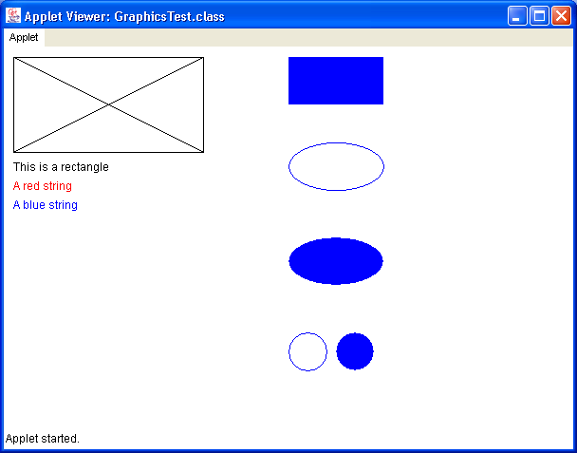
Output of GraphicsTest

Slide 21
Animation
Simple animations can be accomplished by drawing a shape, then erasing it. Then drawing it again in a slightly altered position.
Timing must be controlled so that animation does not move too fast.

Slide 22
BannerTest
import java.applet.Applet;
import java.awt.*;
public class BannerTest extends Applet {
private final String BANNER="Ilyas Cicekli";
private int WIDTH;
private final int DELAY=30;
public void init() {
Dimension d;
d = getSize();
WIDTH = d.width;
}
public void paint(Graphics g) {
int i=1;
long currtime;
for (;;i++) {
if (i%WIDTH==0) i=0;
g.clearRect(0,0,WIDTH,100);
g.drawString(BANNER,i,20);
// Wait DELAY
for (currtime=System.currentTimeMillis();
currtime+DELAY>System.currentTimeMillis();) ;
}
}
}

Slide 23
BallTest
import java.applet.Applet;
import java.awt.*;
public class BallTest extends Applet {
private int WIDTH,HEIGHT;
private int BALLSIZE=1;
private final int DELAY=50;
public void init() {
Dimension d;
d = getSize();
WIDTH = d.width;
HEIGHT = d.height;
}
public void paint(Graphics g) {
int i;
if (WIDTH<HEIGHT) i=WIDTH/2; else i=HEIGHT/2;
long currtime;
g.setColor(Color.red);
for (;i>0;i=i-3,BALLSIZE=BALLSIZE+6) {
g.drawOval(i,i,BALLSIZE,BALLSIZE);
// Wait DELAY
for (currtime=System.currentTimeMillis();
currtime+DELAY>System.currentTimeMillis();) ;
}
}
}

Slide 24
BouncingBallTest
import java.awt.*;
import java.applet.Applet;
public class BouncingBallTest extends Applet {
private final int INC=1;
private final long WTIME = 30;
private final int BALLSIZE=15;
private int WIDTH, HEIGHT;
public void init() {
Dimension d;
resize(700,250);
d = getSize();
WIDTH = d.width;
HEIGHT = d.height;
}

Slide 25
BouncingBallTest – paint method
public void paint(Graphics g) {
long currtm;
int x=0, y=HEIGHT-100-BALLSIZE, yinc=0; int radius,j;
g.drawLine(0,HEIGHT-99,WIDTH,HEIGHT-99);
g.drawLine(0,HEIGHT-98,WIDTH,HEIGHT-98);
g.drawLine(0,HEIGHT-97,WIDTH,HEIGHT-97);
g.setColor(Color.red);
g.drawString("StartTime: "+System.currentTimeMillis(),10,HEIGHT-80);
g.fillOval(x,y-yinc,BALLSIZE,BALLSIZE);
for (radius=80; radius>0; radius-=10) {
for (j=-radius+1; j<=radius; j++) {
for(currtm=System.currentTimeMillis();
currtm+WTIME > System.currentTimeMillis(); ) ;
g.clearRect(0,0,WIDTH,HEIGHT-100);
g.fillOval(x,y-yinc,BALLSIZE,BALLSIZE);
x++; yinc = (int) Math.sqrt((radius*radius)-(j*j));
}
}
g.drawString("EndTime: "+System.currentTimeMillis(),10,HEIGHT-60);
}

Slide 26
GUI (Graphical User Interface)
Today’s modern software includes a graphical user interface (GUI).
  user can interact with a program using a GUI.
A GUI is composed of many pieces.
Java provides a set of classes derived from Component class to construct GUIs.
These classes are available in java.awt package.

Slide 27
Component Class Hierachy (some of it)
Object
Component ➔ an abstract class
Button
Checkbox
Choice
Label
TextComponent
TextArea
TextField
Container ➔ a special component, we can put other GUI components into this component
Panel
Applet ➔ Normally we use this class when we implement an applet.
Window
Frame ➔ Normally we use this class to provide GUI from an application
Dialog

Slide 28
What does this all mean?
Applets must be displayed through a browser or through the appletviewer
Similarly, a panel must be displayed within the context of another container
A frame is a container that is free standing and can be positioned anywhere on the screen
Frames give us the ability to do graphics and GUIs through applications (not just applets)

Slide 29
GUI
Arranging components in a container is the job of layout managers.
  The layout manager decides where to put a component in a container.
  A container can be put into another container too.
  The default layout manager in applets is FlowLayout.
After we arrange our components in a container, we will have a visual representation of a program.
Depending on a specific program, when the user presses a button, types a key, or moves the mouse, an event is issued.
The program should respond to these events (if it wants).
Event-driven programming is a technique used in the development of the software. The program operates in response to events as they occur.

Slide 30
AWT vs. Swing
Early Java development used graphic classes defined
in the Abstract Windowing Toolkit (AWT)
With Java 2, Swing classes were introduced
Many AWT components have improved Swing counterparts
For example, the AWT Button class corresponds to a more
versatile Swing class called Jbutton
However, Swing does not generally replace the AWT;
we still use AWT events and the underlying AWT event
processing model

Slide 31
Swing Components
There are various Swing GUI components that we can incorporate into our software:
  labels (including images)
  text fields and text areas
  buttons
  check boxes
  radio buttons
  menus
  combo boxes
  and many more…
Using the proper components for the situation is an important part of GUI design

Slide 32
Swing provides three generally useful top-level container classes:
JFrame, JDialog, and JApplet.
Swing contains a fourth top-level container, JWindow,
which isn't generally useful. JWindow is the Swing version
of the AWT Window class, which provides a window with no
controls or title that is always on top of every other window.
To appear onscreen, every GUI component must be part of
a containment hierarchy. Each containment hierarchy has
a top-level container as its root.
Each top-level container has a content pane that contains
the visible components in that top-level container's GUI.
You can optionally add a menu bar to a top-level container.
The menu bar is positioned within the top-level container,
but outside the content pane.

Slide 33
Labels and Image Icons
A label is used to provide information to the user or to add decoration to the GUI
A Swing label is defined by the JLabel class
It can incorporate an image defined by the ImageIcon class
The alignment and relative positioning of the text and image of a label can be explicitly set

Slide 34
BGColor01
import java.awt.*;
import java.awt.event.*;
import java.applet.Applet;
public class BGColor01 extends Applet implements ActionListener {
private Button b1=new Button("Red"), b2=new Button("Green"),
b3=new Button("Blue");
private TextField t=new TextField(60);
public void init() {
add(t); add(b1); add(b2); add(b3);
b1.addActionListener(this);
b2.addActionListener(this);
b3.addActionListener(this);
}
public void actionPerformed(ActionEvent e) {
t.setText(e.toString());
if (e.getSource() == b1) setBackground(Color.red);
else if (e.getSource() == b2) setBackground(Color.green);
else if (e.getSource() == b3) setBackground(Color.blue);
}
}

Slide 35
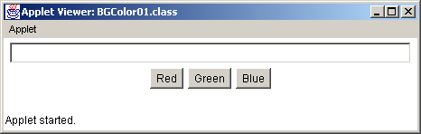
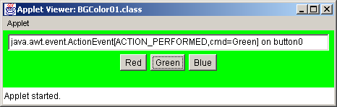
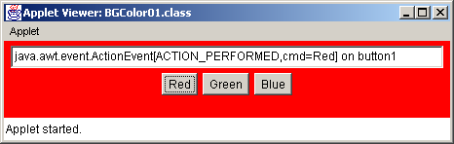
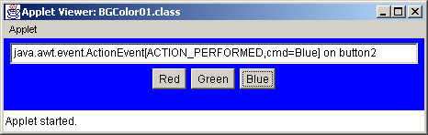
BGColor01 -- Output

Slide 36
Using java.awt.Frame in application:
import java.awt.*;
import java.awt.event.*;
public class Test extends Frame {
public static void main(String[] args) {
Frame frame =new Frame("My Frame");
frame.setSize(300,200);
frame.show();
} // end main
}

Slide 37
Using java.awt.Frame in application:
import java.awt.*;
import java.awt.event.*;
public class Test {
public static void main(String[] args) {
Frame frame =new Frame("My Frame");
frame.setSize(300,200);
GenericWindowListener listener = new GenericWindowListener();
frame.addWindowListener(listener);
frame.show();
}} // end main

Slide 38
Frame generates WindowEvents. We can ‘listen’ them with
a class extending WindowAdapter:
import java.awt.*;
import java.awt.event.*;
public class GenericWindowListener extends WindowAdapter{
public void windowClosing(WindowEvent e){
System.exit(0);
}
}

Slide 39
javax.swing.JFrame can be used instead
import javax.swing.*;
import java.awt.event.*;
public class ShowJFrames {
public static void main(String[] args) {
JFrame frame =new JFrame("My JFrame");
frame.setSize(300,200);
GenericWindowListener listener = new GenericWindowListener();
frame.addWindowListener(listener);
frame.show();
} // end main
// the same listener comes here
}// end class ShowJFrame

Slide 40
BGColor02
import java.awt.*;
import java.awt.event.*;
public class BGColor02 extends Frame
implements ActionListener, WindowListener, ComponentListener
{
private Button b1 = new Button("Red"), b2 = new Button("Green"),
b3 = new Button("Blue");
private TextArea log = new TextArea(6,80);
private int eventCount = 0;
private int FRAMEWIDTH=600; private int FRAMEHEIGHT=200;
public BGColor02() {
// Set the title of the frame, Frame size, Set layout to FlowLayout
setTitle("BGColor-02"); setBounds(0,0,FRAMEWIDTH,FRAMEHEIGHT);
setLayout(new FlowLayout());
// ARRANGE GUI
add(b1); add(b2); add(b3); add(log);
// ADD LISTENERS
b1.addActionListener(this);b2.addActionListener(this);b3.addActionListener(this);
addComponentListener(this); addWindowListener(this);
}
public static void main(String args[]) {
Frame f = new BGColor02();
f.show();
}

Slide 41
BGColor02
public void log_it(AWTEvent e) {
eventCount++;
log.append("Event "+eventCount+": "+e.toString()+"\n");
}
// Action Listener
public void actionPerformed(ActionEvent e) {
log_it(e);
if (e.getSource() == b1)
setBackground(Color.red);
else if (e.getSource() == b2)
setBackground(Color.green);
else if (e.getSource() == b3)
setBackground(Color.blue);
repaint();
}

Slide 42
BGColor02
// Component Listener
public void componentMoved(ComponentEvent e) { log_it(e); }
public void componentHidden(ComponentEvent e) { log_it(e); }
public void componentShown(ComponentEvent e) { log_it(e); }
public void componentResized(ComponentEvent e) {
log_it(e);
setBounds(0,0,FRAMEWIDTH,FRAMEHEIGHT);
}
// Window Listener
public void windowClosing(WindowEvent e) {
System.exit(0);
}
public void windowOpened(WindowEvent e) {}
public void windowIconified(WindowEvent e) {}
public void windowDeiconified(WindowEvent e) {}
public void windowClosed(WindowEvent e) {}
public void windowActivated(WindowEvent e) {}
public void windowDeactivated(WindowEvent e) {}
}

Slide 43
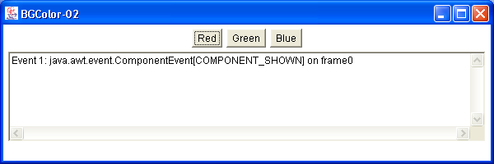
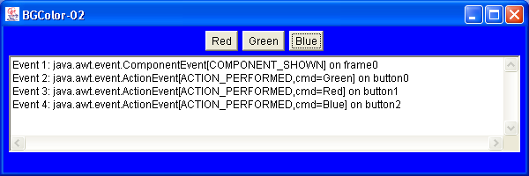
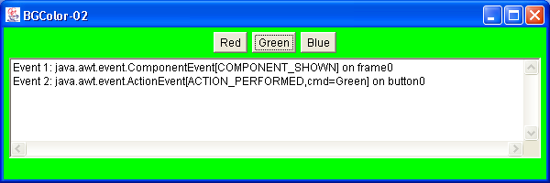
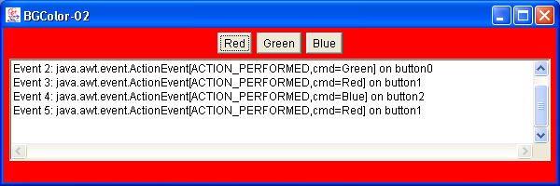
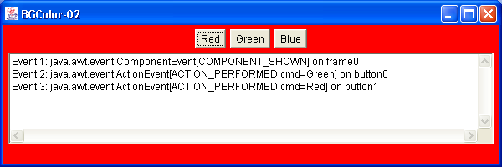
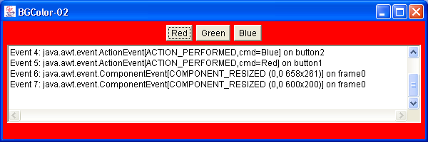
BGColor02 -- Output

Slide 44
BGCCheckbox
import java.awt.*;
import java.awt.event.*;
public class BGCCheckbox extends Frame
implements ItemListener, WindowListener
{
private CheckboxGroup chbox = new CheckboxGroup();
private Checkbox ch1 = new Checkbox("Red",chbox,false);
private Checkbox ch2 = new Checkbox("Green",chbox,false);
private Checkbox ch3 = new Checkbox("Blue",chbox,false);
private TextArea log = new TextArea(5,90);
private int eventCount=0;
public BGCCheckbox() {
// Set the title of the frame
setTitle("BGColor-Checkbox");
setLayout(new FlowLayout()); setBounds(0,0,700,200);
// ARRANGE GUI
add(ch1); add(ch2); add(ch3); add(log);
// ADD LISTENERS
ch1.addItemListener(this); ch2.addItemListener(this);
ch3.addItemListener(this); addWindowListener(this);
}

Slide 45
BGCCheckbox
public void log_it(AWTEvent e) {
eventCount++;
log.append("Event "+eventCount+": "+e.toString()+"\n");
}
// Item Listener
public void itemStateChanged(ItemEvent e) {
log_it(e);
if (e.getSource() == ch1)
setBackground(Color.red);
else if (e.getSource() == ch2)
setBackground(Color.green);
else if (e.getSource() == ch3)
setBackground(Color.blue);
repaint();
}

Slide 46
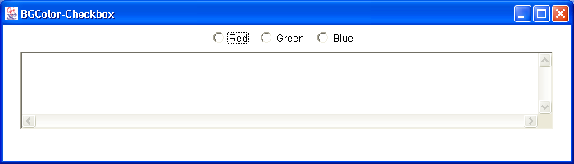
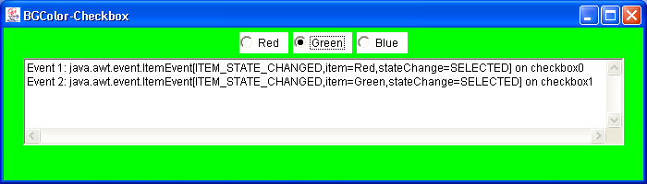
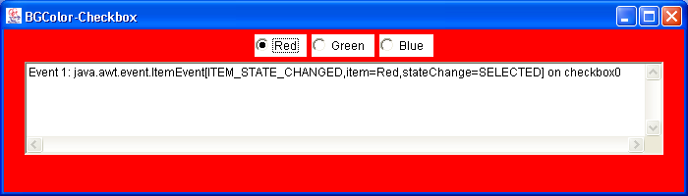
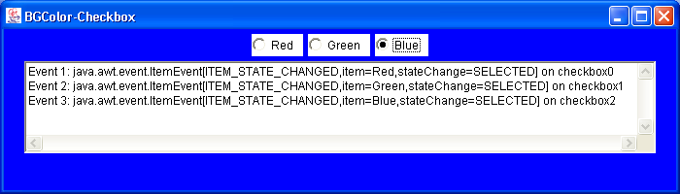
BGCCheckbox -- Output

Slide 47
How to Use Combo Boxes
A JComboBox comes in two very different forms:
uneditable and editable.
By default, a combo box is uneditable.
An uneditable combo box looks like a button until the user
interacts with it. When the user presses or clicks it, the combo box displays a menu of items to choose from.
Use an uneditable combo box to display one-of-many choices
when space is limited, when the number of choices is large, or
when the menu items are computed at run-time.

Slide 48
BGC ComboBox
import java.awt.*;
import java.awt.event.*;
public class BGCChoice extends Frame
implements ItemListener, WindowListener
{
private Choice ch = new Choice();
private TextArea log = new TextArea(5,90);
private int eventCount=0;
public BGCChoice() {
// Set the title of the frame
setTitle("BGColor-Choice");
setLayout(new FlowLayout());
setBounds(0,0,700,200);
// ARRANGE GUI
ch.addItem("Red"); ch.addItem("Green"); ch.addItem("Blue");
add(ch); add(log);
// ADD LISTENERS
ch.addItemListener(this);
addWindowListener(this);
}

Slide 49
BGC ComboBox
public static void main(String args[]) {
Frame f = new BGCChoice();
f.show();
}
public void log_it(AWTEvent e) {
eventCount++;
log.append("Event "+eventCount+": "+e.toString()+"\n");
}
// Item Listener
public void itemStateChanged(ItemEvent e) {
log_it(e);
Choice ch = (Choice) e.getSource();
String item = ch.getSelectedItem();
if (item.equals("Red") )
setBackground(Color.red);
else if (item.equals("Green") )
setBackground(Color.green);
else if (item.equals("Blue"))
setBackground(Color.blue);
repaint();
}

Slide 50
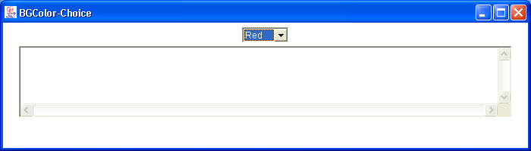
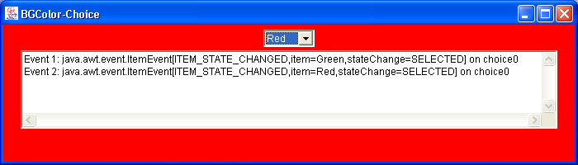
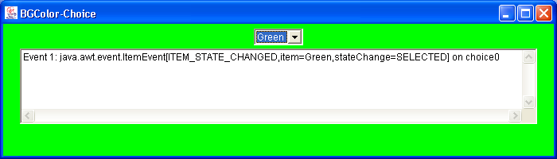
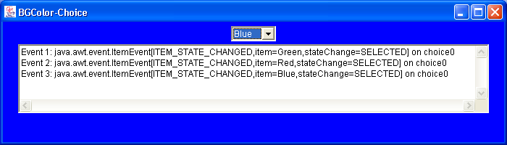
BGC ComboBox -- Output

Slide 51
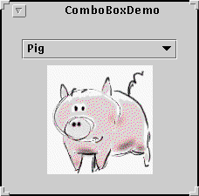
uneditable combo box for choosing a pet picture:
String[] petStrings ={"Bird","Cat","Dog","Rabbit","Pig"};
// Create the combo box, select item at index 4.
// Indices start at 0, so 4 specifies the pig.
JComboBox petList = new JComboBox(petStrings); petList.setSelectedIndex(4); ...

Slide 52
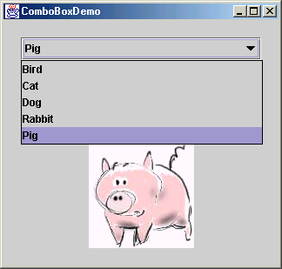

Slide 53
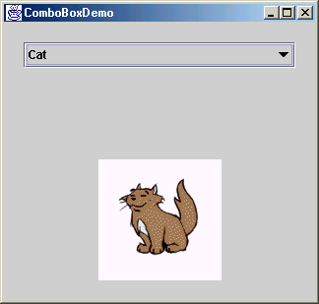

Slide 54
import java.awt.*;
import java.awt.event.*;
import javax.swing.*;
public class ComboBoxDemo extends JPanel {
JLabel picture;
public ComboBoxDemo() {
String[] petStrings = {"Bird", "Cat", "Dog", "Rabbit", "Pig" };
// Create the combo box, select the pig
JComboBox petList = newJComboBox(petStrings);
petList.setSelectedIndex(4);

Slide 55
petList.addActionListener(new ActionListener() {
public void actionPerformed(ActionEvent e) {
JComboBox cb = (JComboBox)e.getSource();
String petName = (String)cb.getSelectedItem();
picture.setIcon(new ImageIcon(petName +".gif"));
}
});

Slide 56
// Set up the picture
picture = new JLabel(new ImageIcon( petStrings[petList.getSelectedIndex()] +
".gif")); picture.setBorder(BorderFactory.createEmptyBorder
(10,0,0,0));
picture.setPreferredSize(new Dimension(177, 122+10));
setLayout(new BorderLayout());
add(petList, BorderLayout.NORTH);
add(picture, BorderLayout.SOUTH);
setBorder(BorderFactory.createEmptyBorder
(20,20,20,20));
}

Slide 57
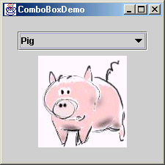
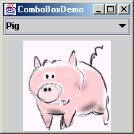
Without
setBorder(BorderFactory.createEmptyBorder
(20,20,20,20));

Slide 58
public static void main(String s[]) {
JFrame frame = new JFrame("ComboBoxDemo");
// anonymous listener
frame.addWindowListener(new WindowAdapter() {
public void windowClosing(WindowEvent e){
System.exit(0);
}
});
equivalent to:
frame.addWindowListener(new GenericListener());
GenericListener extends WindowAdapter{
public void windowClosing((WindowEvent e){
System.exit(0);
}
}

Slide 59
frame.setContentPane(new ComboBoxDemo());
frame.pack();
frame.setVisible(true);
}
} // end of main

Slide 60
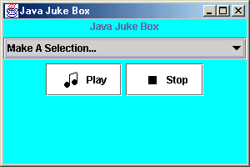
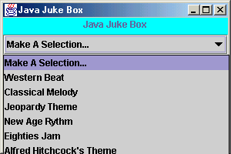
JLabel titleLabel =new Jlabel(“Java Juke Box”);
titleLabel.setAlignmentX(Component.CENTER_ALIGNMENT);

Slide 61
playButton = new JButton ("Play", new ImageIcon ("play.gif"));
playButton.setBackground (Color.white);
stopButton = new JButton ("Stop", new ImageIcon ("stop.gif"));
stopButton.setBackground (Color.white);

Slide 62
String[] musicNames = {"Make A Selection...", "Western Beat",…};
musicCombo = new JComboBox (musicNames);
musicCombo.setAlignmentX(Component.CENTER_ALIGNMENT);

Slide 63
buttonPanel
buttonPanel = new JPanel();
buttonPanel.setLayout(new BoxLayout(buttonPanel, BoxLayout.X_AXIS));
buttonPanel.add (playButton);
buttonPanel.add (Box.createRigidArea (new Dimension(5,0)));
buttonPanel.add (stopButton);

Slide 64
appPanel = new JPanel();
appPanel.setLayout (new BoxLayout(appPanel, BoxLayout.Y_AXIS));
appPanel.add (titleLabel);
appPanel.add (Box.createRigidArea (new Dimension(0,5)));
appPanel.add (musicCombo);
appPanel.add (Box.createRigidArea (new Dimension(0,5)));
appPanel.add (buttonPanel);
appPanel.setBackground (Color.cyan);

Slide 65
Loading audio clips to application:
try {
music = new AudioClip[7];
music[0] = null; // "Make a Selection..."
music[1] = Applet.newAudioClip (
new URL("file", "localhost", "westernBeat.wav"));
music[2] = Applet.newAudioClip (
new URL("file", "localhost", "classical.wav"));
...
} catch (Exception exception) {}

Slide 66
In applets we have special method
public AudioClip getAudioClip(URL url)
where URL stands for Uniform Resource Locator,
a pointer to a "resource" on the World Wide Web.
A resource can be something as simple as a file or a directory,
or it can be a reference to a more complicated object,
such as a query to a database or to a search engine.
java.net.URL constructor:
URL(String protocol, String host, String file)
Creates a URL object from the specified protocol, host, and file.
In Applet class there is a static method:
public final static AudioClip newAudioClip(URL url)

Slide 67
import java.applet.Applet;
...
public class JukeBoxControls extends JFrame{
AudioClip[] music=new AudioClip[7];
music[0]=Applet.newAudioClip(new URL
(“file”, “localhost”, “western.wav”));
…
}
In java.applet:
public interface AudioClip {
void play();
void loop();
void stop();
}
so music[] is array of type AudioClip.What type of Object it ponts to?

Slide 68
You can figure out by calling Object.getClass().getName();

Slide 69
Labels
A label defines a line of text displayed on a GUI
Labels are static in the sense that they cannot be selected or modified by the human user once added to a container
A label is instantiated from the Label class
The Label class contains several constructors and methods for setting up and modifying a label's content and alignment
  Label(label)
  Label(label,alignment) where label is a string and
  setText(label) alignment is LEFT,RIGHT, or CENTER
  setAlignment(alignment) defined in Label class

Slide 70
Text Fields and Text Areas
A text field displays a single line of text in a GUI
It can be made editable, to get input from the user
A text area is similar, but displays multiple lines of text
They are defined by the TextField and TextArea classes
A text area automatically has scrollbars on its bottom and right sides
  TextField(columns)
  TextField(text,columns)
  TextArea(rows,columns)
  TextArea(text,rows,columns)
  setText(text)
  getText()
  setEditable(abooleanvalue)

Slide 71
Buttons
The java.awt package supports four distinct types of buttons:
  Push buttons
  Choice Buttons
  Checkbox buttons
  Radio buttons
Each button type serves a particular purpose

Slide 72
Push Button
A push button is a single button which can be created with or without a label
A system is usually designed such that when a push button is pressed, a particular action occurs
It is defined by the Button class

Slide 73
ComboBox button
A ComboBox button is a single button which displays a list of choices when pushed
The user can then scroll through and choose the appropriate option
The current choice is displayed next to the ComboBox button
It is defined by the Choice class

Slide 74
Checkbox button
A checkbox button can be toggled on or off
A set of checkbox buttons are often used to define a set of options as a group, though one can be used by itself
If used in a group, more than one option can be chosen at any one time
Defined by the Checkbox class

Slide 75
Radio buttons
A radio button, like a checkbox button, is toggled on or off
Radio buttons must be grouped into a set, and only one button can be selected at any one time
When one button of a group is selected, the currently selected button in that group is automatically reset
They are used to select among a set of mutually exclusive options
Radio button sets are defined by the Checkbox and CheckboxGroup classes

Slide 76
Layout Managers
There are five predefined layout managers in the java.awt package:
  flow layout
  border layout
  card layout
  grid layout
  grid bag layout
Each container has a particular layout manager associated with it by default
A programmer can also create custom layout managers

Slide 77
Flow Layout
Components are placed in a row from left to right in the order in which they are added
A new row is started when no more components can fit in the current row
The components are centered in each row by default
The programmer can specify the size of both the vertical and horizontal gaps between the components
Flow layout is the default layout for panels and applets

Slide 78
FlowLayoutTest
import java.awt.*;
import java.awt.event.*;
public class FlowLayoutTest extends Frame implements WindowListener {
private Button b1 = new Button("Red"), b2 = new Button("Green"),
b3 = new Button("Blue"), b4 = new Button("Yellow"),
b5 = new Button("Pink");
public FlowLayoutTest() {
// Set the title of the frame, Set layout manger and Frame size
setTitle("FlowLayout Test");
setLayout(new FlowLayout()); setBounds(0,0,400,200);
// ARRANGE GUI
add(b1); add(b2); add(b3); add(b4); add(b5);
// ADD LISTENERS
addWindowListener(this);
}
public static void main(String args[]) {
Frame f = new FlowLayoutTest(); f.show();
}

Slide 79
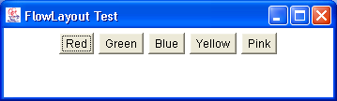
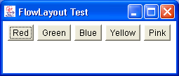
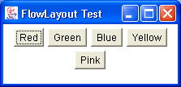
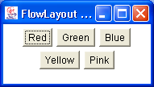
FlowLayoutTest -- Snapshots

Slide 80
Border Layout
Defines five locations each of which a component or components can be added
  North, South, East, West, and Center
The programmer specifies the area in which a component should appear
The relative dimensions of the areas are governed by the size of the components added to them

Slide 81
Border Layout (cont.)
North
West
Center
East
South

Slide 82
BorderLayoutTest
import java.awt.*;
import java.awt.event.*;
public class BorderLayoutTest extends Frame implements WindowListener {
private Button b1 = new Button("Red"), b2 = new Button("Green"),
b3 = new Button("Blue"),b4 = new Button("Yellow"),
b5 = new Button("Pink");
public BorderLayoutTest() {
// Set the title of the frame, Set layout manger, Frame size
setTitle("BorderLayout Test");
setLayout(new BorderLayout());
setBounds(0,0,400,200);
// ARRANGE GUI
add(b1,"North"); add(b2,"South"); add(b3,"East");
add(b4,"West"); add(b5,"Center");
// ADD LISTENERS
addWindowListener(this);
}

Slide 83
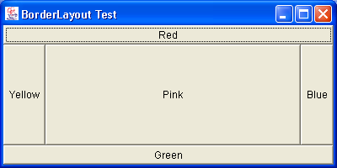
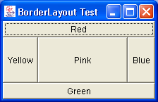
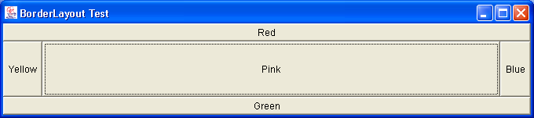
BorderLayoutTest -- Snapshots

Slide 84
Card Layout
Components governed by a card layout are "stacked" such that only one component is displayed on the screen at any one time
Components are ordered according to the order in which they were added to the container
Methods control which component is currently visible in the container

Slide 85
CardLayoutTest
import java.awt.*;
import java.awt.event.*;
public class CardLayoutTest extends Frame
implements ActionListener, WindowListener {
private Button b1 = new Button("Red"),b2 = new Button("Green"),
b3 = new Button("Blue"),b4 = new Button("Yellow"),
b5 = new Button("Pink");
private CardLayout lo = new CardLayout();
public CardLayoutTest() {
// Set the title of the frame, Set layout manger, Frame size
setTitle("CardLayout Test"); setLayout(lo); setBounds(0,0,200,200);
// ARRANGE GUI
add(b1,"1"); add(b2,"2"); add(b3,"3"); add(b4,"4"); add(b5,"5");
// ADD LISTENERS
addWindowListener(this);
b1.addActionListener(this); b2.addActionListener(this);
b3.addActionListener(this); b4.addActionListener(this);
b5.addActionListener(this);
}

Slide 86
CardLayoutTest (cont.)
public static void main(String args[]) {
Frame f = new CardLayoutTest();
f.show();
}
public void actionPerformed(ActionEvent e) {
if (e.getSource() == b1) lo.next(this);
else if (e.getSource() == b2) lo.next(this);
else if (e.getSource() == b3) lo.next(this);
else if (e.getSource() == b4) lo.next(this);
else if (e.getSource() == b5) lo.next(this);
}

Slide 87
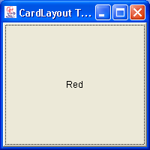
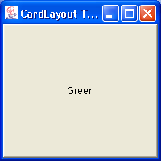
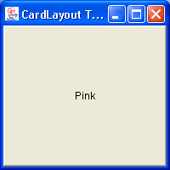
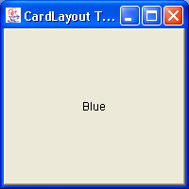


CardLayoutTest -- Snapshots

Slide 88
Grid Layout
Components are placed in a grid with a user-specified number of columns and rows
Each component occupies exactly one grid cell
Grid cells are filled left to right and top to bottom
All cells in the grid are the same size

Slide 89
GridLayoutTest
import java.awt.*;
import java.awt.event.*;
public class GridLayoutTest extends Frame implements WindowListener {
private Button b1 = new Button("Red"),b2 = new Button("Green"),
b3 = new Button("Blue"),b4 = new Button("Yellow"),
b5 = new Button("Pink");
public GridLayoutTest() {
// Set the title of the frame, Set layout manger, Frame size
setTitle("GridLayout Test");
setLayout(new GridLayout(2,3));
setBounds(0,0,300,200);
// ARRANGE GUI
add(b1);add(b2);add(b3);add(b4);add(b5);
// ADD LISTENERS
addWindowListener(this);
}

Slide 90
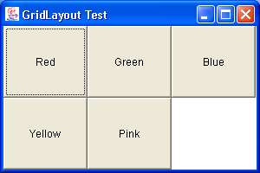
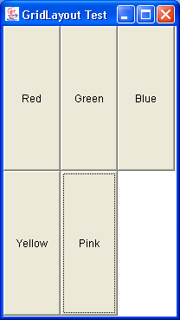
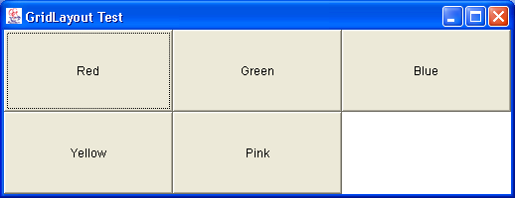
GridLayoutTest -- Snapshots

Slide 91
PanelTest
import java.awt.*;
import java.awt.event.*;
public class PanelTest extends Frame implements WindowListener {
private Button b1 = new Button("Red"),b2 = new Button("Green"),
b3 = new Button("Blue"),b4 = new Button("Yellow"),
b5 = new Button("Pink");
public PanelTest() {
// Set the title of the frame, Set layout manger, Frame size
setTitle("Panel Test");
setLayout(new FlowLayout());
setBounds(0,0,400,300);
// Arrange GUI
Panel p1 = new Panel();
Panel p2 = new Panel();
Panel p3 = new Panel();

Slide 92
PanelTest (cont.)
p1.setLayout(new GridLayout(3,1));
p1.add(new Button("Button-P1-1")); p1.add(new Button("Button-P1-2"));
p1.add(new Button("Button-P1-3"));
p2.setLayout(new GridLayout(3,3));
p2.add(new Button("Button-P2-1"));p2.add(new Button("Button-P2-2"));
p2.add(new Button("Button-P2-3"));p2.add(new Button("Button-P2-4"));
p2.add(new Button("Button-P2-5"));p2.add(new Button("Button-P2-6"));
p2.add(new Button("Button-P2-7"));
p3.setLayout(new BorderLayout());
p3.add(new Button("Button-P3-1"),"North");
p3.add(new Button("Button-P3-2"),"South");
p3.add(new Button("Button-P3-3"),"East");
p3.add(new Button("Button-P3-4"),"West");
p3.add(new Button("Button-P3-5"),"Center");
add(p1); add(p2); add(p3);
// ADD LISTENERS
addWindowListener(this);
}

Slide 93
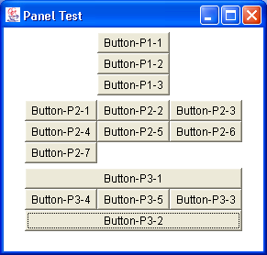
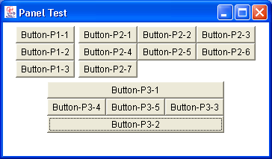
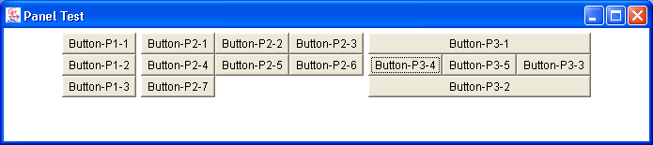
PanelTest -- Snapshots

