Slide 1
CHAPTER 1
Assembly Programming and the SIC/XE
Jan Kinzler
CGS 3204 System Software
UCF, Spring 2003

Slide 2
What is system software?
Application Programs are concerned with the solution to some user defined problem, using the computer as a tool. The focus is the application, not the computer.
System Programs are intended to support the operation and use of the computer itself rather than any particular application. The focus is making the computer more usable. Generally speaking, system software is machine / hardware dependent.
Examples of System Software:
  Operating Systems
  Assemblers / Compilers
  Linkers/ Loaders
  Macro Processors

Slide 3
Assembler Overview
Source Program written in assembly language
Macro Processor expands Macros
Intermediate version in assembly language with expanded macro definitions
Assembler converts program to machine language object code
Linker connects object code program to existing libraries
Loader puts program in memory and starts execution
Program becomes a process managed by the OS.

Slide 4
SIC Machine
Simplified Instructional Computer (SIC)
Two versions
  Standard Version
  XE or Extended Version

Slide 5
SIC Hardware
Memory
  8-bit bytes
  3-byte words (24 bits)
  uses byte addressing
  words addressed by location of lowest numbered byte
  total memory = 32768 bytes (2¹⁵ or FFFF)
Registers
  Five special purpose 24-bit registers
    A #0 Accumulator
    X #1 Index Register
    L #2 Linkage Register
    PC #8 Program Counter
    SW #9 Status Word (contains CC Condition Code)

Slide 6
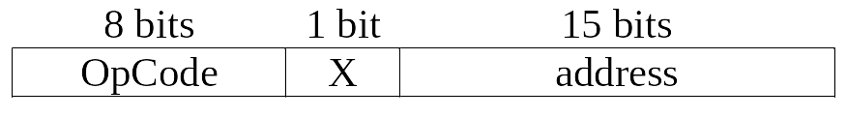
SIC Data / Instruction Format
Data Formats
  SIC supports two data formats
    Integers - 24 bits binary numbers in 2’s complement
    Characters - 8-bit ASCII code
    Floating point offered in XE version
  Data typing not provided in assembly language
Instruction Representations
  Assembly Code (LDA 1009)
  Machine Language (001009)
Instruction Format (for machine language)

Slide 7
SIC Addressing Modes
Direct Addressing:
  If X is 0 then Memory Address = address
Indirect Addressing:
  If X is 1 then Memory Address = (X) + address
Examples:
  Direct:
  LDA 1009 Memory Address = 1009
  Indirect
  LDX 2000
  LDA 1009, X Memory Address = 3009

Slide 8
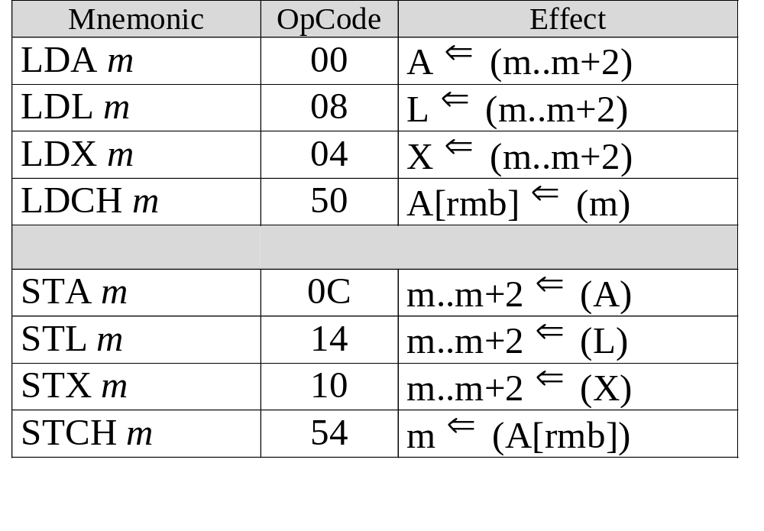
SIC Data Movement

Slide 9
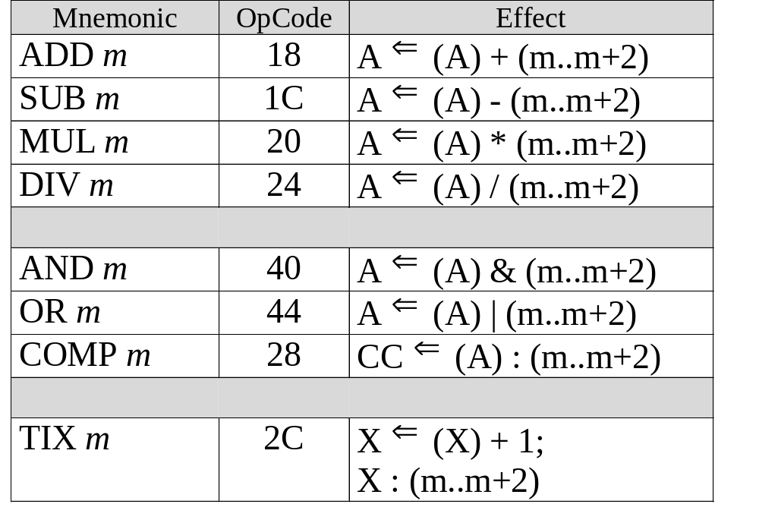
SIC Arithmetic / Logical Operations

Slide 10
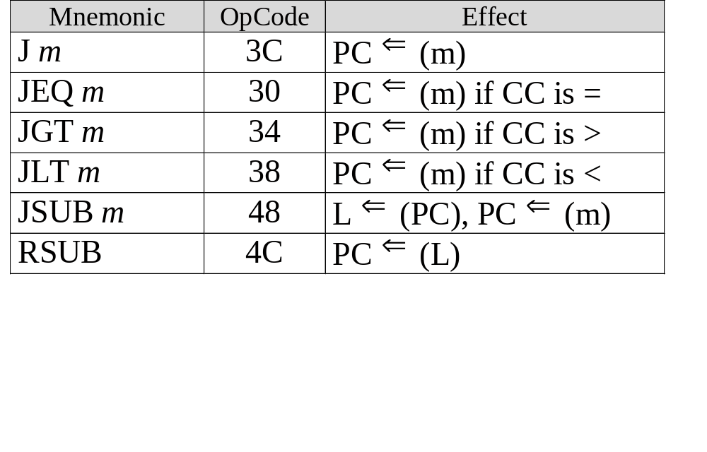
SIC Program Flow & Control

Slide 11
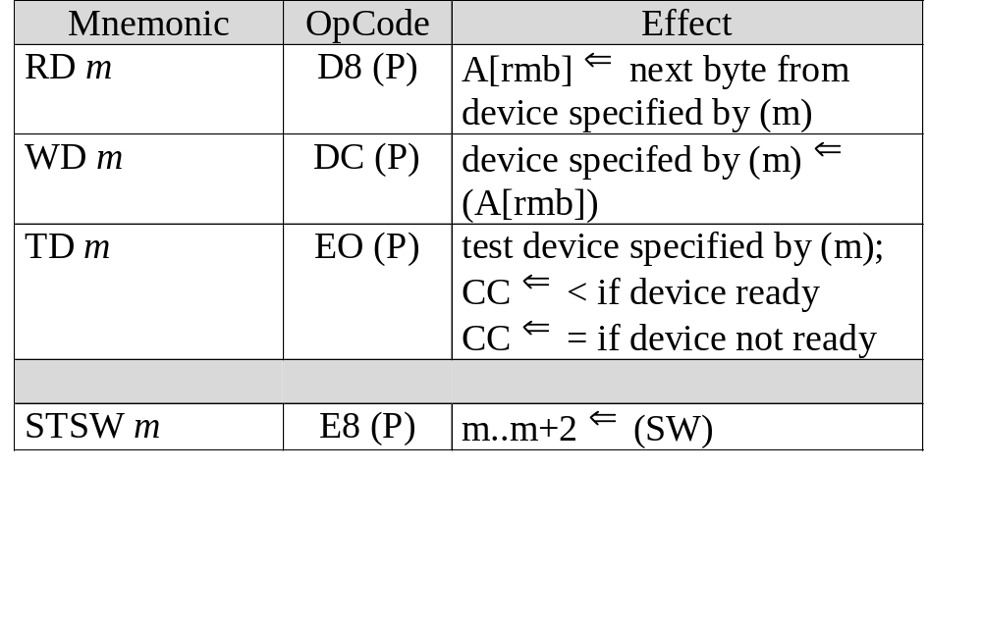
SIC I/O & Misc. Instructions

Slide 12
SIC Assembly Directives
Directives provide addition information to the assembler.
They are not instructions and can’t be executed.
For the SIC, allowable directives are:
  START specifies name and starting address for the program.
  END indicates end of source program and (optionally) first executable instruction in program
  BYTE reserves and fills as many bytes as needed to hold and represent character or hexadecimal constant listed in source
  WORD reserves and fills one word with integer constant listed in source program
  RESB reserves the indicated number of bytes for a data area
  RESW reserves the indicated number of words for a data area

Slide 13
Writing an Assembly Program
File Format Important
Typically Uses Fixed Length Fields
For SIC/XE examples:
  1-8: Labels
  9: blank
  10-15 Mnemonic OpCode or Directive
  16-17 blank
  18-35 Operand (and optional X flag)
  36 - 66 Comment
No embedded blanks in labels, op codes, etc.
Usually written as all upper case
Line starting with “.” is treated as comment

Slide 14
Sample SIC Assembly Program
LABEL OPCODE OPERANDS COMMENT_________________
EXAMPLE START 1000 LOAD PROGRAM AT H1000
.
FIRST LDA FIVE LOAD ACC WITH 5
ADD SIX ADD 6 TO ACC
STA ANSWER STORE THE ANSWER
FIVE WORD 5 CONSTANT INTEGER = 5
SIX WORD 6 CONSTANT INTEGER = 6
ANSWER RESW 1 ONE-WORD VARIABLE
.
END FIRST START RUNNING AT FIRST
During assembly, three files are created:
  Intermediate File (to be discussed in Chpt 2)
  Assembler Listing
  Object File

Slide 15
Sample Assembler Listing
ADDR (ADDR) LABEL OPCODE OPERANDS
EXAMPLE START 1000
FIRST LDA FIVE
ADD SIX
STA ANSWER
FIVE WORD 5
SIX WORD 6
ANSWER RESW 1
END FIRST

Slide 16
Sample Assembler Listing
ADDR (ADDR) LABEL OPCODE OPERANDS
1000 EXAMPLE START 1000
1000 001009 FIRST LDA FIVE
1003 18100C ADD SIX
1006 0C100F STA ANSWER
1009 000005 FIVE WORD 5
100C 000006 SIX WORD 6
100F ANSWER RESW 1
1012 END FIRST

Slide 17
Object File Contents
Object file is used to load assembled program. This file contains:
  Header Record - one per file
    Program Name
    Starting Address
    Program Length
  Text Record - one or more per file
    Starting address for code in the record
    Length of record
    Object Code
  End Record - one per file
    Address of first executable instruction

Slide 18
Sample Object File
ADDR (ADDR) LABEL OPCODE OPERANDS
1000 EXAMPLE START 1000
1000 001009 FIRST LDA FIVE
1003 18100C ADD SIX
1006 0C100F STA ANSWER
1009 000005 FIVE WORD 5
100C 000006 SIX WORD 6
100F ANSWER RESW 1
1012 END FIRST
HEXAMPL001000000012
T0010000F00100918100C0C100F000005000006
E001000

Slide 19
Sample Program - Version 2
ADDR (ADDR) LABEL OPCODE OPERANDS
1000 EXAMPLE START 1000
1000 000005 FIVE WORD 5
1003 000006 SIX WORD 6
1006 ANSWER RESW 1
1009 001000 FIRST LDA FIVE
100C 181003 ADD SIX
100F 0C1006 STA ANSWER
1012 END FIRST
HEXAMPL001000000012
T00100006000005000006
T001009090010001810030C1006
E001009

Slide 20
Looping and Indexing - Example 1
ADDR (ADDR) LABEL OPCODE OPERANDS
FIG14 START 1000
BEGIN LDX ZERO
MOVECH LDCH STR1,X
STCH STR2,X
TIX ELEVEN
JLT MOVECH
STR1 BYTE C'TEST STRING'
STR2 RESB 11
ZERO WORD 0
ELEVEN WORD 11
END BEGIN

Slide 21
Looping and Indexing - Example 1
ADDR (ADDR) LABEL OPCODE OPERANDS
1000 FIG14 START 1000
1000 041025 BEGIN LDX ZERO
1003 50900F MOVECH LDCH STR1,X
1006 54901A STCH STR2,X
1009 2C1028 TIX ELEVEN
100C 381003 JLT MOVECH
100F 544553 STR1 BYTE C'TEST STRING'
542053
545249
4E47
101A STR2 RESB 11
1025 000000 ZERO WORD 0
1028 00000B ELEVEN WORD 11
102B END BEGIN

Slide 22
ADDR (ADDR) LABEL OPCODE OPERANDS
FIG15 START 1000
FIRST LDA ZERO Initialize index
STA INDEX
ADDLP LDX INDEX Load Index
LDA ALPHA,X Load ALPHA[index]
ADD BETA,X Add BETA[index]
STA GAMMA,X Save in GAMMA[index]
LDA INDEX index = index + 3
ADD THREE
STA INDEX
COMP STOP index < stop condition
JLT ADDLP yes; repeat loop
INDEX RESW 1
ALPHA WORD 12
WORD 24
WORD 5
WORD 32
BETA WORD 15
WORD 8
WORD 21
WORD 16
GAMMA RESW 4
ZERO WORD 0
STOP WORD 12
THREE WORD 3
END FIRST

Slide 23
ADDR (ADDR) LABEL OPCODE OPERANDS
1000 FIG15 START 1000
1000 001048 FIRST LDA ZERO Initialize index
1003 0C1021 STA INDEX
1006 041021 ADDLP LDX INDEX Load Index
1009 009024 LDA ALPHA,X Load ALPHA[index]
100C 189030 ADD BETA,X Add BETA[index]
100F 0C903C STA GAMMA,X Save in GAMMA[index]
1012 001021 LDA INDEX index = index + 3
1015 18104E ADD THREE
1018 0C1021 STA INDEX
101B 28104B COMP STOP index < stop condition
101E 381006 JLT ADDLP yes; repeat loop
1021 INDEX RESW 1
1024 00000C ALPHA WORD 12
1027 000018 WORD 24
102A 000005 WORD 5
102D 000020 WORD 32
1030 00000F BETA WORD 15
1033 000008 WORD 8
1036 000015 WORD 21
1039 000010 WORD 16
103C GAMMA RESW 4
1048 000000 ZERO WORD 0
104B 00000C STOP WORD 12
104E 000003 THREE WORD 3
1051 END FIRST

Slide 24
I/O Operations
.
.
INLOOP TD INDEV TEST INPUT DEVICE
JEQ INLOOP LOOP UNTIL DEVICE READY
RD INDEV READ 1 BYTE INTO REGISTER A
STCH DATA STORE BYTE IN DATA
.
.
OUTLP TD OUTDEV TEST OUTPUT DEVICE
JEQ OUTLP LOOP UNTIL DEVICE READY
LDCH DATA LOAD DATA BYTE INTO REGISTER A
WD OUTDEV WRITE 1 BYTE TO OUTPUT DEVICE
.
.
INDEV BYTE X'F1' INPUT DEVICE IDENTIFIER
OUTDEV BYTE X'05' OUTPUT DEVICE IDENTIFIER
DATA RESB 1 ONE BYTE VARIABLE
.
.

Slide 25
Subroutines
.
.
JSUB READ CALL READ SUBROUTINE
.
.
READ LDX ZERO INITIALIZE INDEX REG. TO ZERO
RLOOP TD INDEV TEST INPUT DEVICE
JEQ RLOOP LOOP IF DEVICE NOT READY
RD INDEV READ 1 BYTE INTO REG. A
STCH RECORD,X STORE DATA BYTE INTO RECORD
TIX K100 ADD 1 TO INDEX AND COMPARE
JLT RLOOP REPEAT IF INDEX < 100
RSUB RETURN FROM SUBROUTINE
INDEV BYTE X'F1' DEVICE IDENTIFIER
RECORD RESB 100 100-BYTE BUFFER
ZERO WORD 0 1-WORD CONSTANT
K100 WORD 100 1-WORD CONSTANT, STOPPING CONDITION
.
.

Slide 26
Combining I/O with Subroutines
See example from SIC simulator

Slide 27
SIC/XE Hardware
Memory
  8-bit bytes
  3-byte words (24 bits)
  uses byte addressing
  words addressed by location of lowest numbered byte
  total memory = 1 megabyte (2²⁰)
Registers
  Four additional 24-bit registers
    B #3 Base Register
    S #4 General Purpose Register
    T #5 General Purpose Register
    F #6 Floating Point Accumulator (48 bits)

Slide 28
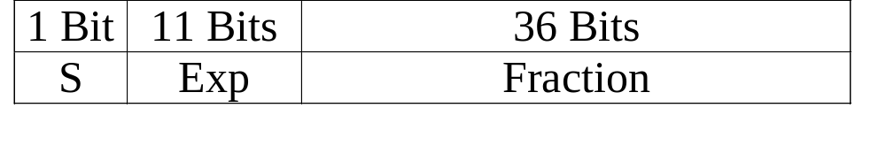
SIC/XE Data Formats
Data Formats
  SIC/XE supports three data formats
    Integers - 24 bits binary numbers in 2’s complement
    Characters - 8-bit ASCII code
    Floating point offered in XE version
      S Sign Bit (0 = positive, 1 = negative)
      Fraction (f) Value between 0 and 1
      Exp (e) Integer between 0 and 2047
    f * 2^{(e-1024)}

Slide 29
Generic Address Modes
Immediate
  instruction contains operand
Memory Direct (Simple)
  instruction references target address containing operand
Memory Indirect
  instruction references memory address which holds the target address containing the operand
Register Direct
  instruction references register containing operand
Register Indirect
  instruction references register which holds the target address containing the operand
Indexed Addressing
  target address of operand determined by adding instruction address or displacement to contents of some index register

Slide 30
Generic Relative Addressing
Similar to Indexed Addressing
Base Relative
  Similar to Index
  target address of operand = (B) + address
  typically used to reference data in larger memory systems
PC Relative
  relative to current instruction address
  address of operand = (PC) + address
  can be used to reference data in larger memory systems but most useful for relocation of code.
Can sometimes be used in combination with other addressing modes

Slide 31

SIC Addressing Modes
Direct Addressing:
  If X-bit is 0 then Target Address = address
Indexed Addressing:
  If X-bit is 1 then Target Address = (X) + address
Examples:
  Direct:
  LDA 1009 Target Address = 1009
  Indexed
  LDX 2000
  LDA 1009, X Target Address = 3009

Slide 32
SIC/XE Addressing
Larger memory means that SIC instruction format (15-bit address field) no longer works.
Need new addressing modes / formats
  Memory Direct increased to 20 bits
  Base Relative
  Program Counter Relative
Addition of general purpose registers (S, T) requires register direct instructions
Addition of instructions without operands allows us to use a new no-operand format

Slide 33
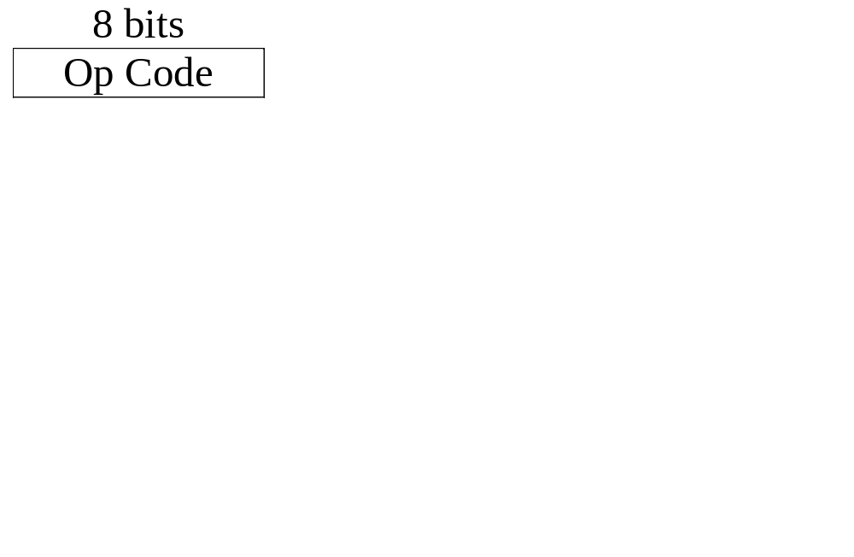
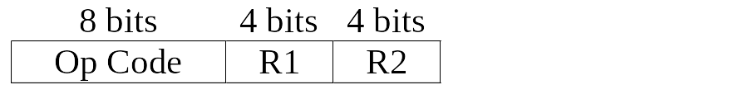
SIC/XE Instruction Formats
Format 1 (1 byte)
Format 2 (2 bytes)

Slide 34

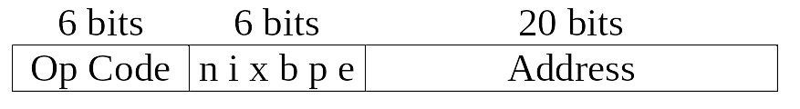
SIC/XE Instruction Formats
Format 3 (3 bytes)
Format 4 (4 bytes)

Slide 35
Addressing Flag Bits
n & i bits Indicates mode type
  (i = 0, n = 0) or (i = 1, n = 1) : simple/direct addressing
  i = 1, n = 0: immediate addressing (instruction contains operand)
  i = 0, n = 1: indirect addressing
x bit: Indicates index addressing
  x = 1: indexed addressing
  x = 0: no indexing
b & p bits Indicates type of relative addressing
  b = 1, p = 0: Base Relative
  b = 0, p = 1: PC Relative
  b = 0, p = 0: Direct
e bit Distinguishes between formats 3 & 4
  e = 0: format 3
  e = 1: format 4

Slide 36
SIC/XE Addressing Modes
Immediate
  Direct ( 0 1 0 0 0 _ )
  Relative ( 0 1 0 _ _ 0 )
Simple
  Direct ( 0 0 _ 0 0 _ ) SIC Assembler or
  ( 1 1 _ 0 0 _ ) SIC/XE Assembler
  Relative ( 0 0 _ _ _ 0 ) SIC Assembler or
  ( 1 1 _ _ _ 0 ) SIC/XE Assembler
  If n & i bits set to “0”, SIC/XE assumes b, p & e bits part of address
Indirect
  Direct ( 1 0 0 0 0 _ )
  Relative ( 1 0 0 _ _ 0 )

Slide 37
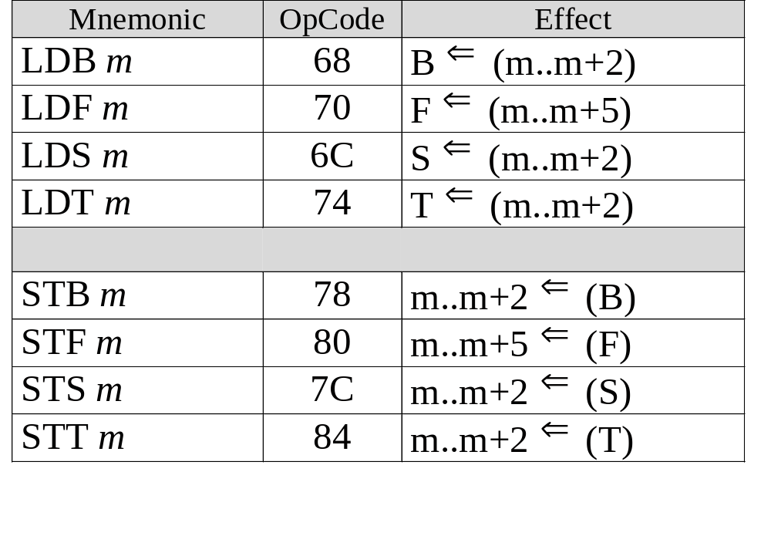
SIC/XE Data Movement

Slide 38
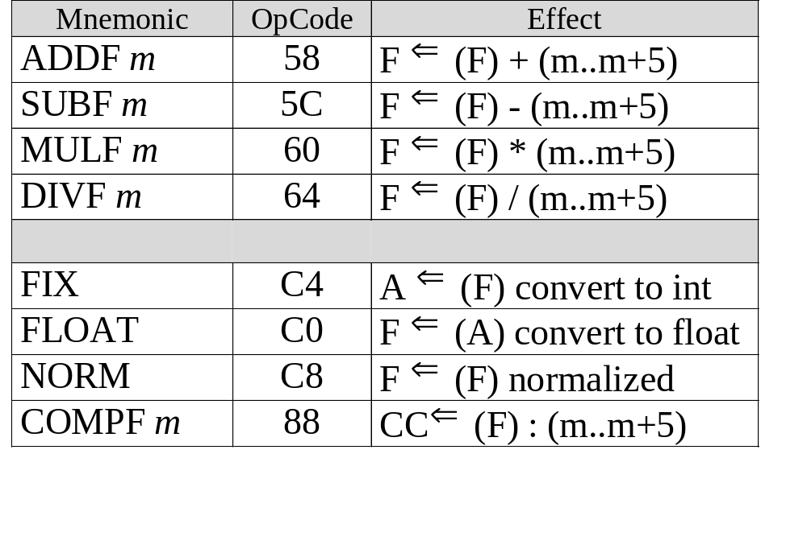
SIC/XE Floating Point Operations

Slide 39
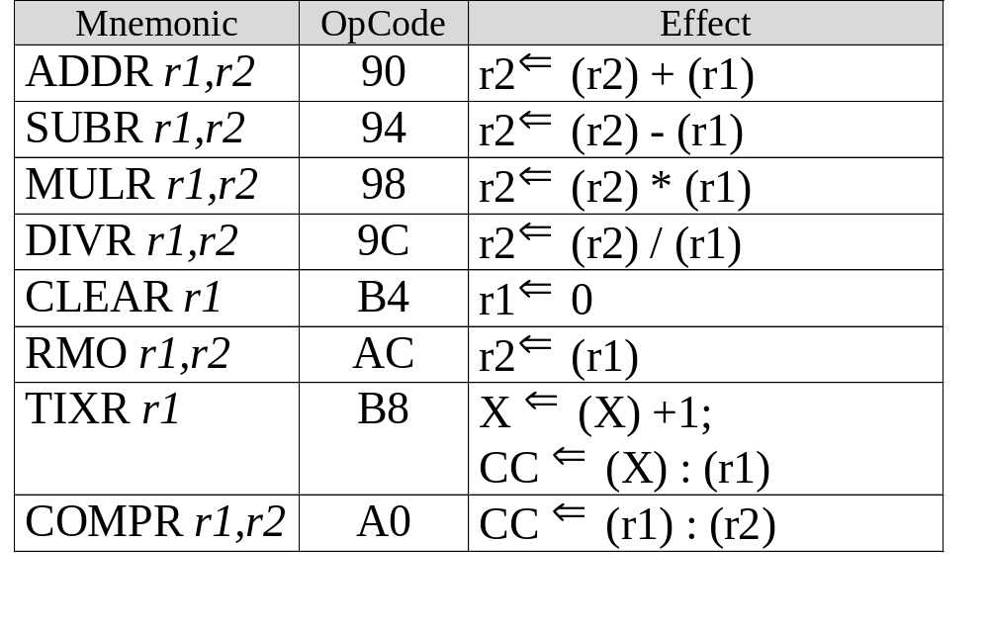
SIC/XE Register Operations

Slide 40
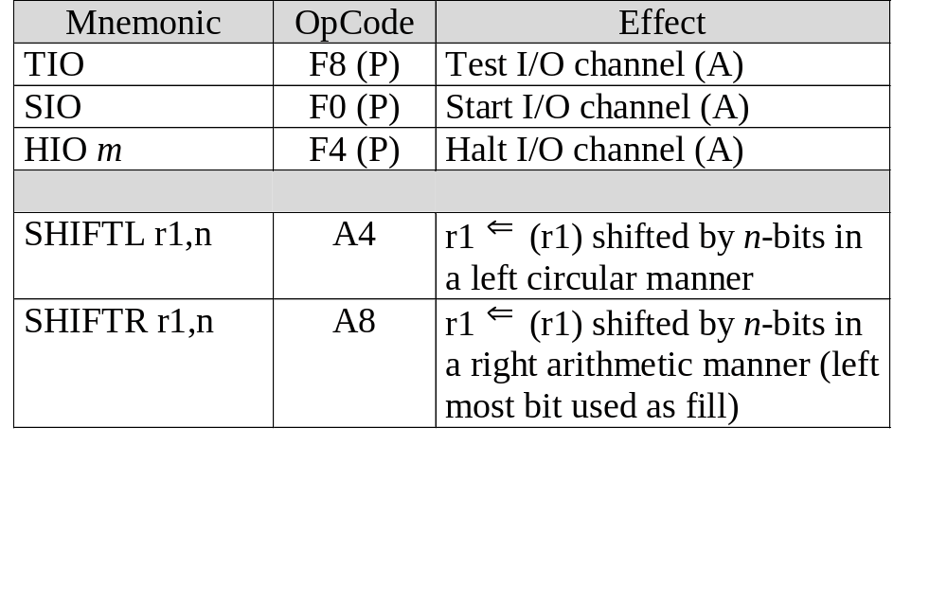
SIC/XE I/O & Misc. Instructions

Slide 41
SIC/XE Assembly Directives
For the SIC/XE, additional directives are:
  LTORG used to request organization of literals since last LTORG
  BASE, NOBASE tells assembler what address or location, if any, to use as contents of base register
  EQU allows programmer to define a symbol and its value
  ORG resets location counter during assembly to specified value
  USE, CSECT, EXTDEF, EXREF used to define and organize blocks of code and data in larger programs

