Slide 1
Chapter 1—A Perspective
Alan Turing showed that an abstract computer, a Turing machine, can compute any function that is computable by any means
A general purpose computer with enough memory is equivalent to a Turing machine
Over 50 years, computers have evolved
  from memory size of 1 kiloword (1024 words) clock periods of 1 millisecond (0.001 s)
  to memory size of a terabyte (2⁴⁰ bytes) and clock periods of 1 ns (10⁻⁹ s)
More speed and capacity is needed for many applications, such as real-time 3D animation

Slide 2
Scales, Units, and Conventions
Term
Normal Usage
As a power of 2
K (kilo-)
10³
2¹⁰
= 1,024
M (mega-)
10⁶
2²⁰
= 1,048,576
G (giga-)
10⁹
2³⁰
= 1,073,741,824
T (tera-)
10¹²
2⁴⁰
= 1,099,511,627,776
Term
Usage
Note the differences between usages. You should commit the powers of 2 and 10 to memory.
m (milli-)
10⁻³
μ
(micro-)
10⁻⁶
n (nano-)
10⁻⁹
p (pico-)
10⁻¹²
Units: Bit (b), Byte (B), Nibble, Word (w), Double Word, Long Word,
Second (s), Hertz (Hz)

Slide 3
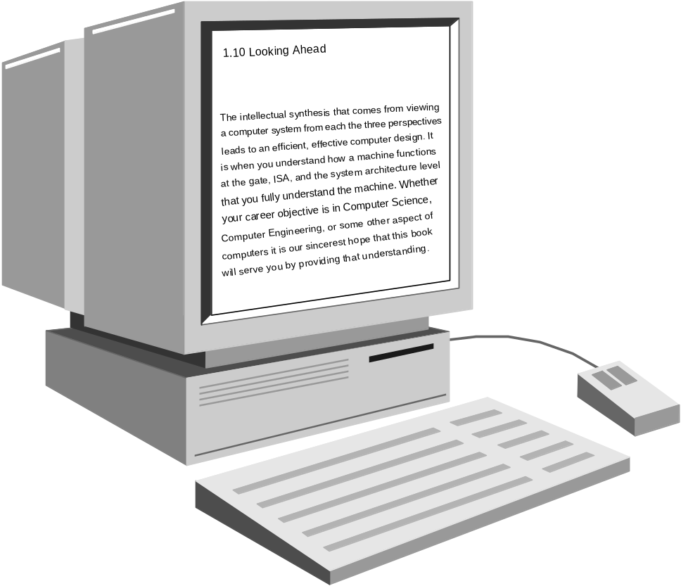
Fig 1.1 The User’s View of a Computer
The user sees software, speed, storage capacity,
and peripheral device functionality.

Slide 4
Machine/Assembly Language Programmer’s View
Machine language:
  Set of fundamental instructions the machine can execute
  Expressed as a pattern of 1’s and 0’s
Assembly language:
  Alphanumeric equivalent of machine language
  Mnemonics more human-oriented than 1’s and 0’s
Assembler:
  Computer program that transliterates (one-to-one mapping) assembly to machine language
  Computer’s native language is machine/assembly language
  “Programmer,” as used in this course, means machine/assembly language programmer

Slide 5
Machine and Assembly Language
The assembler converts assembly language to machine language. You must also know how to do this.
Op code
Data reg. #5
Data reg. #4
MC68000 Assembly Language
Machine Language
MOVE.W D4, D5
0011 101 000 000 100
ADDI.W #9, D2
0000 000 010 111 100
0000 0000 0000 1001
Tbl 1.2 Two Motorola MC68000 Instructions

Slide 6
The Stored Program Concept
The stored program concept says that the program
is stored with data in the computer’s memory. The
computer is able to manipulate it as data—for
example, to load it from disk, move it in memory,
and store it back on disk.
It is the basic operating principle for every computer.
It is so common that it is taken for granted.
Without it, every instruction would have to be initiated manually.

Slide 7
Fig 1.2 The Fetch-Execute Process
M
C
6
8
0
0
0
C
P
U
M
a
i
n
m
e
m
o
r
y
3
1
0
0
V
a
r
i
o
u
s
C
P
U
r
e
g
i
s
t
e
r
s
4
0
0
0
0
0
1
1
1
0
1
0
0
0
0
0
0
1
0
0
1
5
0
P
C
4
0
0
0
1
5
0
3
1
I
2
–
1
R
0
0
1
1
1
0
1
0
0
0
0
0
0
1
0
0
1
5
0
C
o
n
t
r
o
l
s
i
g
n
a
l
s
T
h
e
c
o
n
t
r
o
l
u
n
i
t

Slide 8
Programmer’s Model:
Instruction Set Architecture (ISA)
Instruction set: the collection of all machine operations.
Programmer sees set of instructions, along with the machine resources manipulated by them.
ISA includes
  Instruction set,
  Memory, and
  Programmer-accessible registers of the system.
There may be temporary or scratch-pad memory used to implement some function is not part of ISA.
  Not Programmer Accessible.

Slide 9
Fig 1.3 Programmer’s Models of 4 Commercial Machines
M
6
8
0
0
I
8
0
8
6
V
A
X
1
1
P
P
C
6
0
(
1
i
n
t
r
o
d
u
c
e
d
1
9
7
5
)
(
i
n
t
r
o
d
u
c
e
d
1
9
7
9
)
(
i
n
t
r
o
d
u
c
e
d
1
9
8
1
)
(
i
n
t
r
o
d
u
c
e
d
1
9
9
3
)
7
0
1
5
8
7
0
3
1
0
0
6
3
A
A
0
X
R
0
3
6
2
4
-
b
i
B
t
1
X
5
B
D
a
t
a
1
2
g
e
n
e
r
a
l
f
l
o
a
t
i
n
g
p
o
i
n
r
t
e
g
i
s
t
e
r
s
p
u
r
p
o
s
C
e
X
R
1
I
1
6
X
s
p
e
c
i
a
l
r
e
g
i
s
t
e
r
r
s
e
g
i
s
t
e
r
p
s
u
r
p
o
s
e
D
X
3
A
1
S
P
r
P
e
g
i
s
t
e
r
s
P
C
F
P
0
3
S
1
S
P
t
a
t
u
s
A
d
d
r
e
s
s
S
P
3
0
2
3
2
-
b
i
B
t
a
P
n
d
P
C
g
e
n
e
r
a
c
l
o
u
n
t
S
I
p
u
r
p
o
s
r
e
e
g
i
s
t
e
r
s
D
I
r
e
g
i
s
t
e
r
P
s
S
W
3
C
1
M
S
e
m
o
r
y
0
3
D
1
0
S
3
0
s
2
e
g
m
e
n
t
2
b
y
t
e
1
s
6
2
b
y
t
e
s
S
r
S
e
g
i
s
t
e
r
s
o
f
m
a
i
n
M
o
r
e
t
h
a
n
5
o
0
f
m
a
i
n
m
e
m
o
r
y
3
2
-
b
i
t
s
p
e
c
i
a
m
l
e
m
o
r
y
E
S
c
a
p
a
c
i
t
y
p
u
r
p
o
s
c
e
a
p
a
c
i
t
y
3
1
2
6
2
–
2
–
1
1
r
e
g
i
s
t
e
r
I
s
P
M
o
r
e
t
h
a
n
3
0
S
0
t
a
t
u
F
s
e
w
e
r
i
n
s
t
r
u
c
t
i
o
n
t
s
h
a
n
1
0
i
0
0
0
n
s
t
r
u
c
t
i
o
n
s
5
2
2
b
y
t
e
2
s
0
2
b
y
t
e
s
o
f
m
a
i
o
n
f
m
a
i
n
m
e
m
o
r
m
y
e
m
o
r
y
c
a
p
a
c
i
t
c
y
a
p
a
c
i
t
y
5
2
2
0
2
–
2
–
1
1
M
o
r
e
t
h
a
n
2
5
M
0
o
r
e
t
h
a
n
1
2
0
i
n
s
t
r
u
c
t
i
o
n
i
s
n
s
t
r
u
c
t
i
o
n
s

Slide 10
Machine, Processor, and Memory State
The Machine State: contents of all registers in system, accessible to programmer or not
The Processor State: registers internal to the CPU
The Memory State: contents of registers in the memory system
“State” is used in the formal finite state machine sense
Maintaining or restoring the machine and processor state is important to many operations, especially procedure calls and interrupts

Slide 11
Data Type: HLL Versus Machine Language
HLLs provide type checking
  Verifies proper use of variables at compile time
  Allows compiler to determine memory requirements
  Helps detect bad programming practices
Most machines have no type checking
  The machine sees only strings of bits
  Instructions interpret the strings as a type: usually limited to signed or unsigned integers and FP numbers
  A given 32-bit word might be an instruction, an integer, a FP number, or 4 ASCII characters

Slide 12
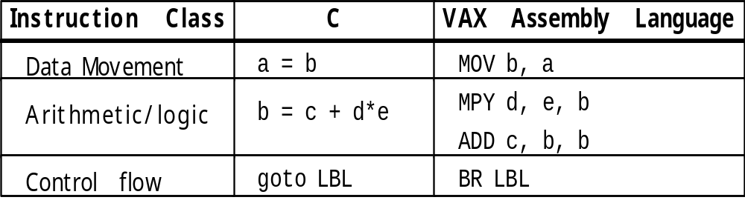
Tbl 1.3 Instruction Classes
This compiler:
  Maps C integers to 32-bit VAX integers
  Maps C assign, *, and + to VAX MOV, MPY, and ADD
  Maps C goto to VAX BR instruction
The compiler writer must develop this mapping for each language-machine pair

Slide 13
Tools of the Assembly Language Programmer’s Trade
The assembler
The linker
The debugger or monitor
The development system

Slide 14
Who Uses Assembly Language
The machine designer
  Must implement and trade off instruction functionality
The compiler writer
  Must generate machine language from a HLL
The writer of time or space critical code
  Performance goals may force program-specific optimizations of the assembly language
Special purpose or imbedded processor programmers
  Special functions and heavy dependence on unique I/O devices can make HLLs useless

