Slide 1
The Computer Architect’s View
Architect is concerned with design & performance
Designs the ISA for optimum programming utility and optimum performance of implementation
Designs the hardware for best implementation of the instructions
Uses performance measurement tools, such as benchmark programs, to see that goals are met
Balances performance of building blocks such as CPU, memory, I/O devices, and interconnections
Meets performance goals at lowest cost

Slide 2
Buses as Multiplexers
Interconnections are very important to computer
Most connections are shared
A bus is a time-shared connection or multiplexer
A bus provides a data path and control
Buses may be serial, parallel, or a combination
  Serial buses transmit one bit at a time
  Parallel buses transmit many bits simultaneously on many wires

Slide 3
Fig 1.4 Simple One- and
Two-Bus Architectures
M
e
m
o
r
y
M
e
m
o
r
y
M
e
m
o
r
y
b
u
s
C
P
U
C
P
U
I
/
O
b
u
s
I
n
p
u
t
/
I
n
p
u
t
/
o
u
t
p
u
t
o
u
t
p
u
t
s
u
b
s
y
s
t
e
m
s
u
b
s
y
s
t
e
m
n
n
-
b
i
t
s
y
s
t
e
m
b
u
I
s
n
p
u
t
/
o
u
t
p
u
t
I
n
p
u
t
/
o
u
t
p
u
t
d
e
v
i
c
e
s
d
e
v
i
c
e
s
(
a
)
O
n
e
b
u
s
(
b
)
T
w
o
b
u
s
e
s

Slide 4
Fig 1.5 The Apple Quadra 950
Bus System (Simplified)
L
o
c
a
l
T
a
l
k
b
u
s
P
r
i
n
t
e
r
s
,
o
t
h
e
L
r
o
c
a
l
T
a
l
k
c
o
m
p
u
t
e
r
i
s
n
t
e
r
f
a
c
e
K
e
y
b
o
a
r
d
A
,
D
B
b
u
A
s
D
B
m
o
u
s
e
,
b
i
t
p
a
d
t
s
r
a
n
s
c
e
i
v
e
r
D
i
s
k
d
r
i
v
e
s
S
,
C
S
I
b
u
S
s
y
s
t
e
m
S
C
S
I
C
D
R
O
M
d
r
i
v
e
b
s
u
s
i
n
t
e
r
f
a
c
e
V
i
d
e
o
a
n
d
s
p
e
c
i
a
N
l
u
B
u
N
s
u
B
u
s
p
u
r
p
o
s
e
c
a
r
d
i
s
n
t
e
r
f
a
c
e
C
P
U
E
t
h
e
r
n
e
E
t
t
h
e
r
n
e
t
O
t
h
e
r
c
o
m
p
u
t
e
r
s
t
r
a
n
s
c
e
i
v
e
r
M
e
m
o
r
y

Slide 5
Fig 1.6 The Memory Hierarchy
Modern computers have a hierarchy of memories
  Allows tradeoffs of speed/cost/volatility/size, etc.
CPU sees common view of levels of the hierarchy.
C
a
c
h
e
M
a
i
n
D
i
s
k
T
a
p
C
e
P
U
m
e
m
o
r
y
m
e
m
o
r
y
m
e
m
o
r
y
m
e
m
o
r
y

Slide 6
Tools of the Architect’s Trade
Software models, simulators and emulators
Performance benchmark programs
Specialized measurement programs
Data flow and bottleneck analysis
Subsystem balance analysis
Parts, manufacturing, and testing cost analysis

Slide 7
Logic Designer’s View
Designs the machine at the logic gate level
The design determines whether the architect meets cost and performance goals
Architect and logic designer may be a single person or team

Slide 8
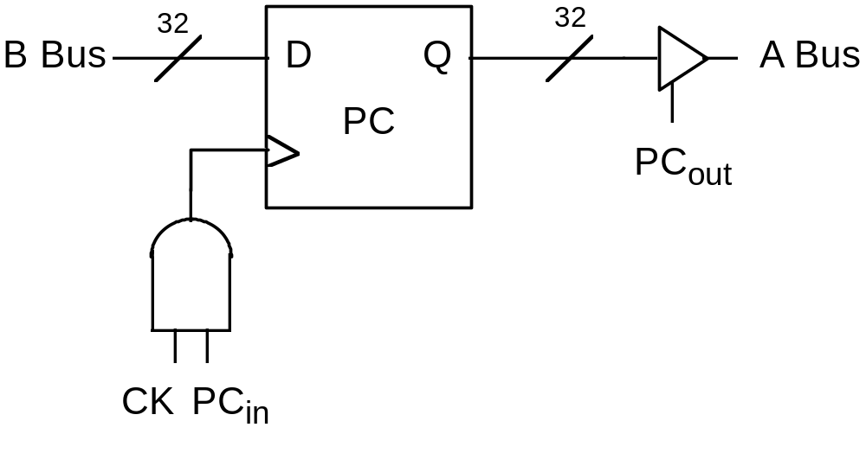
Two Views of the CPU PC Register
31
0
Programmer:
PC
Logic Designer
(Fig 1.8):

Slide 9
Tools of the Logic Designer’s Trade
Computer-aided design tools
  Logic design and simulation packages
  Printed circuit layout tools
  IC (integrated circuit) design and layout tools
Logic analyzers and oscilloscopes
Hardware development system

Slide 10
Chapter 1 Summary
Three different views of machine structure and function
Machine/assembly language view: registers, memory cells, instructions
  PC, IR
  Fetch-execute cycle
  Programs can be manipulated as data
  No, or almost no, data typing at machine level
Architect views the entire system
  Concerned with price/performance, system balance
Logic designer sees system as collection of functional logic blocks
  Must consider implementation domain
  Tradeoffs: speed, power, gate fan-in, fan-out

