Slide 1
Chapter 2: Machines, Machine Languages, and Digital Logic
Topics
2.1 Classification of Computers and Their Instructions
2.2 Computer Instruction Sets
2.3 Informal Description of the Simple RISC Computer, SRC
2.4 Formal Description of SRC Using Register Transfer Notation, RTN
2.5 Describing Addressing Modes with RTN
2.6 Register Transfers and Logic Circuits: From Behavior to Hardware

Slide 2
What Are the Components of an ISA?
Sometimes known as The Programmer’s Model of the machine
Storage cells
  General and special purpose registers in the CPU
  Many general purpose cells of same size in memory
  Storage associated with I/O devices
The machine instruction set
  The instruction set is the entire repertoire of machine operations
  Makes use of storage cells, formats, and results of the fetch/execute cycle
  i.e., register transfers
The instruction format
  Size and meaning of fields within the instruction
The nature of the fetch-execute cycle
  Things that are done before the operation code is known

Slide 3
Fig. 2.1 Programmer’s Models of Various Machines
We saw in Chap. 1 a variation in number and type of storage cells
M
6
8
0
0
I
8
0
8
6
V
A
X
1
1
P
P
C
6
0
(
1
i
n
t
r
o
d
u
c
e
d
1
9
7
5
)
(
i
n
t
r
o
d
u
c
e
d
1
9
7
9
)
(
i
n
t
r
o
d
u
c
e
d
1
9
8
1
)
(
i
n
t
r
o
d
u
c
e
d
1
9
9
3
)
7
0
1
5
8
7
0
3
1
0
0
6
3
A
A
0
X
R
0
3
6
2
4
-
b
i
B
t
1
X
5
B
D
a
t
a
1
2
g
e
n
e
r
a
l
f
l
o
a
t
i
n
g
p
o
i
n
r
t
e
g
i
s
t
e
r
s
p
u
r
p
o
s
C
e
X
R
1
I
1
6
X
s
p
e
c
i
a
l
r
e
g
i
s
t
e
r
r
s
e
g
i
s
t
e
r
p
s
u
r
p
o
s
e
D
X
3
A
1
S
P
r
P
e
g
i
s
t
e
r
s
P
C
F
P
0
3
S
1
S
P
t
a
t
u
s
A
d
d
r
e
s
s
S
P
3
0
2
3
2
-
b
i
B
t
a
P
n
d
P
C
g
e
n
e
r
a
c
l
o
u
n
t
S
I
p
u
r
p
o
s
r
e
e
g
i
s
t
e
r
s
D
I
r
e
g
i
s
t
e
r
P
s
S
W
3
C
1
M
S
e
m
o
r
y
0
3
D
1
0
S
3
0
s
2
e
g
m
e
n
t
2
b
y
t
e
1
s
6
2
b
y
t
e
s
S
r
S
e
g
i
s
t
e
r
s
o
f
m
a
i
n
M
o
r
e
t
h
a
n
5
o
0
f
m
a
i
n
m
e
m
o
r
y
3
2
-
b
i
t
s
p
e
c
i
a
m
l
e
m
o
r
y
E
S
c
a
p
a
c
i
t
y
p
u
r
p
o
s
c
e
a
p
a
c
i
t
y
3
1
2
6
2
–
2
–
1
1
r
e
g
i
s
t
e
r
I
s
P
M
o
r
e
t
h
a
n
3
0
S
0
t
a
t
u
F
s
e
w
e
r
i
n
s
t
r
u
c
t
i
o
n
t
s
h
a
n
1
0
i
0
0
0
n
s
t
r
u
c
t
i
o
n
s
5
2
2
b
y
t
e
2
s
0
2
b
y
t
e
s
o
f
m
a
i
o
n
f
m
a
i
n
m
e
m
o
r
m
y
e
m
o
r
y
c
a
p
a
c
i
t
c
y
a
p
a
c
i
t
y
5
2
2
0
2
–
2
–
1
1
M
o
r
e
t
h
a
n
2
5
M
0
o
r
e
t
h
a
n
1
2
0
i
n
s
t
r
u
c
t
i
o
n
i
s
n
s
t
r
u
c
t
i
o
n
s

Slide 4
What Must an Instruction Specify?
Data Flow
Which operation to perform add r0, r1, r3
  Ans: Op code: add, load, branch, etc.
Where to find the operand or operands add r0, r1, r3
  In CPU registers, memory cells, I/O locations, or part of instruction
Place to store result add r0, r1, r3
  Again CPU register or memory cell
Location of next instruction add r0, r1, r3 br endloop
  Almost always memory cell pointed to by program counter—PC
Sometimes there is no operand, or no result, or no next instruction. Can you think of examples?

Slide 5
Instructions Can Be Divided into
3 Classes
Data movement instructions
  Move data from a memory location or register to another memory location or register without changing its form
  Load—source is memory and destination is register
  Store—source is register and destination is memory
Arithmetic and logic (ALU) instructions
  Change the form of one or more operands to produce a result stored in another location
  Add, Sub, Shift, etc.
Branch instructions (control flow instructions)
  Alter the normal flow of control from executing the next instruction in sequence
  Br Loc, Brz Loc2,—unconditional or conditional branches

Slide 6
Fig 2.2 The 4-Address Machine and Instruction Format
C
P
U
a
d
d
,
R
e
s
,
O
p
1
,
O
p
2
,
N
e
x
t
i
(
R
e
s
←
O
p
1
+
O
p
2
M
)
e
m
o
r
y
O
p
1
A
d
d
r
:
O
p
1
O
p
2
A
d
d
r
:
O
p
2
R
e
s
A
d
d
r
:
R
e
s
N
e
x
t
i
A
d
d
r
:
N
e
x
t
i
I
n
s
t
r
u
c
t
i
o
n
f
o
r
m
a
t
B
i
t
s
:
8
2
4
2
4
2
4
2
4
a
d
d
R
e
s
A
d
d
r
O
p
1
A
d
d
r
O
p
2
A
d
d
r
N
e
x
t
i
A
d
d
r
W
h
i
c
h
W
h
e
r
e
t
o
W
h
e
r
e
t
o
f
i
n
d
W
h
e
r
e
t
o
f
i
n
d
o
p
e
r
a
n
d
o
s
p
e
r
a
t
i
o
n
p
u
t
r
e
s
u
l
t
n
e
x
t
i
n
s
t
r
u
c
t
i
o
n
Explicit addresses for operands, result, & next instruction
Example assumes 24-bit addresses
  Discuss: size of instruction in bytes

Slide 7
Fig 2.3 The 3-Address Machine and Instruction Format
M
e
m
o
r
y
C
P
U
a
d
d
,
R
e
s
,
O
p
1
,
O
p
2
(
R
e
s
←
O
p
2
+
O
p
1
)
O
p
1
A
d
d
r
:
O
p
1
O
p
2
A
d
d
r
:
O
p
2
R
e
s
A
d
d
r
:
R
e
s
P
r
o
g
r
a
m
2
N
4
e
x
t
i
A
d
d
r
:
N
e
x
t
i
c
o
u
n
t
e
r
W
h
e
r
e
t
o
f
i
n
d
n
e
x
t
i
n
s
t
r
u
c
t
i
o
n
I
n
s
t
r
u
c
t
i
o
n
f
o
r
m
a
t
B
i
t
s
:
8
2
4
2
4
2
4
a
d
d
R
e
s
A
d
d
r
O
p
1
A
d
d
r
O
p
2
A
d
d
r
W
h
i
c
h
W
h
e
r
e
t
o
W
h
e
r
e
t
o
f
i
n
d
o
p
e
r
a
n
d
o
s
p
e
r
a
t
i
o
n
p
u
t
r
e
s
u
l
t
Address of next instruction kept in processor state register—the PC (except for explicit branches/jumps)
Rest of addresses in instruction
  Discuss: savings in instruction word size

Slide 8
Fig 2.4 The 2-Address Machine and Instruction Format
C
P
M
U
e
m
o
r
y
a
d
d
O
p
2
,
O
p
1
(
O
p
2
←
O
p
2
+
O
p
1
)
O
p
1
A
d
d
r
:
O
p
1
O
p
2
A
d
d
r
:
O
p
2
,
R
e
s
P
r
o
g
r
a
m
2
N
4
e
x
t
i
A
d
d
r
:
N
e
x
t
i
c
o
u
n
t
e
r
W
h
e
r
e
t
o
f
i
n
d
n
e
x
t
i
n
s
t
r
u
c
t
i
o
n
I
n
s
t
r
u
c
t
i
o
n
f
o
r
m
a
t
B
i
t
s
:
8
2
4
2
4
a
d
d
O
p
2
A
d
d
r
O
p
1
A
d
d
r
W
h
i
c
h
W
h
e
r
e
t
o
f
i
n
d
o
p
e
r
a
n
d
s
o
p
e
r
a
t
i
o
n
W
h
e
r
e
t
o
Result overwrites Operand 2
Needs only 2 addresses in instruction but less choice in placing data
p
u
t
r
e
s
u
l
t

Slide 9
Fig 2.5 1-Address Machine and Instruction Format
C
P
M
U
e
m
o
r
y
a
d
d
O
p
1
(
A
c
c
←
A
c
c
+
O
p
1
)
O
p
1
A
d
d
r
:
O
p
1
W
h
e
r
e
t
o
f
i
n
d
o
p
e
r
a
n
d
2
,
a
n
d
w
h
e
r
e
t
o
p
u
t
r
e
s
u
l
t
A
c
c
u
m
u
l
a
t
o
r
P
r
o
g
r
a
m
2
N
4
e
x
t
i
A
d
d
r
:
N
e
x
t
i
c
o
u
n
t
e
r
W
h
e
r
e
t
o
f
i
n
d
n
e
x
t
i
n
s
t
r
u
c
t
i
o
Need instructions to load and store operands:
LDA OpAddr
STA OpAddr
n
I
n
s
t
r
u
c
t
i
o
n
f
o
r
m
a
t
B
i
t
s
:
8
2
4
a
d
d
O
p
1
A
d
d
r
W
h
i
c
h
W
h
e
r
e
t
o
f
i
n
d
Special CPU register, the accumulator, supplies 1 operand and stores result
One memory address used for other operand
o
p
e
r
a
t
i
o
n
o
p
e
r
a
n
d
1

Slide 10
Fig 2.6 The 0-Address, or Stack, Machine and Instruction Format
I
n
s
t
r
u
c
t
i
o
n
f
o
r
m
a
t
s
M
e
m
o
r
y
C
P
U
p
u
s
h
O
p
1
(
T
O
S
←
O
p
1
)
B
i
t
s
:
8
2
O
4
p
1
A
d
d
r
:
O
p
1
F
o
r
m
a
t
p
u
s
h
O
p
1
A
d
d
T
r
O
S
O
p
e
r
a
t
i
o
n
R
e
s
u
l
t
S
O
S
e
t
c
.
a
d
d
(
T
O
S
←
T
O
S
+
S
O
S
)
B
i
t
s
S
:
8
t
a
c
k
a
d
F
d
o
r
m
a
P
t
r
o
g
r
a
N
m
e
x
t
i
A
d
d
r
:
N
e
x
t
i
2
4
W
h
i
c
h
o
p
e
r
a
t
i
o
c
n
o
u
n
t
e
r
W
h
e
r
e
t
o
f
i
n
d
W
h
e
r
e
t
o
f
i
n
d
o
p
e
r
a
n
d
s
,
n
e
x
t
i
n
s
t
r
u
c
t
i
o
n
a
n
d
w
h
e
r
e
t
o
p
u
t
r
e
s
u
l
t
(
o
n
t
h
e
s
t
a
c
k
)
Uses a push-down stack in CPU
Arithmetic uses stack for both operands and the result
Computer must have a 1-address instruction to push and pop operands to and from the stack

Slide 11
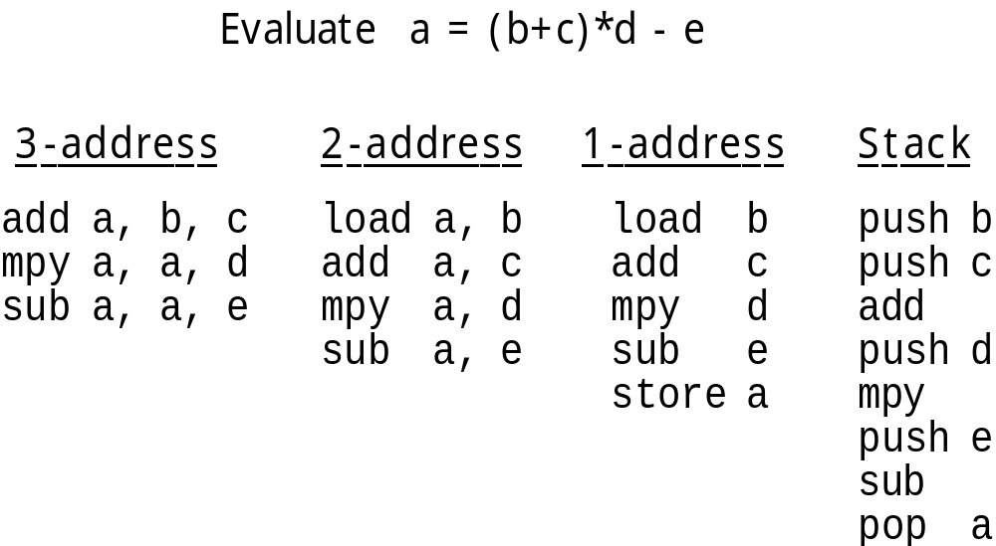
Example 2.1 Expression Evaluation for 3-, 2-, 1-, and 0-Address Machines
Number of instructions & number of addresses both vary
Discuss as examples: size of code in each case

Slide 12
Fig 2.7 General Register Machine and Instruction Formats
C
P
U
I
n
s
t
r
u
c
t
i
o
n
f
o
r
m
a
t
R
s
e
g
i
s
t
e
r
M
s
e
m
o
r
y
l
o
a
d
R
8
,
O
p
1
(
R
8
←
O
p
1
l
)
o
a
d
R
O
8
p
1
A
d
d
r
:
O
p
1
l
o
a
d
R
8
O
p
1
A
d
d
r
R
6
R
4
a
d
d
R
2
,
R
4
,
R
6
(
R
2
←
R
4
+
R
6
)
a
d
d
R
2
R
4
R
R
6
2
P
r
o
g
r
a
N
m
e
x
t
i
c
o
u
n
t
e
r
It is the most common choice in today’s general-purpose computers
Which register is specified by small “address” (3 to 6 bits for 8 to 64 registers)
Load and store have one long & one short address: 1½ addresses
Arithmetic instruction has 3 “half” addresses

Slide 13
Real Machines Are Not So Simple
Most real machines have a mixture of 3, 2, 1, 0, and 1½ address instructions
A distinction can be made on whether arithmetic instructions use data from memory
If ALU instructions only use registers for operands and result, machine type is load-store
  Only load and store instructions reference memory
Other machines have a mix of register-memory and memory-memory instructions

Slide 14
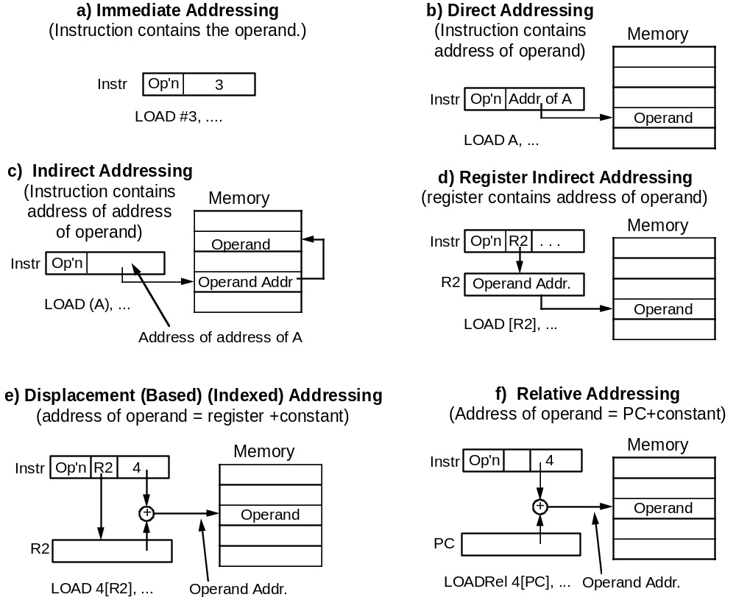
Fig 2.8 Common Addressing Modes

