Slide 1
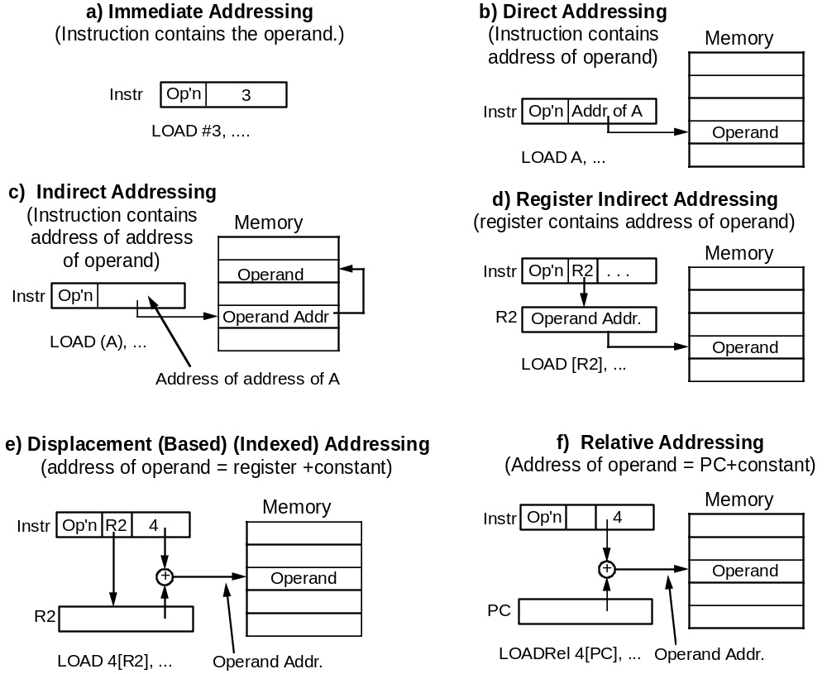
Fig 2.8 Common Addressing Modes

Slide 2
Example: Computer, SRC
Simple RISC Computer
32 general purpose registers of 32 bits
32-bit program counter, PC, and instruction register, IR
2³² bytes of memory address space
T
h
e
S
R
C
C
P
U
M
a
i
n
m
e
m
o
r
y
3
1
0
7
0
R
0
3
0
2
3
2
-
b
i
t
3
g
2
e
n
e
r
a
l
2
p
u
r
p
o
s
e
b
y
t
e
s
r
e
g
i
s
t
e
r
s
o
f
R
[
7
]
m
e
a
n
s
c
o
n
t
e
n
t
m
s
a
i
R
n
3
1
o
f
r
e
g
i
s
t
e
r
m
7
e
m
o
r
y
P
C
M
[
3
2
]
m
e
a
n
s
c
o
n
t
e
n
t
3
s
2
2
–
1
o
f
m
e
m
o
r
y
l
o
c
a
t
i
o
n
3
I
2
R

Slide 3
SRC Characteristics
Load-store design: only way to access memory is through load and store instructions
Only a few addressing modes are supported
ALU instructions are 3-register type
Branch instructions can branch unconditionally or conditionally on whether the value in a specified register is = 0, <> 0, >= 0, or < 0
Branch and link instructions are similar, but leave the value of current PC in any register, useful for subroutine return
All instructions are 32 bits (1 word) long

Slide 4
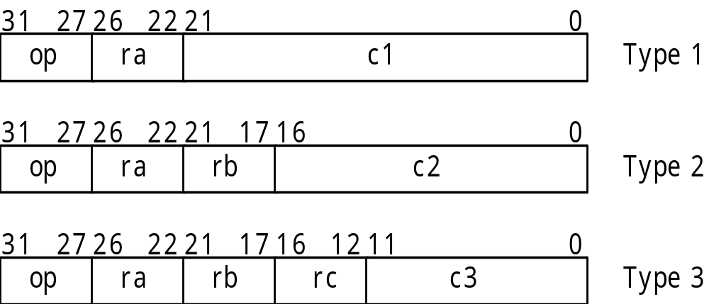
SRC Basic Instruction Formats
There are three basic instruction format types
The number of register specifier fields and length of the constant field vary
Other formats result from unused fields or parts
Details of formats on next slide

Slide 5
Fig 2.9 (Partial) Total of 7 Detailed Formats
I
n
s
t
r
u
c
t
i
o
n
f
o
r
m
a
t
s
E
x
a
m
p
l
e
I
d
r
3
,
A
(
R
[
3
]
=
M
[
A
]
3
)
1
2
7
2
6
2
2
2
1
1
7
1
1
6
0
.
I
d
,
s
t
,
l
a
,
I
d
r
3
,
4
(
r
5
)
(
R
[
3
]
=
M
[
R
[
5
]
+
4
]
O
)
p
r
a
r
b
c
a
2
d
d
i
,
a
n
d
i
,
o
r
i
a
d
d
i
r
2
,
r
4
,
#
1
(
R
[
2
]
=
R
[
4
]
+
1
)
2
0
7
2
6
2
2
2
3
1
1
I
d
r
r
5
,
8
(
R
[
5
]
=
M
[
P
C
+
8
]
2
)
.
I
d
r
,
s
t
r
,
l
a
r
O
p
r
a
c
1
I
a
r
r
6
,
4
5
(
R
[
6
]
=
P
C
+
4
5
)
3
0
1
2
7
2
6
2
2
2
1
1
7
1
6
n
e
g
r
7
,
r
9
(
R
[
7
]
=
–
R
[
9
]
3
)
.
n
e
g
,
n
o
t
O
p
r
a
r
c
u
n
u
s
e
d
u
n
u
s
e
d
3
0
1
2
7
2
6
2
2
2
1
1
7
1
6
1
2
1
1
2
b
r
z
r
r
4
,
r
4
0
.
b
r
O
p
r
b
(
c
3
)
u
n
u
s
e
r
d
c
C
o
n
d
(
b
r
a
n
c
h
t
o
R
[
4
]
i
f
R
[
0
]
=
=
0
u
)
n
u
s
e
d
1
2
1
3
1
2
0
1
2
7
2
6
2
2
2
1
1
7
1
6
b
r
l
n
z
r
6
,
r
4
,
r
5
0
.
b
r
l
O
p
r
a
r
b
(
c
3
)
u
n
u
s
e
d
C
o
n
r
d
c
(
R
[
6
]
=
P
C
;
b
r
a
n
c
h
t
o
R
[
4
]
i
f
R
[
0
]
≠
0
)
1
2
1
3
1
0
1
2
7
2
6
2
2
2
1
1
7
1
6
6
.
a
d
d
,
s
u
b
,
a
d
d
r
0
,
r
2
,
r
4
(
R
[
0
]
=
R
[
2
]
+
R
[
4
]
O
)
p
r
a
r
b
u
n
u
s
e
r
d
a
c
n
d
,
o
r
3
4
0
1
2
7
2
6
2
2
2
1
1
7
s
h
r
r
0
,
r
1
,
#
(
4
c
3
7
)
a
O
p
r
a
r
b
(
c
3
)
C
o
u
n
u
t
n
u
s
e
d
(
R
[
0
]
=
R
[
1
]
s
h
i
f
t
e
d
r
i
g
h
t
b
y
4
b
i
t
7
s
.
s
h
r
,
s
h
r
a
s
h
l
,
s
h
i
c
1
3
2
4
0
1
2
7
2
6
2
2
2
1
1
7
1
6
s
h
l
r
2
,
r
4
,
r
7
6
b
O
p
r
a
r
b
(
c
3
(
)
c
3
)
u
n
u
s
e
d
0
0
0
0
r
0
c
(
R
[
2
]
=
R
[
4
]
s
h
i
f
t
e
d
l
e
f
t
b
y
c
o
u
n
t
i
n
R
[
6
]
)
2
3
6
0
1
2
7
s
t
o
8
p
.
n
o
p
,
s
t
o
p
O
p
u
n
u
s
e
d

Slide 6
Tbl 2.4 Example SRC Load and Store Instructions
Address can be constant, constant + register, or constant + PC
Memory contents or address itself can be loaded
I
n
s
t
r
u
c
t
i
o
n
o
p
r
a
r
b
c
1
M
e
a
n
i
n
g
A
d
d
r
e
s
s
i
n
g
M
o
d
e
l
d
r
1
,
3
2
1
1
0
3
2
D
i
r
e
c
R
t
[
1
]
←
M
[
3
2
]
l
d
r
2
2
,
2
4
(
r
4
)
1
2
2
4
2
4
D
i
s
p
l
a
c
e
m
e
n
R
t
[
2
2
]
←
M
[
2
4
+
R
[
4
]
]
s
t
r
4
,
0
(
r
9
)
3
4
9
0
R
e
g
i
s
t
e
r
i
n
d
i
r
e
c
M
t
[
R
[
9
]
]
←
R
[
4
]
l
a
r
7
,
3
2
5
7
0
3
2
I
m
m
e
d
i
a
t
R
e
[
7
]
←
3
2
l
d
r
r
1
2
,
-
4
8
2
1
2
–
-
4
8
R
e
l
a
t
i
v
R
e
[
1
2
]
←
M
[
P
C
-
4
8
]
l
a
r
r
3
,
0
6
3
–
0
R
e
g
i
s
t
e
r
(
!
R
)
[
3
]
←
P
C
(note use of la to load a constant)

Slide 7
Assembly Language Forms of Arithmetic and Logic Instructions
Format Example Meaning
neg ra, rc neg r1, r2 ;Negate (r1 = -r2)
not ra, rc not r2, r3 ;Not (r2 = r3´ )
add ra, rb, rc add r2, r3, r4 ;2’s complement addition
sub ra, rb, rc ;2’s complement subtraction
and ra, rb, rc ;Logical and
or ra, rb, rc ;Logical or
addi ra, rb, c2 addi r1, r3, #1 ;Immediate 2’s complement add
andi ra, rb, c2 ;Immediate logical and
ori ra, rb, c2 ;Immediate logical or
Immediate subtract not needed since constant in addi may be negative

Slide 8
Branch Instruction Format
There are actually only two branch instructions:
br rb, rc, c3<2..0> ; branch to R[rb] if R[rc] meets
; the condition defined by c3<2..0>
brl ra, rb, rc, c3<2..0> ; R[ra] ← PC; branch as above
It is c3<2..0>, the 3 lsbs of c3, that governs what the branch condition is:
lsbs condition Assy language form Example
000 never brlnv brlnv r6
001 always br, brl br r5, brl r5
010 if rc = 0 brzr, brlzr brzr r2, r4, r5
011 if rc ≠ 0 brnz, brlnz
100 if rc >= 0 brpl, brlpl
101 if rc < 0 brmi, brlmi
Note that branch target address is always in register R[rb].
It must be placed there explicitly by a previous instruction.

Slide 9
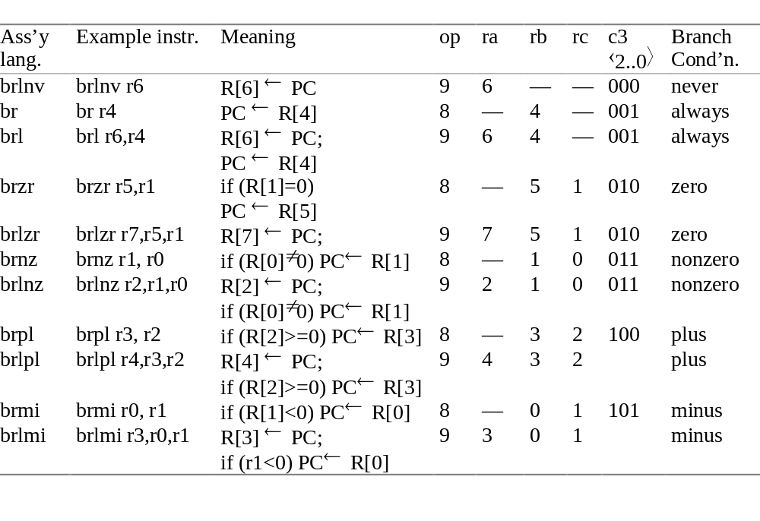
Tbl 2.6 Forms and Formats of the br and brl Instructions

Slide 10
Branch Instructions—Example
C: goto Label3
SRC:
lar r0, Label3 ; put branch target address into tgt reg.
br r0 ; and branch
• • •
Label3 • • •

Slide 11
Example of Conditional Branch
in C: #define Cost 125
if (X<0) then X = -X;
in SRC:
Cost .equ 125 ;define symbolic constant
.org 1000 ;next word will be loaded at address 1000₁₀
X: .dw 1 ;reserve 1 word for variable X
.org 5000 ;program will be loaded at location 5000₁₀
lar r0, Over ;load address of “false” jump location
ld r1, X ;load value of X into r1
brpl r0, r1 ;branch to Else if r1≥0
neg r1, r1 ;negate value
Over: • • • ;continue

Slide 12
RTN (Register Transfer Notation)
Provides a formal means of describing machine structure and function
Is at the “just right” level for machine descriptions
Does not replace hardware description languages
Can be used to describe what a machine does (an abstract RTN) without describing how the machine does it
Can also be used to describe a particular hardware implementation (a concrete RTN)

Slide 13
RTN (cont’d.)
At first you may find this “meta description” confusing, because it is a language that is used to describe a language
You will find that developing a familiarity with RTN will aid greatly in your understanding of new machine design concepts
We will describe RTN by using it to describe SRC

Slide 14
Some RTN Features—
Using RTN to Describe a Machine’s Static Properties
Static Properties
Specifying registers
  IR⟨31..0⟩ specifies a register named “IR” having 32 bits numbered 31 to 0
“Naming” using the := naming operator:
  op⟨4..0⟩ := IR⟨31..27⟩ specifies that the 5 msbs of IR be called op, with bits 4..0
  Notice that this does not create a new register, it just generates another name, or “alias,” for an already existing register or part of a register

Slide 15
Using RTN to Describe
Dynamic Properties
Dynamic Properties
Conditional expressions:
  (op=12) → R[ra] ← R[rb] + R[rc]: ; defines the add instruction
“if” condition “then” RTN Assignment Operator
This fragment of RTN describes the SRC add instruction. It says,
“when the op field of IR = 12, then store in the register specified
by the ra field, the result of adding the register specified by the
rb field to the register specified by the rc field.”

Slide 16
Using RTN to Describe the SRC (Static) Processor State
Processor state
PC⟨31..0⟩: program counter
        (memory addr. of next inst.)
IR⟨31..0⟩: instruction register
Run: one bit run/halt indicator
Strt: start signal
R[0..31]⟨31..0⟩: general purpose registers

Slide 17
RTN Register Declarations
General register specifications shows some features of the notation
Describes a set of 32 32-bit registers with names R[0] to R[31]
R[0..31]⟨31..0⟩:
Name of
registers
Colon separates
statements with
no ordering
Register #
in square
brackets
msb #
lsb#
Bit # in
angle
brackets
.. specifies
a range of
indices

Slide 18
Memory Declaration:
RTN Naming Operator
Defining names with formal parameters is a powerful formatting tool
Used here to define word memory (big-endian)
Main memory state
Mem[0..2³² - 1]⟨7..0⟩: 2³² addressable bytes of memory
M[x]⟨31..0⟩:= Mem[x]#Mem[x+1]#Mem[x+2]#Mem[x+3]:
Dummy
parameter
Naming
operator
Concatenation
operator
All bits in
register if no
bit index given

Slide 19
RTN Instruction Formatting Uses Renaming of IR Bits
Instruction formats
op⟨4..0⟩ := IR⟨31..27⟩: operation code field
ra⟨4..0⟩ := IR⟨26..22⟩: target register field
rb⟨4..0⟩ := IR⟨21..17⟩: operand, address index, or
branch target register
rc⟨4..0⟩ := IR⟨16..12⟩: second operand, conditional
test, or shift count register
c1⟨21..0⟩ := IR⟨21..0⟩: long displacement field
c2⟨16..0⟩ := IR⟨16..0⟩: short displacement or
immediate field
c3⟨11..0⟩ := IR⟨11..0⟩: count or modifier field

Slide 20
Specifying Dynamic Properties of SRC: RTN Gives Specifics of Address Calculation
Effective address calculations (occur at runtime):
disp⟨31..0⟩ := ((rb=0) → c2⟨16..0⟩ {sign extend}: displacement
(rb≠0) → R[rb] + c2⟨16..0⟩ {sign extend, 2's comp.} ): address
rel⟨31..0⟩ := PC⟨31..0⟩ + c1⟨21..0⟩ {sign extend, 2’s comp.}: relative
address
Renaming defines displacement and relative addresses
New RTN notation is used
  condition → expression means if condition then expression
  modifiers in { } describe type of arithmetic or how short numbers are extended to longer ones
  arithmetic operators (+ - * / etc.) can be used in expressions
Register R[0] cannot be added to a displacement

Slide 21
Detailed Questions Answered by the RTN for Addresses
What set of memory cells can be addressed by direct addressing (displacement with rb=0)
  If c2⟨16⟩=0 (positive displacement) absolute addresses range from 00000000H to 0000FFFFH
  If c2⟨16⟩=1 (negative displacement) absolute addresses range from FFFF0000H to FFFFFFFFH
What range of memory addresses can be specified by a relative address
  The largest positive value of C1⟨21..0⟩ is 2²¹-1 and its most negative value is -2²¹, so addresses up to 2²¹-1 forward and 2²¹ backward from the current PC value can be specified
Note the difference between rb and R[rb]

Slide 22
Instruction Interpretation: RTN Description of Fetch-Execute
Need to describe actions (not just declarations)
Some new notation
Logical NOT
Logical AND
instruction_interpretation := (
¬Run∧Strt → Run ← 1:
Run → (IR ← M[PC]: PC ← PC + 4; instruction_execution) );
Register transfer
Separates statements
that occur in sequence

Slide 23
RTN Sequence and Clocking
In general, RTN statements separated by : take place during the same clock pulse
Statements separated by ; take place on successive clock pulses
This is not entirely accurate since some things written with one RTN statement can take several clocks to perform
More precise difference between : and ;
  The order of execution of statements separated by : does not matter
  If statements are separated by ; the one on the left must be complete before the one on the right starts

Slide 24
More About Instruction Interpretation RTN
In the expression IR ← M[PC]: PC ← PC + 4; which value of PC applies to M[PC] ?
The rule in RTN is that all right hand sides of “:” - separated RTs are evaluated before any LHS is changed
  In logic design, this corresponds to “master-slave” operation of flip-flops
We see what happens when Run is true and when Run is false but Strt is true. What about the case of Run and Strt both false?
  Since no action is specified for this case, the RTN implicitly says that no action occurs in this case

Slide 25
Individual Instructions
instruction_interpretation contained a forward reference to instruction_execution
instruction_execution is a long list of conditional operations
  The condition is that the op code specifies a given instruction
  The operation describes what that instruction does
Note that the operations of the instruction are done after (;) the instruction is put into IR and the PC has been advanced to the next instruction

Slide 26
RTN Instruction Execution for Load and Store Instructions
instruction_execution := (
ld (:= op= 1) → R[ra] ← M[disp]: load register
ldr (:= op= 2) → R[ra] ← M[rel]: load register relative
st (:= op= 3) → M[disp] ← R[ra]: store register
str (:= op= 4) → M[rel] ← R[ra]: store register relative
la (:= op= 5 ) → R[ra] ← disp: load displacement address
lar (:= op= 6) → R[ra] ← rel: load relative address
The in-line definition (:= op=1) saves writing a separate definition ld := op=1 for the ld mnemonic
The previous definitions of disp and rel are needed to understand all the details

Slide 27
SRC RTN—The Main Loop
ii := instruction_interpretation:
ie := instruction_execution :
ii := ( ¬Run∧Strt → Run ← 1:
Run → (IR ← M[PC]: PC ← PC + 4;
ie) );
ie := (
ld (:= op= 1) → R[ra] ← M[disp]: Big switch
ldr (:= op= 2) → R[ra] ← M[rel]: statement
. . . on the opcode
stop (:= op= 31) → Run ← 0:
); ii
Thus ii and ie invoke each other, as coroutines.

Slide 28
Use of RTN Definitions:
Text Substitution Semantics
ld (:= op= 1) → R[ra] ← M[disp]:
disp⟨31..0⟩ := ((rb=0) → c2⟨16..0⟩ {sign extend}:
(rb≠0) → R[rb] + c2⟨16..0⟩ {sign extend, 2's comp.} ):
ld (:= op= 1) → R[ra] ← M[
((rb=0) → c2⟨16..0⟩ {sign extend}:
(rb≠0) → R[rb] + c2⟨16..0 ⟩ {sign extend, 2's comp.} ):
]:
An example:
  If IR = 00001 00101 00011 00000000000001011
  then ld → R[5] ← M[ R[3] + 11 ]:

Slide 29
RTN Descriptions of SRC Branch Instructions
Branch condition determined by 3 lsbs of instruction
Link register (R[ra]) set to point to next instruction
cond := ( c3⟨2..0⟩=0 → 0: never
c3⟨2..0⟩=1 → 1: always
c3⟨2..0⟩=2 → R[rc]=0: if register is zero
c3⟨2..0⟩=3 → R[rc]≠0: if register is nonzero
c3⟨2..0⟩=4 → R[rc]⟨31⟩=0: if positive or zero
c3⟨2..0⟩=5 → R[rc]⟨31⟩=1 ): if negative
br (:= op= 8) → (cond → PC ← R[rb]): conditional branch
brl (:= op= 9) → (R[ra] ← PC:
        cond → (PC ← R[rb]) ): branch and link

Slide 30
RTN for Arithmetic and Logic
add (:= op=12) → R[ra] ← R[rb] + R[rc]:
addi (:= op=13) → R[ra] ← R[rb] + c2⟨16..0⟩ {2's comp. sign ext.}:
sub (:= op=14) → R[ra] ← R[rb] - R[rc]:
neg (:= op=15) → R[ra] ← -R[rc]:
and (:= op=20) → R[ra] ← R[rb] ∧ R[rc]:
andi (:= op=21) → R[ra] ← R[rb] ∧ c2⟨16..0⟩ {sign extend}:
or (:= op=22) → R[ra] ← R[rb] ∨ R[rc]:
ori (:= op=23) → R[ra] ← R[rb] ∨ c2⟨16..0⟩ {sign extend}:
not (:= op=24) → R[ra] ← ¬R[rc]:
Logical operators: and ∧ or ∨ and not ¬

Slide 31
End of RTN Definition of instruction_execution
nop (:= op= 0) → : No operation
stop (:= op= 31) → Run ← 0: Stop instruction
); End of instruction_execution
instruction_interpretation.
We will find special use for nop in pipelining
The machine waits for Strt after executing stop
The long conditional statement defining instruction_execution ends with a direction to go repeat instruction_interpretation, which will fetch and execute the next instruction (if Run still =1)

