Slide 1
VLSI
Computers
Ch. 56
Michael DePouw

Slide 2
Overview
I. Vacuum Tube Computers
II. Transistors
III. Junction Transistors
IV. Integrated Circuits
V. MOS & LSI
VI. VLSI Computers

Slide 3
I. Vacuum Tube Computers
1906 Venerable Vacuum Tube Computer invented
Problems with vacuum tube computers
  Extremely large
  Consumed enormous amounts of electricity
  Produced tremendous amounts of heat
  Ultimately limited by tube-failure rates
  Example: A computer with a 1000 vacuum tubes might operate as short as 1 hour between malfunctions

Slide 4
II. Transistors
1947 at Bell Labs, Shockley, Bardeen, & Brattain invented the transistor

Slide 5
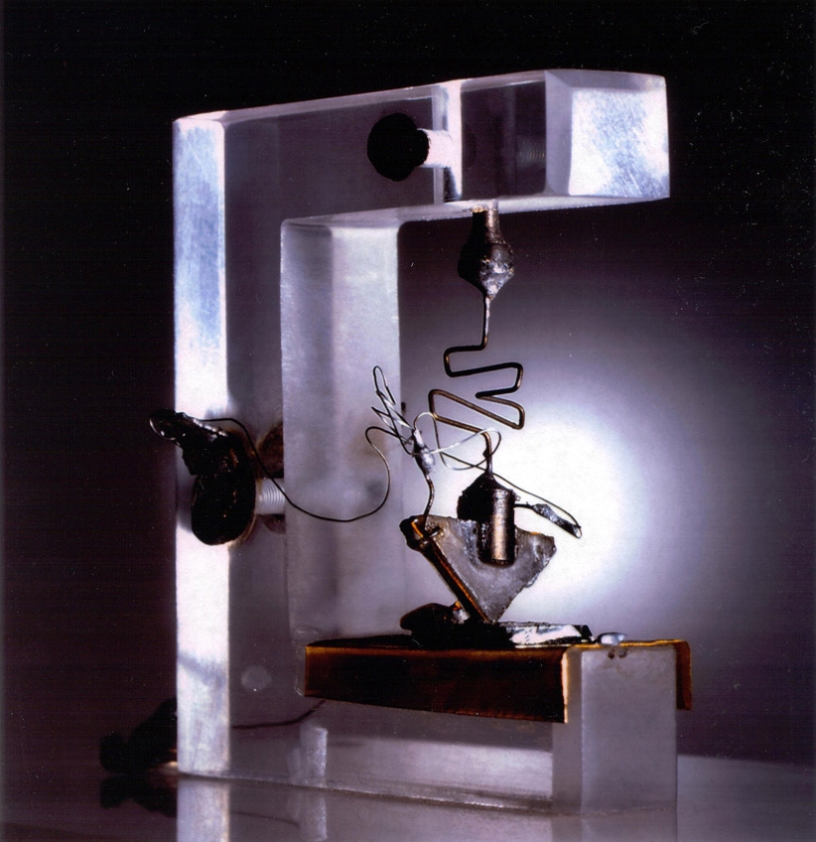

Slide 6
II. Transistors
1947 at Bell Labs: Shockley, Bardeen, & Brattain invented the transistor
Transistor has 2 basic functions: switching & modulation/amplification
Example: A transistor is analogous to a dimmer. A dimmer can act like a switch turning the light on or off. It can also act like a modulator regulating the amount of light produced.

Slide 7
II. Transistors cont.
Transistors solved vacuum tube problems
  Size
  Power consumption
  Reliable
Transistors allowed for creation of more complex systems
Problem with transistors
  As complexity increased the # of soldering connections skyrocketed

Slide 8
III. Junction Transistors
Around 1949 at Bell Labs, Shockley developed the junction transistor
Junction transistor are composed of three layers of semiconductors
Silicon and germanium are two common semiconductors
Semiconductors do not readily allow the passage of electricity until they are doped
Doping is adding an element to the semiconductor to reduce or increase the number of electrons

Slide 9
III. Junction Transistors cont.
Once doped, semiconductors can carry current like a wire can
Semiconductors with a surplus of electrons are n-type
Semiconductors with a shortage of electrons are p-type
Junction transistors have a slice p-type sandwiched between two n-types

Slide 10
III. Junction Transistors cont.
Example:
Emitter
N-Type Semiconductor
Base
P-Type Semiconductor
Collector
N-Type Semiconductor
Bell Labs shared junction transistor with practically any company that expressed interest

Slide 11
IV. Integrated Circuits
1952 British scientist Dummer developed idea of “wireless electrical circuits”
Wireless circuits was an extension of the junction transistor
1958 at Texas Instruments: Kilby created first integrated circuit or chip
1958 at Fairchild Semiconductor: Hoerni took junction transistor to next level, creating the planar transistor

Slide 12
IV. Integrated Circuits cont.
Planar transistors are like junction transistors except n- and p-type layers are only a few atoms thick and multiple layers are nested on top of each other
1959 at Fairchild: Noyce applied planar fabrication technique to other electronic components created on a silicon slab
Integrated Circuits solve transistor wiring problem
  Noyce also proposed narrow conducting channels to remove wires
Noyce’s chip became prototype for all chips that followed

Slide 13
IV. Integrated Circuits cont.
Initial problem with integrated circuits
  Cost
    Example: A flip-flop, which holds one bit, was $450.
Answer to problem
  Apollo Project
    1961 President Kennedy said “I believe we should go to the moon, I believe that this nation should commit itself to achieving the goal, before the end of the decade is out, of landing a man on the moon and returning him safely to earth.”
Problem with planar transistors
  Became harder to produce as integration increased
  Heat

Slide 14
V. MOS & Large Scale Integration
Researches at Motorola found a compelling reason to reduce chip size.
  Smaller chips were more likely to work than bigger chips
  Dust particles will ruin a chip
In early 1970’s Metal-Oxide-Semiconductors were introduced
  MOS solved planar transistor problems
    Consumed less electricity thus reducing heat

Slide 15
V. MOS & Large Scale Integration cont.
1970s was the era of LSI
Problem with LSI
  LSI became a black art
    Very few people understood principles
    Training came from senior employees
    Human designer kept track of thousands of connections

Slide 16
VI. Vary Large Scale Integration Computers
1978 Introduction to VLSI Systems by Mead & Conway
  Provided a central location for acquiring information on chip design
  Developed idea of logical networks
  Spawned a design course at nearly all major engineering schools
  Allowed small businesses to hire chip designers

Slide 17
VI. Vary Large Scale Integration Computers cont.
VLSI circuits are fabricated on a three-layer substrate with an insulating layer between them
Source
Metal
Silicon Dioxide
Gate
Polysilicon
Silicon Dioxide
Drain
Diffusion
Voltage in the polysilicon layer controls voltage in diffusion layer
  Creates a transistor

Slide 18
VI. Vary Large Scale Integration Computers cont.
If the gate is high a pathway between the source and the drain is created
If the gate is low no pathway between the source and the drain is created
Example 1: NOT Gate
Polysilicon (Gate)
Diffusion (Drain)
X
Supply
Ground
X'

Slide 19
VI. Vary Large Scale Integration Computers cont.
Example 2: NOR Gate
Polysilicon (Gate)
Diffusion (Drain)
Supply
(X+Y)'
X
Y
Ground

Slide 20
VI. Vary Large Scale Integration Computers cont.
Steps for creating VSLI circuit
  Large crystal of silicon grown
    Cut crystal into wafers
    Each wafer contains several hundred copies of a circuit
  Cover wafer with silicon dioxide
    Remove areas of insulating material
      Cover silicon dioxide with a mask
      Project intense radiation
  Cover silicon dioxide with polycrystalline silicon
    Use another mask to remove certain areas
    Dope polycrystalline

Slide 21
VI. Vary Large Scale Integration Computers cont.
  Cover polycrystalline silicon with silicon dioxide
    Mask area to remove certain areas
  Cover silicon dioxide with metal
    Final mask
  Cut wafer into individual circuits
  Cement circuit into plastic

