Slide 1
Requirements Elaboration
(Unified Software Process)
CEN 5016
Software Engineering
Dr. David A. Workman
School of EE and CS
February 3, 2004

Slide 2
References
Software Engineering: A Practioner’s Approach (text)
  Chapters 10,11,12 & 20,21
Unified Software Development Process
  Chapters 8
UML Reference Manual
  Chapters 6,7,8

Slide 3
Where We’ve Been and Where We’re Going
1: Requirements
Elicitation
(Capture)
2: Requirements
Elaboration
(Analysis &
Specification)
3: Software
Design
Use Case
Model
Partition
Software into
Work packages.
Estimate cost, resources,
Size, and schedule.
Software
Requirements
Spec
Software
Development
Plan
State
Chart
Collaboration
Diagram
Use Case
Diagram
Define Internal
View of System
Identify Subsystems
Identify Classes & Objects
Allocate Functional
Responsibilities
Analysis
Model
Model
System/Gui
behavior
Model
Use Case
behavior
Define System
Boundary;
Identify Actors
And External
Interfaces;
Identify Use Cases
Class
Diagram
Architecture
Diagram
Identify Boundary, Control
Entity Classes and their
Relationships
Identify Packages
their Interfaces &
Relationships

Slide 4
Requirements Analysis ( USDP )*
Purpose
  "To achieve a more precise understanding of requirements and to achieve a description of requirements that is easy to maintain and that helps give structure to the whole system - including the architecture."
Requirements capture leaves unresolved issues because:
  Use cases must be kept independent of each other (issues regarding interference, concurrency, and conflicts among use cases may be unresolved in requirements capture.)
  Use cases are written in natural language for the benefit of the client and users. Thus expressive power and many details are lost.
  Use cases are an intuitive expression of functionality. Thus many redundancies occur that must be eliminated for maintainability.
*Note: The Unified Software Development Process (Booch, Jacobson, Rumbaugh)

Slide 5
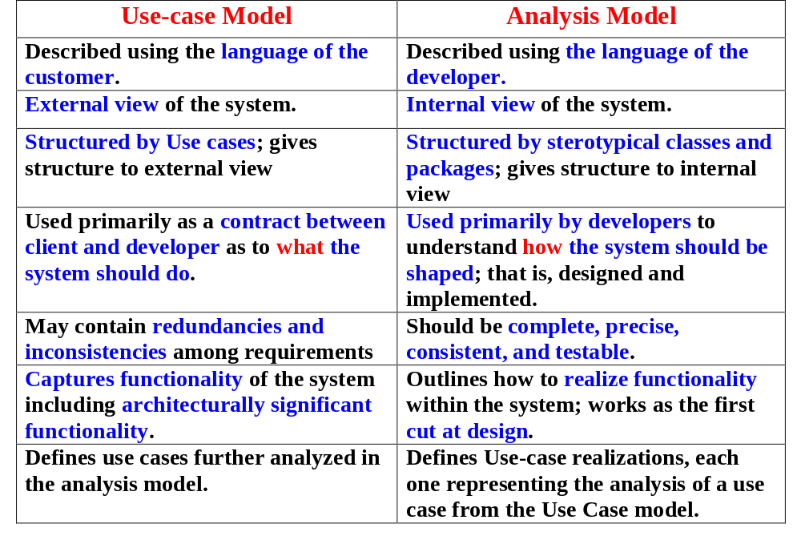
Requirements Analysis vs Capture(USDP)

Slide 6
Requirements Analysis & Specification
Inputs
  Outputs from Requirements Elicitation ( Use Case Model ).
  Technical documents or expertise relevant to problem domain, in general, and to the Client's problem, in particular.
Activities
  Refine requirements by eliminating inconsistencies and ambiguities. Formalize requirements by preparing a System Requirements Specification. Develop an initial software development plan.
Outputs
  System Requirements Specification (SRS)
    UML Use Case Model and Scenarios
    UML Class Model
    UML Collaboration and Sequence Diagrams
    UML State Diagrams
    Problem Glossary
    Other info.
  Software Development Plan (SDP)

Slide 7
Requirements Analysis (USDP)
Artifacts
  Analysis Classes
    Abstractions of one or several classes and/or subsystems in the design. Has the following characteristics:
    Focuses on functional requirements
    Seldom defines or provides any interface in terms of operations. Behavior is defined in terms of responsibilities on a more or less informal level.
    Defines attributes, but at an abstract level. Attribute types are conceptual and have meaning in the problem domain. Attributes found during analysis commonly become classes in the design and implementation.
    Class relationships are more informal and have less significance compared to design and implementation.
    Fall into one of three categories: Boundary, Entity, and Control
  Boundary Classes
    Used to model interaction between the system and its actors! The interaction often involves receiving and presenting information and/or requests. They collect and encapsulate requirements defining external system interfaces - if these change, only boundary classes should be effected.
    Boundary classes are often realized by windows, forms, panes, comm ports, etc. They are characterized by the content and granularity of information that they exchange at the system interface - not the form and style of the exchange.

Slide 8
Requirements Analysis (USDP)
Artifacts
  Entity Classes
    Used to model information that is long-lived and often persistent. They model information and behavior of some phenomenon or concept such as an individual, a real-life object or event.
    Normally derived from a business (or domain) entity class. However, entity classes differ from their corresponding business counterparts in that they express the developer's view of how a business entity should be represented in the system; i.e., business entities may encapsulate information that is irrelevant to the system.
    Entity object need not be passive.
  Control Classes
    Used to represent coordination, sequencing, transactions, and control of other objects and are often used to encapsulate control (thread) related to a specific use cases. They are used to encapsulate complex computations or business logic that cannot be logically associated with an entity class.
    They encapsulate high-level control flow.
    They delegate work to boundary and entity classes where appropriate.
    They do not encapsulate issues related to interactions with actors (boundary classes).
    They do not encapsulate issues related to persistence (entity classes).

Slide 9
Requirements Analysis (USDP)
Artifacts
  Use-case Realizations
    A collaboration within the analysis model that describes how a specific use case is realized and performed in terms of analysis class instances. A use-case realization traces directly to a system use case in the requirements model.
    A use-case realization includes the following:
    Class diagrams that identify participating analysis classes ( names & responsibilities, may include important problem attributes )
    Interaction diagrams ( preferably collaboration diagrams ) that depict the particular interaction flow among analysis objects engaged in the use-case scenario
    notes:
    (1) boundary objects need not be specific to a given use case – many use cases may share the same boundary objects;
    (2) entity objects also persist beyond a single use case
    (3) control objects frequently created when the use case starts and are destroyed when the use case ends – but, like boundary objects, control objects may manage more than one use case
    Flow-of-events analysis is narrative that accompanies the interaction diagram and explains details about the interaction sequence that may not be obvious from the diagram. This narrative explains the internal system view of events relating to a use case.
    Special requirements (non-functional)

Slide 10
Requirements Analysis (USDP)
Artifacts
  Analysis Package
    Provides a means of organizing the artifacts of the analysis model into manageable pieces. Consists of: analysis classes, use-case realizations, and nested analysis packages.
    Packages generally group related use cases that can share a thread of control, although they may cross use case boundaries. They encapsulate a coherent set of related functional requirements.
    Packages are likely to become, or are likely to be distributed among, subsystems in the top application layers of the design model.
    Packages are typically shared by multiple use-case realizations.
  Architecture Description
    An identification and discussion of the architecturally significant artifacts of the analysis model.
    Packages and their dependencies are architecturally significant
    Key control, entity, and boundary classes are architecturally significant
    Use-case realizations for critical functionality are architecturally significant
    Architectural descriptions are best presented in the form of collaboration diagrams that depict the architecturally significant packages, analysis classes, and use-case realizations.
Name
package

Slide 11
Software Requirements Specification¹
Title
TOC
1. Introduction
  1.1 Purpose
  1.2 Scope
  1.3 Definitions. Acronyms, and Abbreviations
  1.4 References
  1.5 Overview
Overall Description
Specific Requirements
Appendices
Index
Purpose of this SRS.
Intended audience.
Identify the software product.
Enumerate what the system will and will not do.
Describe user classes and benefits to each.
This sections defines the
vocabulary of the SRS. It
may reference an appendix.
Reference all documents
and SMEs used to write the SRS.
E.g. Use Case Model and Problem
Statement; Experts in the field.
Describe the content of the rest of the SRS.
Describe how the SRS is organized.
NOTES: Info. from the USDP Use Case Model maps into the above outline as follows.
1.2 Scope should summarize the main concepts and details presented in the System Concept and Vision of the UCM.
1.3 corresponds to the Glossary of the UCM.
¹ IEEE Std 830-1998

Slide 12
Software Requirements Specification¹
Present the business case and operational concept of the system.
Describe how the proposed system fits into the business context.
Describe external interfaces: system, user, hardware, software, comm.
Describe constraints: memory, operational, site adaptation.
Title
TOC
1. Introduction
2. Overall Description
  2.1 Product Perspective
  2.2 Product Functions
  2.3 User Characteristics
  2.4 Constraints
  2.5 Assumptions and Dependencies
Specific Requirements
Appendices
Index
Summarizes the major functional capabilities.
Include the Use Case Diagram and supporting
narrative; identify actors and use cases.
A Data Flow Diagram may be appropriate.
Describes and justifies technical skills and
capabilities of each user class.
Describes other constraints that will
limit developer’s options; e.g., PL,
target platform, database, network
software and protocols, development
standards requirements.
States assumptions about availability of certain
resources that, if not satisfied, will alter system
requirements and/or effect the design.
¹ IEEE Std 830-1998

Slide 13
Software Requirements Specification
Specifies software requirements in sufficient
detail to enable designers to design to satisfy
those requirements and testers to verify
requirements.
Every stated requirement
should be externally perceivable by users,
operators, or externally connected systems.
Requirements should include, at a minimum,
a description of every input (stimulus) into the
system, every output (response) from the
system, and all functions performed by the
system in response to an input or in support
of an output.
(a) Requirements should be stated in
conformance with section 4.3 of this standard.
(b) Requirements should be cross-ref’d to their
source.
(c) All requirements should be uniquely
identifiable.
(d) They should be organized to maximize
readability.
3.0 Specific Requirements
  3.1 External Interfaces
  3.2 Functions
  3.3 Performance Requirements
  3.4 Logical Database Requirements
  3.5 Design Constraints
  3.6 Software System Quality Attributes
  3.7 Object Oriented Models
  3.8 Implementation Issues
Appendices
Index

Slide 14
Software Requirements Specification
Should detail description of all inputs and outputs,
but should complement, not duplicate, information
presented in section 5.2.
Examples: ( GUI screens, File formats)
3.0 Specific Requirements
  3.1 External Interfaces
  3.2 Functions
  3.3 Performance Requirements
  3.4 Logical Database Requirements
  3.5 Design Constraints
  3.6 Software System Quality Attributes
  3.7 Object Oriented Models
  3.8 Additional Comments
Index
Appendices
Should include detailed specifications of each
use case (analysis view) , including collaboration
and other diagrams useful for this purpose.
Should include:
Types of information stored in DB
Data entities and their relationships
Performance requirements
Should include:
Standards compliance
Accounting & Auditing procedures
The main body of requirements organized in
a variety of possible ways.
Architecture Specification
Class Diagram
State and Collaboration Diagrams
Activity Diagram (concurrent/distributed)

Slide 15
Software Requirements Specification
3.7 Object Oriented Design
  3.7.1 Software Architecture
    Package Diagram with narrative: decompose the software system into packages or subsystems; show the dependencies among subsystems; identify key classes and or subcomponents within
Checkout Station
Grocery Conveyor
Sales Terminal
Conveyor
Controller
POSS
Coveyor
Belt
Cash
Drawer
Shopper
Waiting Line
Clerk
Shopper
Queue
Queue Mgr

Slide 16
Software Requirements Specification
3.7 Object Oriented Design
  3.7.1 Software Architecture
    System State Diagram with narrative: define the system states and transitions; transitions should be triggered by use cases or major system events.
Start
World
Instance
Built
Simulation
Initialized
Simulation
Running
Simulation
Complete
Stop
[1]
[3]
[4]
[8]
[9]
[2]
[2]
[5]
[2]
[6]
[7]
[1] Construct World instance from input files.
[2] Display World Objects
[3] Each Agent primes the event queue.
[4] Run Simulation
[5] Output simulation events to log file.
[6] Suspend Simulation
[7] Resume Simulation
[8] Simulation Ends
[9] Exit Application
Simulation
Suspended
[2]

Slide 17
Software Requirements Specification
3.7 Object Oriented Design
  3.7.1 Software Architecture
    System Layers: define organization of functional layers and
    the relationships among layers, classes and subsystems.
Event
CSS
EventMgr
Control Layer
*
Agent
2
Shopper
Clerk
Conveyor
Bagger
Active Agent Layer
This layer of the design contains all and only the classes that define the behavior of active agents in the simulated world. In the CSS, this layer contains classes for the Shopper, the Clerk, the Conveyor, and the Bagger. All agent classes must communicate by sending messages to one another, that is, by creating and posting an Event that defines the future time at which the interaction event will occur, the identity of the recipient agent, and a Message object that identifies the specific event and provides the necessary data to service the event. Each of these classes must be derived subclasses of Agent.
Message
1
MoneyMsg
CkoutMsg
CartMsg
ReceiptMsg
Players
Message Layer
This layer contains all the derived subclasses of Message. These classes are used to pass data for servicing interaction events between active agents. Only recipient agent classes know the content or use instances of these classes. Methods of a recipient agent designed to service interaction events for that agent will optionally take parameters which are instances of one of these classes.
Passive Class Layer
Cart
Bin
Receipt
Bag
Money
Ckout
This layer contains all the passive classes of the simulated world. Active agents may direct calls on passive objects. Passive objects make direct calls to each other, if necessary. Passive objects may be passed from one active agent to another as part of a Message.

Slide 18
Software Requirements Specification
3.7 Object Oriented Design
  3.7.1 Software Architecture
    Interaction Table: for simulations, give a table documenting the message sent and received by each Agent in the simulation.
Sender | Receiver | Message purpose (requested action) | Message Data Content | Message Class | Event Delay

Slide 19
Software Requirements Specification
3.7 Object Oriented Design
  3.7.2 Package Specifications
    Describe the purpose of each package or subsystem. Identify all the classes that belong to the package and give a brief description of each: their purpose, whether they are public or private classes (for the package). Give indexing information for each class – that is, where to find their specification in this document.
    Give a detailed class diagram for the package showing the relationships among its classes. Show classes external to the package that have some relationship with public classes in the package. Give a narrative explaining important details not obvious from the diagram.
    Give sequence, activity, or state diagrams, as appropriate, to explain the dynamic behavior of the package and its interaction with the rest of the system.

Slide 20
Software Requirements Specification
3.7 Object Oriented Design
  3.7.3 Class Specifications
    Define the name of the class and its type (boundary, control, entity)
    Indentify super class(es) and subclasses
    Document all data members
      Name and type
      Purpose to the class
    Document all methods
      Name and type of result
      Parameter profile (signature)
      Purpose, function, responsibilities
      Required methods of other classes (package.class.method())
    Document method protocol and class behavior states
      Statecharts (or diagrams)
      Ordering constraints

Slide 21
Software Development Plan²
² IEEE Std 1058-1998
(see also Schach 8.4)
Front Matter (Title, Toc, LoF, LoT)
1. Overview
  1.1 Project Summary
  1.2 Evolution of Plan
2. References
3. Definitions
4. Project Organization
5. Managerial Process Plans
  5.1 Start-up Plan
  5.2 Work Plan
  5.3 Control Plan
  5.4 Risk Management Plan
  5.5 Closeout Plan
6. Technical Process Plan
7. Supporting Plans

Slide 22

Requirements Analysis Work Flow
Architectural
Analysis
Architect
Use Case
Engineer
Analyze a
Use Case
Analyze a
Class
Analyze a
Package
Component
Engineer

Slide 23
Work Flow Detail
1. Activity: Architectural Analysis
  Purpose: to outline the architectural model and the architecture by identifying analysis packages, key analysis classes, and special requirements
  Steps
    Identify Analysis Packages
      Divide analysis work into manageable parts (assigned to individuals or teams)
      Divide according to related functional requirements (group functionally related use cases)
      Use cases required to support a specific business process
      Use cases required to support a specific actor
      Use cases related by <<extends>> relation (note: <<extends>> is functional generalization)
      Factor common analysis classes and use-case scenarios shared by two or more existing packages.
    Identify Common Special Requirements
      Persistence, distribution and concurrency, security features, fault tolerance, transaction mgmt
Pay
Invoice
Create
Account
Inovice
Buyer
Send
Reminder
Deposit
Account
Accounts
Withdrawl
Account
Buyer Invoice
Mangement
Account
Mangement
Seller Invoice
Mangement

Slide 24
Work Flow Detail
2. Activity: Analyze a Use Case (Use Case Analysis = Use Case refinement)
  Purpose:
    Identify the analysis classes whose objects are needed to perform the use case’s flow of events.
    Distribute the behavior of the use case to interacting analysis objects.
    Capture special requirements on the realization of the use case.
  Steps:
    Identify Analysis Classes: Identify boundary, entitiy, and control classes needed to realize a use case and outline their names, attributes, responsibilities, and relationships. Capture this information in an Analysis Class Diagram.
      Refine in more detail the use case descriptions (flow of events) from the Requirements Model.
      Entity class identification guidelines: What information (data) needs to be involved and manipulated in the use case realization? Would this information be better defined as an attribute of some defined analysis class?
      Boundary class identification guidelines: Identify one central boundary class for each human actor, and let this class represent the primary window in the user interface that the actor is interacting with. Identify one central boundary class for each external system actor. Consider if central boundary classes for the same actor can be merged into one. Central boundary classes are often aggregates of more primitive boundary classes. Identify one primitive boundary class for each entity class identified above.
      Control class identification guidelines: Identify one control class responsible for handling the control and coordination of the use-case realization. Control may be best handled within a central boundary class – especially if a large part of control is dictated by the corresponding actor. Two or more control class may be necessary if multiple threads appear necessary – identify a control class to manage each thread.

Slide 25
Work Flow Detail
2. Activity: Analyze a Use Case (continued)
  Steps:
    Describe Analysis Object Interactions: This is done using collaboration diagrams that contains the participating actors and analysis objects. If use-case realizations have subflows or conditional paths, it may be appropriate to model these with separate diagrams.
      A collaboration diagram is created by starting from the beginning of the flow of a use case, and then going through the flow one step at a time deciding which analysis objects and actors must interact to accomplish the function of the use case.
      A use case is invoked by a message or signal from an actor instance to a boundary class instance.
      Messages are not assigned to operations, since operations are not assigned to analysis classes. The message, instead, should denote an “intent” to interact and represent more a responsibility of the receiving object. Messages are requirements directed to the analysis class that has the primary responsibility for realizing them.
      Interactions on a collaboration frequently suggest "associations" (and other relations - such as aggregation) between analysis classes - make sure that the class diagram is consistent with your collaboration diagrams.
    Capture Special Requirements: Identify all non-functional requirements implied by the use-case realization. These will be incorporated in the Design phase.

Slide 26
Work Flow Detail
3. Activity: Analyze a Class
  Purpose:
    Identify and maintain the responsibilities of an analysis class based on its role in a use-case realization.
    Identify and maintain the attributes and relationships of the analysis class.
    Capture special requirements on the class realization.
  Steps:
    Identify Responsibilities: Examine all use-case realizations in which the class participates. Combine the roles in all these realizations to define class responsibilities. Responsibilities should map to functional requirements and should be stated in terms of an action the class performs.
    Identify Attributes: Define properties of class instances. These should be obvious or implied by the class responsibilities. Guidelines are:
      Attributes should be nouns
      Attribute types should be defined in terms of problem related concepts ("dollars" instead of "real")
      Try to reuse attribute types that have already been defined - either from the current class, or from other classes.
      A single attribute instance cannot be shared by class instances - if this is so, then the attribute should be considered for elevation to class status - however, if its value is constant across all class instances, then it may defined as a class attribute (as opposed to an instance attribute).
      If the number of attributes becomes large and complex, it may be wise to consider splitting the class and responsibilities into two or more classes. Look to future flux in requirements and responsibilities in making this decision.

Slide 27
Work Flow Detail
3. Activity: Analyze a Class (continued )
  Purpose:
    Identify and maintain the responsibilities of an analysis class based on its role in a use-case realization.
    Identify and maintain the attributes and relationships of the analysis class.
    Capture special requirements on the class realization.
  Steps: (continued)
    Identify Associations and Aggregations: Study the links in collaboration diagrams between the given class and other classes. The links may represent references to instances in a whole-part relation, or they may denote associations. These relationships should exist to satisfy a use-case realization, not just to satisfy a real-world relationship. Multiplicities should also be defined at this time: roles, self-associations, qualified roles, and n-ary relations. Guidelines for defining aggregations:
      Concepts that physically contain each other (e.g. Cart contains groceries )
      Objects that are composed of one another (e.g. Car is composed of an engine and a transmission )
      Objects or concepts that have a logical containment relationship (e.g. Club or family contains members )
    Identify Generalizations:
    Capture Special Requirements: Identify all non-functional requirements implied by the use-case realization. These will be incorporated in the Design phase.

Slide 28
Work Flow Detail
3. Activity: Analyze a Class (continued )
  Purpose:
    Identify and maintain the responsibilities of an analysis class based on its role in a use-case realization.
    Identify and maintain the attributes and relationships of the analysis class.
    Capture special requirements on the class realization.
  Steps: (continued)
    Identify Generalizations: Used to extract shared properties and behavior among related analysis classes. Introduce "generalizations" to reduce intellectual complexity and to avoid unnecessary duplication. Apply the rule that all instances of a subclass must be specialized examples of the class defined by the generalization (e.g humans are animals).
    Capture Special Requirements: Identify all non-functional requirements implied by the use-case realization. These will be incorporated in the Design phase. Examples:
      Minimum capacity constraint
      Minimum response time or delay
      Persistence of objects over time
      Fault tolerance
      Access security
      Interoperability
      Conformance to industry and government standards

Slide 29
Work Flow Detail
4. Activity: Analyze a Package
  Purpose:
    Ensure that analysis packages are as independent of each other as possible
    Ensure that the analysis package fulfils its purpose of realizing some domain classes or use cases.
    Describe dependencies so that the effect of future changes can be controlled and estimated.
  Examples:
Checkout Station
Grocery Conveyor
Sales Terminal
Conveyor
Controller
POSS
Coveyor
Belt
Cash
Drawer
Shopper
Waiting Line
Clerk
Shopper
Queue
Queue Mgr

Slide 30
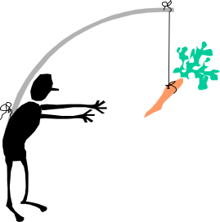
Architectural Analysis Summary
Inputs
  Requirements Model (inputs and output of previous phase)
Outputs
  Software Requirements Specification
    Outlined Analysis Package
    Outlined Analysis Classes
    Architectural Description (View of Analysis Model)
  Software Development Plan
    Workers and work assignments
    Resource size and cost analyses
    Schedule and milestones
    Risk analysis
Purpose
Process

