Slide 1
Analysis Model for the
Coffee Maker II Simulation
(CM2S)
COP 4232: Software Systems Development
© Dr. David A. Workman
School of Computer Science
University of Central Florida
June 23, 2004

Slide 2
Use Case Diagram: CM2
Coffee Maker II
Toggle
Power
Switch
[Dis]Connect/
Power
Toggle
Hot Plate
Switch
Set
Brew Time
Power
Source
Toggle
Brew Mode
« initiates »
Set
Wall Time
Coffee
User
Brew
Coffee
Fill Coffee
Basket
Coffee
User
Remove/
Replace
Basket
Fill Water
Reservoir
New Use Cases
Insert/
Remove
Carafe
Legacy Use Cases

Slide 3
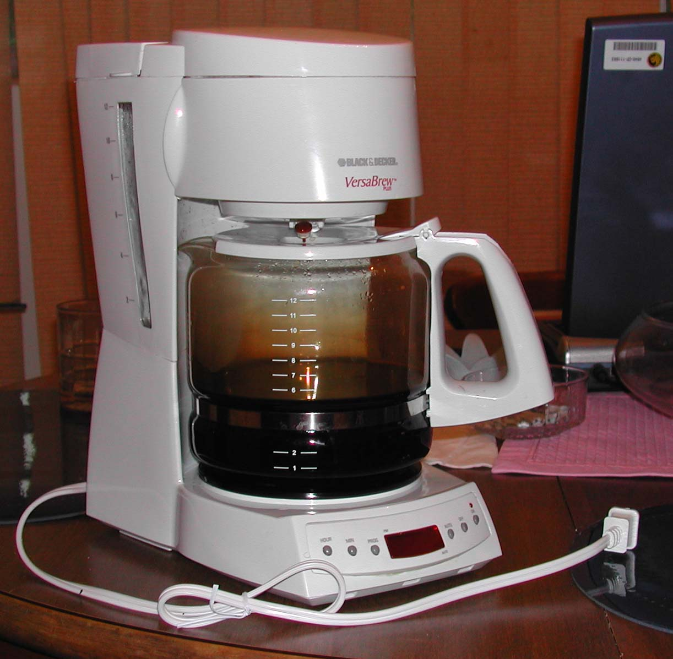
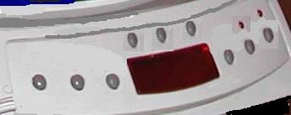
Physical Interface: CM2
Water
Reservoir
Lid
Removable
Coffee Basket
Overflow Valve
Brew
Time
Manual
Brew
HotPlate
Status
Power
Status
Removable
Carafe
Brew
Mode
Button
Power
Button
Water Level
Indicator
Power
Cord
Min
HotPlate
Button
Hour
AM/PM
LED
Display Panel

Slide 4
Use Case Diagram: Simulator (CM2S)
Simulation System
Specify
Input
Simulation
Input
File
Construct
World
Specify
Output
Simulation
User
Initialize
Simulation
Simulation
Log
File
Output
World
Objects
Simulate
World
Report
Simulation
Data

Slide 5
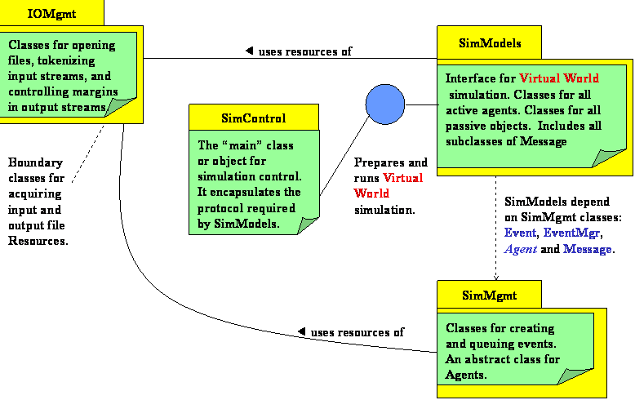
Simulation Architecture

Slide 6
Simulation Architecture: CM2SS
See Notes
Interface and Control Layer
CM2
EventMgr
*
Event
*
All Active
Objects
*
Agent
2
This layer consists of all active object classes. Active objects must be
instances of some subclass of abstract class Agent. The simulation progresses as a result of Events created and
serviced by Agents. An Event has four components: a Sender agent, a Recvr agent, an instance of some Message
subclass, and an event time. When one Agent wishes to interact with another, it must do so by creating an Event
that defines a “future” time at which the interaction will occur. The message component defines an action to the
Recevr agent and possibly data necessary to complete the action.
Agent Layer
(Active Objects)
This layer contains all the derived subclasses of Message.
These classes are used to pass data for servicing interaction events
between Agents. Only recipient Agent classes know the content and use of instances of these classes. Methods of Agents receiving messages optionally take parameters which are instances of one (or more) of the Passive classes and return an instance of class Message or one of its sub-classes. Instances of the root class Message carry no data and denote
signals that require some action on the part of the receiver Agent.
Message
*
1
Other
Subclasses
Players
Message Layer
*
All Passive
Classes/Objects
*
Passive Class Layer
The Passive layer contains all classes that model problem data and inanimate objects of the simulated world. Agents make direct calls on passive objects, but must account for the simulation time consumed when doing so. Passive objects make direct calls to each other, if necessary. Passive objects may be passed from one Agent to another as part of a instance of some Message subclass.
SimModels Classes
SimMgmt Classes
Notes:
Interface and Control Layer
Class CM2S defines and represents the “Simulated or Virtual World”. An instance of this class is the object to be simulated. One of its methods, Simulate(), controls the simulation by remove Events from the EventMgr and dispatching the contained Message instance to the designated receiver Agent. The receiving Agent acts on the Message it receives which may spawn new Events that are posted to the EventMgr. This scenario repeats until all Events have been dispatched and the Event queue (encapsulated by EventMgr) becomes empty.
Message Classes
Messages contain two important data members, a message handler id or code, and, optionally, a Passive data object that is needed by the message handler to execute the requested action. Message instances are created by the receiver Agent class – for each potential incoming message, the receiver Agent class assigns an integer code that identifies the private message handler that will be called to service or act on the message when it is received during simulation. Message handlers are called by the Dispatch method of the receiver Agent class – the Dispatch method uses the handler code to identify an internal private method that will act on the message data (if any).

Slide 7
Simulator States and Transitions
[2]
Start
[1]
World
Instance
Built
[3]
Simulation
Initialized
[2]
[4]
[5]
Simulation
Running
[6]
Simulation
Complete
[7]
Stop
[2]
Transition Use Cases:
[1] Identify input and output files and construct CM2S instance.
[2] Output constructed image of CM2S instance on SimLog.
[3] Initialize each Agent and prime the event queue.
[4] Run Simulation
[5] Output simulation events (Agent interactions) to SimLog.
Update simulation analysis data when simulated objects
change state.
[6] Simulation ends when event queue empties.
[7] Produce simulation analysis and summary reports.

Slide 8
Analysis Model: Class Diagram (#1)
See Notes
Power
Plug
LED
Wall Time
Brew Time
AM/PM
Button
Power
Button
Power Ctl
Time Ctl
Minute
Button
Coffee User
Power
Light
Coffee User
Hour
Button
Hot Plate
Light
Hot-Plate
Brew Ctl
Brew Time
Button
Hot Plate
Button
Carafe
Basket
Reservoir
Brew Mode
Button
Coffee User
Manual Brew
Button
Notes:
Boundary Classes/Objects
All buttons and switches the Coffee User uses for input.
All console lights and displays the Coffee Maker II uses for output.
The Power Plug connects the CM2S to the Power Source (special input interface).
The Water Reservoir is also a special input interface object.
The Carafe and Basket could be modeled as boundary objects, but because of their unique interaction requirements with the Coffee User and the rest of the CM2S,
we have chosen to model them as Control (active) objects; Basket behaves like a bounded buffer shared between Brew Ctl and Carafe – Brew Ctl deposits a hot water packet
while Carafe removes a hot coffee packet; Carafe’s capability to remove coffee packets depends on whether or not it is connected to Basket and this is controlled by Coffee User;
furthermore, Carafe also makes contact with Hot Plate. So, Carafe becomes an extension of Coffee User during the brewing process – it can be removed and replaced at any
time by an action of the Coffee User – thus it is best modeled as an active object so that it can interact dynamically with Hot Plate and Basket. Once we have made the decision
to make Carafe an active object, then Basket must be active by applying the principle: any object shared concurrently by two or more active objects, must itself be made active.
The Hot Plate is a boundary object, not unlike Basket. In fact, applying the same reasoning that argues for making an active object also makes a case for Hot Plate being a
control (active) object.
Entity Classes/Objects
Wall Time and Brew Time are time memory devices that hold the current value of wall time and brew time respectively.
Control Classes/Objects
The availability of electric power to the CM2S components is controlled via the Power Ctl object. This object allows us to hide design decisions about what
components are controlled exclusively by the Power Plug and which ones are also affected by the Power Button.
Hot Plate Ctl encapsulates the rules for ON/OFF status of the Hot Plate (boundary object). Of course, it must have an internal interface with Power Ctl and
Brew Ctl and an external interface with Carafe.
Time Ctl controls and manages changes to Wall Time and Brew Time and the periodic updates and display of these time devices on the LED.
Whenever Brew Time equals Wall Time, a signal is sent to Brew Ctl. Every clock tick, the value of Wall Time is updated.
Brew Ctl controls the brewing cycle. It encapsulates the conditions that trigger the start of the brew cycle and sends an “ON” signal to the Hot Plate Ctl.
It displays the Brew Mode on the LED. It removes water from the Reservoir, heats it, and then deposits the heated water in the Basket.
Basket and Carafe are Control objects because they are shared (and can therefore be accessed concurrently) by Brew Ctl and Coffee User. Carafe and Basket
communicate via the outlet port and pressure valve at the bottom of the Basket. The Carafe also draws heat from the Hot Plate when it is ON.
Hot Plate models both the internal control interface with Brew CTL and Power Ctl as well as the external interface with Carafe.

Slide 9
Modeling Principles
Scenario: Two or more Active objects communicate indirectly through a Passive object, where information flow is one-way.
Active
Passive
Active
Design Principle: Model the relationship as a direct interaction between the Active objects, where
a derived Message subclass is introduced to carry an instance of the Passive class,
or the equivalent information.
Active
Active
PassiveMsg
Message

Slide 10
Modeling Principles
Scenario: Two or more Active objects communicate indirectly through a Passive object, where information flow is two-way, but access by Active objects is mutually exclusive in time.
Active
Passive
Active
Design Principle: Model the new relationship so that all interaction with the Passive object is
initiated by the Active objects, regardless of the direction of information flow in the original
relationship. The designer is burdened with proving or guaranteeing that no two Active
objects sharing the Passive object will attempt access at the same time.
Active
Passive
Active

Slide 11
Modeling Principles
Scenario: Two or more Active objects communicate indirectly through a Passive object, where information flow is two-way, but access by the Active objects may not be mutually exclusive in time.
Active
Passive
Active
Design Principle: For this scenario, the Passive object must be modeled and implemented as an Active
object to guarantee that its state will not be corrupted by concurrent access by two or more
Active objects that attempt to change its state.
Active
Active
(Shared)
Active

Slide 12
Analysis Model: Class Diagram (#2)
See Notes
LED
Wall Time
Brew Time
Power Ctl
Time Ctl
Power
Light
Coffee User
Hot-Plate
Brew Ctl
Hot Plate
Light
Carafe
Basket
Reservoir
Notes:
Since all input boundary objects are under control of the Coffee User, the design can be greatly simplified by removing them as simulated objects
and modeling their effect by messages sent from the Coffee User to one or more of the other control objects in the system. Thus, interactions between the Coffee User and some input boundary object now become direct interactions between the Coffee User and an internal control object.

Slide 13
Use Case: Set Brew Time
1: display Wall Time & Indicator
2b: display Brew Time & Indicator
3b: updated Brew Time
4b: display Wall Time
& Indicator
Use Case
Model
LED Panel
2a: press
4a: press
Auto Brew Button
3a: press
Coffee User
HR|MN|am/pm Buttons
1: display Wall Time & Indicator
3d: display Brew Time & Indicator
6c: display updated Brew Time
8d: display Wall Time & Indicator
8c: set Time
Analysis
Model
Wall Time
LED Panel
8b: Display
3a: set Brew Time Indicator
8a: set Wall Time Indicator
3c, 6b: set Time
2,7: Press Auto Brew Button
3b, 6a: Display
Coffee User
4a: Press HR button
4b: Press MN button
4c: Press AM/PM button
Time Ctl
5a: Increment HR
5b: Increment MN
5c: Toggle AM/PM
Brew Time

Slide 14
Use Case: Connect Power Source
Use Case
Model
1: insert power plug
2b: set Wall Time indicator
2d: display ON
3b: display OFF
4b: display ON
Coffee User
Power
Source
3a: flash OFF
2c: initialize
2c: set time
Time Ctl
5c: set time
[PSW = ON]
2a: power ON
Wall Time
LED Panel
5b: increment Min
4a: flash ON
5a: one minute
Coffee User
1: connect plug to
power source
Power Ctl
2b: initialize
[PSW = ON]
2a: power ON
2b: set Brew Mode (Manual)
[PSW = ON]
2a: power ON
Brew Time
Hot Plate
Brew Ctl
Analysis
Model

Slide 15
Use Case: Brew Coffee
“press
Manual Brew
botton”
Wall Time
One Minute
Brew Time
Water Heated
Get time
Get time
Coffee User
Time Ctl
[1] Start Brew
cycle
Brew Ctl
Not Empty?
Remove Water
packet
Turn OFF
Brew End
Reservoir
Turn ON
Turn OFF
Heat to (temp)
Brew
End
Hot Plate
Ctl
Turn ON
Accept
heated
water
Water
Packet
Get Temp?
Accept brewed coffee
All coffee delivered
Carafe
Basket
Analysis
Model
Remove/
Replace
Water
Packet
brewed
Update
coffee
state
Carafe removed
Carafe replaced

Slide 16
State Transition Models (Active Objects)
Behavior
Mode
Start
[C] Event/Action
[C] Event/Action
Stop
[C] an [optional] boolean precondition that must be true before the Event
can trigger a transition; no precondition implies the transition will occur
unconditionally whenever the Event occurs in the system.
Event: a signal or message received that triggers a change in state.
Action: computation performed and/or message(s) sent in response to an event.
Activity: a state of processing that will continue until the next event; an activity
could be a state of idleness.

Slide 17
States & Transitions
[Power-ON](HPB-ON | Brew-start )
Hot Plate
ON
Hot Plate
OFF
Start
Auto Brew pressed
(Power-OFF | HPB-OFF | Brew-end + 2hr)
Set/Display
Brew Time
Set/Display
Wall Time
Power-ON
[Power-ON & ¬Brew-end]((Brew-mode = manual & Manual Brew pressed )
OR ( Brew-mode = auto & Wall-time = Brew-time))
Auto Brew pressed
Brewing
Not
Brewing
Start
[Power-OFF | Brew-end]
Brew Timer
Power-ON/ Set to “6:00am”
Clock-tic/ Increment 1sec.
Wall Timer
Power-ON/ Set to “12:00am”
[Brew-time]( Hour pressed/increment 1hr) |
( Min pressed/increment 1min) |
( Am-pm pressed/ toggle AM/PM)
[Wall-time]( Hour pressed/increment 1hr) |
( Min pressed/increment 1min) |
( Am-pm pressed/ toggle AM/PM)

Slide 18
Simulation Architecture: CM2SS
See Notes
CM2
Interface and Control Layer
EventMgr
*
Event
Agent
2
Coffee User
Time Ctl
Power Ctl
Brew Ctl
Hot Plate
Agent Layer
(Active Objects)
Carafe
Basket
Message Layer
Message
This layer contains all the derived subclasses of Message.
These classes are used to pass data for servicing interaction events
between active agents. Only recipient agent classes know the
content or use instances of these classes. Methods of a recipient
agent designed to service interaction events for that agent will
optionally take parameters which are instances of one of these classes.
1
WaterMsg
Players
Passive Class Layer
Brew Time
Wall Time
Reservoir
LED
Pwr Lght
HP Lght
Water
This layer contains all the passive classes of the simulated world. Active agents may direct calls on passive objects. Passive objects make direct calls to each other, if necessary. Passive objects may be passed from one active agent to another as part of a Message.
Notes:
Interface and Control Layer
Class CM2S defines and represents the “Simulated or Virtual World”. An instance of this class is the object to be simulated. One of its methods, Simulate(), controls the simulation by remove Events from the EventMgr and dispatching the contained Message instance to the designated receiver Agent. The receiving Agent acts on the Message it receives which may spawn new Events that are posted to the EventMgr. This scenario repeats until all Events have been dispatched and the Event queue (encapsulated by EventMgr) becomes empty.
Message Classes
Messages contain two important data members, a message handler id or code, and, optionally, a Passive data object that is needed by the message handler to execute the requested action. Message instances are created by the receiver Agent class – for each potential incoming message, the receiver Agent class assigns an integer code that identifies the private message handler that will be called to service or act on the message when it is received during simulation. Message handlers are called by the Dispatch method of the receiver Agent class – the Dispatch method uses the handler code to identify an internal private method that will act on the message data (if any).

Slide 19
SimulationMgmt
Event
EventMgr
Agent
Message
simtime: int
sendr: Agent *
recvr: Agent *
msg: Message *
eventQ: List<Event>
Name: string
handler: int
descr: string
EventMgr()
PostEvent( Event )
NextEvent(): Event
MoreEvents(): Boolean
Clock() : Simtime
GetSendr(): Agent *
GetRecvr(): Agent *
Agent( Tokenizer )
Initialize( Message * )
Dispatch( Message * )
Operator<< ( ofstream&,
&Agent )
Operator>> ( ifstream&,
&Agent)
#Extract( ifstream& )
#Insert( ofstream& )
#Get( ifstream& )
#Put( ofstream& )
NameOf(): String
Message( int, string )
GetId(): int
Operator <<
Event( Time,
Sendr
Recvr,
Msg )
GetSndr(): Agent *
GetRecvr(): Agent *
GetTime(): int
GetMsg(): Message *
Operator <<
An concrete class.
All Messages denote
an interaction event
that must be serviced
by the recipient agent.
The agent dispatch
method uses the Id to
determine the method
of the agent that should
be called to service the
event.
This class is extended by
the agent to define the
data needed by the
Method called to service
the event.
The encapsulated
event queue. The
queue orders posted
events by their Time.
The Clock() always
returns the current
simulation time.
The object by which
active objects interact.
An abstract class.
All active agents of
the simulated world
must be derived
subclasses of this
class.
The Dispatch() method
interprets the Message
of the receiver agent.

Slide 20
Simulated World Interface
World(): The Constructor – it invokes the constructors of all “parts” of the simulated world that must exist when simulation starts. Each constructor parses its image from an input file.
Initialize(): This method “connects” the active agents that may need to interact during simulation. Each Agent is given an opportunity to “prime” the EventMgr to start the simulation.
Simulate(): This manages the simulation loop and outputs events to the simulation log. It may also serve to update the simulation display.
Put(): This method outputs to the simulation log the instantaneous state of the simulated world object – it calls Put for each “part”, etc.
WrapUp(): This is the postmortem analysis method. It controls any clean up and display of simulation results.
World
World()
Initialize()
Simulate()
Put()
WrapUp()
The object that represents
the simulated world. It
is the only interface with
the application main()

Slide 21
Sample Simulation Input
CMS2{
CoffeeUser{
Script{ Plug-In-Power-Cord, Set-WallTime(8:15pm), Set-BrewMode(Auto),
Set-BrewTime(5:30am), Open-Basket, Delay(27), Insert-Coffee,
Delay(7), Close-Basket, Remove-Carafe, Delay(78), Add-Water(6cups),
Replace-Carafe, Delay(500sec), Press(ManualBrew), …
}Script
}CoffeeUser
TimeCtl{ WallDefault: 12:00am BrewDefault: 6:00am FlashDelay: 20Ms }TimeCtl
BrewCtl{ PacketSize: 50ml BrewTemp: 156F }BrewCtl
Carafe{ HeatTransCoef: 0.08Kcal/Sec HeatUpdateFreq: 1sec }Carafe
Basket{ DripRate: 0.15cup/sec CoolRate: 5F/hr }Basket
Water{ Temperature: 45F }
…
}CMS2

