Slide 1
Software Metrics
Software Quality
Process Improvement
COP 4232
Software Systems Development
© Dr. David A. Workman
School of CS
University of Central Florida
July 21, 2004

Slide 2
References
Software Engineering Fundamentals
  by Behforhooz & Hudson, Oxford Press, 1996
  Chapter 18: Software Quality and Quality Assurrance
Software Engineering: A Practioner's Approach
  by Roger Pressman, McGraw-Hill, 1997
IEEE Standard on Software Quality Metrics Validation Methdology (1061)
Object-Oriented Metrics
  by Brian Henderson-Sellers, Prentice-Hall, 1996

Slide 3
Metrics Introduction
Definitions
  "When you can measure what you are speaking about and express it in numbers, you know something about it; but when you cannot measure, when you cannot express it in numbers, your knowledge is of a meager and unsatisfactory kind: it may be the beginning of knowledge, but you have scarcely, in your thoughts, advanced to the stage of science."
  Lord Kelvin
  Software Metrics: an assortment of measurements applied to computer software.
  Measure (noun): a quantitative indication of the extent, amount, dimensions, capacity, or size of some attribute of a product or process.
  Measurement (verb): a process of collecting measures.
  Metric: a quantitative measure of the degree to which a system, component, or process possesses a given attribute. (IEEE)
  Indicator: a metric or collection of metrics combined in some way as to predict a given attribute of the measured object.

Slide 4
Metrics Introduction
Definitions
  Process Indicators give insight into the dynamics of a given software process enabling project management to evaluate the efficacy of that process.
  Project Indicators provide software project management:
    an assessment of the well-being of the project
    a means for tracking potential risk
    a means for identifying problem areas before they "go critical"
    a feedback mechanism for adjusting work flow and load
    a means for evaluating a team's ability to manage and maintain quality in work products
  Software Errors: flaws uncovered before delivery to end-users
  Software Defects: flaws uncovered after delivery by end-users

Slide 5
Metrics Classification
Process/Project
  People
  effort expended (force)
  schedule expended (distance)
  budget expended (efficiency)
  productivity rates ( pages/hour, delivered documents, sloc/day )
  error rates and counts
  defect rates and counts
Product Metrics
  Size (Function Pts, SLOC, Modules, Subsystems, Pages, Documents )
  Error density ( errors/ KSLOC )
  Defect density ( defects/ KSLOC or defects/ FP )
  Quality (Correctness, Maintainability, Reliability, Efficiency, Integrity, Usability, Flexibility, Testability, Portability, Reusability, Availability, Complexity, Understandability, Modifiability )
Power Concepts

Slide 6
Process Metrics & Process Improvement
Determinants for
software quality
and organizational
effectiveness
Paulish & Carleton '94
Product
(complexity)
Process
Customer
Characteristics
Business
Conditions
People
(skill and
motivation)
Technology
(methods & tools)
Development
Environment
The efficacy of a software process is measured indirectly by the outcomes of activities defined by the process.
For example:
#errors uncovered before release
defects delivered to and reported by end-users
effort expended
work products delivered
calendar time expended
schedule conformance

Slide 7
Statistical Software Process Improvement
Use failure analysis to collect information about all errors and defects.
  1. All errors and defects are categorized by origin ( e.g., in specification, in logic, non-conformance to standards)
  2. Record the cost to correct each error and defect.
  3: Construct a frequency diagram
  4: Construct a "fishbone" diagram to diagnose cause of error and defects
  5: Develop a plan to adjust the process with the purpose of reducing or eliminating the most costly class of errors or defects.
Percent
100
90
80
70
60
50
40
30
20
10
Missing
Ambiguous
Specification
Defects
Customer gave
wrong info
Used outdated
info.
Stds DH Specs UI HI SI Logic
Incorrect
Changes
Defect Origin

Slide 8
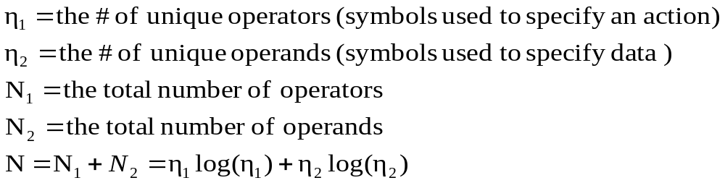
Size Metrics
Controversial !
Size Metrics
  SLOC (non-comment line, non-blank line )
  Token counts
    Halstead's metrics
    SLOC = N/C, where C is a constant that depends on the Prog. Language
  Function Points
    Research suggests that the "unadjusted" function points may actually be a better indicator of effort that the original adjusted metric.
  Feature Points

Slide 9
Complexity Metrics
Complexity
Computational
Psychological
Representational
External
Attributes
Functional
Programmer
Characteristics
Structural
Complexity
influences
Style
Module
Intermodule
(design)
Size
Internal
Attributes
Data
Structure
Coupling
Procedural
Complexity
Semantic
complexity
Logic Flow
influences
Internal
Cohesion
Semantic
Cohesion

Slide 10
McCabe's* Cyclomatic Complexity
For a flow graph G:
V(G)* = E - N + p + 1
E = # edges in the flow graph
N = # nodes in the flow graph
p = number of independent
program components.
A component can be represented by a 1-entry/1-exit DAG (directed acyclic graph).
McCabe proved that his metric gives the number of linearly independent flow paths through
the DAG. The number of LI paths relate strongly to the testing complexity of the component.
Branch nodes = 1,3 (fan out > 1)
Join nodes = 6, 7 (fan in > 1)
Sequential nodes = 0, 2, 4, 5
In this example:
E = 9
N = 8
p = 1
and
V(G)* = 3
0
It can also be shown that if G
is a planar graph, then V(G)*
is the number of bounded regions
or faces of the graph.
1
3
2
4
5
6
7
*NOTE: This formula is actually a variant of McCabe’s metric proposed by Brian Henderson-Sellers.
McCabe’s metric for p isolated components is given by: V(G) = E – N + 2p. Henderson-Sellers showed that
his variant gives a consistent value when the isolated components are treated as procedures connected to
their call sites.

Slide 11
McCabe's* Cyclomatic Complexity
Main()
A()
B()
0
A1
B1
B3
1
A2
A3
A4
B2
B4
B5
2
3
Call A
V(A)* = 4 – 4 + 2 = 2
B6
4
B7
5
Call B
V(main+A+B)* = 19 – 18 + 4 = 5
Note: p =2 (Independent Modules A, B)
V(B)* = 8 – 7 + 2 = 3
6
V(main)* = 7 – 7 + 2 = 2

Slide 12
McCabe's* Cyclomatic Complexity
Main()
A()
B()
0
A1
B1
B3
1
A2
A3
3
B2
B4
B5
Call A
A4
2
3’
B6
4
B7
5
Call B
Linearly Independent Paths are:
(0,1,2,4,5,B1,B2,B7,5’,6)
(0,1,2,4,5,B1,B3,B4,B6,B7,5’,6)
(0,1,2,4,5,B1,B3,B5,B6,B7,5’,6)
(0,1,3,A1,A2,A4,3’,4,5,B1,B3,B4,B6,B7,5’,6)
(0,1,3,A1,A3,A4,3’,4,5,B1,B3,B5,B6,B7,5’,6)
5’
Call nodes are “split” to
match the single entry and
exit nodes of the called
component. 1 node and 2
edges are added for each
called component.
6
V(main+A+B)* = 23 – 20 + 2 = 5

Slide 13
Example Method (C++)
void Server::Work()
{
ifstream input; // input file stream
ofstream output; // output file stream
Tray tray;
cout << "McDonald's Implementation in C++" << endl;
cout << "by Amit Hathiramani and Neil Lott" << endl;
cout << endl;
while(1) {
string szInputFileName;
cout << "Please enter the name of the input file: ";
cin >> szInputFileName;
input.open(szInputFileName.c_str());
if(!input) cerr << endl << "No file named " << szInputFileName << " found." << endl;
else break;
}
} //Server::Work
1
2
3
5
4
6
Insert
Segment
A
16

Slide 14
Example Method (C++)
Segment A
FoodItems *pFood;
while(!input.eof()) {
char szMarker[4];
input >> szMarker;
strupper(szMarker);
if(strcmp(szMarker, "$D") == 0) pFood = new Drinks; // drink
else
if(strcmp(szMarker, "$S") == 0) pFood = new Sandwiches; // sandwich
else
if(strcmp(szMarker, "") == 0) continue; // blank line; skip it
else throw InputException("Unknown type found " + string(szMarker));
pFood->Get(input);
tray.Add_Item(pFood);
} //while
6
7
8
9
10
11
12
13
14
15

Slide 15
Example Method (C++)
1
17
System
exit
V(G)* = 19 – 16 + 2 = 5
Or
V(G)* = 21 – 17 + 2 = 6
2
14
Exception
exit
3
5
13
Normal
exit
4
16
11
12
6
7
8
9
10
15

Slide 16
Object-Oriented Metrics
References
  Object-Oriented Metrics
    by Brian Henderson-Sellers, Prentice-Hall, 1996
  "A Metrics Suite for Object-Oriented Design"
    by Chidamber & Kemerer, IEEE TSE, June 1994

Slide 17
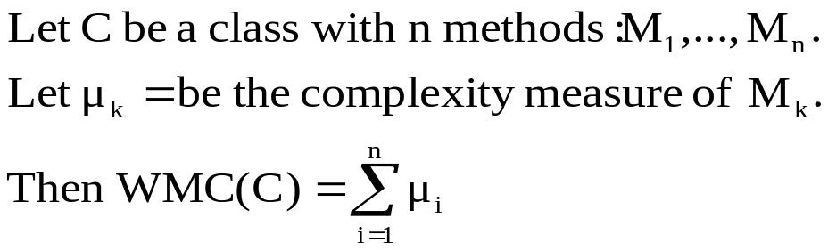
Object-Oriented Metrics
Chidamber & Kemerer Metrics
  Weighted Methods per Class (WMC)
  Depth of Inheritance Tree (DIT)
    Let T be an inheritance DAG, then DIT(T) is the length of the longest path from any root to any leaf of T.
  Number of Children (NOC)
    Let C be a class, then NOC(C) is the number of immediate subclasses of C.
  Coupling Between Object Classes (CBO)
    Let C be a class, then CBO(C) is the number of other classes to which it is coupled. Note: the authors do not define what they mean by coupling between classes. This is probably intentional, as there are several ways this concept has been defined by other authors - you use your own definition.

Slide 18
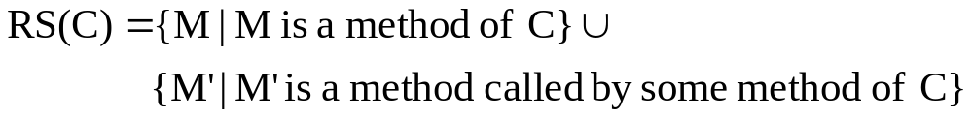
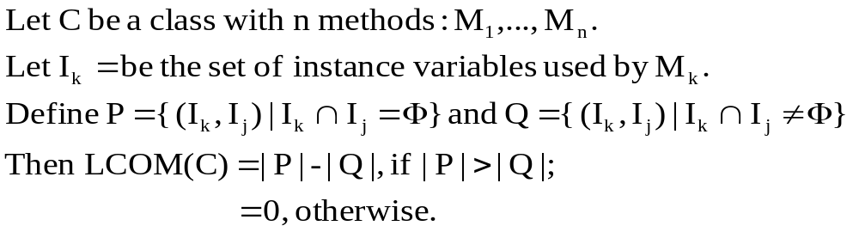
Object-Oriented Metrics
Chidamber & Kemerer Metrics
  Response for a Class (RFC)
    The response set for a class, C, is
    RFC(C) = |RS(C)|
  Lack of Cohesion in Methods (LCOM)

Slide 19
Research Questions
Class Coupling
  CBO did not give an explicit definition of Class Coupling. Several other authors have defined and studied this concept. While it appears to be a significant concept in evaluating OO design, more research on this topic is clearly indicated.
  Class coupling ought to be a function of the "volume of data" exchanged by instances of one class interacting with instances of another class. Data volume is determined by the number and types of parameters transmitted via method calls. It is suggested by some authors that data volume should be low in good designs - is this true?
Dynamic Metrics
  Most of the CK metrics measure static properties of classes. RFC is one addresses coupling and dynamic interaction between objects. Could RFC be extended to indicate the complexity of dynamic interactions?
Function Points for OO Designs
OO Metrics for Reuse and Reliability (Non-functional properties)

Slide 20
Software Quality Metrics Validation Methodology
Reference
  IEEE Standard 1061-1998 : Software Quality Metrics Validation Methodology
Definitions
  Attribute: a measurable physical or abstract property of an entity.
  Critical value (range): a metric value (range of values) of a validated metric that is used to identify software that has unacceptable quality
  Direct metric: a metric that does not depend upon a measure of any other attribute.
  Predictive metric: a metric applied during development and used to predict the values of a software quality factor.
  Metric validation: the act or process of ensuring that a metric reliably predicts or assesses a quality factor.
  Metrics framework: a decision aid used for organizing, selecting, communicating, and evaluating the required quality attributes for a software system. A hierarchical breakdown of quality factors, quality subfactors, and metrics for a software system.

Slide 21
Software Quality Metrics Framework
Software Quality
for
System X
E.g. Maintainability
Quality Factor
Quality Factor
Quality Factor
Repair cost/
Operational
week.
Direct Measure
Direct Measure
Direct Measure
Quality subfactor
Quality subfactor
Quality subfactor
Quality subfactor
Quality subfactor
E.g. Understandability
E.g. Modifiability
E.g. Testability
...
...
Metric
Metric
Metric
E.g. Comment Density
E.g. Modularity
E.g. Cyclomatic Complexity

Slide 22
Software Quality Metrics Process
Establish Software Quality Requirements
  Identify quality requirements that are applicable to the software system
Identify Software Quality Metrics
  Construct a Software Quality Metrics Framework
  Perform cost/benefit analysis
  Select metrics
Implement Software Quality Metrics
  Define data collection procedures and tools
  Prototype the measurement process
  Collect data and compute metrics
Analyze Software Metrics Results
Validate the Software Quality Metrics
  Apply validation methodology
  Apply validity criteria
  Document results

Slide 23
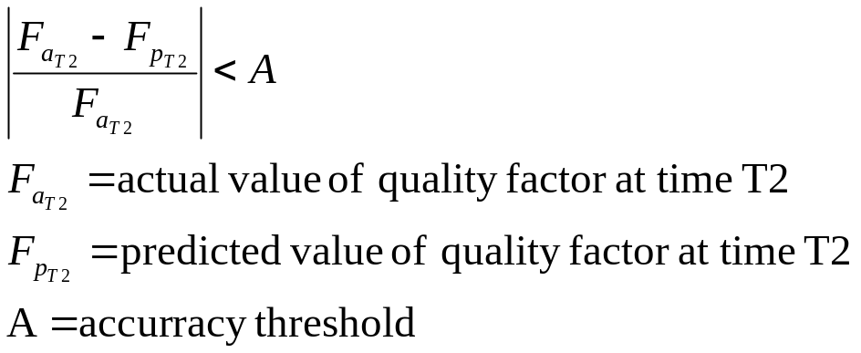
Validation Criteria
Correlation
  Compute the linear correlation coefficient (R²) between the metric and the corresponding quality factor (direct measure).
Tracking
  A change in the quality factor at different times should be accompanied by a corresponding change in the metric. The direction of change should be in the same for both.
Consistency
  If F₁ > F₂ > F₃, where F_{k} is the value of the quality factor for artifact k, then M₁ > M₂ > M₃, where M_{k} is the metric value applied to artifact k.
Predictability
  A metric measured at
  time T1 is used to
  predict the quality
  factor at T2.

Slide 24
Validation Criteria
Discriminative Power
  A critical value or range of the metric shall be able to distinguish between high-quality and low-quality software components based on where the metric value falls with respect to the critical value or range.
Reliability
  A metric shall demonstrate the correlation, tracking, consistency, predictability, and discriminative power for at least P% of the applications of the metric.

Slide 25
SEI
Capability Maturity Model
CEN 5016: Software Engineering
© Dr. David A. Workman
School of EE and CS
University of Central Florida
April 12, 2001

Slide 26
Introduction
Reference: The Capability Maturity Model: Guidelines for Improving the Software Process, by Carnegie Mellon University, SEI, Addison-Wesley, 1994, ISBN=0-201-54664-7
History
  Originally the vision of Watts Humphrey and produced by a team of SEI researchers including:
  Mark Paulk
  Bill Curtis
  Mary Beth Chrissis
  Ed Averill
  Judy Bamberger
  Tim Kasse
  Mike Konrad
  Jeff Perdue
  Charlie Weber
  Cindi Wise
  Jim Withey
  Version 1.0 was released in August 1991

Slide 27
Motivation
“Software Crisis”
“No Silver Bullet” (technology is only part of the solution)
Demand for more and more complex software systems have outstripped our ability to cope with changes required to meet these demands.
Organizations began to realize the fundamental problem is the inability to manage the software process!
Examples
  A review of 17 major DOD contracts found that the average 28-month schedule was missed by 20 months!
  Deployment of the B1 bomber was delayed by software problems and the $58 billion A12 aircraft program was canceled partly for the same reason.
  GAO concluded a study of more than 20 large software projects with this statement, “The understanding of software as a product and of software development as a process is not keeping pace with the growing complexity and software dependence of existing and emerging mission-critical systems.”

Slide 28
Evolution
Humphrey’s Book, “Managing the Software Process”
Addison-Wesley, 1989.
“Characterizing the Software Process: A Maturity Framework,” IEEE Software, March 1988.
  Method: Software Process Assessment
  An appraisal by a team of trained software professionals to determine the state of an organization’s current software process, to determine the most important process-related issues, and to obtain organizational support for improvement.
  Method: Software Capability Evaluation
  An appraisal by a team of trained software professionals to identify contractors qualified to perform the software work or to monitor the state of the software process used on an existing software effort.
  Maturity Questionaire
SEI Development and Release 1991-92
SEI Influenced the ISO 9000 Standard series, specifically 9001.

Slide 29
Fundamental Concepts
The CMM focuses on the capability of software organizations to produce high-quality products consistently and predictably. Software process capability is the inherent ability of a software process to produce planned results.
DEFINITION (Process) A sequence of steps performed for a given purpose. The process integrates people, tools, and procedures.
DEFINTION (Software Process) A set of activities, methods, practices, and transformations that people employ to develop and maintain software and the associated products (documents, etc.)
DEFINTION (Software Process Capability)decribes the range of expected results that can be achieved by following a software process.

Slide 30
Fundamental Concepts
The CMM focuses on the capability of software organizations to produce high-quality products consistently and predictably. Software process capability is the inherent ability of a software process to produce planned results.
DEFINITION (Software Process Performance) the actual results achieved by following a software process.
DEFINTION (Software Process Maturity) the extent to which a specific process is explicitly defined, managed, measured, controlled, and effective.
As a software organization matures, it needs an infrastructure and culture to support its methods, practices, and procedures so that they endure after those who originally defined them have gone.
DEFINTION (Institutionalization) is the building of infrastructure and culture to support methods, practices, and procedures so that they are the ongoing way of doing business.

Slide 31
Software Process Maturity Framework
Five Maturity Levels:
Initial: The software process is characterized by ad hoc, and occasionally even chaotic. Few processes are defined, and success depends on individual effort and heroics.
Repeatable: Basic project management processes are established to track cost, schedule, and functionality. The necessary process discipline is in place to repeat earlier successes on projects with similar applications.
Defined: The software process for both management and engineering activities is documented, standardized, and integrated into a standard software process for the organization. All projects use an approved, tailored version of the organization’s standard software process for developing and maintaining software.

Slide 32
Software Process Maturity Framework
Five Maturity Levels (continued):
Managed: Detailed measures of the software process and product quality are collected. Both the software process and products are quantitatively understood and controlled.
Optimizing: Continuous process improvement is enabled by quantitative feedback from the process and from piloting innovative ideas and technologies.

Slide 33
The CMM Structure
Maturity
Levels
Indicate
Contains
Process
Capability
Key
Process
Areas
Achieves
Organized by
Goals
Common
Features
Address
Contain
Implementation/
Institutionalization
Key
Practices
Describe
Activities or
Infrastructure

Slide 34
Key Process Areas
Definition
  Except for level 1, each maturity level is decomposed into several key process areas that indicate where an organization should focus to improve its software process. KPAs identify the issues that must be addressed to achieve a maturity level. If an organization is at level K+1 then it has addressed all of the KPAs at levels ≤ K.
  Each KPA identifies a cluster of activities that, when performed collectively, achieve a set of goals considered important for enhancing process capability.
  The KPAs may be considered to be the requirements for achieving a particular maturity level.

Slide 35
KPAs – Level 2
Focus: project concerns related to establishing basic project management controls.
  Requirements Management:
  Software Project Planning:
  Software Project Tracking and Oversight:
  Software Subcontract Management:
  Software Quality Assurance:
  Software Configuration Management:

Slide 36
KPAs – Level 3
Focus: project and organizational issues leading toward the infrastructure that institutionalizes effective software engineering across all projects.
  Organization Process focus: coordinate and integrate process across all projects.
  Organization Process definition: develop a reusable set of process assets (documents, training materials) defining the organization’s standard software process (includes a tool set)
  Training program: train personnel in the various process procedures and roles
  Integrated Software Management:
  Software Product engineering:
  Inter-group coordination:
  Peer Reviews:

Slide 37
KPAs – Level 4
Focus: establishing a quantitative understanding of both the software process and the software products being built (process and product metrics and measures).
  Quantitative Process Management: develop the quantitative measures necessary to control process performance of software projects.
  Software Quality Management: develop quantitative measures necessary to control the quality of software products.

Slide 38
KPAs – Level 5
Focus: addressing issues concerning organization and projects relating to continuous and measurable software process improvement.
  Defect Prevention: detect causes of defects and prevent them from recurring.
  Technology Change Management: identify beneficial new technologies (tools, methods, and processes) and transfer them into the organization in an orderly manner.
  Process Change Management: continually improve software processes in the organization with the intent of improving software quality, increasing productivity, and decreasing the cycle time for product development.

Slide 39
Common Features
Definition
  Attributes that indicate whether the implementation and institutionalization of a KPA is effective, repeatable, and lasting. There are 5:
  Commitment to perform:
    actions the organization must take to ensure that the process is established and will endure; establish organizational policies and leadership.
  Ability to perform:
    defines the preconditions that must exist in the project or organization to implement the software process competently; resources, organizational entities, and training.
  Activities to perform:
    activities, roles, and procedures necessary to implement KPAs; create plans and procedures, tracking progress, taking corrective action when not done.
  Measurement and analysis:
    determine process status.
  Verifying implementation:
    steps to ensure compliance with process.

