Slide 1
Software Engineering
Research
© Dr. David A. Workman
School of Computer Science
July 26, 2004

Slide 2
Program Analysis and Comparator
System (PACS)
© Dr. David A. Workman
School of EE and CS
University of Central Florida
September 2000

Slide 3
Problem Description
A common problem in Computer Science programs in many universities is program plagiarism . That is, the unauthorized copying or reuse of program code written by another person.
In an attempt to solve this problem, or at least minimize its likelihood of occurrence, computer science researchers have developed numerous tools for analyzing programs to detect telltale clues of “borrowed code” from another source. Two approaches have been used in the design of such tools:
  Feature Extraction and Distribution
    Example: Extract unique variables of a given type. Two programs, A and B, are suspicious if and only if the number of variables of each type are almost equal for every type represented.
  Structural Extraction and Encoding
    Example: Extract and encode the control structure of procedure and functions. If the number of procedures and functions in one program that have identical or similar control structure to those in the other program exceeds some predefined percentage of the total number of procedures and functions, then the programs are considered to be suspicious.

Slide 4
Problem Description
Obfuscation Transform
Source File
of
Program A
Source File
of
Program B
When a student “copies” another student’s program, there is normally
some attempt to disguise the plagiarism by making changes that obfuscate
the similarity between the original and the copy.
The purpose of a program analysis tool is to “invert” such transforms, or at
least detect whether or not they were applied.

Slide 5
PACS
The Program Analyzer and Comparator (PACS) system is intended to provide a capability for analyzing and comparing two (or more) programs written in the same source language to determine their degree of similarity as measured in some feature space.
A “program” shall be specified to PACS by its name, and shall be physically composed of a number of source files (also identified to PACS). The source files shall contain correct and compilable source code written in some source programming language recognized by PACS. The source language shall also be identified to PACS as part of program specification.
Source
Files
PACS
Source
Files
Source Program

Slide 6
PACS
A program shall be logically composed of instances of the following unit types: program, file, package, class, interface, function, procedure. Any source language supported by PACS shall define modular elements corresponding to these unit types.
The result of an analysis operation applied to a specified program shall be performed with respect to a particular unit type specified by the user. For each instance of the specified unit type, PACS shall output a corresponding Lexical Feature Distribution (LFD) File uniquely identified by program name, unit type, and unit instance name.
Source
Files
Source
Files
Source
Files
PACS
Feature
Distribution
Files
Source Program
For a specified
Unit Type
and Program

Slide 7
Unit Type Hierarchy
Program
Class
*
1..*
1..*
Package
1..*
Function
Procedure
mutually
exclusive
1..*
Interface
File
1
NOTE: This is most reflective of the Java Model.
However, C++ and Ada can be mapped into this
structure as well.
1..*
Function
Procedure

Slide 8
Feature Types
Lexical Features fall into one of the following categories or types:
  Comments
  Reserved Words
  Identifiers (Names)
    Unit names
    Variable | Parameter
    Types, subtypes, exceptions
    Constants
    Enumeration literals
  Literals
    String
    Real
    Integer
    Boolean
    Character
    Pointer
  Operators
  Delimiters

Slide 9
Lexical Feature Distributions
Feature Id
Unit Name
Feature Type: F1 | Frequency
Instance1 | f1
Instance2 | f2
Instancek | fk
…
Instance Counts
Feature Type: F2 | Frequency
Instance1 | f1
Instance2 | f2
Instancek | fk
…
Instance Ids

Slide 10
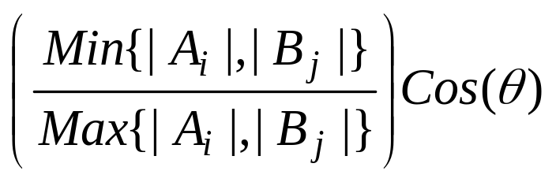
Program Similarity
Feature Similarity Matrix (FSM)
B1 B2 B3 ………… Bn
Units of B
A1
A2
A3
…
Am
See
Notes
For a given feature, the similarity between units Ai and Bj is given by
where Ai and Bj denote vectors in “feature space” defined by units Ai and Bj.
Units of A
Notes:
Ai and Bj are feature vectors. Let F be the union of the unique feature instances present in unit Ai and Bj. Ai and Bj represent vectors over feature set F, where each component is the frequency of occurrence of that particular feature instance in Ai and Bj respectively. The dot product of these vectors divided by the product of their lengths gives the cosine of the angle between these two vectors. This will always be a value between 0 and 1. The cosine is then multiplied by the ratio of the vector lengths, shortest to longest. This product will always be between 0 and 1.
Now, once the FSM has been computed, we can compute an overall similarity of Program A with respect to B, and the similarity of B with respect to A. This metric will be called the PSM (Program Similarity Metric) and is computed as follows:
Let σ be a similarity threshold in the interval [0,1]. For each A_{i}, define its similarity set S_{A}(i) = { j | B_{j} ∈B and FSM(i, j) ≥ σ }. Then, if n denotes the number of units in program A,
PSM(A,B) =
PSM(B,A) is computed in an analogous fashion.

Slide 11
Program Similarity
Feature Alias Relation (FAR)
B1 B2 B3 ………… Bn
Units of B
A1
A2
A3
…
Am
See
Notes
For a given feature, and a given pair of units Ai and Bj, we wish to know which instances of the feature in Ai are equivalent to feature instances of Bj. For example, “x in Ai” might be an alias for “y in Bj”. The entries in this matrix are sets of ordered pairs of instances (a, b) , one from Ai and one from Bj, such that
| freq(a) – freq(b) | ≤ t, where “t” is the alias threshold.
Units of A
Notes:
NOTE: A PACS user may wish to use the FAR matrix to determine aliases between different pairs of units from the two programs being compared. By selecting or establishing aliases for each unit-pair, the Feature Similarity Matrix can be recomputed. Since distinct instances have not been identified as being the same instance, the similarity of two units may increase dramatically.

Slide 12
PACS Use Case Model
See
Notes
Program Analysis and Comparator System
* *
Tokenize
Program
Install
Language
* *
(4)
Analyze
Program
(1)
Produce
LFD Files
(2)
Metrics
Engineer
Examine
LFD Files
(3)
Language
Analyst
Output
FAR
Identify
Programs
(12)
* *
Compute
FAR
Examine
FAR
(5)
* *
(7)
(11)
Compare
Programs
(13)
(8)
Examine
FSM
(6)
Compute
FSM
(9)
Plagiarism
Analyst
Plagiarism
Analyst
Specify
Comparison
Parameters
(10)
Output
FSM
Notes:
includes ( Produce LFD Files is not a use case, but it is a necessary step of Analyze Program )
uses ( Examine LFD files is not necessary to Analyze a program, even though it is a use case)
uses ( Produce LFD Files is a necessary step to Examine LFD Files the first time, but once generated it is unnecessary )
uses ( Tokenize Program is a necessary step of Produce LFD Files the first time, but once generated it is not necessary )
includes
includes
includes ( although Compute FAR is not necessary for comparison, it must be performed to support other use cases, thus I would attach
the responsibility for performing this function to the primary use case, Compare Programs )
includes ( Compute FSM is necessary for comparison )
uses (Compute FSM is necessary only the first time for Examine FSM; it is shared by other use cases )
uses (Compute FSM is necessary only the first time for Output FSM ; it is shared by other use cases )
uses ( Compute FAR is necessary only the first time for Examine FAR; it is shared by other use cases )
uses ( Compute FAR is necessary only the first time for Output FAR; it is shared by other use cases )
uses ( Compute FSM and Compute FAR can be performed indepently, but Compute FSM may incorporate the relations computed
by Compute FAR )

Slide 13
PACS Actor Descriptions
Metrics Engineer
  The Metrics Engineer is concerned with and responsible for performing the necessary use cases to generate LFD files from a given source program. The use cases in which the Metrics Engineer participates are the following:
    Analyze Program: this is the controlling use case. The ME interacts with this use case to identify a new source program for analysis. The expected output is a set of LFD files for a unit type specified by the ME.
    Examine LFD Files: once the LFD files have been generated, the ME may wish to examine them on-line.
Language Specialist
  The Language Specialist is responsible for designing, producing, testing, and installing analysis capability for a new source language. The installation process is the only one of these activities that is actually supported by PACS, the others are performed outside the boundary of the PACS system.
    Install Language: this use case is used to inform PACS of new source language support.

Slide 14
PACS Actor Descriptions
Plagiarism Analyst
  The Plagiarism Analyst is responsible for comparing two programs for possible suspicious evidence that the two programs, or components of the two programs, have common authorship. This involves the exercise of the following use cases.
    Compare Programs: this is the controlling use case. It provides a single point of entry for accessing and activating all other use cases.
    Identify Programs: this is the first step in the comparison process. It interacts with the PA to identify and locate the two programs to be compared.
    Specify Parameters: this use case interacts with the PA to obtain or change unit types, and the comparison feature set.
    Generate FAR: this use case interacts with the PA to define and generate Feature Alias Relations.
    Generate FSM: this use case interacts with the PA to define and generate Feature Similarity Matrices. This use case may incorporate FAR data.
    Examine and Output FAR: Examine FAR enables the PA to browse FAR data via a GUI. The Output FAR enables the PA to save FAR data to external files.
    Examine and Output FSM: Examine FSM enables the PA to browse FSM data via a GUI. The Output FSM enables the PA to save FSM data to external files.

Slide 15
User Interface Concept
Title Bar
-
X
File FSM FAR Menu Bar
Comments
Variables
Operators
Literals
FSM
B1 B2 B3 B4 B5
X
A1
A2
A3
A4
0.34 | 0.56 | 0.13 | 0.48 | 0.65
0.17 | 0.67 | 0.89 | 0.25 | 0.33
0.92 | 0.12 | 0.21 | 0.47 | 0.28
0.55 | 0.79 | 0.62 | 0.39 | 0.81
Variables

Slide 16
PACS Architecture
«subsystem»
Tokenizer
.TKN
Files
Source
Files
PACS.LCF
File
/B
Parser
.TKN
Files
A
.TKN
Files
B
.TKN
Files
B.PGM
File
Source
Files
/A
«subsystem»
Compare
A.PGM
File
«subsystem»
Analyze
PCS
A
.LFD
Files
B
.LFD
Files
.TKN
Files
.TKN
Files
PAS
FSM
Files
FAR
Files

Slide 17
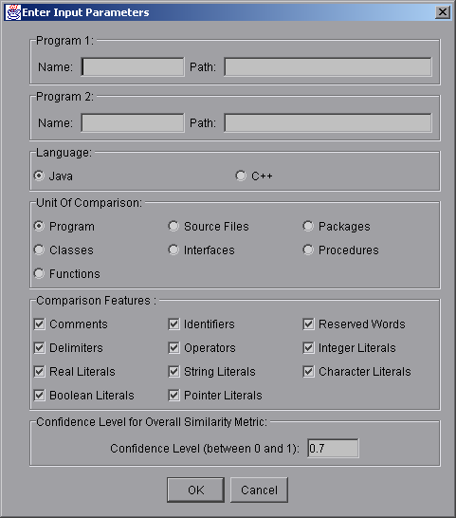
FSM Parameters Dialog

Slide 18
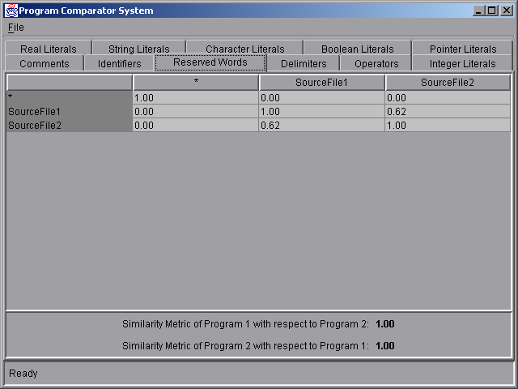
Feature Similarity Matrix

Slide 19
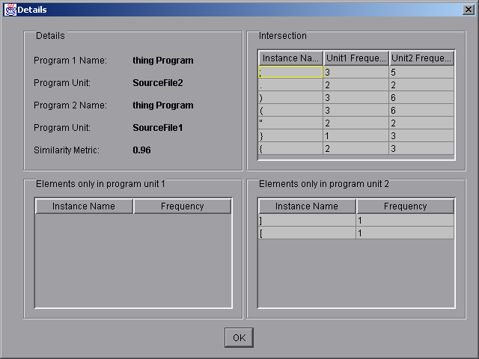
FSM Detail Display

Slide 20
Intro to FAMS
Finite Automata Manipulation System
© Dr. David A. Workman
School of CS
University of Central Florida
October 2000
Revised: January 2004

Slide 21

FAMS Architecture
NFA
Source
Files
FAMS
FAMS
User
FAMSDB

Slide 22
FAMS Class Diagram
Alphabet
-Nsym
-Symbols
File
1
input from ③
① indexed by
output to ③
TransTab
① manages
1
UI
NFA
Map
-NameIs
-DescrIs
-HistoryIs
-Status
-Nstates
-InitSet
-AccpSet
1
② updates
& accesses
1..Nstates
StateSet
saved in ③
2
1..Nstates*Nsym
retrieved from ③
FAMSDB
History
1

Slide 23
FAMS Project Areas
FAMS-0: Basic GUI
  This provides the top level user interface with all menus, panels, layout features and other look and feel properties.
FAMS-1: Load/Save from/to Ascii Files.
  This implements the Load and Save functions from the File menu. It displays error messages as NFA specifications are loaded from file and creates instances of all valid specifications as internal NFA objects. Finally, it presents a scrollable master list of all NFA objects “known to FAMS.” It also provides capability for selecting one or more list items for subsequent File, View, or Operation functions.
FAMS-2: Import/Export from/to FAMSDB
  This capability provides for the import and export of FAs “known to FAMS”. All imported FAs are added to the master list. Selected FAs on the master list are exported to the FAMSDB, replacing existing entries.
FAMS-3: Implement View Functions
FAMS-4: Implement Operation Functions
FAMS-5: Implement FAMS Foundation Classes
  5a: Alphabet, TransTab, Map
  5b: History, StateSet

Slide 24
FAMS Basic GUI
Finite Automata Manipulation System
File
View
Operations
Help
Load
Save
Import
Export
Print
Exit
Properties
T-Table
Diagram
History
State Map
Dfa
Min
Complement
Reverse
Union
Intersect
Difference
Concat
Kleene*
Cross Product
Simulation

Slide 25
FAMS – 1
Finite Automata Manipulation System
File
View
Operations
Help
Parsing: /home/work/cot4210.NFA
FAMS Work Area
Load
Save
Import
Export
Print
Exit
### NFA Description
!name: M1
!history: Min(Dfa(M13))
!alphabet: “abc”
!states: 5
!start: {3, 2}
!accept: {1,4}
1:’a’=>{2,3};=>{1,5};
2:’c’=>{1,6};
*********$ error

Slide 26
FAMS - 1
Finite Automata Manipulation System
File
View
Operations
Help
Parsing: /home/work/cot4210.nfa
FAMS Work Area
Load
Save
Import
Export
Print
Exit
### NFA Description
!name: M1
!history: Min(Dfa(M13))
!alphabet: “abc”
!states: 5
!start: {3, 2}
!accept: {1,4}
1:’a’=>{2,3};=>{1,5};
2:’c’=>{1,6};
$$$
Error File?
cot4210-errors.txt
OK
Parsing Complete
OK

Slide 27
FAMS - 1
Finite Automata Manipulation System
File
View
Operations
Help
FA Known to FAMS
FAMS Work Area
NAME DESCRIPTION
M1 Exam 1 Problem 1
M2 Exam 3 Problem 5(a)
M13 M3 minus M17
M14 M1 union M3
M15 Minimal form of M3
Load
Save
Import
Export
Print
Exit
Selected NFA
Selected NFAs

Slide 28
FAMS - 3
Finite Automata Manipulation System
File
View
Operations
Help
FA Known to FAMS
FAMS Work Area
Properties
T-Table
Diagram
History
State Map
NAME DESCRIPTION
M13
M1 Exam 1 Problem 1
M2 Exam 3 Problem 5(a)
M13 M3 minus M17
M14 M1 union M3
M15 Minimal form of M3
a
2
1
b
b
a
3
6
5
a
4
Selected NFAs
Selected NFAs
M15
1
a
2
b
b
a
3
6
5
a
4
Clear

Slide 29
FAMS - 3
Finite Automata Manipulation System
File
View
Operations
Help
FA Known to FAMS
FAMS Work Area
Properties
T-Table
Diagram
History
State Map
NAME DESCRIPTION
Name: M15
Description: Minimal form of M3
Type: DFA
Alphabet: “abc”
Number States: 7
Start States: {1}
Accept States: {3, 5}
M1 Exam 1 Problem 1
M2 Exam 3 Problem 5(a)
M13 M3 minus M17
M14 M1 union M3
M15 Minimal form of M3
Selected NFA
Clear

Slide 30
FAMS - 3
Finite Automata Manipulation System
File
View
Operations
Help
FA Known to FAMS
FAMS Work Area
Properties
T-Table
Diagram
History
State Map
NAME DESCRIPTION
Name: M1
Description: Minimal form of M3
Type: DFA
Alphabet: “abc”
Number States: 7
Start States: {1}
Accept States: {3, 5}
M1 Exam 1 Problem 1
M2 Exam 3 Problem 5(a)
M13 M3 minus M17
M14 M1 union M3
M15 Minimal form of M3
Selected NFA
M1 a b c
1
2
3
4
5
6
7
Clear

Slide 31
FAMS - 4
Finite Automata Manipulation System
File
View
Operations
Help
Dfa
Min
Comp
Reverse
Union
Intersect
Diff
Concat
Kleene*
Cross
Simulation
FA Known to FAMS
FAMS Work Area
NAME DESCRIPTION
M1 Exam 1 Problem 1
M2 Exam 3 Problem 5(a)
M13 M3 minus M17
M14 M1 union M3
M15 Minimal form of M3
M13^M15
a
b
c
! 1=(1’,1”)
2=(1’,2”)
3=(1’,3”)
4=(2’, 1”)
5=(…)
6 =(…)
7 =(…)
8 =(…)
Selected NFA
Selected NFAs
9 =(…)
Clear

Slide 32
FAMS - 4
Finite Automata Manipulation System
File
View
Operations
Help
Dfa
Min
Comp
Reverse
Union
Intersect
Diff
Concat
Kleene*
Cross
Simulation
FA Known to FAMS
FAMS Work Area
NAME DESCRIPTION
M1 Exam 1 Problem 1
M2 Exam 3 Problem 5(a)
M13 M3 minus M17
M14 M1 union M3
M15 Minimal form of M3
M13^M15
a
b
c
! 1=(1’,1”)
2=(1’,2”)
3=(1’,3”)
4=(2’, 1”)
5=(…)
6 =(…)
7 =(…)
Name of NFA
Description
8 =(…)
9 =(…)
M16
Intersect (M13, M15)
OK
Clear

Slide 33
FAMS - 4
Finite Automata Manipulation System
File
View
Operations
Help
Dfa
Min
Comp
Reverse
Union
Intersect
Diff
Concat
Kleene*
Cross
Simulation
FA Known to FAMS
FAMS Work Area
NAME DESCRIPTION
M1 Exam 1 Problem 1
M2 Exam 3 Problem 5(a)
M13 M3 minus M17
M14 M1 union M3
M15 Minimal form of M3
M16 Intersect (M13,M15)
M13^M15
a
b
c
!1=(1’,1”)
2=(1’,2”)
3=(1’,3”)
4=(2’, 1”)
5=(…)
6 =(…)
7 =(…)
8 =(…)
9 =(…)
Clear

Slide 34
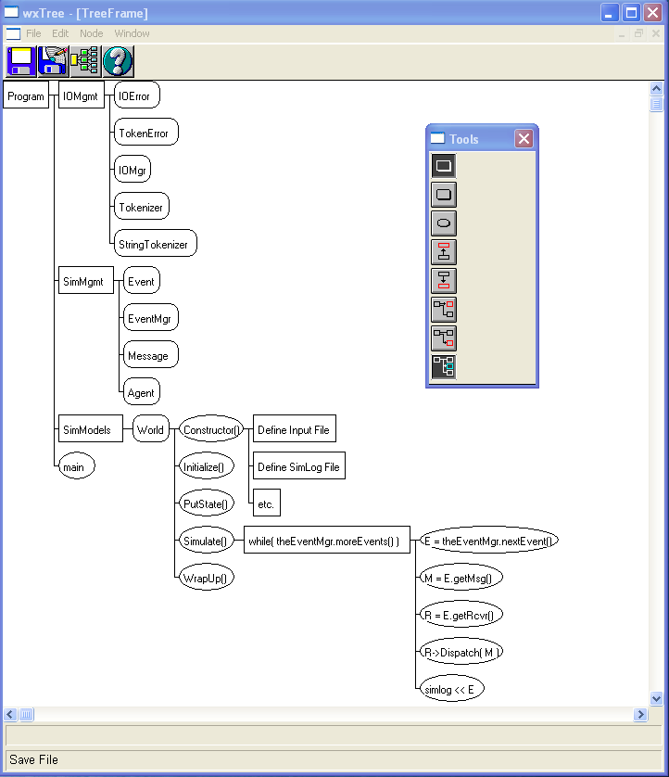
TRED

