Slide 1

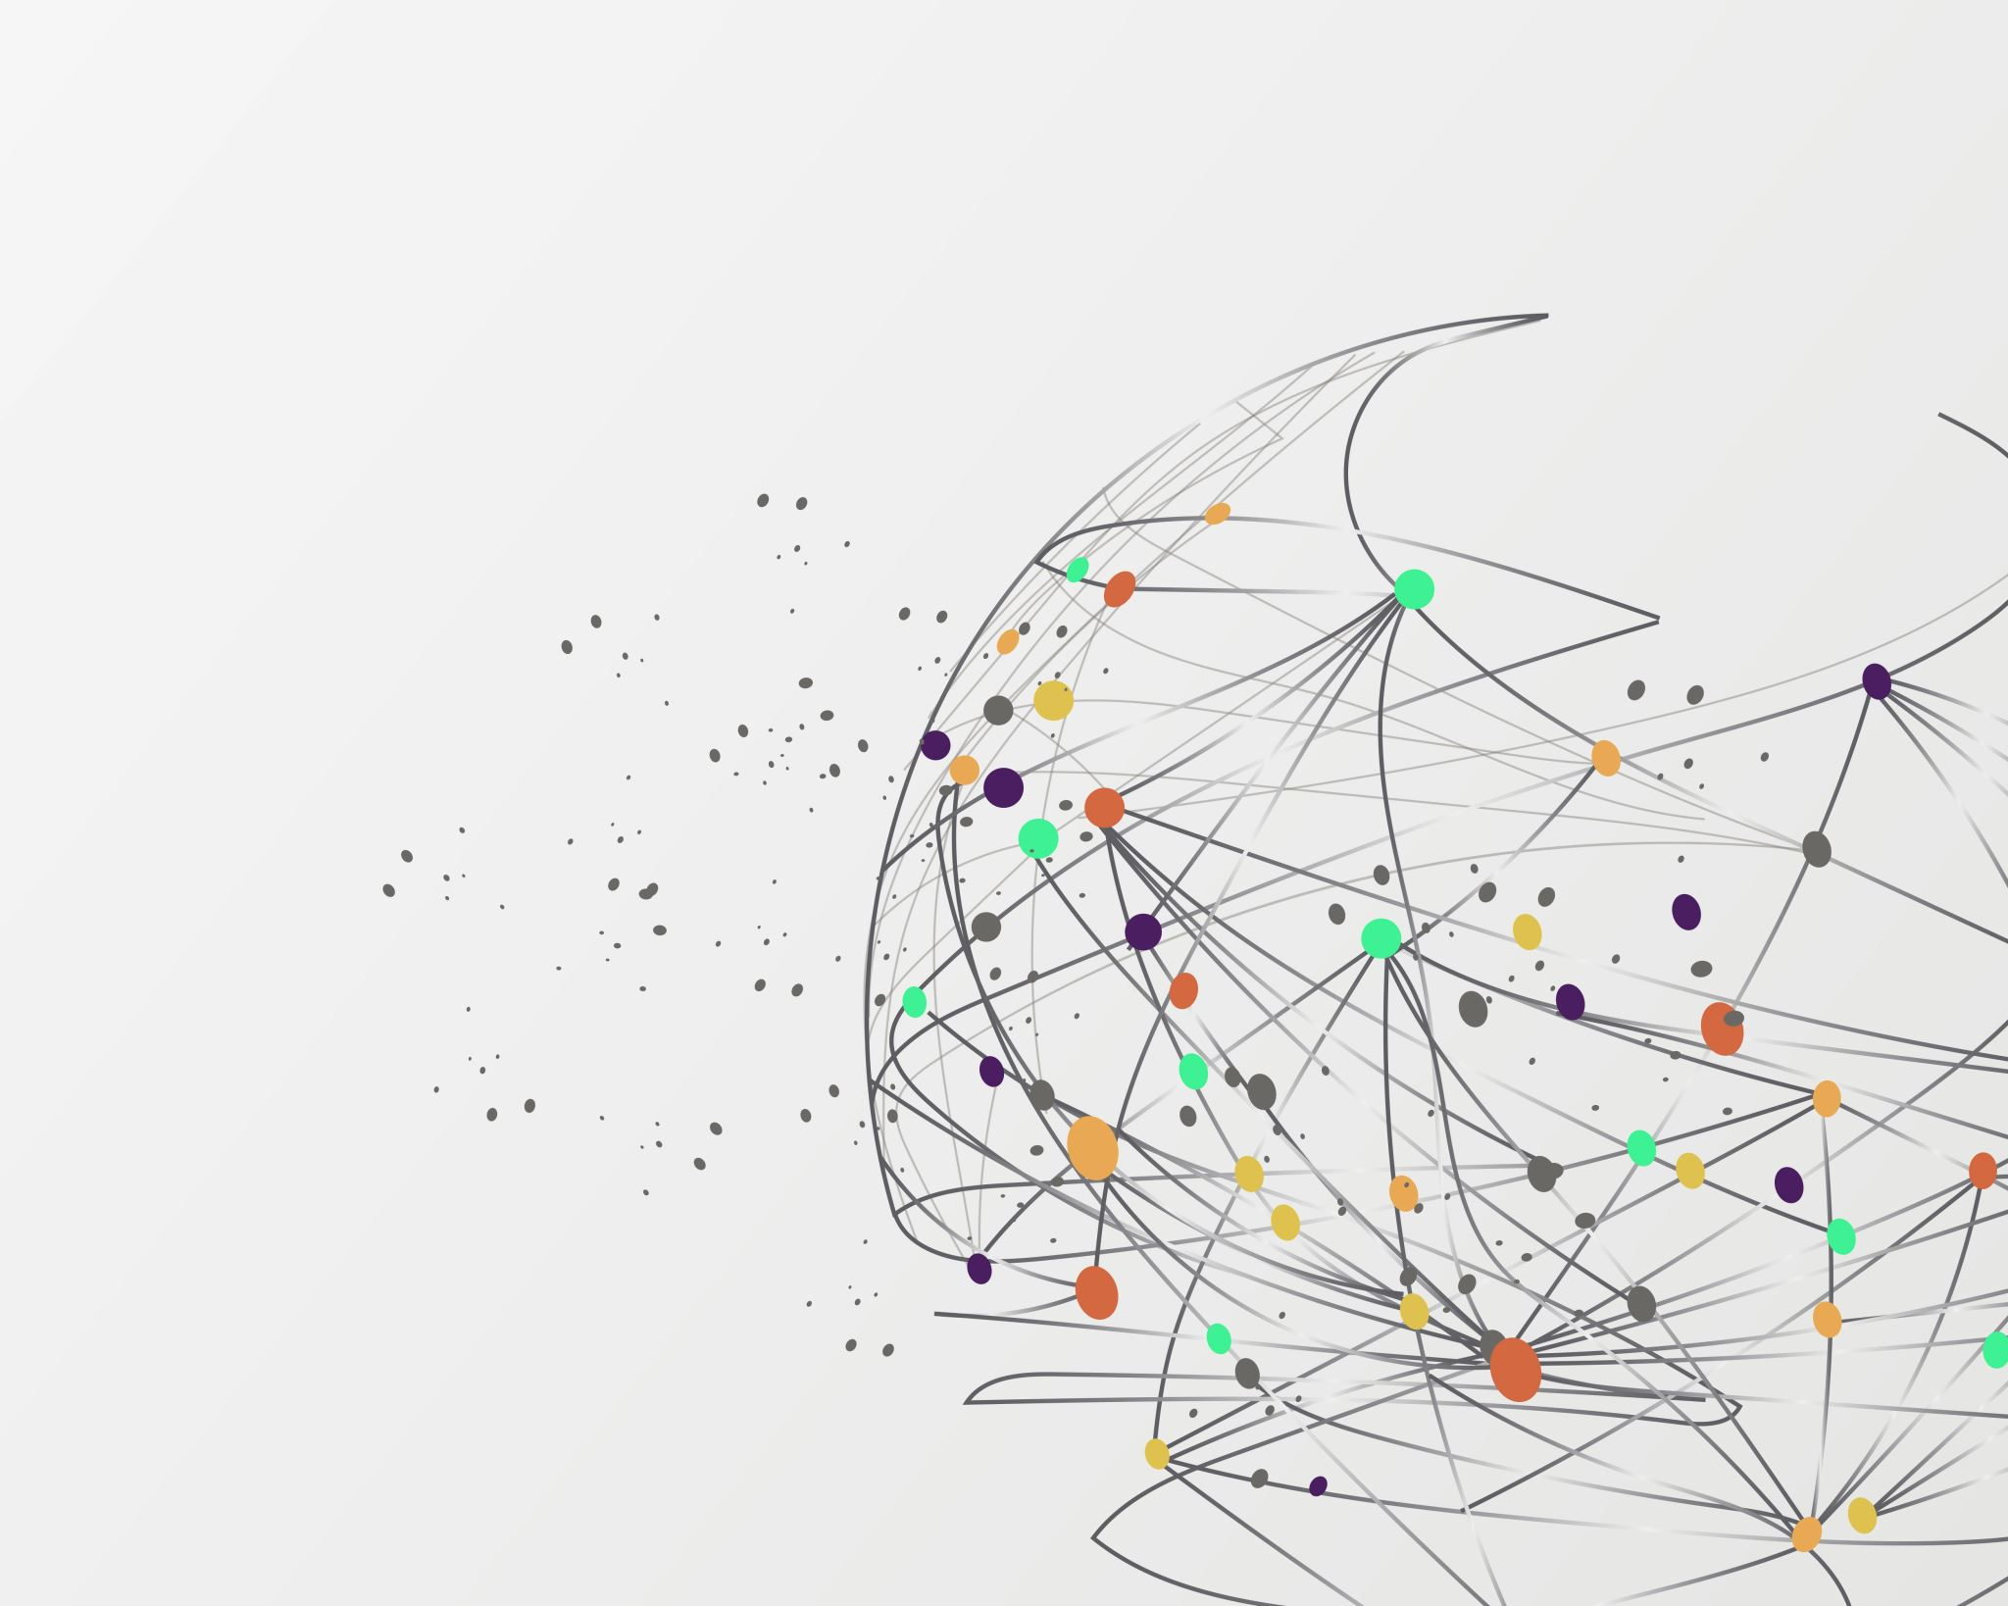

Deep Learning
Text-Based Sentiment Analysis
based on IMDb movie reviews
Sykallou Sofia - 2022202204009
Pouli Stavroula - 2022202204008

Slide 2
What is text-based sentiment analysis?
Branch of natural language processing (NLP)
Identifies the emotional tone behind a body of text
positive sentiment
negative sentiment
(or neutral)

Slide 3
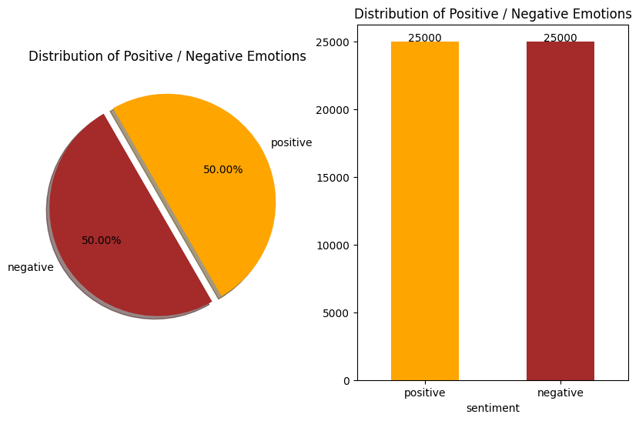
The IMDb Dataset
Data source: Kaggle
Contains 50K Movie Reviews
25.000 positive labeled reviews
25.000 negative labeled reviews

Slide 4
Features
Sentiment
Indicates whether the review is positive or negative.
Review
The text content of the movie reviews.

Slide 5

Data cleaning and preprocessing Duplicate Values
There are 418 duplicate values in our dataset.
After deleting them, the dataset consisted of 49.582 instances.

Slide 6
Data cleaning and preprocessing Label transformation
Sentiment
positive
negative
Sentiment
1
0

Slide 7
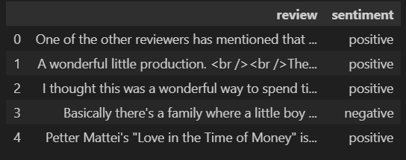
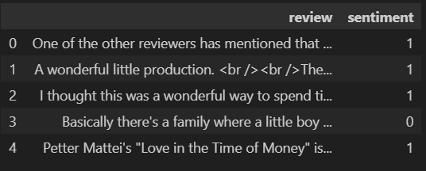
Data cleaning and preprocessing

Slide 8
Data cleaning and preprocessing Stemming
Reduces words to their base or root form, known as a stem.
Removes suffixes or affixes from words to normalize them and group similar words together.
Stemming algorithms
Porter
Snowball
Lancaster

Slide 9
Data cleaning and preprocessing Transformations and removals
Before performing stemming, we defined a word mapping dictionary:
informal contractions or abbreviations are transformed to their corresponding expanded form.
Hyperlinks
HTML tags
Numbers
Emoticons and emojis
Symbols and pictographs
Transport and map symbols
Flags
Punctuations such as [’!"#$%&\'()*+,-./:;<=>?@[\\]^_`{|}~]+
Whitespaces
Separate the text into individual words

Slide 10
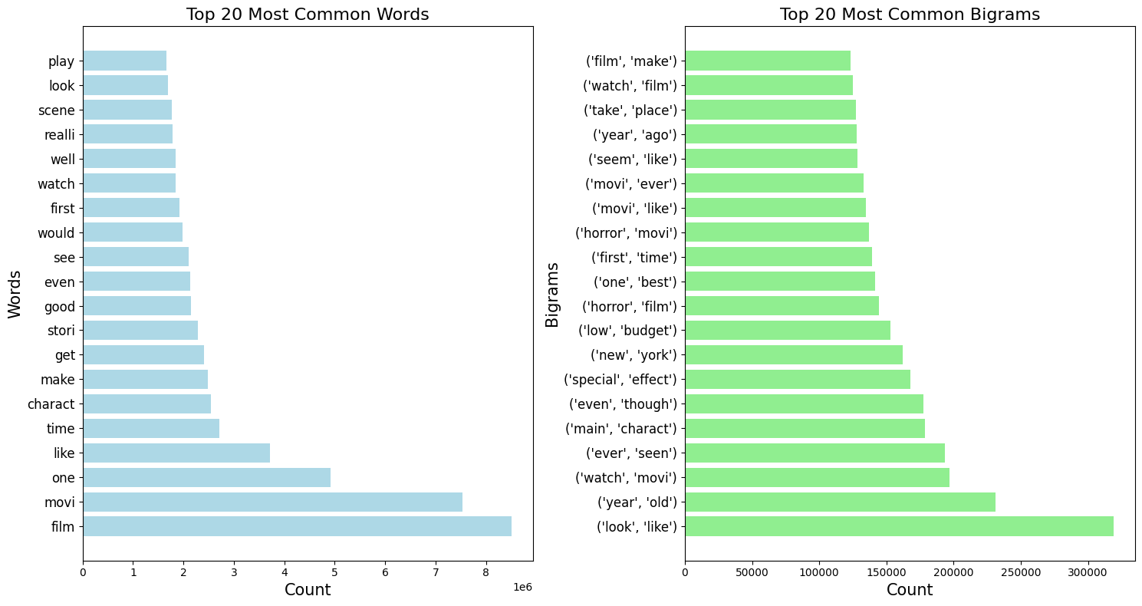
Exploratory analysis Top 20 most common words and bigrams

Slide 11
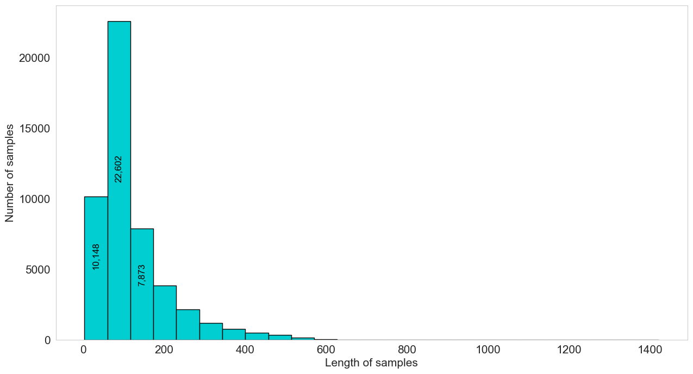
Exploratory analysis Distribution of the lengths of the reviews

Slide 12
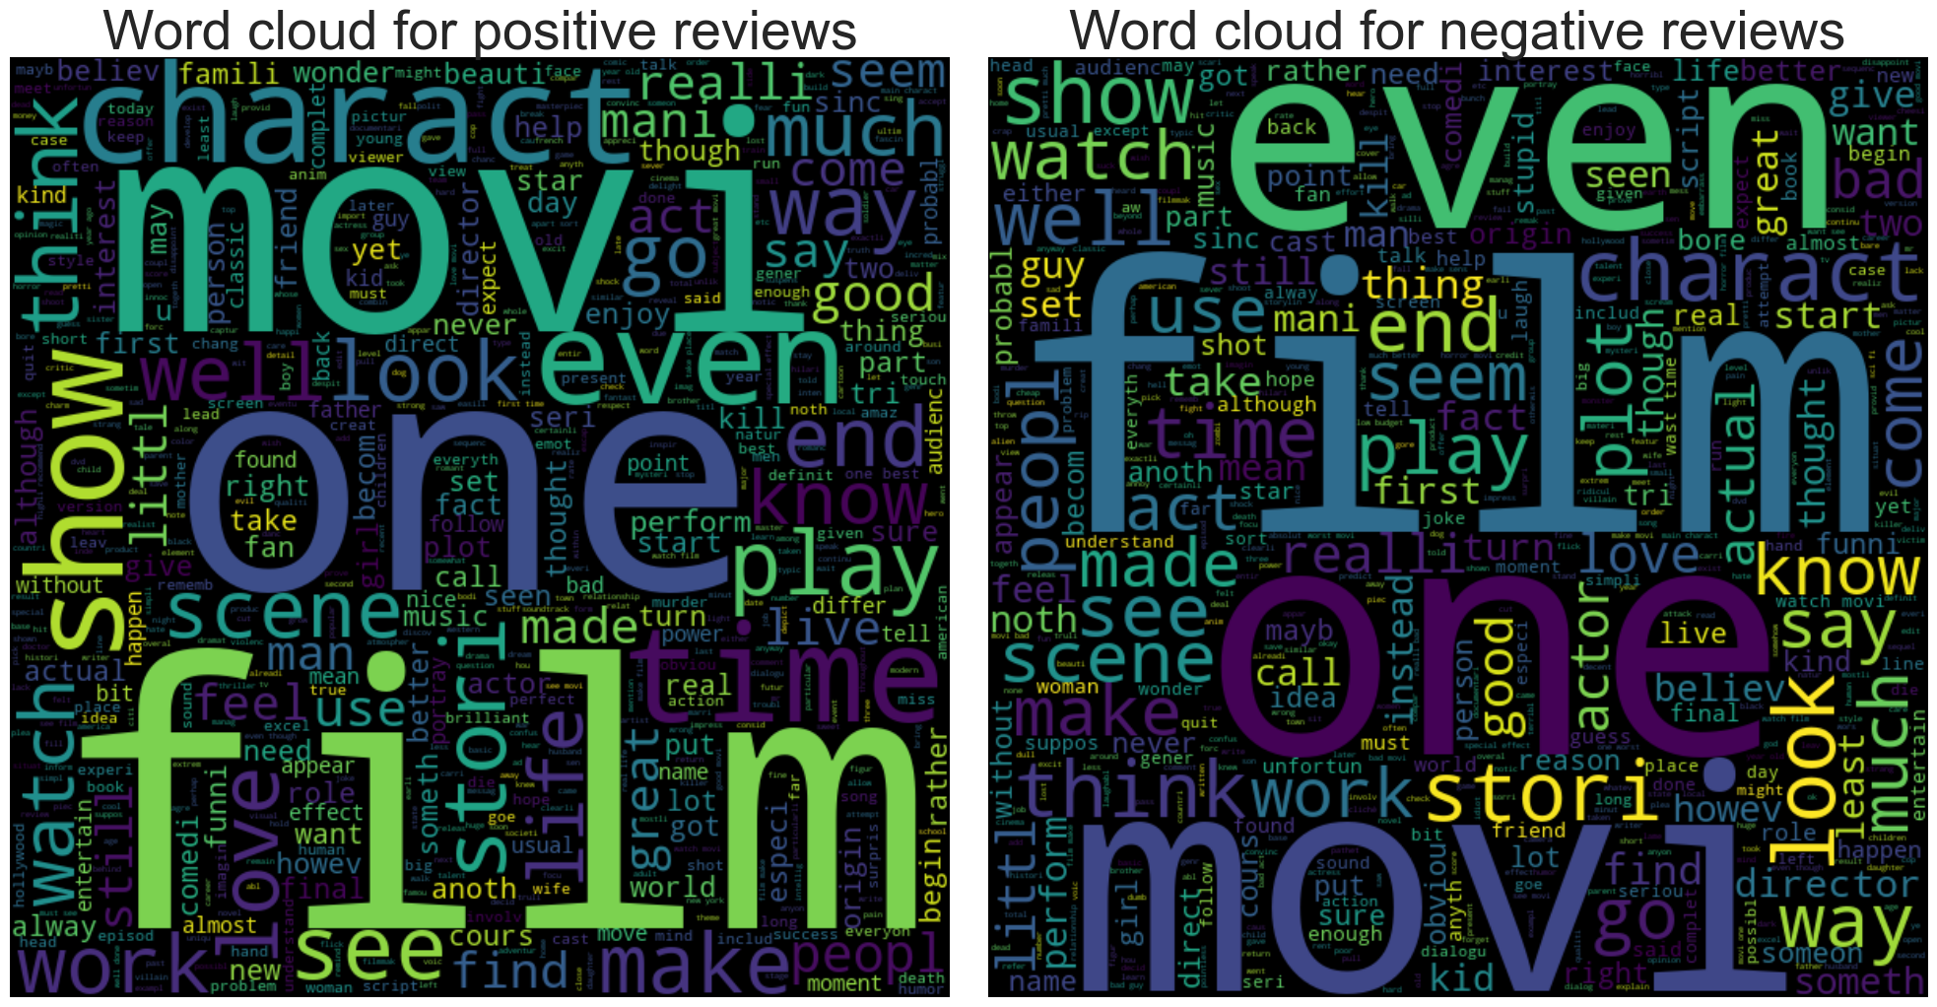
Exploratory analysis Word clouds

Slide 13
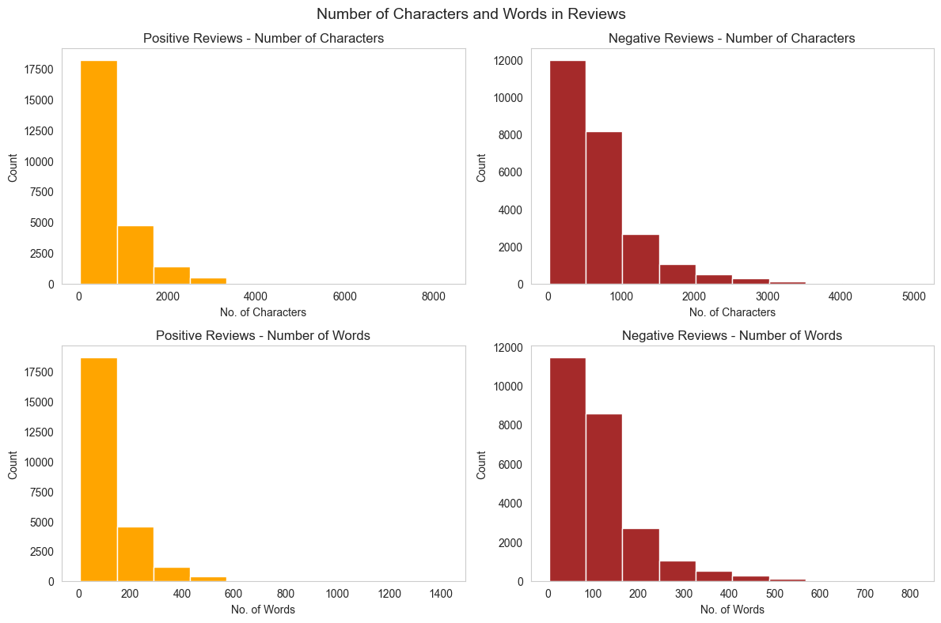
Exploratory analysis Characters and words in the reviews

Slide 14
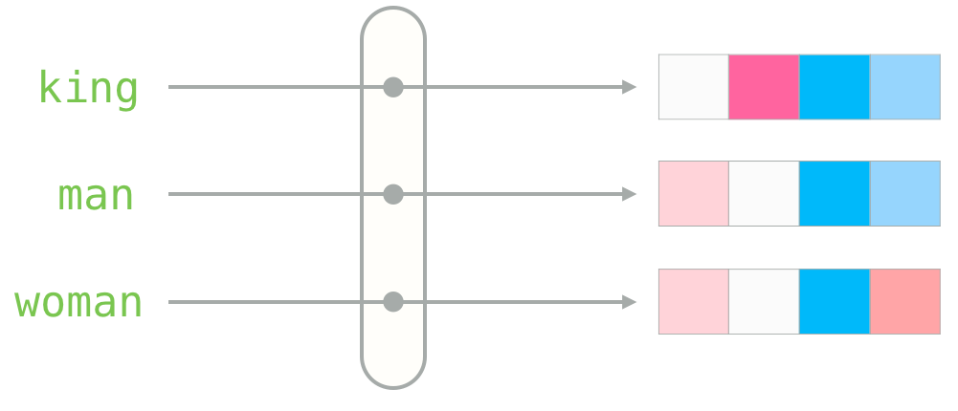
Represent words as dense vectors Word2Vec model
To discover the semantic relationships between words
To analyze the context of each word and generate word embeddings
The model will learn the relationships between words based on their positions
After executing the above process, the vocabulary’s length is equal to 24221 words.

Slide 15
Tokenization and padding
Tokenization
Breaking down a sequence of text into smaller units called tokens
Padding
Ensure that all sequences have the same length

Slide 16
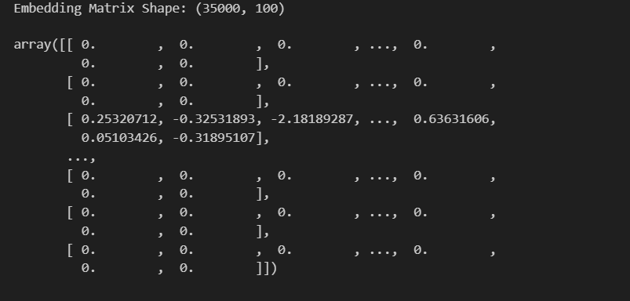
Embedding matrix
Store the embedding vectors in a matrix.
If the model contains the word, then retrieve the embedding vector

Slide 17
Model selection
Split the dataset
Training set - 80% of the data (39665 records)
Test set - 20% of the data (9917 records)

Slide 18
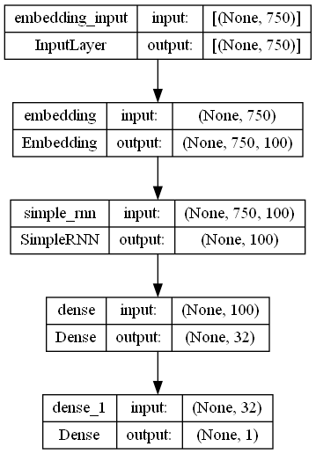
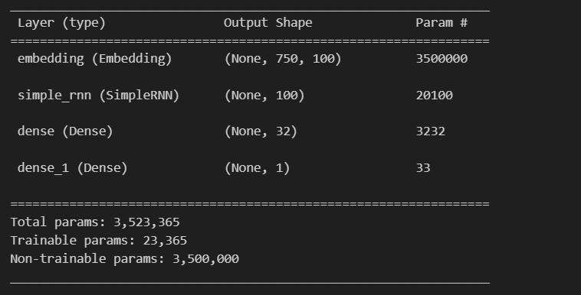
Model selection RNN (Recurrent Neural Network)
RNN Loss: 35%
RNN Accuracy: 84%

Slide 19
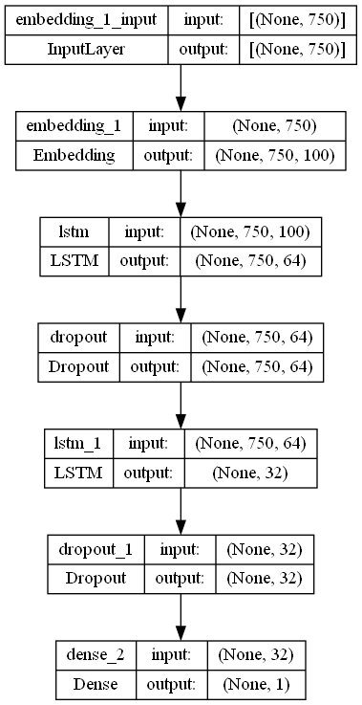
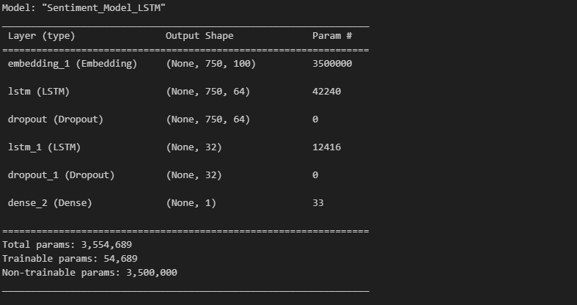
Model selection LSTM (Long Short-Term memory)
LSTM Loss: 30%
LSTM Accuracy: 87%

Slide 20
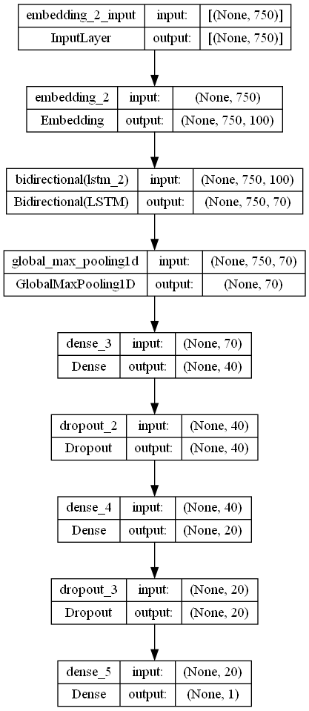
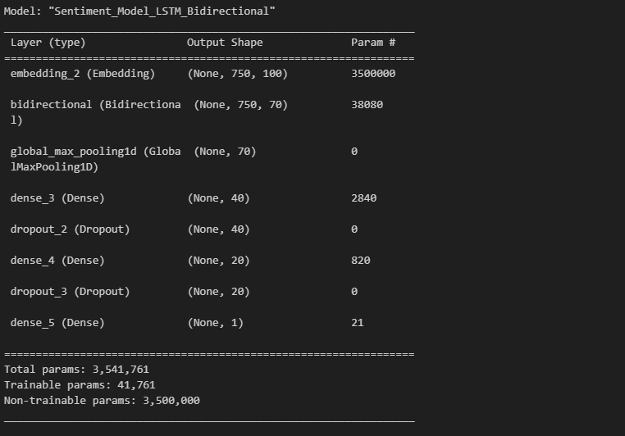
Model selection BiLSTM (Bidirectional LSTM)
BiLSTM Loss: 28%
BiLSTM Accuracy: 88%

Slide 21
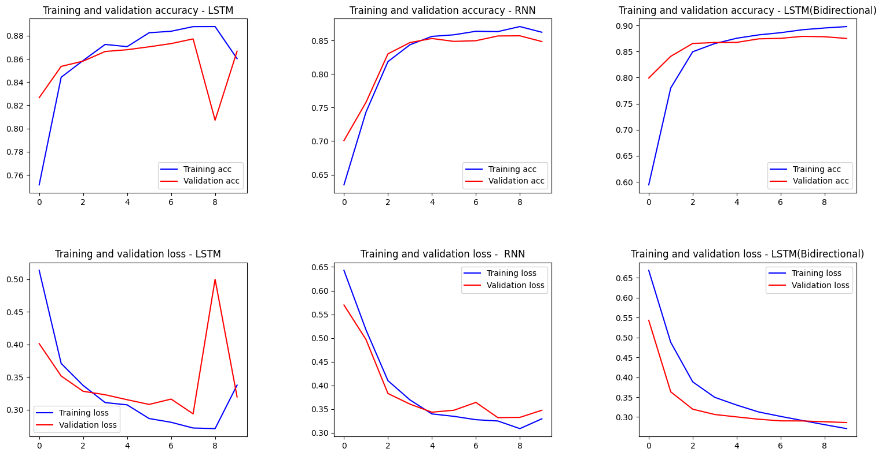
Model evaluation

Slide 22
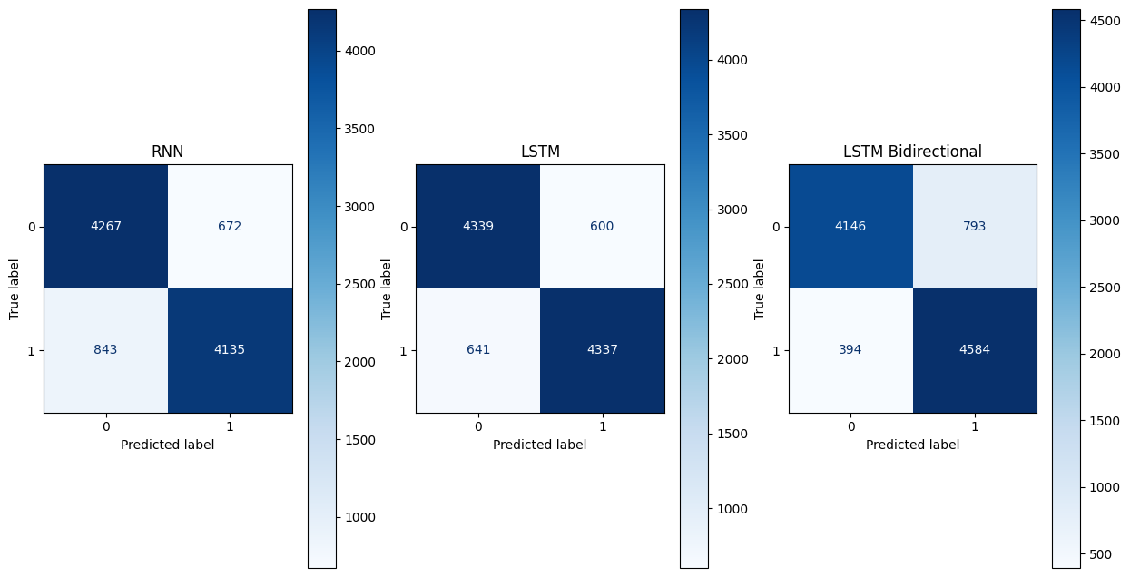
Confusion matrix

Slide 23
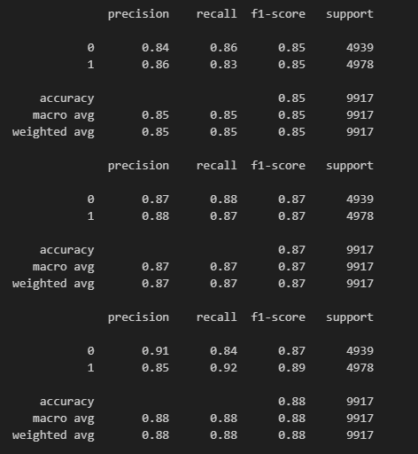
Classification report
All the evaluation metrics for our (classification) problem.
uses the true labels (y_test) and the predicted labels (y_pred)
creates a report with the
precision
recall
f1-score
support

Slide 24
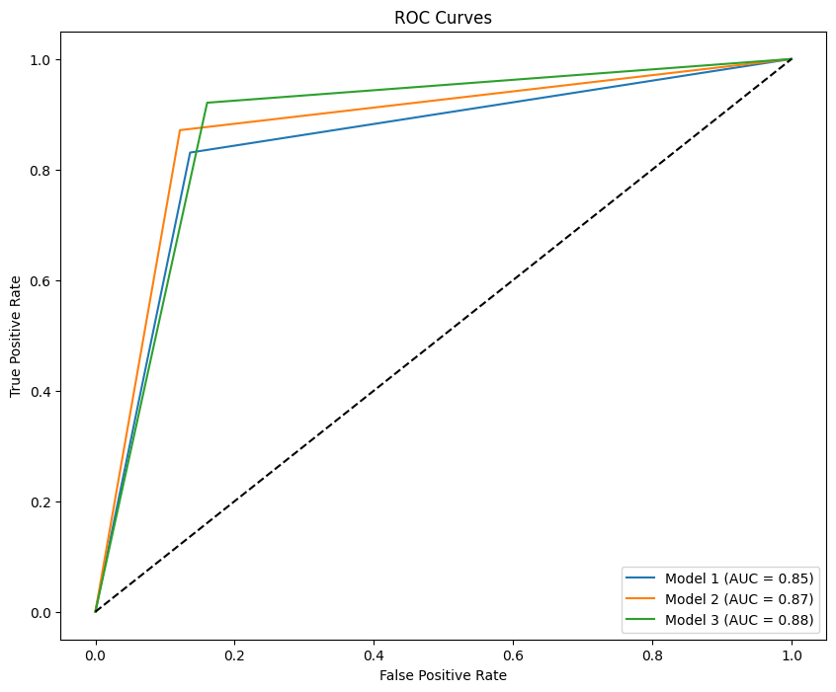
ROC AUC Curves
ROC curve: represents the performance of a binary classification model.
AUC: represents the overall performance of the classification model.

Slide 25
Winner model BiLSTM
Loss
28%
Accuracy
88%
The BiLSTM model process the input sequence both forward and backwards. As a result, the model can better interpret the overall sentiment of the text by capturing contextual information from both past and future situations.

Slide 26
Thank you
any questions?

