Slide 1
Application of Q Estimation at Basin Scales
Sam Poulter

Slide 2
Project Outline:
Aim:
To produce a regional view of effective seismic attenuation as derived from stacked traces & volumes data, by applying the Spectral Ratio method to stacked seismic sections around the North Sea region.
Objectives:
1.Develop automated Spectral ratio code
2. Validate code by testing and applying it to synthetic wavelets.
3. Adapt code into AWS workspace and run on all UK regional lines
4. Assess any correlations of regional Q values through clustering
5. Assess if these correlations could be useful in predicting data quality and resolution

Slide 3
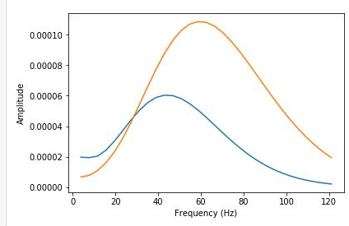


What Is Q?
Attenuation is the loss of amplitude during the propagation of a seismic wave through an attenuating material and quantified by the seismic quality factor Q
Attenuation causes a loss of vertical resolution and results in a lower amplitude and lowers the dominant frequency of traveling wavelets .
Also has a phase effect, as low frequencies must travel slower than high frequencies

Slide 4
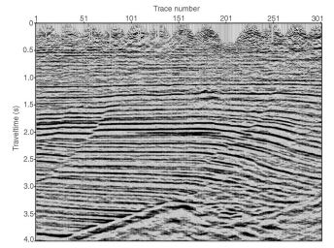
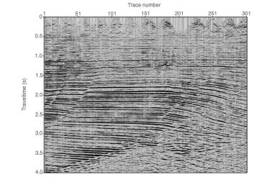
Why are we interested
Corrections during processing seismic data
- Amplitude recovery
- AVO corrections
-Compensate for loss of resolution
Used as a indicator for reservoir properties
-Gas saturation
-Fracture Azimuth
-Monitor injection processes

Slide 5
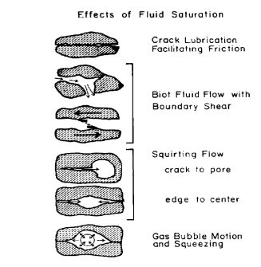
Causes of Intrinsic attenuation
Rock Frame Causes:
1. Friction at grain boundary
2. Compression of fractures and micro cracks
Fluid Saturation Effects:
1. Fluid flow in and out of fractures
2.Bubble Compression
3. Squirt Flow
After Jonhston 1979

Slide 6
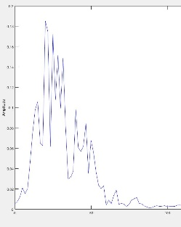

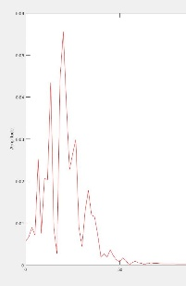
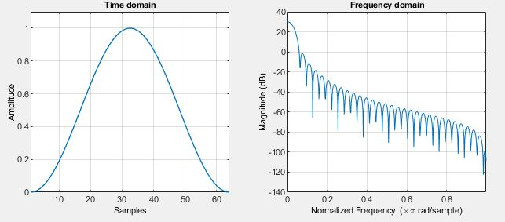
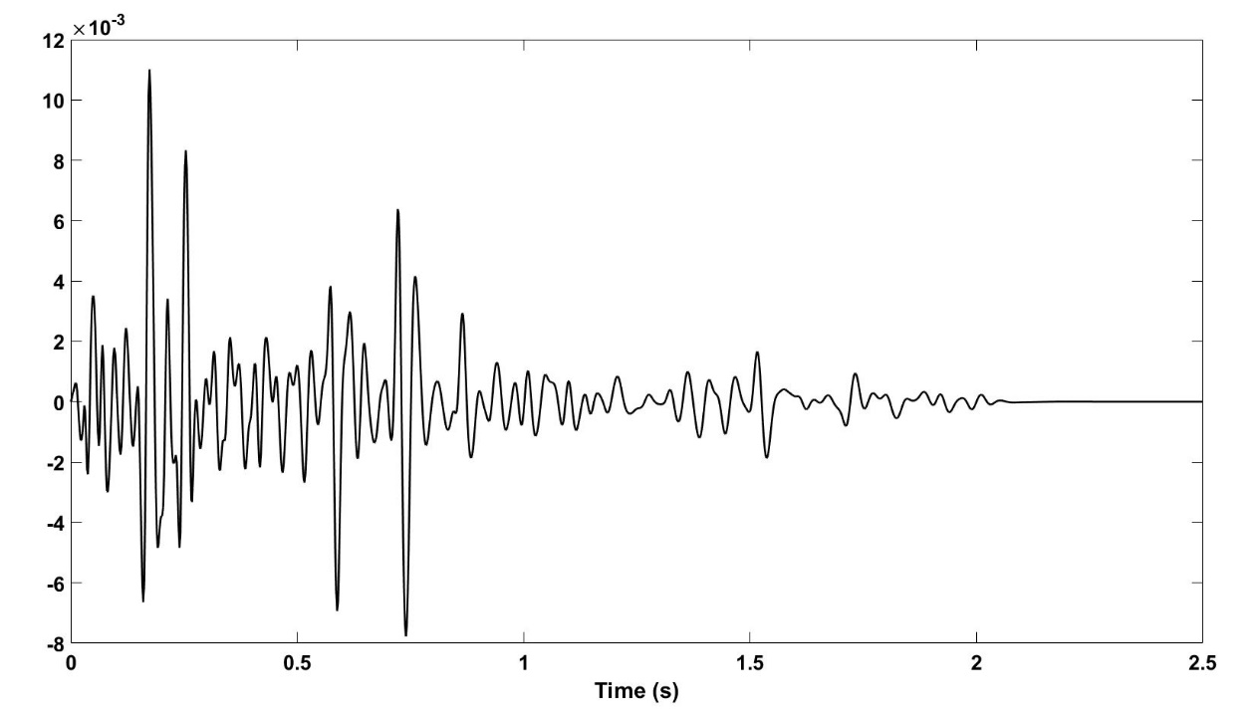
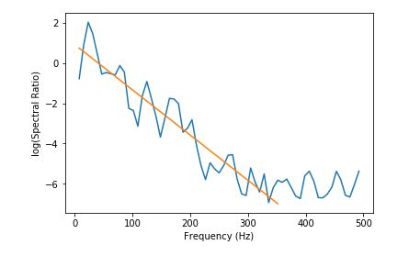

Methods of Measuring: Spectral Ratio
Frequency Independent Mechanisms e.g. Geometric Spreading G, Reflectivity R

Slide 7
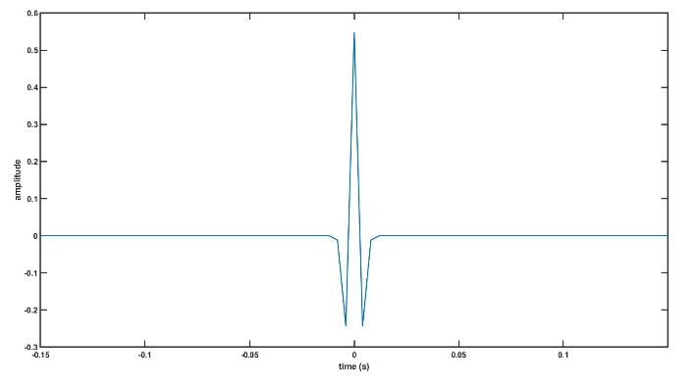
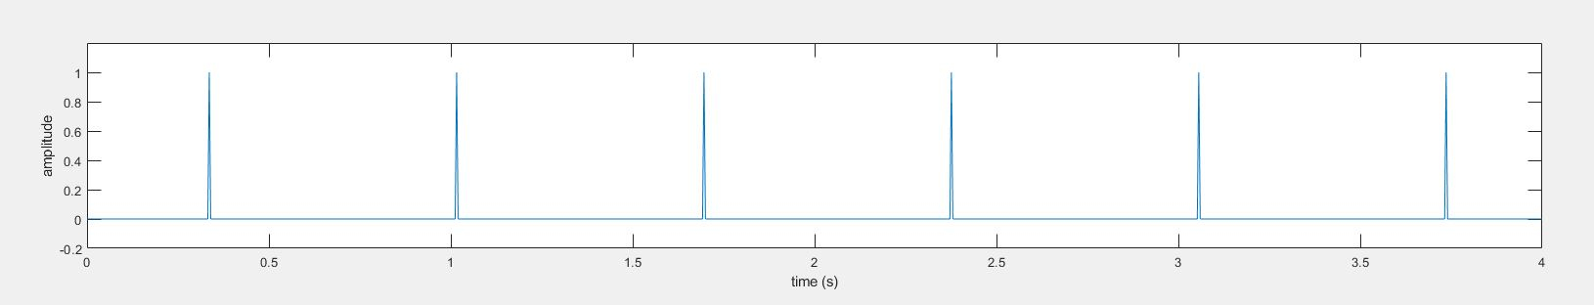

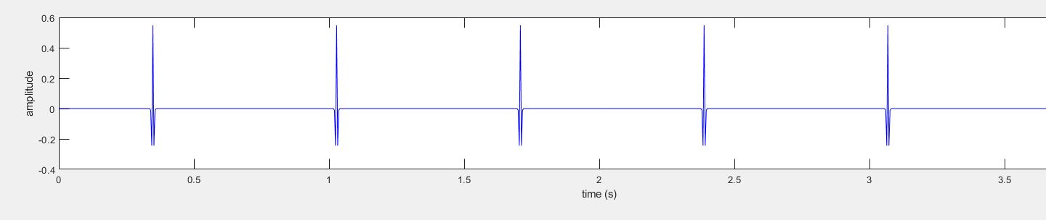
Synthetic Attenuated Trace
No attenuation to see the effect of windowing function and general Fourier artefacts
Spiked Reflectivity
Input wavelet – 100Hz ricker
Hanning filter – Spectral properties
Final Trace

Slide 8
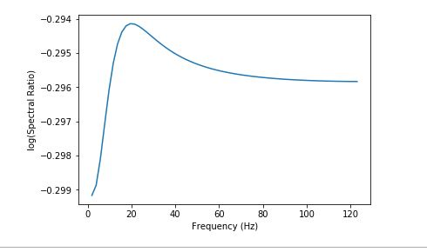
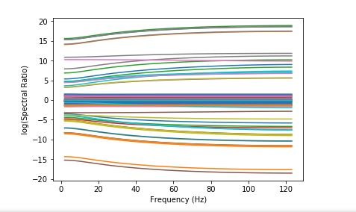
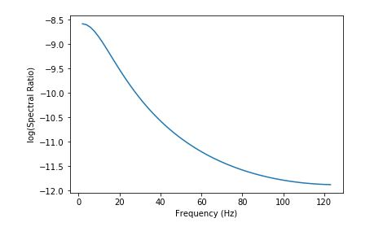
No AttenSpectral Ratios
Near zero gradient gives infinite Q
Spectra of all possible window combinations
Small gradient affects due transform artefacts and imprint of window spectrum on data

Slide 9
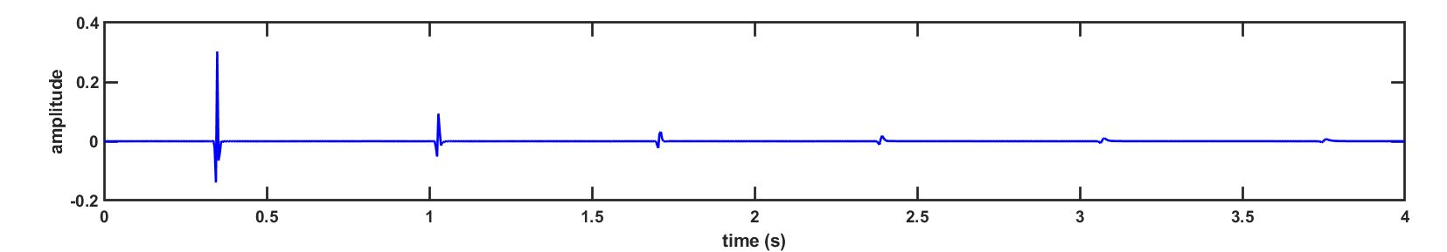
Noise less synthetic
Spiked Reflectivity
Trace with Q = 150
Using Kjartansson's 1979 constant Q model

Slide 10
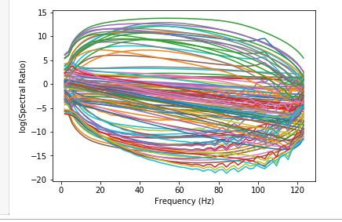
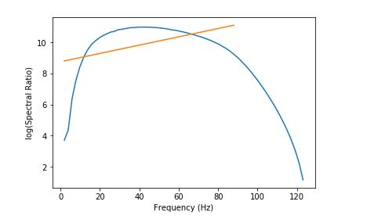
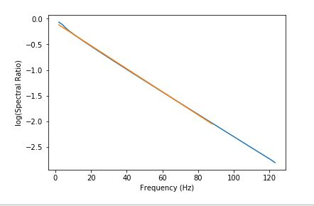
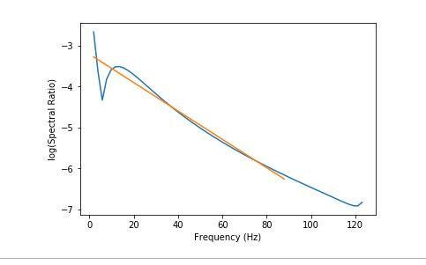
Spectral Ratios
Spectra of all possible window combinations
Ratio of two windows over non- events
Ratio of two windows over events
Ratio of windows over edge of event

Slide 11
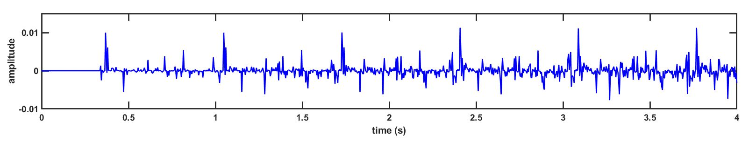
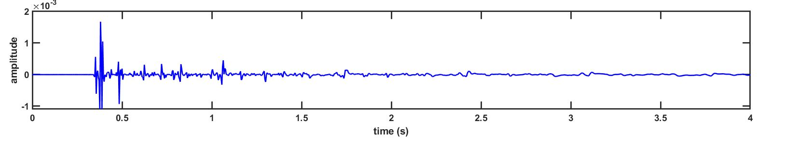
Noisy Synthetic
Pseudo Random Reflection Series – Still with 6 spikes
Band limited noise rather than random white noise
Band limited noise rather than random white noise
Noisy Attenuated Trace

Slide 12
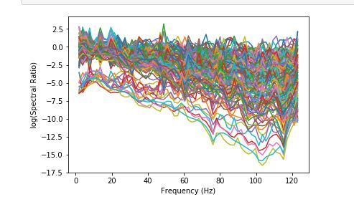
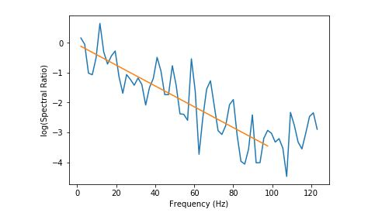
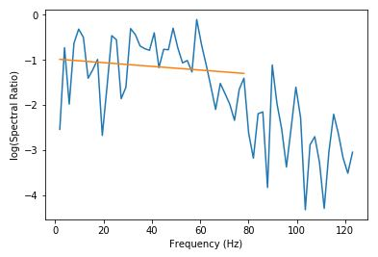
Spectral Ratios
Ratio of two windows over events
Noise in the synthetic results in spikier spectral ratios
Spectra of all possible window combinations
Ratio of two windows over two non events

Slide 13
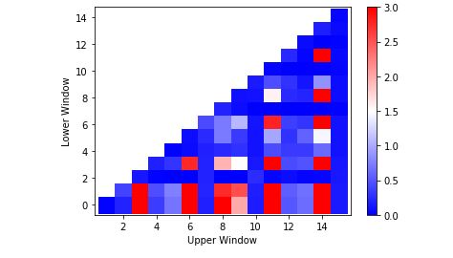
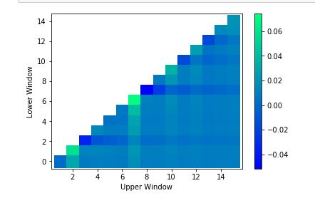
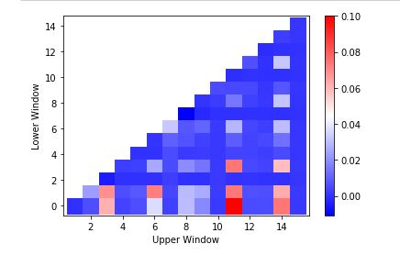
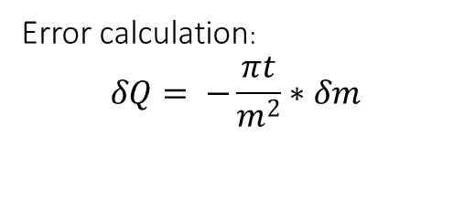
QC- Finding optimal window pairing
Tartan Triangle for 1/Q error
Error calculation:
$$δQ= −\frac{πt}{m^{2}}∗δm$$
Tartan Triangle for 1/Q
Tartan Triangle for 1/Q weighted by the error in Q

Slide 14
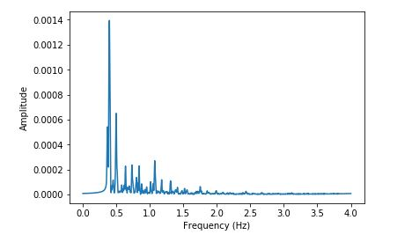
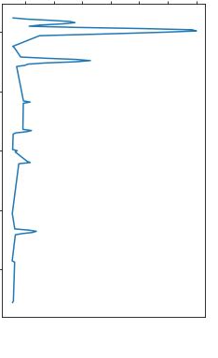
Methods of Automating the QC
Hilbert Transform
3. RMS of trace window
2. Set cut off above noise level, conduct spectral ratio on only data above level
1. Take product of analytic signal in each investigation window

Slide 15
Future Work
Optimise bandwidth for line fitting
Apply to single trace of real data
Apply at scale

Slide 16
Thesis Overview
1. Introduction
Motivation for project
Aims and objectives
2. Methodology and Background
Overview of Q
Uses of Q
Q estimation
3. Results
Synthetic trace results
Regional Scale results
4. Interpretation and Discussion
Q clustering
Assess any correlations of regional Q values
5. Conclusions

