Slide 1
CST2335 Graphical Interface programming
Extra material
iOS and XAML comparison

Slide 2
Introduction
We will see how iOS has solved some of the same problems faced by Android.
We will also look at how XAML for C# also has adopted some of the same programming patterns.

Slide 3
Apple iOS Programming
The default language was Objective-C. It is an object-oriented language that is based on C, and Smalltalk. It is a “sibling” of C++. It requires header files “*.h” and implementation files: “*.m”
Any object oriented method call is surrounded by brackets: [ button setText:@”Hi” ];
is equivalent to: button.setText(“Hi”);
Strings are preceded with @ symbol: @”Hello World”
XCode is the default programming environment.

Slide 4
Swift
Swift was recently introduced as a modern replacement for Objective-C. Swift can be written in only one file, instead of being split in two files like Objective-C.
Swift is statically linked, making the language run faster. It also uses type inferencing:
var myNum = 5 // means myNum is an int
var otherNum : int // means otherNum is an int

Slide 5
XCode
Xcode development has many graphical programming features. The GUI development must be done graphically.
Start XCode and select “Create a New Xcode Project” -> Select Single View application. You can select if your application will be for iPhone only, iPad only, or universal (both).

Slide 6
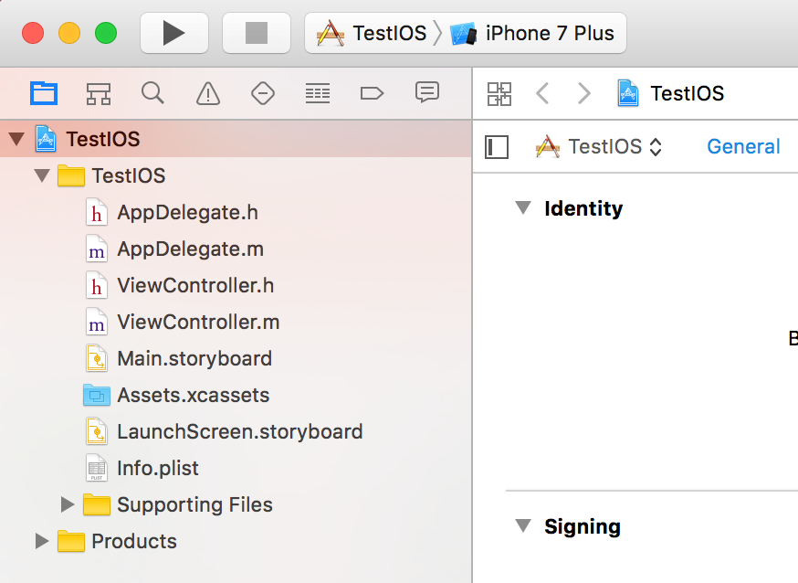
XCode
The Emulator type is at the top.
This is the project view
The AppDelegate file is the file handling the starting behaviour
Each screen on your application has a ViewController class
Instead of an xml layout for each Activity, all layouts are in the storyboard file.

Slide 7
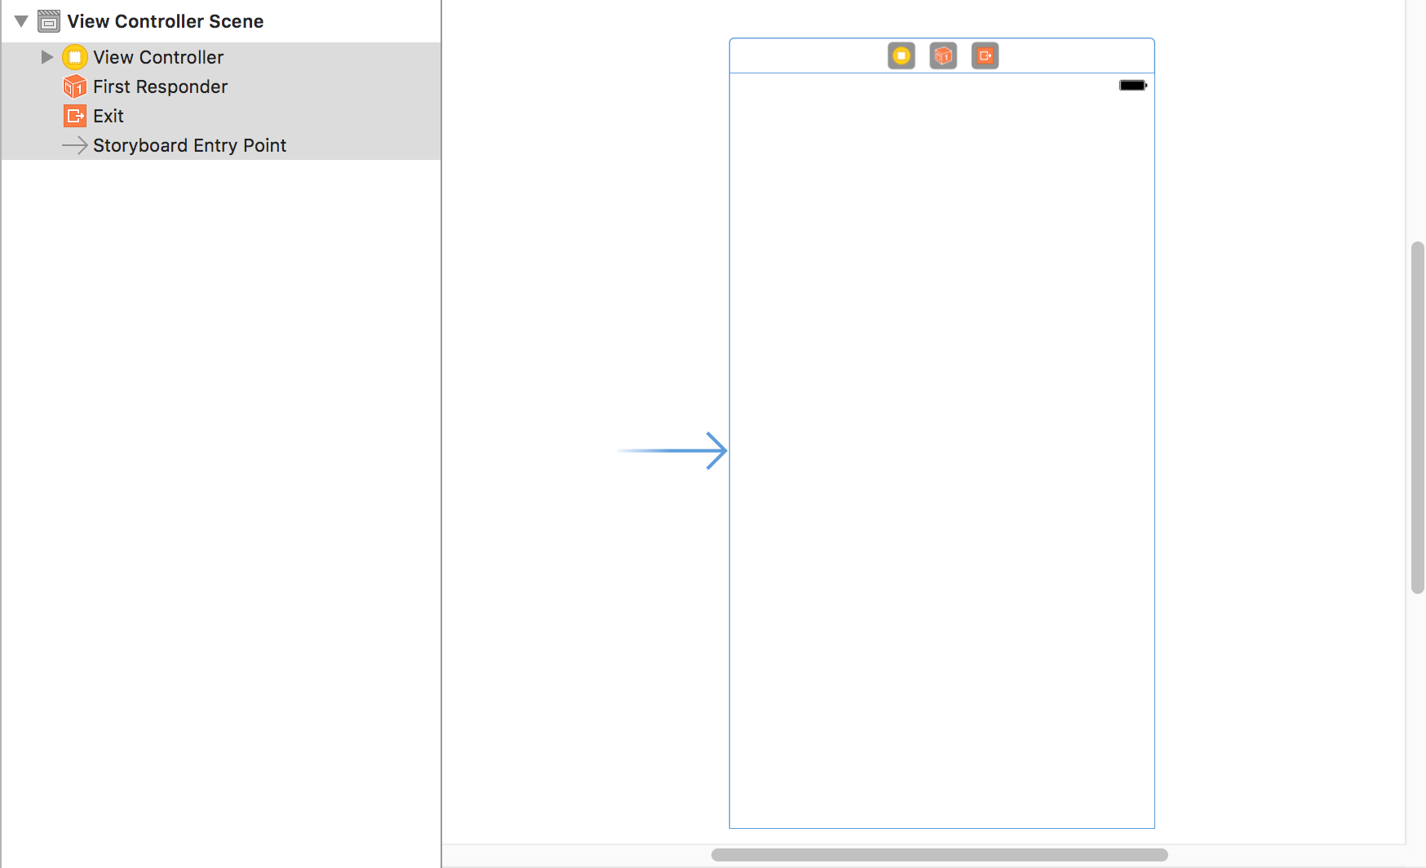
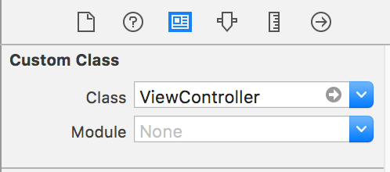
Storyboard
To start, there is only 1 screen on the right.
The widgets are listed on the left, so far there are none.
The blue arrow pointing in to the screen means it is the default launch screen.
Look at the top right of the screen. Click on the yellow circle, View Controller and see the ViewController is responsible for this screen

Slide 8
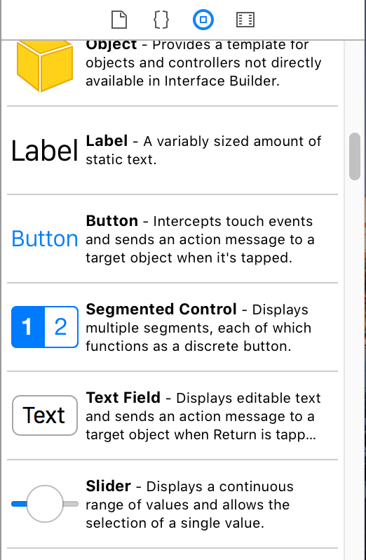
Adding Widgets
Drag a button to the screen and a TextField to the screen.
If you highlight the components on the left window, the properties for that widget are on the right. Set the text of the items.

Slide 9
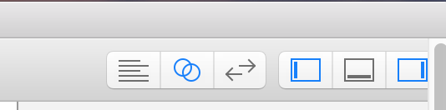
Connecting view to code
Here is where XCode does graphical programming. At the top right of Xcode, click on the button that looks like two rings.
You should see the graphical design on the left, and the ViewControl code on the right.

Slide 10
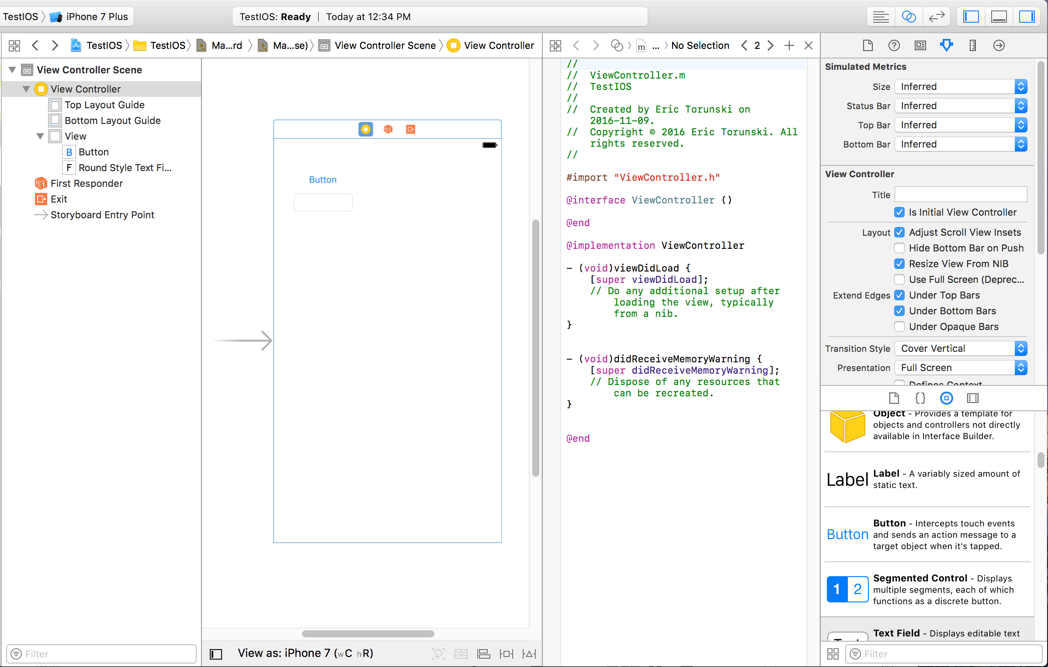
Picture
If you have a two-button mouse, right click on the button and drag to the code. Otherwise, click “Alt/option” and drag to the code

Slide 11
Picture

Slide 12
Creating Outlets (References)
An outlet is reference to an object. It’s the same as typing:
Button b = (Button) findViewById(R.id.button1);
Connect an outlet for the EditText as well by dragging the mouse over from the EditText to the code.
Now connect a callback function by dragging the mouse from the button to the code and select Action instead. Make sure that “TouchUpInside” is the event trigger, and set the name as “clickButton”. In the event handler, call: [self.editText setText:@"Clicked!"];

Slide 13
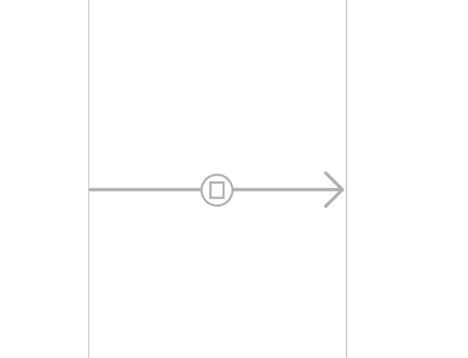
Transitions
In Android, you use Intents to start Activities. In iOS, you use graphical “Segues”. Add a second ViewController to the storyboard. From the first storyboard, right-click from the yellow circle above and drag to the new view controller. Select “Show Modal” as the transition type. You should see a line between the two screens:

Slide 14
Segue
Click on the line to highlight it. There should be the properties on the top right. Set the Identifier to be some name: “transition1”. To trigger the change, type in the button event handler:
[self performSegueWithIdentifier:@"transition1" sender:self];
This is equivalent to writing: startActivity( new Intent( ), …) in Android. It will load the next view. You can also click directly from a button and drag a segue to a new screen and it will automate the transition.

Slide 15
ListView
Just like Android has ListAdapters for supplying data to a ListView, iOS follows the same pattern. In Objective-C, you must set the data source for the table. For this, your class must implement the UITableViewDelegate, and UITableViewDataSource interfaces:
myClass : UIViewController <UITableViewDelegate, UITableViewDataSource>

Slide 16
UITableViewDataSource
There are several functions for the Data Source Interface:
numberOfSectionsInTableView: //this returns the number of sections in a table
- (NSInteger)tableView:(UITableView *)tableView numberOfRowsInSection:(NSInteger)section
{ return [tableData count]; }
//this is the same as getCount() in Android for a ListAdapter
- (UITableViewCell *)tableView:(UITableView *)tableView cellForRowAtIndexPath:(NSIndexPath *)indexPath
//This function is the same as getView(int position, …) etc.

Slide 17
UITableViewDataSource
- (UITableViewCell *)tableView:(UITableView *)tableView cellForRowAtIndexPath:(NSIndexPath *) indexPath
{
static NSString *simpleTableIdentifier = @"SimpleTableItem";
UITableViewCell *cell = [tableView dequeueReusableCellWithIdentifier:simpleTableIdentifier];
if (cell == nil) {
cell = [[UITableViewCell alloc] initWithStyle:UITableViewCellStyleDefault reuseIdentifier:simpleTableIdentifier];
}
cell.textLabel.text = [tableData objectAtIndex:indexPath.row];
return cell;
}

Slide 18
UITableViewDataSource
This code is the view recycler pattern that is also used in Android. However, the cells can only be pre-defined layouts. You can not create a custom layout:
https://developer.apple.com/library/content/documentation/UserExperience/Conceptual/TableView_iPhone/TableViewStyles/TableViewCharacteristics.html
https://developer.apple.com/reference/uikit/uitableviewcellstyle?language=objc

Slide 19
Layouts
In iOS, all screens have the same ratio of width x height. iPads are 2x the size of an iPhone (original). The iPad Pro, iPhone 6 plus are 3x the size of the original iPhone. There is no idea of fragments in iOS.
iOS uses automatically resizing for screens when you rotate them but it is really complicated to use, so few people do.

Slide 20
Summary
Xcode simplifies programming by using the mouse to connect parts from the layout to parts in code.
iOS uses the model – view - controller pattern similar to Android. iOS uses Segue transitions instead of Intent.
ViewController classes are similar to Activity classes, they are responsible for the lifecycle of a screen.
The table / ListView pattern is the same as Android.
Layouts in iOS are harder than Android, since the constraint that all screens use the same ratios. All layouts are stored in the Storyboard, which is actually an XML file.

