Slide 1
CST2335 Graphical Interface programming
Extra material
NavigationDrawer (Sliding Menu)

Slide 2
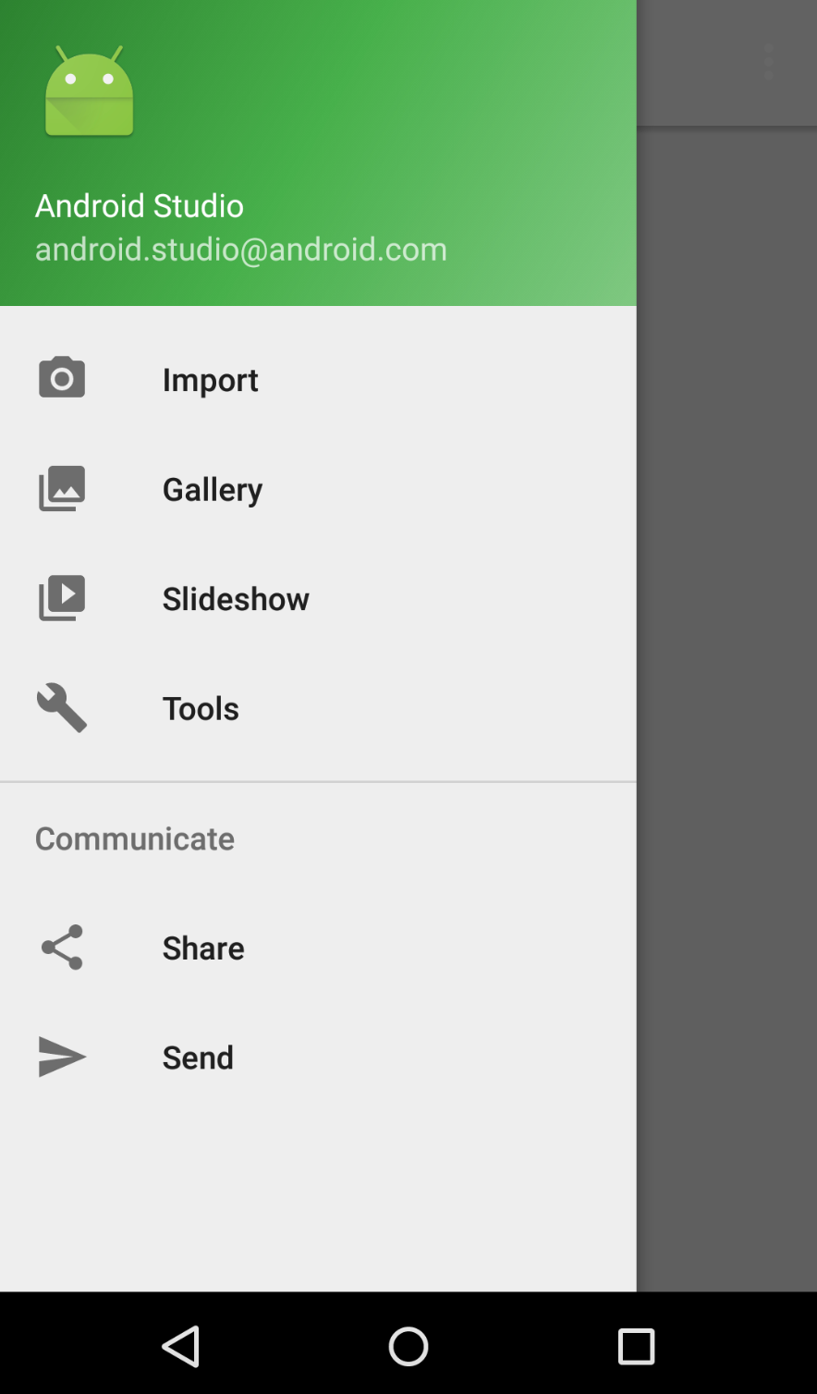
Introduction
This week, you will learn how create a NavigationDrawer and add menu items for selection.

Slide 3
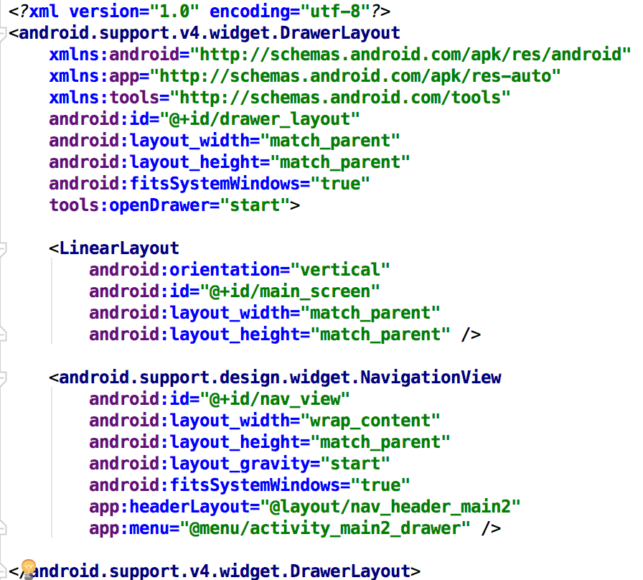
DrawerLayout
A DrawerLayout takes two sub-items. The first is the main screen, the second is the layout for the NavigationView (Sliding Menu).

Slide 4
NavigationView
NavigationViews have a Header, and a Menu.
The Header is pictures/explanation.
The Menu are selectable MenuItems

Slide 5
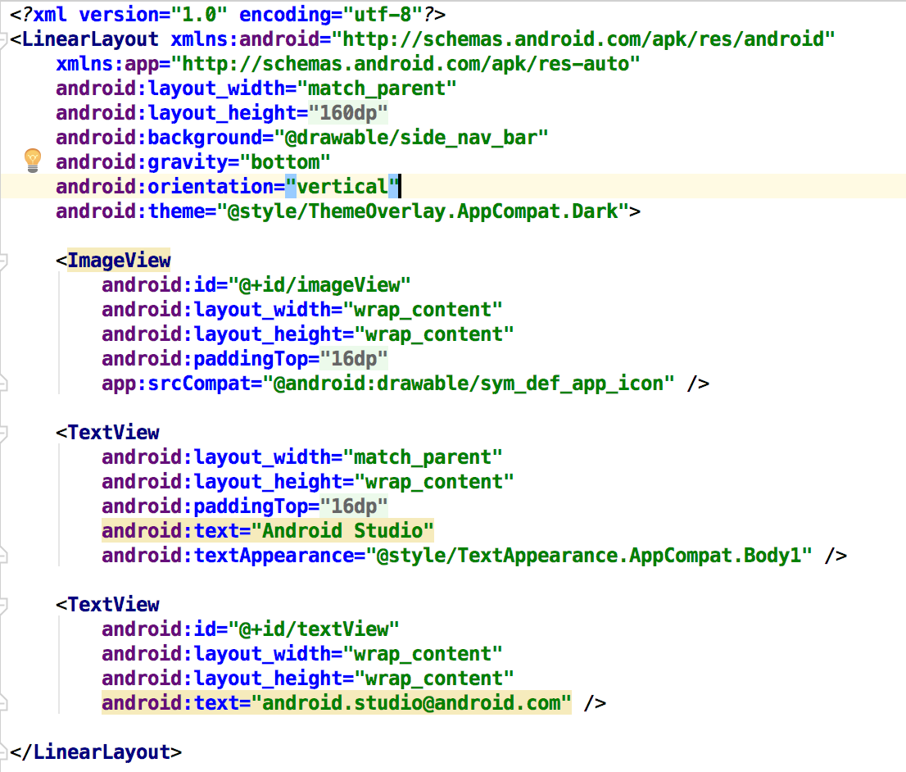

Header
The header can be any layout (LinearLayout, RelativeLayout), containing Text, Images, etc.

Slide 6
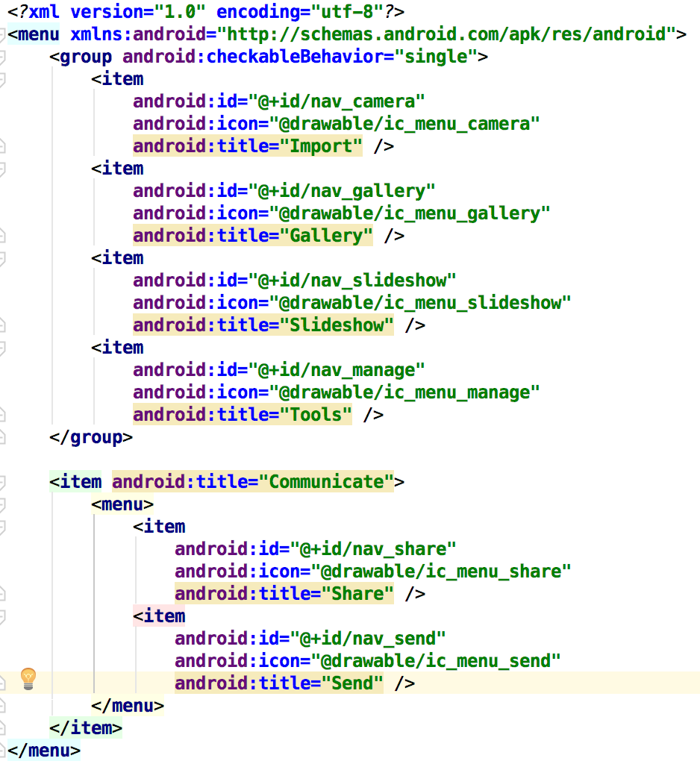
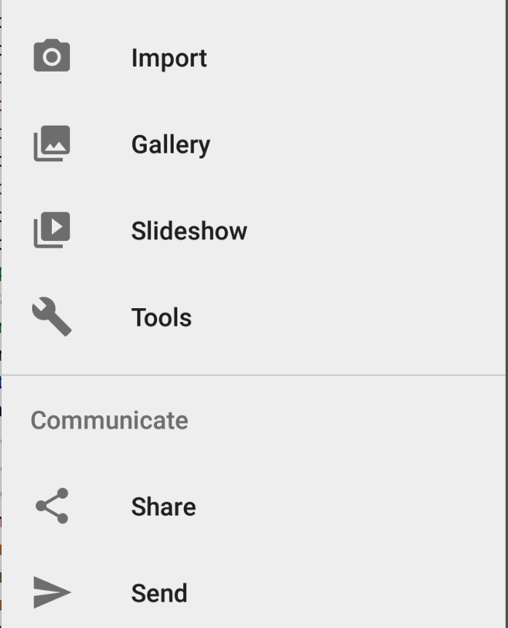
Menu
The selectable menu items are just like the Toolbar:

Slide 7
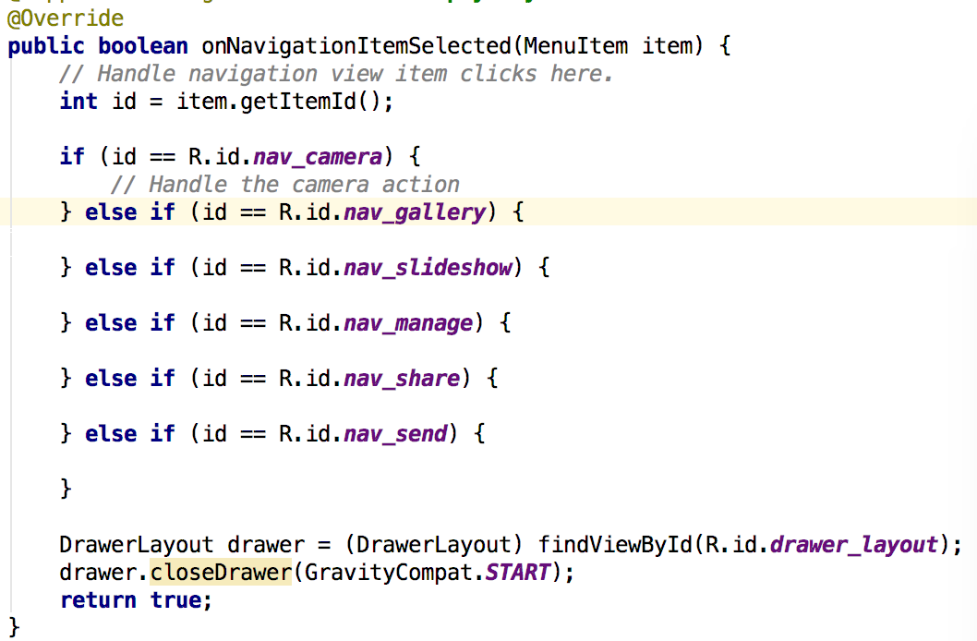
Activity functions
boolean onNavigationItemSelected(MenuItem item) - This function responds to anNavigationItem selection:
Add cases for each ID of items
from your XML menu
Close the drawer

Slide 8
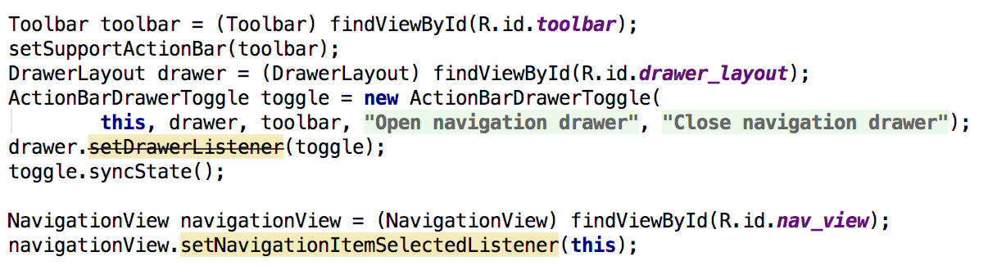
ToolBar integration
You need a Toolbar on your display to show the Drawer toggle button. In your onCreate function, add this code:
This code registers for NavigationItem Selection events

Slide 9
Example
Use AndroidStudio: File -> New -> Activity -> NavigationDrawerActivity
The screenshots and examples in these slides are taken from the code generated by AndroidStudio.

Slide 10
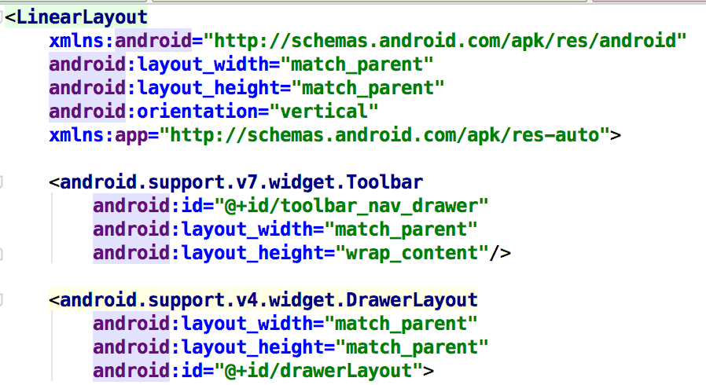
Toolbar placement
Make sure the Toolbar is placed outside the DrawerLayout, or the Navigation drawer will open on top of the Toolbar:

Slide 11
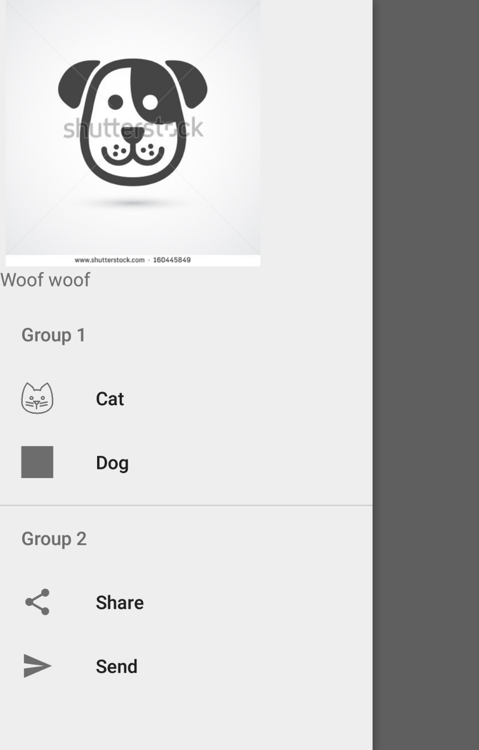
Now it should work

