Slide 1
CST2335 Graphical Interface programming
Extra material
iOS and XAML comparison

Slide 2
Introduction
XAML stands for XML Application Markup Language. It’s an XML-based language for GUI design.
It forms the basis of .NET WPF (Windows Presentation Foundation).
WPF is what is used for Windows 8 layouts (also called Windows Metro, Windows Modern Design)

Slide 3
Microsoft XAML
XAML uses XML similar to Android layouts. Start a new C# project that uses WPF. The default layout is <Grid>.
Grids need Row Definitions and ColumnDefinitions:
<Grid>
<Grid.RowDefinitions>
<RowDefinition Height="Auto" />
<RowDefinition Height="*" />
<RowDefinition Height="28" />
</Grid.RowDefinitions>
<Grid.ColumnDefinitions>
<ColumnDefinition Width="Auto" />
<ColumnDefinition Width="200" />
</Grid.ColumnDefinitions>
</Grid>

Slide 4
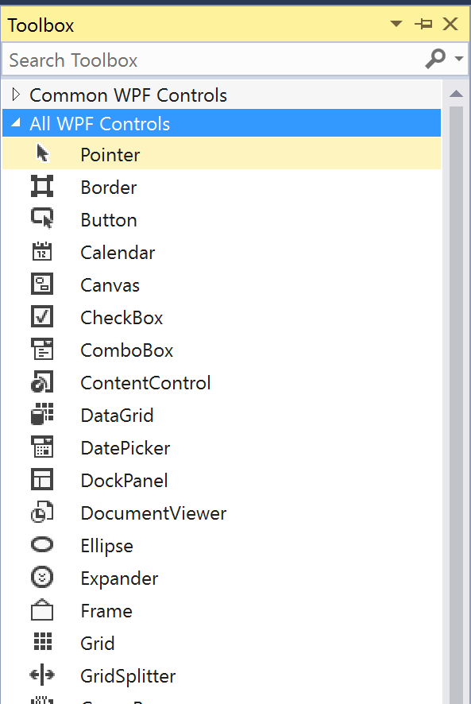
Toolbox
Similar to AndroidStudio and XCode, VisualStudio also has graphical design:
You can drag and drop the elements into the row/column where you want them.
Drag a button into the GUI and set the Grid.Row and Grid.Column numbers.

Slide 5
XML Properties
Set the Height and Width to be either pixels (100, 200, etc) or “Auto” to be set to the grid size (match_parent).
Name – similar to id in Android. It automatically generates the variable name in C#. You don’t have to do something like: button = (Button)findViewById(R.id.button);
The event handlers are set in XML similar to JavaScript:
Click=“ClickHandler”.
Event = “Function Handler Name”

Slide 6
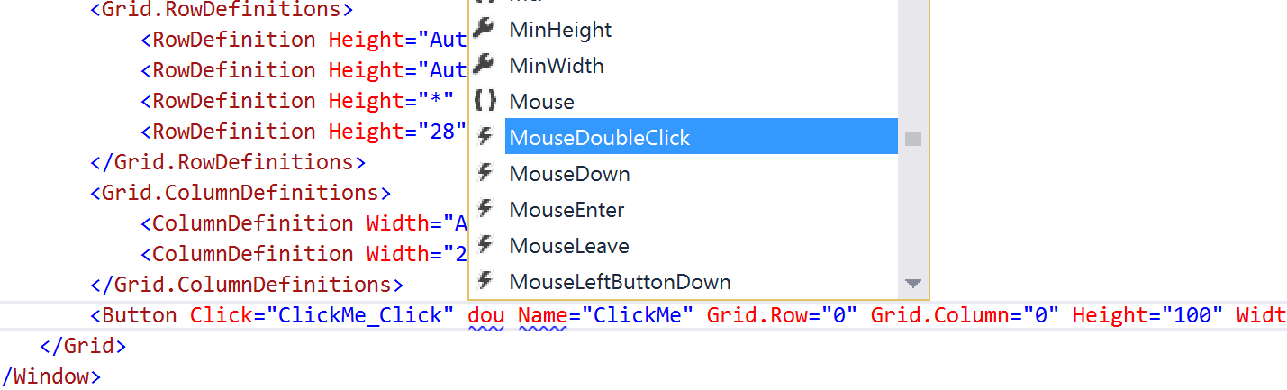
Event Handler
If you start typing anything inside the XML tag, the events are shown by lightning bolts (MouseDoubleClick, MouseDown…):

Slide 7
C# event handlers
In the XAML code, right click on the event handler name, and select Go To Definition. It will generate the C# function for you:
private void ClickMe_Click(object sender, RoutedEventArgs e)
{
}
private void DblClk(object sender, MouseButtonEventArgs e)
{
}
Like JavaFX, XCode, and Android, the sender object is what is being clicked. The parameter e tells you something about the event (position: GetPosition, number of mouse clicks: ClickCount )

Slide 8
XAML Layout Types
In C#, a layout is called a Panel, similar to JavaFX Pane
StackPanel is similar to LinearLayout, HBox, VBox
GridPanel is similar to GridPane
WrapPanel is similar to FlowPane, where items wrap to the next line if there is not enough room.
DockPanel is similar to BorderPane (Top,Bottom, Left, Right, Center)
Example: http://www.c-sharpcorner.com/UploadFile/0b73e1/different-types-of-panels-in-xaml-layout/

Slide 9
ListView
You can set the data source of a ListView. In XAML, set ItemsSource=“C# List variableName”.
In C#, set listVariable.ItemsSource = aListObject
List<string> items = new List<String>() { "A", "B", "C" };
this.theList.ItemsSource = items;

Slide 10
C# grid view binding
Similar to showing various columns in a TableView in JavaFX, C# can also show the results of getter functions in various columns:
<ListView ItemsSource="{Binding Rows, UpdateSourceTrigger=PropertyChanged, Mode=TwoWay}">
<ListView.View>
<GridView>
<GridViewColumn Width="200" Header="ID" DisplayMemberBinding="{Binding Path=ID}" />
<GridViewColumn Width="200" Header="Category" DisplayMemberBinding="{Binding Path=Category}" />
<GridViewColumn Width="200" Header="Text" DisplayMemberBinding="{Binding Path=Text}" />
</GridView>
</ListView.View>
http://stackoverflow.com/questions/17003998/simple-listview-data-binding

Slide 11
Summary
XAML is similar to Android XML layouts, where you can directly manipulate the XML code.
Windows XAML has failed to gain popularity, since the Windows 8 Menu system has reverted to previous look. However, Live tiles remain and are written in XAML.
Windows phone is dead, no more Nokia phones. What remains to see is how the Windows 10 ecosystem will work (XBox, Tablet Mode, Windows desktop)

