Slide 1
CST2335 Graphical Interface programming
Week 8
Toolbar and Dialogs

Slide 2
Introduction
This week, you will learn how create a toolbar, and add items for a menu.
You will also learn how to create dialog boxes for getting user input, and displaying information to the user.

Slide 3
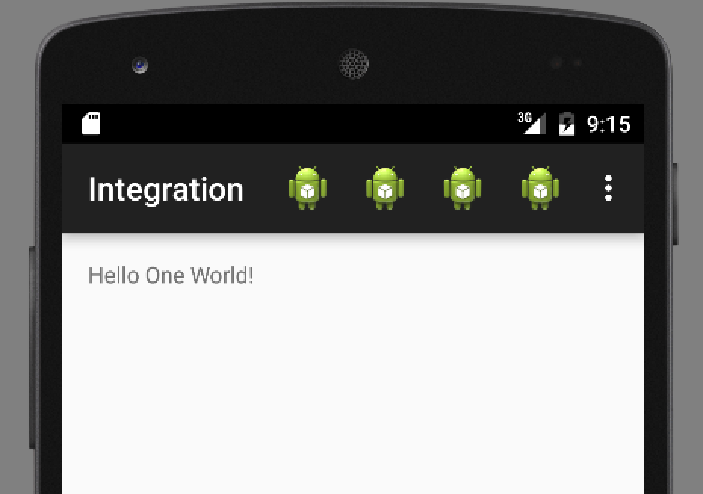
Action Bar
Menu Items
Overflow menu

Slide 4
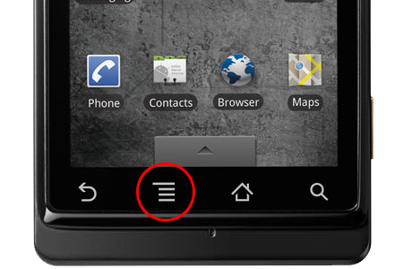
Action Bar
All Activities have an Action Bar associated with them. It is really a menu, but you can associate Icons with the menu items.
It was introduced in Android version 3. Previously, Android had a dedicated hardware button for making the menu appear.

Slide 5
Toolbar
To use the ToolBar class:
Add V7 AppCompat library to the project
See http://developer.android.com/tools/support-library/setup.html
Make your Activity extend AppCompatActivity
In the Manifest, specify a theme with NO ActionBar
Add a ToolBar element to the Activity’s layout

Slide 6
Using the ToolBar
... In MyActivity.java…
public class MyActivity extends AppCompatActivity {
// ...
}
... In Manifest...
<application
android:theme="@style/Theme.AppCompat.Light.NoActionBar"
/>

Slide 7
ToolBar
... Then in layout...
<android.support.v7.widget.Toolbar
android:id="@+id/my_toolbar"
android:layout_width="match_parent"
android:layout_height="?attr/actionBarSize"
android:background="?attr/colorPrimary"
android:elevation="4dp"
android:theme="@style/ThemeOverlay.AppCompat.ActionBar"
app:popupTheme="@style/ThemeOverlay.AppCompat.Light"/>

Slide 8
ToolBar
... In MyActivity.java…
@Override
protected void onCreate(Bundle savedInstanceState) {
super.onCreate(savedInstanceState);
setContentView(R.layout.activity_my);
Toolbar myToolbar = (Toolbar) findViewById(R.id.my_toolbar);
setSupportActionBar(myToolbar);
}

Slide 9
Adding items
By now, the toolbar is empty but it is integrated with the Activity. The next step is to create a <Menu> resource, and add <Item> tags to your menu.

Slide 10
Menu Items
There are several important parts of a menu item:
android:id=“@+id/someID” // This is used later
android:icon=“@drawable/someFilename” //A PNG file to draw
android:title=“@string/text” //Text for overflow menu
android:orderInCategory=“100” //Items are drawn in order
app:showAsAction=“always|ifRoom|never” //should icon be drawn?

Slide 11
Example
/res/menu/main_activity_actions.xml
<menu xmlns:android="http://schemas.android.com/apk/res/android" xmlns:app="http://schemas.android.com/apk/res-auto" xmlns:tools="http://schemas.android.com/tools" tools:context=".MainActivity"> <item android:id="@+id/action_settings" android:title="@string/action_settings" android:orderInCategory="100" app:showAsAction="never" /> <item android:id="@+id/action_one" android:title="One" android:icon="@drawable/ic_launcher" android:orderInCategory="101" app:showAsAction="always" /> <item android:id="@+id/action_two" android:title="Two" android:icon="@drawable/ic_launcher" android:orderInCategory="102" app:showAsAction="always" /> <item android:id="@+id/action_three" android:title="Three" android:icon="@drawable/ic_launcher" android:orderInCategory="103" app:showAsAction="always" /> <item android:id="@+id/action_four" android:title="Four" android:icon="@drawable/ic_launcher" android:orderInCategory="104" app:showAsAction="always" /> </menu>

Slide 12
Activity functions
The Activity class has 2 functions you should override:
onCreateOptionsMenu(Menu m)
onMenuItemSelected(MenuItem mi)
onCreateOptionsMenu(Menu M) //This inflates the menu from your XML layout:
@Override
public boolean onCreateOptionsMenu(Menu menu) {
// Inflate the menu items for use in the action bar
MenuInflater inflater = getMenuInflater();
inflater.inflate(R.menu.main_activity_actions, menu);
return true;
}

Slide 13
Activity functions
onMenuItemSelected(MenuItem mi) - This function responds to an Item being selected:
@Override
public boolean onOptionsItemSelected(MenuItem item) {
// Handle presses on the action bar items
switch (item.getItemId()) {
case R.id.action_one:
//show a Toast
break;
case R.id.action_two:
//launch another Activity
break;
...
}
}
Add cases for each ID of items
from your XML menu

Slide 14
ToolBar summary
Add a ToolBar to your Activity Layout.
In the Activity’s OnCreate, get the ToolBar and call setActionToolbar().
Create a Menu resource with Items in the menu.
In onCreateOptionsMenu(), inflate the Menu resource.
Handle each Item id in onOptionsItemSelected()

Slide 15
Dialog Boxes
Dialog boxes are fairly flexible for how you design them.
They follow the builder pattern, where you create a DialogBox, and keep chaining function calls.
The 3 important parts are:
Text – what are you telling / asking the user?
Positive Button – A button for accepting
Negative Button – A button for rejecting / canceling

Slide 16
Dialog Boxes
AlertDialog.Builder builder = new AlertDialog.Builder(getActivity());
builder.setMessage(R.string.dialog_fire_missiles)
.setPositiveButton(R.string.fire, new DialogInterface.OnClickListener() {
public void onClick(DialogInterface dialog, int id) {
// What to do on Accept
}
})
.setNegativeButton(R.string.cancel, new DialogInterface.OnClickListener() {
public void onClick(DialogInterface dialog, int id) {
// What to do on Cancel
}
});

Slide 17
Dialog Boxes
If you need a 3rd button, there is a Neutral button:
.setNeutralButton(R.string.fire, new DialogInterface.OnClickListener() {
public void onClick(DialogInterface dialog, int id) {
// What to do on Neutral button
}
})
Once a Builder has all the information, call .create() to cause Dialog to be built. After, call .show() for the Dialog to be presented:
builder.create().show();

Slide 18
Custom Dialog Boxes
You can create a specific layout resource, and inflate it for your Dialog:
LayoutInflater inflater = getActivity().getLayoutInflater();
builder.setView(inflater.inflate(R.layout.YourLayout, null))
You can then continue setting the Positive/Negative buttons:
.setPositiveButton( ...)
.setNegativeButton( ... )
.create() .show()

Slide 19
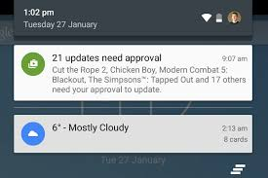
Notifications
Android has a Notification manager (Singleton)
NotificationCompat.Builder mBuilder =
new NotificationCompat.Builder(this)
.setSmallIcon(R.drawable.notification_icon)
.setContentTitle("My notification")
.setContentText("Hello World!");
There should also be an Intent to launch an Activity if you click the Notification:
Intent resultIntent = new Intent(this, ResultActivity.class);

Slide 20
Notifications
Tie the two together:
PendingIntent resultPendingIntent = PendingIntent.getActivity( this, 0, resultIntent, PendingIntent.FLAG_UPDATE_CURRENT);
mBuilder.setContentIntent(resultPendingIntent);
Then launch the Notification:
int mNotificationId = 001;
NotificationManager mNotifyMgr = (NotificationManager) getSystemService(NOTIFICATION_SERVICE);
mNotifyMgr.notify(mNotificationId, mBuilder.build());
When the user clicks the notification, the Intent will transition to the new Activity.

Slide 21
Notifications on Watch or Auto
You need an “Extender” to redirect the Notification to Wear:
NotificationCompat.WearableExtender wearableExtender = new NotificationCompat.WearableExtender(). setHintHideIcon(true).setBackground(mBitmap);
For Android Auto:
NotificationCompat.CarExtender carExtender = new NotificationCompat.CarExtender(). setColor(R.id.colorAccent).setIcon(mBitmap);
Add the “redirect” to the builder() function:
new NotificationCompat.Builder(this).extend(wearableExtender).build();

Slide 22
Summary
ToolBars allow you to put menus at the top of your activity
There is some work involved in getting it set up, but then you can just add Menu Items to your Menu resource, and handle the case when their ID is selected in onOptionsItemSelected().
Dialog boxes allow you to quickly create custom Dialogs. You can also create your own layout and attach callbacks.

