Slide 1

Sex Education & Sexual Activity.
Is there a link?
Sofia Pozsonyiova
Notes:
For my presentation I will be focusing on whether or not there is a link between sexual education and sexual activity.

Slide 2
Motivation
A topic of interest
Own experience
An important issue that has been debated for a lengthy amount of time
Notes:
That being said some motivation for the project:
It is a topic of interest for me and is something I experienced myself. I went to a Catholic high school and a private middle school in South Florida and neither provided any form of sexual education as they thought it would lead to higher rates of sexual activity.
To this day both of those schools still do not provide any form of sexual education….however, this is not uncommon many schools within the United States feel similarly. Statistics actually show only 13 states actually mandate comprehensive sex education but even within those states certain schools chose not to abide (USC Nursing).

Slide 3

Do schools that include comprehensive sex education have higher rates of sexual active adolescents?
Notes:
With that my research question….Do schools that include comprehensive sex education have higher rates of sexually active adolescents?

Slide 4
Who is of interest?
What is the overall goal?
Looking at Schools and Adolescent Students
Schools: Within United States
Students: Middle and High School
Help with advising whether or not schools should implement comprehensive sex education
Notes:
For this study, we are focusing on adolescent students within the United States that are in either middle or high school. The overall goal of this study is to help with advising whether or not schools should implement comprehensive sexual education, and to help debunk the highly anticipated question of does sex ed increase sexual activity.

Slide 5
Variables of Interest
Type of School (Charter, Private, etc.) | Religious Beliefs | Age/Grade
Location | Political Beliefs | Race/Ethnicity
School Funding | Perceived Gender | Perceived Gender
Duration of Course | Knowledge of Safe Sex | Parental Beliefs
Already Active | Substance Use | Parent Education
Comprehensive Sex Education | Adolescent Sexual Activity
Notes:
Here are the variables of interest. We found these to be the most instrumental to our study, and feel as though they can help capture/explain the relationship between sexual activity and sex ed. A lot of these variables are either specific to the school itself, the student, and or parent/guardian.

Slide 6
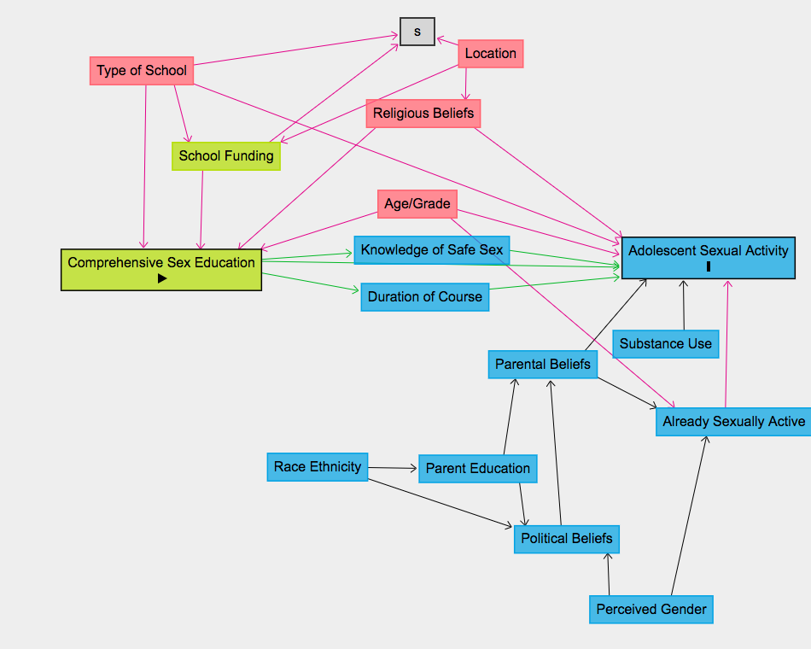
General DAG
Notes:
On that note, the first step of my study was to draw a DAG (directed acyclic graph) that represents my knowledge of the situation. DAGs provide a way to visually represent and better understand the key concepts of exposure, outcome, causation, confounding, and bias. I want to note that comprehensive sex education is my exposure and adolescent sexual activity is my outcome. As you can see there are causal, and non causal pathways between the exposure and outcome.
It is important that we have an appropriate DAG because in order to correctly interpret a causal relationship we must correctly identify and appropriately adjust for confounders (variables that influence both the dependent variable and independent variable) and potential sources of bias.

Slide 7
IP Weighting
Goals:
Identify our population
Remove confounding by creating a “pseudo-population”
Fit a marginal structural model
Make sure each individual received the appropriate weight
Notes:
This brings me to my first step of my analysis, inverse probability weighting, or better known as IP Weighting. As you can see in my DAG there are a couple of confounders indicated by the stars. To account for these confounders we can use Inverse Probability Weighting. Inverse Probability Weighting removes confounding by creating a “pseudo-population” in which the treatment is independent of the measured confounders.
In our pseudo-population everyone essentially exists twice as treated and as untreated. And in our pseudo-population we can fit a marginal structural model using inverse probability weights where each individual received the appropriate \frac{1}{P(A=1|Z)} or \frac{1}{P(A=0|Z)} weight.
The idea of weighting observations in a survey sample is based on the idea that the sample surveyed is not quite representative of the broader population. The goal is to make the sample look more like the population, so we can create weights to in a way standardize our population.

Slide 8

What is the average causal effect of comprehensive sex education from schools that provided data on sexual activity?
Notes:
With that the question we will now be asking is….What is the average causal effect of comprehensive sex education from schools that provided data on sexual activity?

Slide 9
Part 1: Modeling to Obtain Weights
Step 1: Find the de-separating set: Age/Grade, S, School Funding, Type of School
Step 2: Fit an appropriate treatment propensity score model
Step 3: Create the treatment propensity scores
Step 4: Form inverse probability weights
ps_treat_mod <- (education[treatment] ~ poly(Grade,2) + factor(Type of School) + poly(School Funding,2))
ps_treat <- dplyr::case_when( dataset$sexualactivity==1 ~ predict(ps_treat_mod, type = "response"), dataset$sexualactivity==0 ~ 1-predict(ps_treat_mod, type = "response") )
dataset$weights_treat <- 1/ps_treat
Notes:
Part 1 of IP Weighting involves modeling to obtain our IP weights.
Step 1:
First, we want to find the deseparating set. The deseparating set is the minimal sufficient adjustment set containing S for estimating the total effect of Comprehensive Sex Education on Adolescent Sexual Activity. Therefore, based on the DAG in the previous slide, the set of variables Z that d-separates treatment (comprehensive sex education) and outcome(Adolescent Sexual Activity) contains: Age/Grade, Religious Beliefs, Type of School, S. I want to note that for our selection node we are just focusing on schools that provided data. It would be nice if we knew about the causal effect for all schools, but it is fairly unlikely that we would receive that data due to a variety of reasons, thus, we are going to just focus on schools that do provide data.
Step 2:
To continue, after identifying the de-separation set, it is important to fit an appropriate treatment propensity score model. There is a very defined set of variables that must go into the treatment propensity score model and these variables are exactly the set that is needed to d-separate comprehensive sex education and sexual activity under the null. The model on the right is that treat model.
*I want to note that for simplicity I assumed that a quadratic relationship for the quantitative variables gives a good fit, and I wrapped categorical variables inside factor in my model formula. Additionally, for the purpose of this analysis I am assuming age and grade go hand in hand. This isn't always accurate as there could be age outliers in each grade.
Step 3:
Once my model is created I can create a new variable that contains the IP weights for treatment..The second set of code is the code that would create the treatment propensity scores. In that code each row computes predictive probabilities of the outcome when it is 1 or 0, which helps us obtain our actual propensity scores.
Step 4:
The last row of code forms the propensity scores and it actually adds the weights into the dataset.
*Again because I am focusing on schools that provided data IP Censoring is not needed.

Slide 10
Part 2: Obtaining Summaries
Step 5: Fit our marginal structural models
Step 6: Obtain model summary and 95% confidence intervals
Step 7: Interpretations!
msm_fit <- geeglm(sexualactivity ~ education, data = dataset, weights = weight1, id = schooldistrict, corstr = "independence" )
summary(msm_fit)
mean_estimate + c(qnorm(0.025), qnorm(0.975))*Std.err
Notes:
Step 5:
From there we want to go ahead and fit our marginal structural models: A marginal structural model (MSM) is a model that relates potential outcomes Y^a to the treatment variable (as opposed to the naturally observed outcomes Y), and it would look as the first set of code on the right.
Step 6:
After the model is fit, we can obtain a summary and even obtain the 95% confidence interval for the treatment variable, education. Based on our CI we can determine if we actually have evidence for a true causal effect in the broader population. The last two pieces of code will provide those summaries/information.
Step 7:
The last step is interpretations! An example interpretation can look as follows:
Intercept: The average potential sexual activity if the entire population were forced to not receive comprehensive sex education (A = 0).
The Education Variable: This is the average causal effect. The average potential rate of sexual activity is ___ higher/lower if we had everyone receive comprehensive sex ed as compared to not having everyone receive comprehensive sex ed.
Lastly the CI: The 95% confidence interval is i.e (2.23, 4.81), so we have evidence that there really is a causal effect. However, if the CI was -2.23 to 4.81 then we would not have evidence that there really is a causal effect.

Slide 11
Mediation Analysis
Goals:
Understand direct and indirect pathways from treatment to outcome
Understand the effect of mediator variables on treatment and outcome
Notes:
The next step in our analysis is mediation analysis. Mediation analysis encompasses a set of tools for breaking down the different components of the effect of a treatment.
As you can see my two mediator variables are duration of course and knowledge of safe sex, and our goals for this portion of the analysis are:
To better understand the direct and indirect pathways from treatment to outcome
Understand the effect of the mediator variables on treatment and outcome

Slide 12

Is the effect of the framing treatment mediated more by the duration of the course or by the amount of knowledge of safe sex?
Notes:
With that, the research question we are now looking at it….Is the effect of the framing treatment mediated more by the duration of the course or by the amount of knowledge of safe sex?

Slide 13
Part 1: Modeling
knowledge_mod <- glm(knowledge ~ education + Agegrade + typeofschool + religiousbeliefs, data = dataset)
out_mod <- lm(sexualactivity ~ knowledge + education + poly(Agegrade,2) + typeofschool + religiousbeliefs, data = dataset)
course_mod <- glm(DurationofCourse ~ education + Agegrade + typeofschool + religiousbeliefs, data = dataset)
out_mod <- lm(sexualactivity ~ DurationofCourse + education + poly(Agegrade,2) + typeofschool + religiousbeliefs, data = dataset)
Step 1: Identify all of our necessary variables
Step 2: Fit appropriate models
Notes:
Part 1 of mediation analysis involves modeling.
Step 1:
We want to first start off my identifying all of our necessary variables:
In this analysis:
Outcome Variable:
• Sexual Activity
Treatment Variable:
• Comprehensive Sex Education
Mediator Variable:
• Duration of Course
• Knowledge of safe sex
Confounder Variables:
• Age/Grade
• Religious Beliefs
• Type of School
Step 2:
Once the variables are identified we can fit appropriate models. We would need to fit an appropriate model for each mediator (duration of course and knowledge of safe sex) and then the outcome (sexual activity). It is important to note that when fitting models I would to keep in mind if the variable I am trying to predict is quantitative/categorical because that will determine the linear regression model I would use for it. I also need to see if my predictors are quantitative/categorical because that too will decide whether linear or nonlinear relationships would be appropriate. Example models can be found on the right. You may notice that I have two output models, which make sense because we want to have one for each mediator model.

Slide 14
Part 2: Simulation
Step 3: Perform simulation to estimate mediation effects
Step 4: Interpret output
mediate_out <- mediate(knowledge_mod, out_mod, treat = "education", mediator = "knowledge", robustSE = TRUE, sims = 1000)
summary(mediate_out)
Notes:
Step 3:
With the mediator and outcome models fit, we can use the core function in the mediation package: mediate(). The code performs the simulation method to estimate mediation effects. In the box I have provided some example code for one of the mediator and output models. Once these models are created we can move on the printing out the summary and interpreting the output.

Slide 15
Part 3: Interpreting Results
Quasi-Bayesian Confidence Intervals
Estimate 95% CI Lower 95% CI Upper p-value
ACME (control) 0.127861 0.035138 0.22 0.006 **
ACME (treated) 0.127848 0.035794 0.22 0.006 **
ADE (control) 0.006869 -0.075335 0.09 0.848
ADE (treated) 0.006856 -0.081682 0.09 0.848
Total Effect 0.134717 -0.000106 0.25 0.052 .
Prop. Mediated (control) 0.926828 0.023210 2.99 0.050 *
Prop. Mediated (treated) 0.931565 0.024946 2.84 0.050 *
ACME (average) 0.127855 0.035344 0.22 0.006 **
ADE (average) 0.006862 -0.078817 0.09 0.848
Prop. Mediated (average) 0.929196 0.024078 2.91 0.050 *
---
Signif. codes: 0 '***' 0.001 '**' 0.01 '*' 0.05 '.' 0.1 ' ' 1
Sample Size Used: 265
Simulations: 1000
Notes:
Step 4: Interpreting results
This is an example of the sample output. To take a step back,considering the mediator explicitly allows us to distinguish between two types of effects that may be of interest: (1) the indirect effect, which is the effect of A that is mediated by M and (2) the direct effect, which is the pathway that does not involve M (may or may not actually be direct).
One such effect is the average controlled direct effect (CDE).It can be interpreted as the average effect when comparing the treated and untreated and when the mediator M has been set to m.
Related to the controlled direct effect is the natural direct effect (NDE).The NDE is the average effect when comparing the treated and untreated and when the mediator M has been set to M0, its natural value under no treatment.
The last effect of interest is the natural indirect effect. This time we fix the treatment at 1, and we compare the situations where the mediator takes its treated value (M1) and its untreated value (M0). The key difference here, as compared to the direct effects, is that we allow the mediator to vary naturally in response to changing treatment.
Thus, saying that:
ACME (treated) corresponds to the natural indirect effect that we have defined:
- Interpretation: If we compare two worlds, (1) a world where everyone receives the treatment (c.education) and let knowledge of safe sex practices occur naturally in response to that treatment as compared to (2) a world where everyone receives the treatment (c.education) and knowledge of safe sex practices occur naturally in response to not receiving (c.education), there would be a ___% increase/decrease in the probability of adolescent sexual activity.
95% confidence interval: If zero is not contained in the 95% CI then we do have evidence for a true indirect effect in the broader population.
ADE (control) corresponds to the natural direct effect.We can interpret this using its potential outcome definition. If we compare two worlds, (1) a world where everyone receives comprehensive sex ed and knowledge of safe sex practices occur naturally in response to not receiving the education as compared to (2) a world where everyone does not receive the education and knowledge of safe sex practices occur naturally in response to not receiving the education, there would be a ___% increase/decrease in the probability of adolescent sexual activity.
We then want to look at `Prop. Mediated (treated)` to see what proportion of the total effect is due to the NIE. To understand how much of the total affect goes through that pathway.
The Prop.Mediated (average) tells us how much of the total effect is due to the indirect effect, so ___% of the effect is explained due to the mediated variable, knowledge of safe sex.

Slide 16
Part 4: Repeating Process & Conclusions
• Duration of Course : 87%
• Knowledge of safe sex : 90%
Step 5: Repeating the analysis for other model
“We then have evidence to say that the effect of comprehensive sex education on adolescent sexual activity is mediated more by a student's knowledge of safe sex rather than the duration of the course.”
Notes:
Step 5:
We need to repeat this analysis for the two other mediators to understand how much of the total effect goes through each pathway.
Let's say we completed the analysis for each of the models and these are our final values:
• Duration of Course : 87%
• Knowledge of safe sex : 90%
We then have evidence to say that the effect of comprehensive sex education on adolescent sexual activity is mediated more by a student's knowledge of safe sex rather than the duration of the course. That is, the main mechanism underlying adolescent sexual activity is whether or not a student is knowledgeable about safe sex practices before the comprehensive education.

Slide 17
Causal Discovery:
All possible edges present
Use regression models to do a conditional independence test
Check the p-value to decide whether an edge can be kept or erased
Repeat iterations until we are left with a skeleton
Notes:
The process of causal discovery aims to find causal relations and can be applied to data to help inspire a new DAG. This will be the fourth step in the analysis.
The Causal Discovery process goes as follows:
The algorithm starts with all possible edges present.
Regression models can then be used for conditional independence tests. The skeleton updating step tries to then make each of the pairs conditionally independent given another set of variables.
Looking at p-value: If the p-value for the variable of interest is below a certain threshold then we can reject the null hypothesis (of independence) and conclude dependence, but if the p-value is above our threshold then we cannot reject the null hypothesis and must assume independence. If we reject the null then we cannot de-separate the set, thus an edge must be there. However, if we accept the null then the set can be de-separated and thus the edge would be erased.
This process continues until we are left with a skeleton with some form of edge direction. Unfortunately, it is hard to get a full DAG with all edges oriented, but the pattern that we do receive from discovery might allow to explore different DAGs.
We would then have to go through the analysis again for the new DAG to understand A to Y, and we actually may see that the relationship changes under the new DAG. We can then use sensitivity analysis to compare different results from the different DAGs to see which one captures/explains the relationship between A and Y.

Slide 18
Goals:
Quasi-Experimental
Design
Used the assess the effectiveness of an intervention
Mimics Randomized Trial
Notes:
Our fourth step includes utilizing Quasi-Experimental Design.
Quasi- Experimental designs are studies that aim to evaluate interventions by mimicking randomized experiment. Randomized experiment are considered the gold standards and this is because in a randomized experiment, investigators randomly assign individuals to treatment groups, so none of these confounders can be a cause of treatment anymore. The only cause of treatment is the random number generator. Although these variables still cause the outcome, there are no longer undesired, non-causal paths between the treatment and outcome. So randomization takes care of both measured and unmeasured confounders. But most of the time, experiments are unethical or infeasible from a time or resource perspective.
Thus, quasi experiments aim to demonstrate causality between an intervention and an outcome just like randomization and are good approaches to take! For my analysis, I will be using Interrupted Time Series.

Slide 19

Interrupted Time Series
Notes:
The quasi-study design that I will be focusing on is interrupted time series. The Interrupted time series focuses on applying an intervention at a certain point in time to affect treatment. The hope is that the timing of the intervention is random enough such that the trends in the outcome are comparable just before/after intervention and that there is a sudden change in the outcome. If a discontinuity in the trend arises around the time of the intervention, we may be able to attribute that jump to the intervention.
Advantages:
It can make full use of the longitudinal nature of the data and account for pre-intervention trends
Can see/not see a change as a result of the intervention
Can include controls which strengthen the analysis and help us understand what trends would have looked like in the absence of the intervention

Slide 20
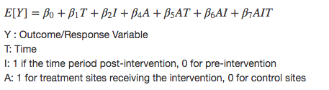
Step 1: Model
Notes:
For ITS: We would usually use an autoregressive and or moving average types of time series model to model trends over time. However, I will just be using a general form of a linear regression model for an interrupted time series design as seen here.
Where:
Y is my outcome
T is time
I is if the time period was post or pre intervention, and
A is whether or not a school received the intervention
Therefore, Step 1 would be creating our model as I have done above.

Slide 21
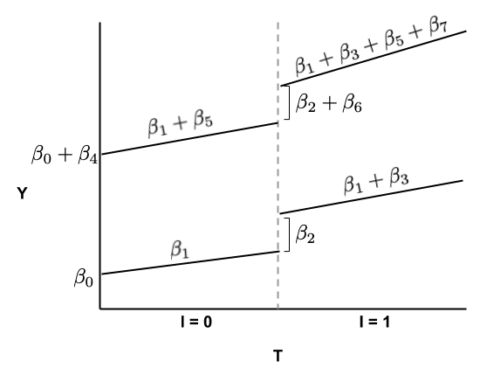
Step 2: Visualization
Treatment Site
Control Site
Notes:
From there I can incorporate a figure to look at the relationship between Y and T and show how the slopes change over time and in between treatment vs. control sites. There is an example above, and in that example we can look at pre vs post intervention and treatment vs. control sites.
Hypothetically speaking: I would look at schools that do not have sex ed offered and split my sample to be a testing and control sample. I would then assign an intervention (providing comprehensive sex education) to my treatment group and see if there is a change in sexual activity. It is important to note that when picking control sites it would be nice if the treatment and control sites had very similar pre-intervention trends because this indicates that the control sites were chosen to be very comparable to the treatment sites.

Slide 22
Step 3: Summarizing
Limitations:
Another event can happen
There are many aspects to consider that rely a lot on solid contextual knowledge and expertise
Notes:
Lastly, we want to summarize our findings. We would then want to look at beta_6 and beta_7 as they represent the causal effect of the intervention.
Specifically:
beta_6 = Captures the jump in the trend because it captures how much more the trend jumps (from pre-intervention to post-intervention) in the treatment sites as compared to the control sites. The jump in control sites can be viewed as an estimate of the effect of any confounding events. How much more the trend for the treatment sites jumps thus gives an estimate of the “jump” part of the causal effect.
beta_7 = Captures the change in the slope of the trend because it captures how much more the slope changes (from pre-intervention to post-intervention) in the treatment sites as compared to the control sites. As for the jump, the change in slope (pre to post) in the control sites is an estimate of the effect of confounding events, and we remove this part from the change in slope for the treatment sites to get β7, an estimate of the causal effect on the slope.
Even though the method does seem advantageous, there are limitations that arise with it:
The jump could be attributed to another event/intervention that could have happened at the same time
There are many aspects to consider that rely a lot on solid contextual knowledge and expertise:
What sorts of confounding events are important to consider? Does this help select control states?
What is the time scale on which we might expect to see effects of sex ed? Surely not instantly, but how soon?

Slide 23

Time-Varying Treatment Setting
What would the outcome be if the comprehensive sex education was over four years instead of another combination?
Notes:
The final step is looking at time-varying treatment setting. A research question that could be addressed in this setting is “What would the outcome be if the comprehensive sex education was over four years instead of another combination?”. By combination I mean if students had to take it year 1 and year 3 or year 2 and 3, etc. In our analysis comprehensive sex education is our treatment, and in our case it is not a fixed point intervention. However, we may be able to ask questions about the complex effect of sex education over time. We need to keep in mind though that in order to de-separate the many A’s and the one Y we need to be able to measure the time varying confounders like age, and in our case age is feasible! But not all will be feasible.

Slide 24
Final Thoughts
Notes:
All in all, as you can see there are several different avenues of investigation from Ip Weighting to Causal Discovery which can aid us in better understanding the relationship between comprehensive sex education and sexually active adolescents.

Slide 25
Thank You! Questions?
Notes:
Thank you! Any questions?

