Slide 1
NYC Taxi Fare Prediction
Prashant Swarnapuri

Slide 2
Dataset
Shared on Kaggle by Google as part of a challenge
55M records of taxi trips in the NYC region from 2009 to 2015
Data set consists of:
Pickup datetime
Pickup coordinates
Dropoff coordinates
Passenger count
Fare amount

Slide 3
Technical Stack
Compute
Spark Cluster hosted on Databricks (AWS)
PySpark 3.1.2
32GB memory and 4 cores
Databricks IPython Notebook Environment
Pandas + Seaborn for visualizations
Machine Learning using MLLib
MLFlow used for tracking results of various runs

Slide 4
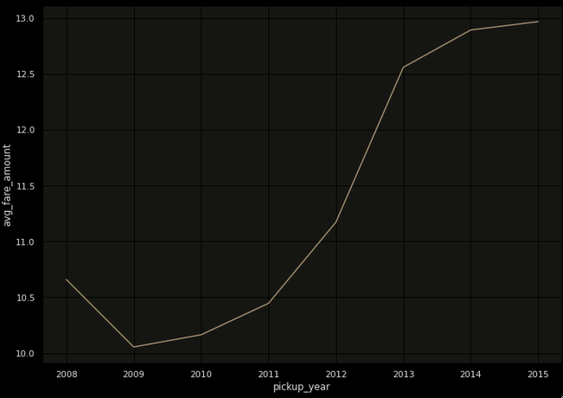
Data Exploration – Avg. Fares by Year
Average fares increased over the years
$10 in 2009 to $13 in 2015

Slide 5
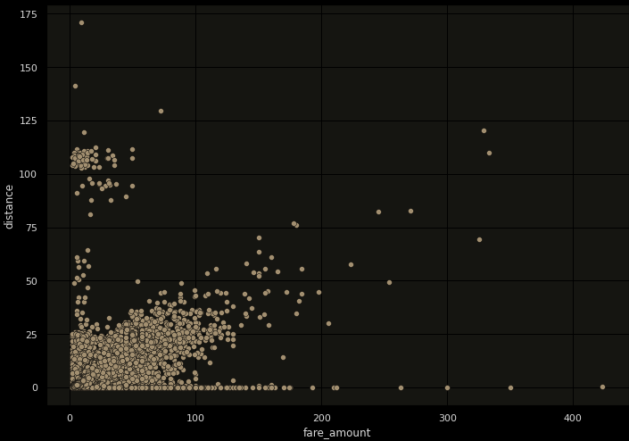
Data Exploration – Distance vs Fare
There is a somewhat linear correlation between distance and fare
Fares with 0 distance and non-zero fares are likely to be bad data

Slide 6
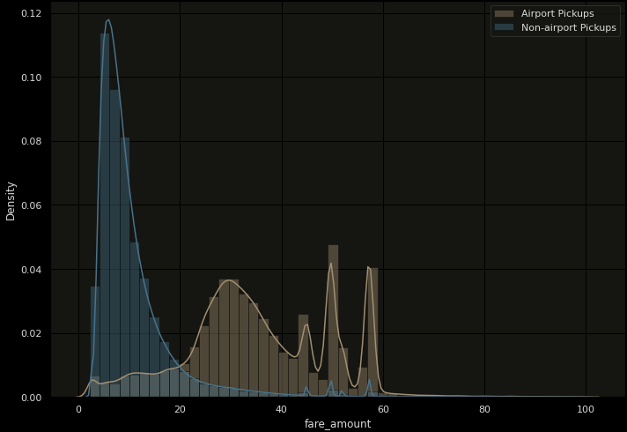
Data Exploration – Special Airport Fares
Airport pickups tend to be more expensive
There seems to be some fixed rate ceilings ($50-$60)

Slide 7
Feature Engineering
Distance calculated using coordinate locations using Haversine formula
Extract day of week, year, month to account for seasonal fare trends
Identify trips in peak time (weekday rush hour) and night trips
Special Fare Locations
Airports pickups – JFK, LGA, EWR
1KM radius around these airports designated as special points of interest
Weather data
Obtained from NOAA ASOS records
Two NYC weather stations report data (Manhattan & LaGuardia)
Contain Precipitation and snow information at hourly level

Slide 8
Training
Baseline Model
Linear Regression from MLLib
Default hyper-parameters (reg = 0, elasticNet = 0)
All 55M records with 80/20 split
RMSE of 5.45
Random Forest Model
Default hyper-parameters (maxDepth=5, numTrees=20)
RMSE of 4.94
Gradient Boosted Model
Default hyper-parameters (maxDepth=10, numTrees=20)
RMSE of 4.32

Slide 9
Cross Validation + Parameter Tuning
Sampling of the dataset – 550K records
Cross Validate with 4 folds
9 different hyper parameter combinations per Model
Linear Regression – regParam, elasticNetParam
Random Forest – numTrees, maxDepth
Gradient Boosted Trees – maxDepth, maxBins
Average RMSE with best parameters
Linear Regression – 5.30
Random Forest - 4.33
Gradient Boosted Trees – 4.35

Slide 10
Final Training
All 55M records included (80/20 split)
All features included
Used the best parameters from the cross validation
Final test data RMSE
Linear Regression – 5.31
Random Forest - 4.31
Gradient Boosted Trees – 4.06

Slide 11
Thank you
Questions?

