Slide 1
NexusThree
Team Members:
PRIYADARSHAN. S P
NITHISH. N
SUPRAJETH. S S
SMART COURSE ORGANIZER
Problem Statement : “Learners and instructors lack a centralized platform to store course materials, track progress, and get AI help.”

Slide 2
Problems:
📁 Scattered Files
📵 No Central Hub
Students store materials in multiple apps, folders, and drives — hard to find.
No single platform to store all course materials in one place.
📊 No Progress Tracking
🤔 Lack of Guidance
Students cannot easily monitor how much they've studied or covered.
No smart assistant to help users find resources or answer questions.

Slide 3
Table Of Contents
Introduction
Objective of the Project
Proposed Solution
Key Features Overview
System Architecture
Overview
Upload Menu
All Materials Menu
Dashboard Menu
AI Chatbot
Advantages
Future Enhancements
Conclusion

Slide 4
Introduction
A web-based platform designed to simplify how students manage study materials.
Allows users to upload, organize, and access course content from any device at any time.
Provides a personal dashboard to track learning progress and stay on top of studies.
Features an AI chatbot to help users navigate the system and answer questions.
Built for students who want a smarter, more organized way to study.

Slide 5
Objective of the Project
Create a unified web platform for uploading and accessing study materials easily.
Help students stay organized by categorizing materials by subject or topic.
Provide a visual dashboard to track study progress and completion status.
Integrate an AI chatbot to assist users with queries and navigation.
Ensure 24/7 accessibility so students can learn at their own pace, from anywhere.

Slide 6
Proposed Solution
Upload
Materials
Store &
Organize
Access
Anytime
Track
Progress
A smart web system with three core menus: Upload, All Materials, and Dashboard.
Secure login so each student sees only their own materials and progress.
AI chatbot for real-time assistance, reducing dependency on external support.
Clean, intuitive UI designed for students with minimal technical knowledge.

Slide 7
Key Features Overview
📤
File Upload
📂
Material Library
📈
Progress Dashboard
Upload PDFs, docs, and notes quickly.
View and search all stored materials.
Visual charts to track study progress.
🤖
AI Chatbot
🔐
Secure Login
📱
Responsive UI
Smart assistant for help and navigation.
Personal accounts with data privacy.
Works on desktop, tablet, and mobile.

Slide 8
System Architecture
Frontend (UI)
HTML, CSS, JS / React
Backend (Server)
Node.js
Database & Storage
Local Storage
Three-tier architecture: Presentation → Logic → Data.
AI chatbot module is integrated into the backend layer.

Slide 9
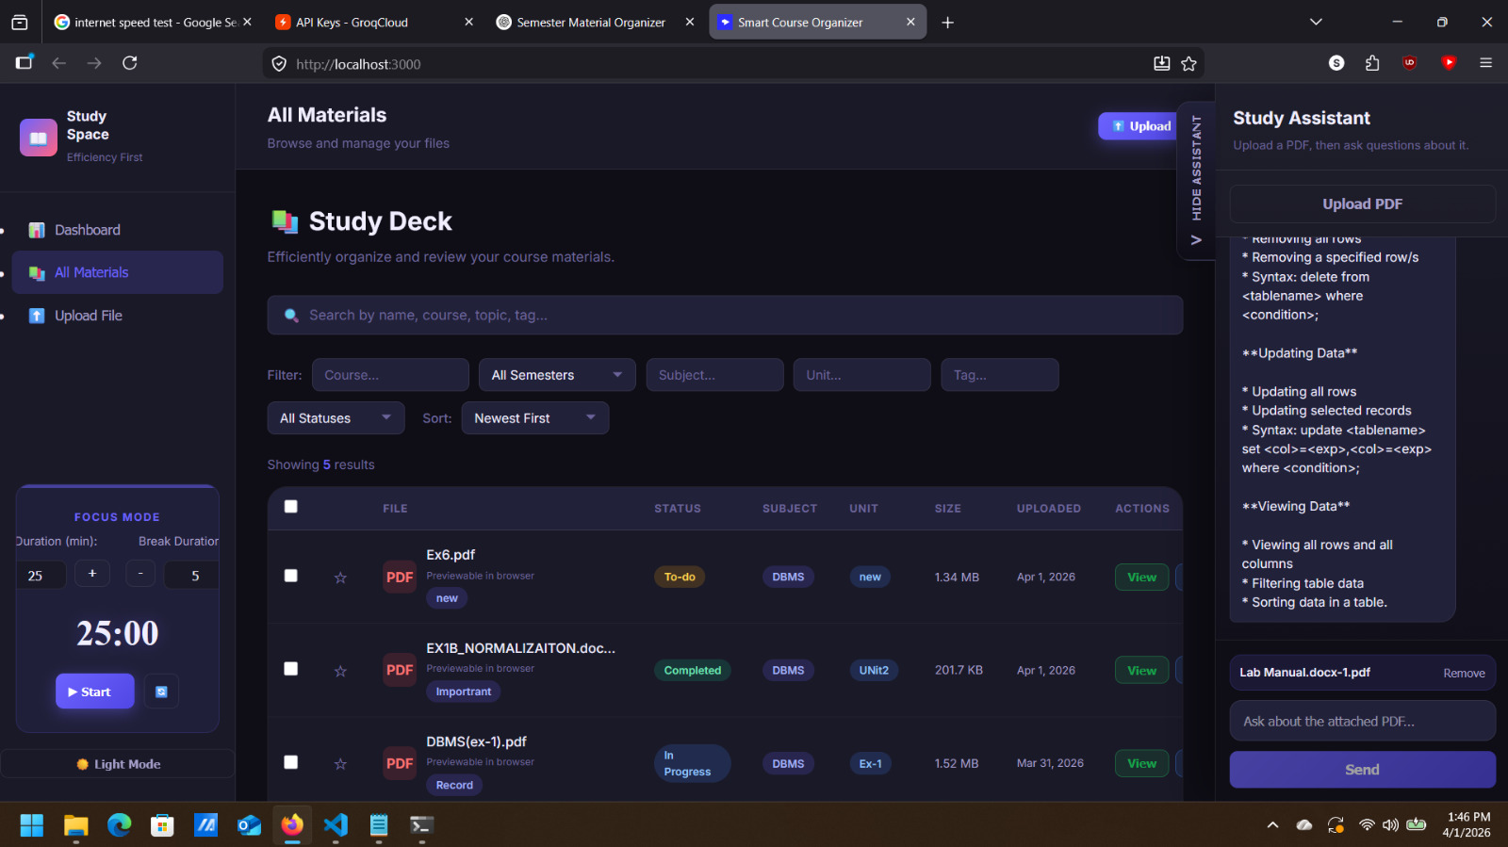
Overview:

Slide 10
Upload Menu — Detailed View
Users can upload files such as PDFs, Word documents, images, and presentation slides.
Option to add a title, subject name, and description for each uploaded file.
Drag-and-drop interface for quick and easy file selection.
Files are automatically categorized and saved to the user's personal library.
Upload history is maintained so users can track what was added and when.
📤
Choose File
Subject Name
Description
Upload

Slide 11
All Materials Menu — Detailed View
Displays a complete list of all study materials uploaded by the user.
Search and filter options to quickly find materials by subject or file type.
One-click download for any stored file to access offline.
Preview option for PDFs and images directly within the browser.
Delete or update materials to keep the library clean and up to date.
📂 All Materials
📄 Math_Notes.pdf
↓ Download
📊 Physics_Slides.pptx
↓ Download
📝 History_Essay.docx
↓ Download
🖼 Bio_Diagram.png
↓ Download

Slide 12
Dashboard Menu — Detailed View
Displays a summary of total files uploaded, subjects covered, and recent activity.
Progress bars and pie charts to visualize study completion per subject.
Streak tracker to motivate daily study habits.
Quick links to recently accessed materials for faster navigation.
All data updates automatically as the user uploads or accesses materials.
📊 Dashboard
12
5
3
Files
Subjects
Days Streak
Math
Physics
History

Slide 13
AI Chatbot — Features & Benefits
🤖
Instant Answers
Responds to user queries about the system in real time.
🔍
Smart Search Help
Helps users find specific materials using natural language.
📌
Navigation Guide
Guides users to the right menu or feature quickly.
💡
Study Tips
Suggests tips, topics, or materials based on user activity.

Slide 14
Advantages
Centralized storage — All materials in one secure, accessible location.
Anytime, anywhere access — Study on any device without transferring files.
Better organization — No more messy folders or lost notes.
Visual progress tracking — Students stay motivated with clear goal visibility.
AI assistance — Instant help without waiting for a teacher or peer.

Slide 15
Future Enhancements
🔔
Smart Reminders
Auto-notify students about upcoming exams or study goals.
👥
Collaboration Tools
Allow group material sharing and peer notes.
🌍
Multi-language Support
Support regional languages for wider accessibility.
📱
Mobile App
A native iOS/Android app for on-the-go learning.

Slide 16
Conclusion
The Smart Course Organizer solves a real student problem:
✔ One place for all study materials — no more scattered files.
✔ Progress dashboard to stay on track and motivated.
✔ AI chatbot for instant, intelligent assistance.
✔ Simple, student-friendly design for everyday use.
This system empowers students to study smarter, not harder.
📚 Smart Course Organizer | Organize. Upload. Learn.

