Slide 1
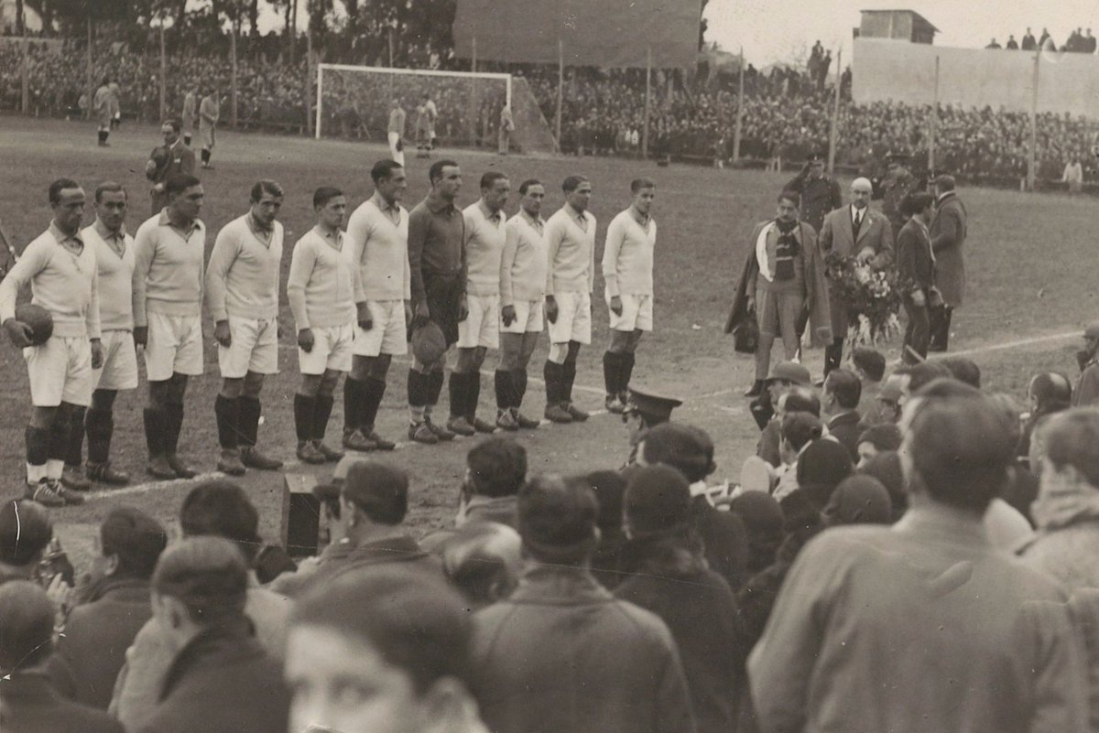
FIFA World Cup Analysis 1930 - 2014
Project by Santiago and Nicolás

Slide 2

Data Selection
We have chosen 3 datasets:
1 - World cups in History.
2- World cups matches.
3- World cup teams formations.
These datasets shows all information about all the World cups in history, all the results from the matches contested and all the players.
source: Kaggle platform for data science

Slide 3
Data Acquisition and exploration
CSV imported and processed in Python to normalize the data, applying methods to organise, filter and clean the data frames: explore unique values in columns, drop_duplicates and irrelevant columns, dropna, dtypes, astype, rename.
Then uploaded in MySQL.
CSV → df → CSV → SQL

Slide 4
Hypothesis
1- Brazil is the team that has played the most matches.
2- Average goals per game have declined over time.
3- Final stages usually have lower goals difference.

Slide 5
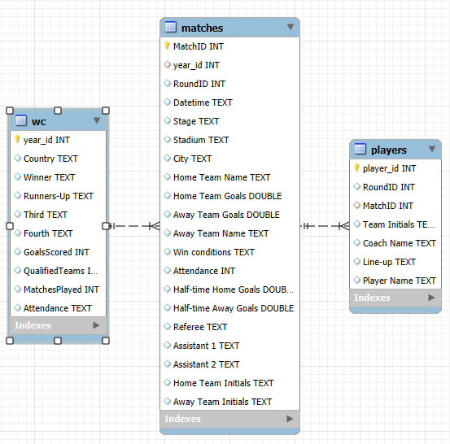
Entity Relationship Diagram (ERD)

Slide 6
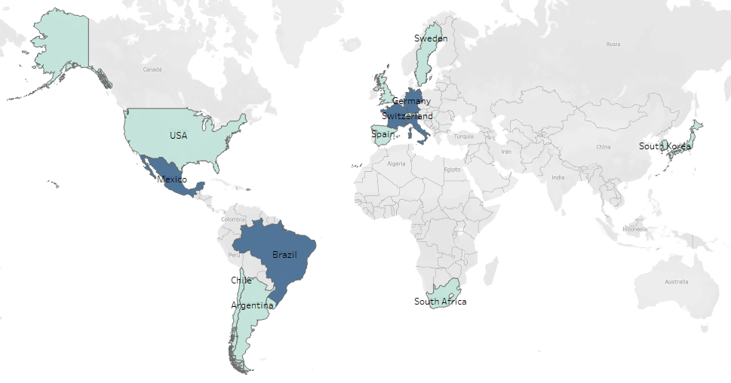
Countries that hosted the World Cup.

Slide 7
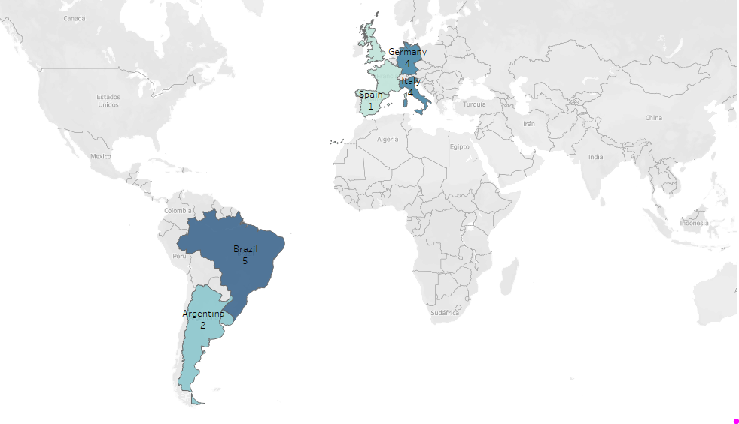
Countries that won the World Cup.

Slide 8
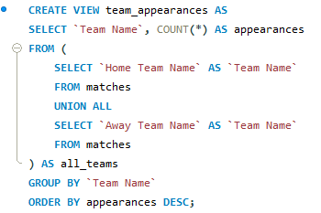
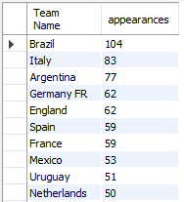
SQL queries and Analysis
SQL query → View → CSV → Python → Matplot

Slide 9
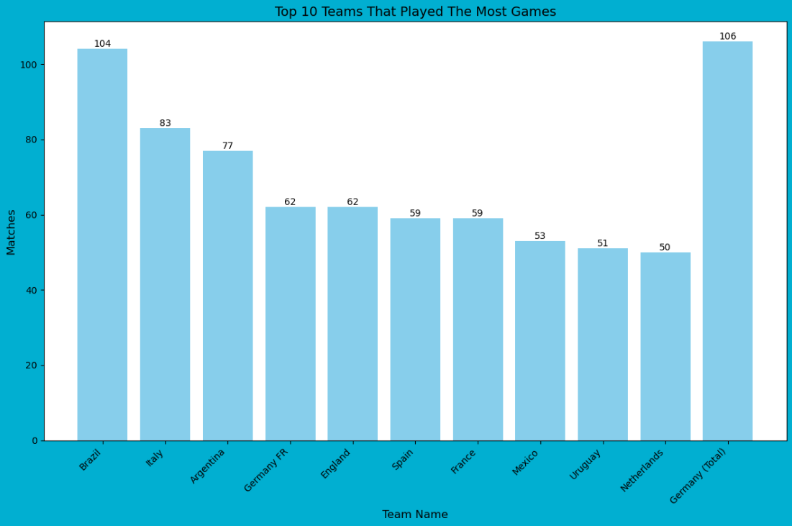
Hypothesis 1: Brazil is the team that has played the most matches.

Slide 10
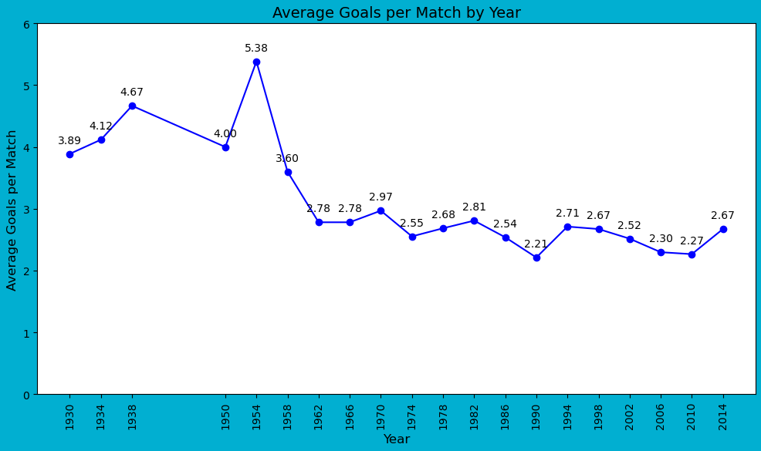
Hypothesis 2: Average goals per game have declined over time.

Slide 11
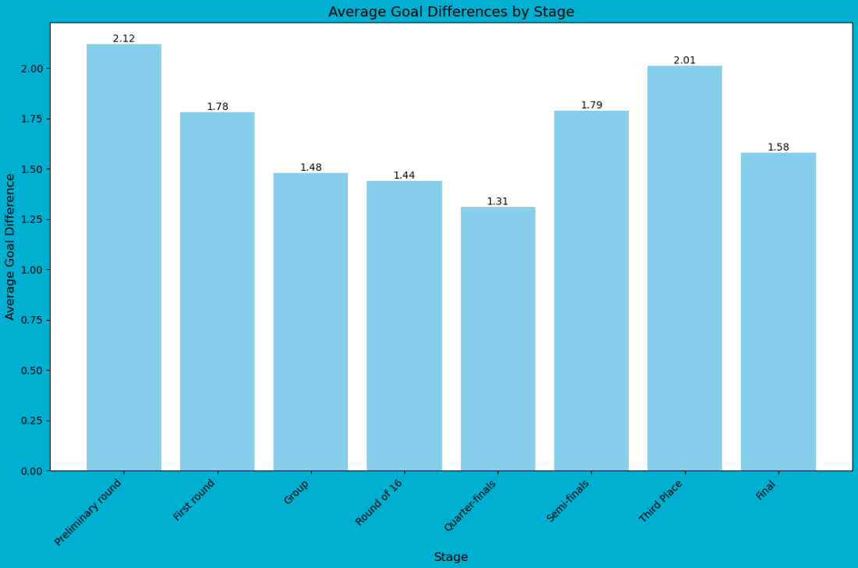
Hypothesis 3: Finals stages usually have lower goals difference.

Slide 12
Results and conclusions
1- Brazil has played the most matches in the history of World Cups.
2- In recent World Cups, the average goals per game has tended to decrease (True).
3- Finals stages usually have lower goals difference (False).

Slide 13
FIFA World Cup Analysis 1930 - 2014
Thanks
Project by Santiago and Nicolás

