Slide 1
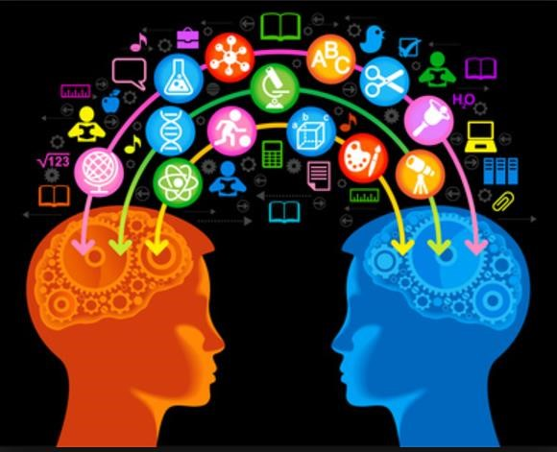
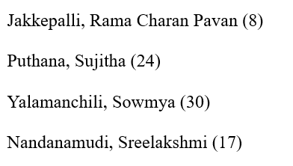
TECH CHAMPS

Slide 2
SIGNIFICANCE
Application that assist user to
Construct the knowledge graph to visualize.
Query the question and execute.
Fetch answer for customized question.

Slide 3
APPLICATION FEATURES
Easy search of information from huge amount of text.
Helps in precise answer for customized questions.
Increase the knowledge management process.
Visualization of the data.
Simple query to fetch information.

Slide 4



TECHNOLOGIES USED

Slide 5


TOOLS USED

Slide 6
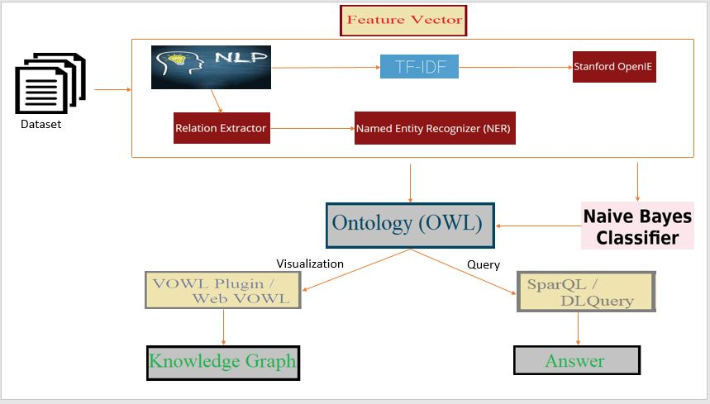
ARCHITECTURE DIAGRAM

Slide 7
DATASET USED
Yahoo Dataset: Business and Finance
1
Stanford Dataset (SQuAD): Construction Articled
2
WikiRef220 Dataset: BBC News
3

Slide 8
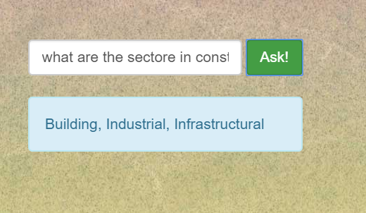
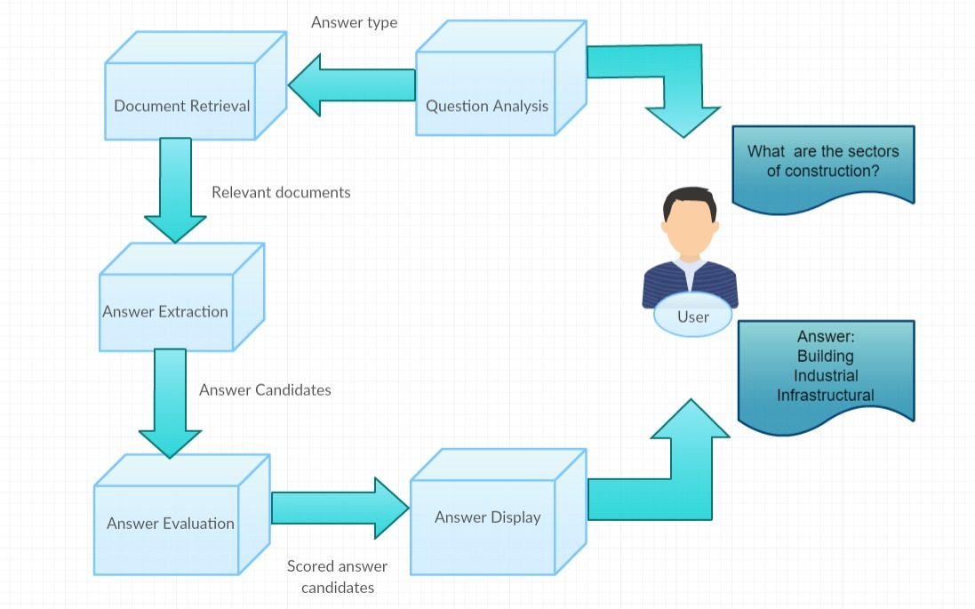
WORKFLOW OF QA SYSTEM

Slide 9
CONCLUSION
High Accuracy Dataset: Stanford dataset
Accuracy: 60%
Processing Time: 13sec
Issues: Completeness and correctness.

Slide 10


