Slide 1
OpenCV for Image processing with AI
Prabhu Swaminathan

Slide 2
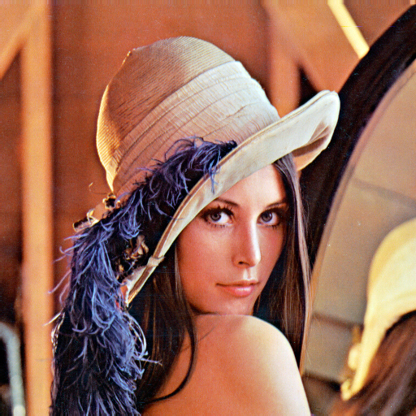
Agenda
About OpenCV
Images and Pixels
OpenCV Image formats
OpenCV Image Processing
OpenCV Realtime Projects
Companies
Reference

Slide 3
About OpenCV
OpenCV is real-time image processing
The library itself is written in C/C++
Python and C++ bindings are provided
Support for Windows and Linux
Open source

Slide 4
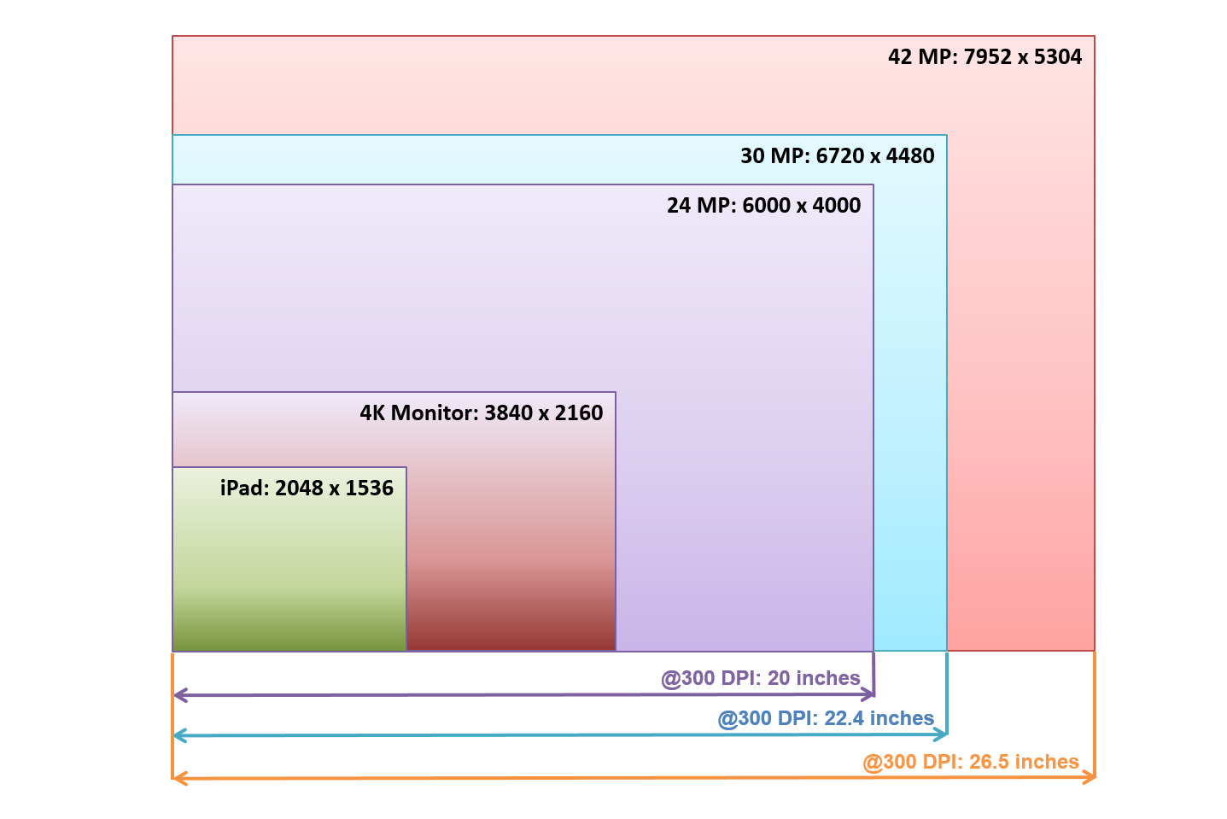
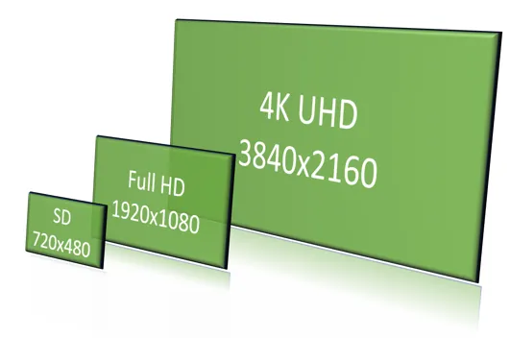
Images and Pixels

Slide 5
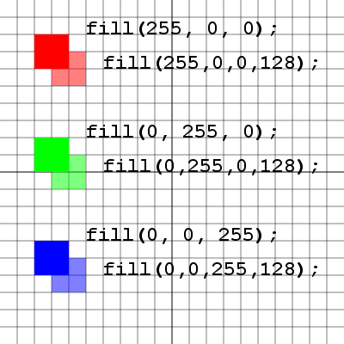
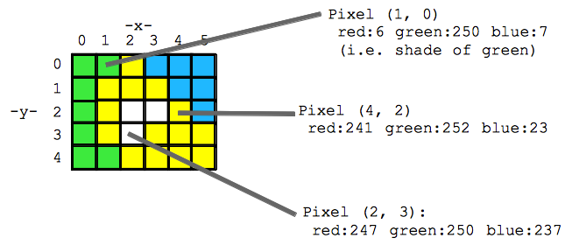
OpenCV Image formats

Slide 6
OpenCV Image Processing
Image Handling:
cv2.imread(): Reads an image from a specified file path.
cv2.imshow(): Displays an image in a window.
cv2.imwrite(): Saves an image to a file
Image Transformations:
cv2.resize(): Resizes an image to a specified dimension.
cv2.rotate(): Rotates an image by a specified angle.
cv2.cvtColor(): Converts an image from one color space to another (e.g., BGR to grayscale, BGR to HSV).
cv2.flip(): Flips an image horizontally, vertically, or both.

Slide 7
Demo 1
Task 1
Task 2
Task 3

Slide 8
OpenCV Image Processing
Image Filtering and Enhancement:
cv2.GaussianBlur(): Applies a Gaussian blur filter to smooth an image.
cv2.medianBlur(): Applies a median blur filter to reduce noise.
cv2.bilateralFilter(): Applies a bilateral filter for edge-preserving smoothing.
cv2.threshold(): Applies a fixed-level thresholding to an image.
cv2.Canny(): Implements the Canny edge detection algorithm.
cv2.Sobel(): Computes the Sobel derivatives for edge detection.
cv2.Laplacian(): Computes the Laplacian of an image for edge detection.
Drawing Functions:
cv2.line(): Draws a line on an image.
cv2.circle(): Draws a circle on an image.
cv2.rectangle(): Draws a rectangle on an image.
cv2.putText(): Draws text on an image.

Slide 9
OpenCV Image Processing
Feature Detection and Object Detection:
cv2.findContours(): Finds contours in a binary image.
cv2.HoughCircles(): Detects circles in an image using the Hough Transform.
cv2.CascadeClassifier(): Used for object detection, commonly for face detection with pre-trained Haar cascades.

Slide 10
Demo 2
Task 4
Task 5
Task 6

Slide 11
OpenCV Realtime Projects
Real-Time Drowsiness Detection:
Detecting signs of drowsiness in drivers or individuals using facial features.
Vehicle Detection and Tracking:
Identifying and tracking vehicles in video footage, potentially for traffic monitoring or self-driving applications.
License Plate Recognition:
Detecting and reading license plates from images or video.
Human Pose Estimation:
Identifying and tracking the position of human body parts in an image or video.
Medical Image Analysis:
Applying computer vision techniques to analyze medical images for diagnosis or research.

Slide 12
OpenCV Realtime Projects
Self-Driving Cars:
Implementing various functionalities like object detection, lane keeping, and path planning.
Attendance System:
Building a system that uses facial recognition to automatically record attendance.
Hand Gesture Recognition:
Recognizing hand gestures for human-computer interaction, used in sign language interpretation and gesture-controlled devices
Pedestrian Detection:
Detecting pedestrians in video streams, used in autonomous vehicles and security systems

Slide 13
Demo

Slide 14
Companies
Google, Yahoo, Microsoft, Intel, IBM, Sony, Honda, and Toyota
There are many startups such as Applied Minds, VideoSurf, and Zeitera, that make extensive use of OpenCV

Slide 15
Reference
https://github.com/sprabhupsg/opencv_image_video
https://medium.com/analytics-vidhya/haar-cascades-explained-38210e57970d
https://www.cs.cmu.edu/~efros/courses/LBMV07/Papers/viola-cvpr-01.pdf
https://medium.com/@odil.tokhirov/how-i-built-a-hand-gesture-recognition-model-in-python-part-1-db378cf196e6

Slide 16
Thank You
https://github.com/sprabhupsg/opencv_image_video
sprabhu.psg@gmail.com

