Slide 1
Please follow the link and complete the survey
send via Discord
https://docs.google.com/forms/d/e/ 1FAIpQLSfhajLrZGmd8fj7imCePn2NXE5c STVXmfeu1J47TnL48HWVhA/viewform? usp=sf_link
if you do not have a phone, tablet or computer you can complete the survey on paper.

Slide 2

R software for statistical computing

Slide 3
Pros and Cons
PRO
it’s open source
offers all types of analyses available in other software, and more!
endless graphic options
always up to date
great community
you can write your own functions
can load large amounts of data

Slide 4
Pros and Cons
PRO
it’s open source
offers all types of analyses available in other software, and more!
endless graphic options
always up to date
great community
you can write your own functions
can load large amounts of data
CONTRA
you need to invest some time in the beginning

Slide 5
Pros and Cons
PRO
it’s open source
offers all types of analyses available in other software, and more!
endless graphic options
always up to date
great community
you can write your own functions
can load large amounts of data
CONTRA
Patience

Slide 6

Pros and Cons
PRO
it’s open source
offers all types of analyses available in other software, and more!
endless graphic options
always up to date
great community
you can write your own functions
can load large amounts of data
CONTRA
Patience
reward

Slide 7
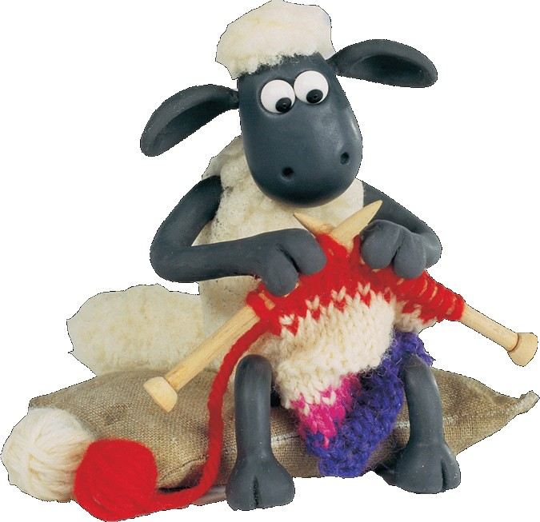
Use your own resources

Slide 8


R-software
Robert Gentleman Ross Ihaka
Statistics Department University of Auckland, New Zealand

Slide 9
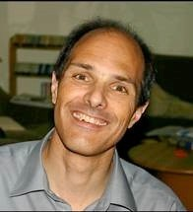
R-software
Robert Gentleman Ross Ihaka
Statistics Department University of Auckland, New Zealand
Martin Mächler
ETH Zürich, Switzerland

Slide 10
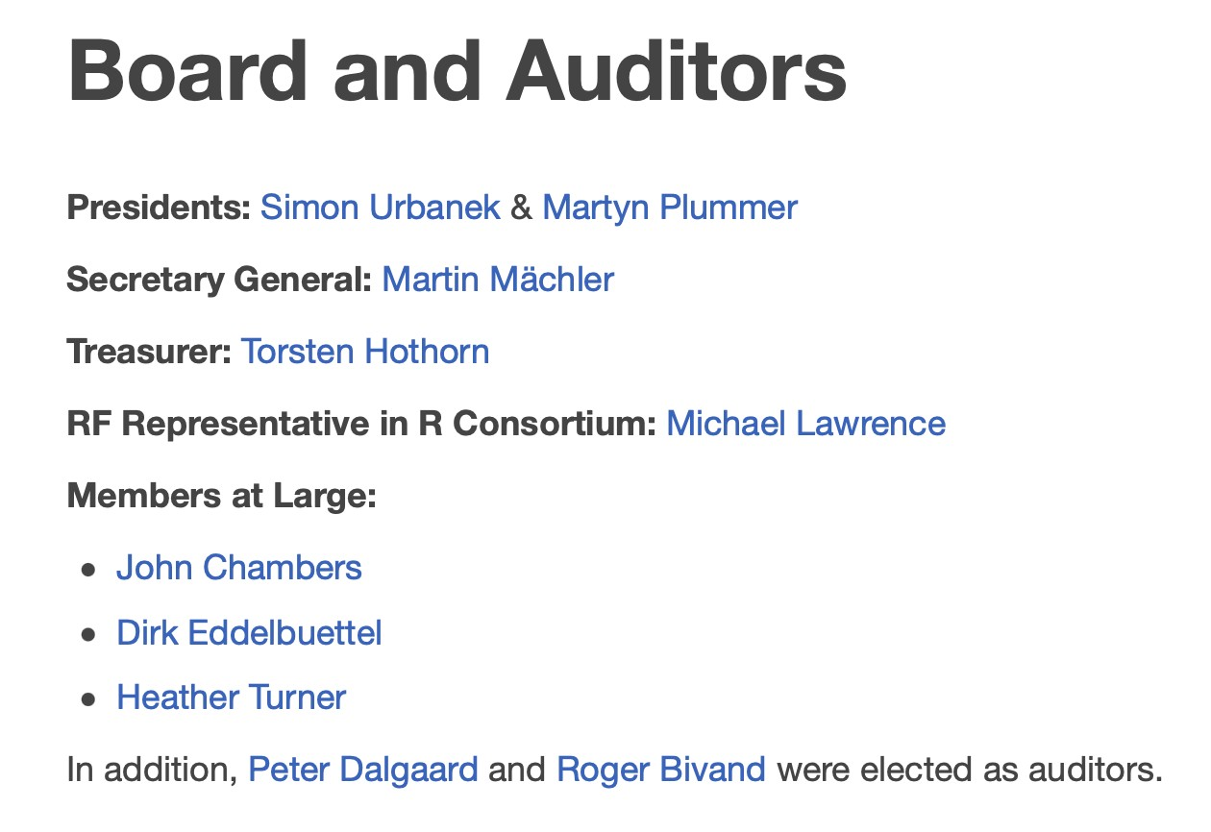




R-software

Slide 11
R-software
Martyn Plummer
WHO, Infections and Cancer Epidemiology Group
Simon Urbanek
AT&T Research Labs

Slide 12
R-software

Slide 13
R-software
core-group (1997):
Douglas Bates, John Chambers, Peter Dalgaard, Seth Falcon, Robert Gentleman, Kurt Hornik, Stefano Iacus, Ross Ihaka, Friedrich Leisch, Thomas Lumley, Martin Maechler, Duncan Murdoch, Paul Murrell, Martyn Plummer, Brian Ripley, Deepayan Sarkar, Duncan Temple Lang, Luke Tierney, Simon Urbanek
•

Slide 14
R-software
core-group (1997):
Douglas Bates, John Chambers, Peter Dalgaard, Seth Falcon, Robert Gentleman, Kurt Hornik, Stefano Iacus, Ross Ihaka, Friedrich Leisch, Thomas Lumley, Martin Maechler, Duncan Murdoch, Paul Murrell, Martyn Plummer, Brian Ripley, Deepayan Sarkar, Duncan Temple Lang, Luke Tierney, Simon Urbanek
•
•
contributers:
Valerio Aimale, Thomas Baier, Roger Bivand, Ben Bolker, David Brahm, Göran Broström, Patrick Burns, Vince Carey, Saikat DebRoy, Brian D'Urso, Lyndon Drake, Dirk Eddelbuettel, John Fox, Paul Gilbert, Torsten Hothorn, Robert King, Kjetil Kjernsmo, Philippe Lambert, Jan de Leeuw, Uwe Ligges, Jim Lindsey, Patrick Lindsey, Catherine Loader, Gordon Maclean, John Maindonald, David Meyer, Jens Oehlschägel, Steve Oncley, Richard O'Keefe, Hubert Palme, José C. Pinheiro, Anthony Rossini, Jonathan Rougier, Günther Sawitzki, Bill Simpson, Gordon Smyth, Adrian Trapletti, Terry Therneau, Bill Venables, Gregory R. Warnes, Andreas Weingessel, Morten Welinder,

Slide 15
R-software

Slide 16
R-software
•
univariate statistics:
t-Test, χ²-Test, correlations (Pearson, Kendall τ, Spearman ρ), Kolmogorov-Smirnow-test, Mann- Whitney-U-test, Kruskal-Wallis-test, Wilcoxon-test, Fisher-test, Mantel-Haenszel- χ²-test, Binomial-test, Mixed Models, ANOVAs…….

Slide 17
R-software
•
univariate statistics:
t-Test, χ²-Test, correlations (Pearson, Kendall τ, Spearman ρ), Kolmogorov-Smirnow-test, Mann- Whitney-U-test, Kruskal-Wallis-test, Wilcoxon-test, Fisher-test, Mantel-Haenszel- χ²-test, Binomial-test, Mixed Models, ANOVAs…….
•
multivariate Statistik:
PCA, CCA, DCA, NMDS, multivariate regression splines, …………..

Slide 18
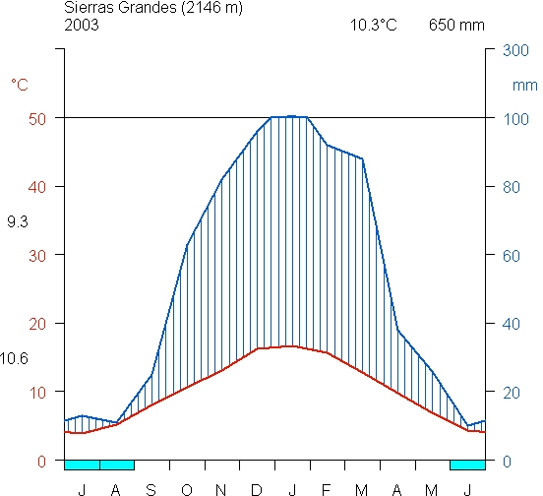
R-software

Slide 19
R-software
y
100 200 300 400 500 600 700 800
x col=heat.colors(100)

Slide 20
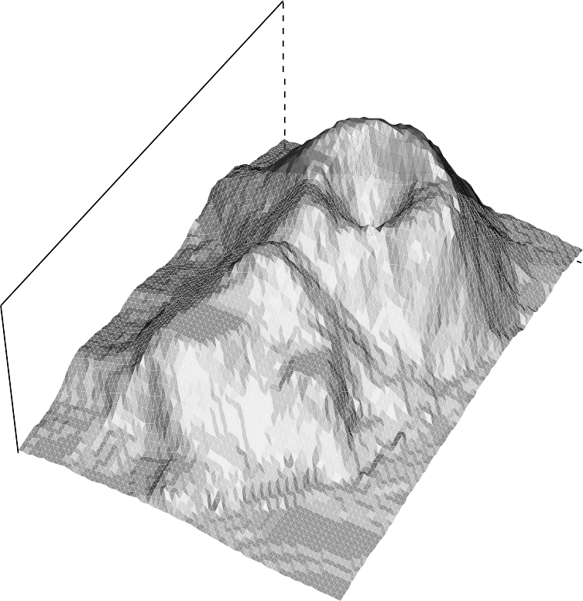
R-software
column
row
olcano

Slide 21

R-software

Slide 22
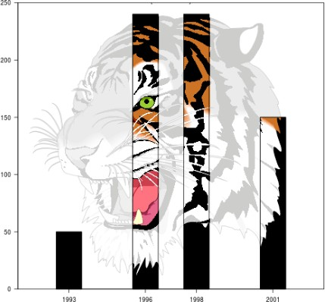
R-software

Slide 23
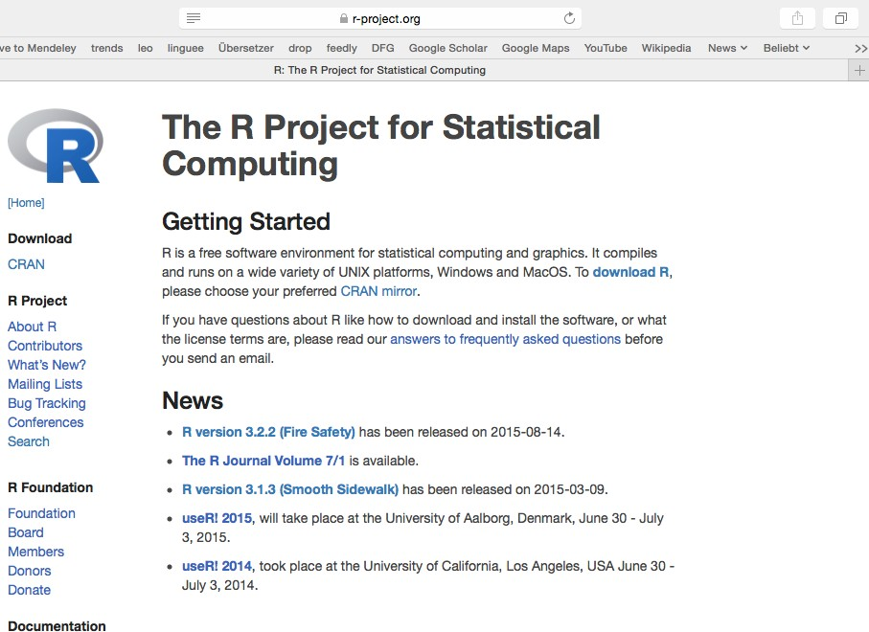
R-software

Slide 24
R-software
www.r-project.org

Slide 25
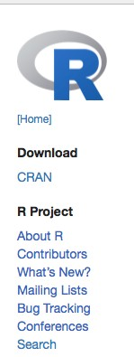
R-software
22

Slide 26
R-software
22

Slide 27
R-software
Download:
www.r-project.org
CRAN (Comprehensive R Archive Network)
CRAN mirror: Germany (e.g. Göttingen)

Slide 28
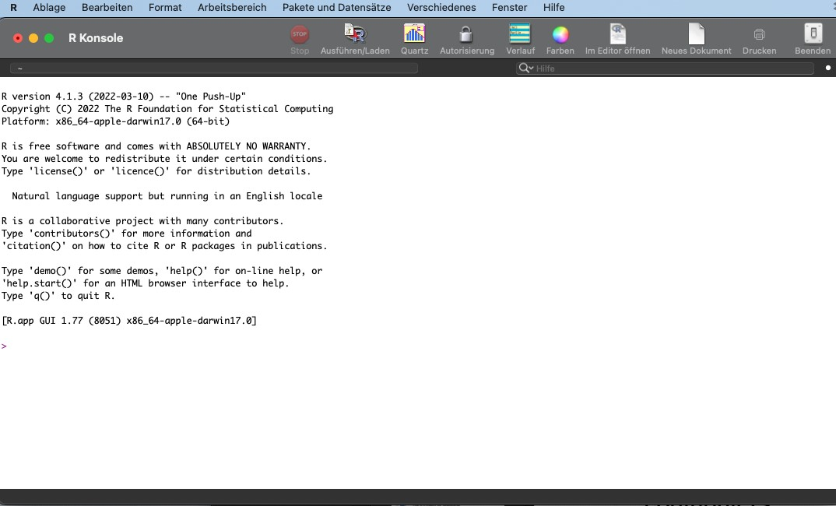
R surface

Slide 29
R surface

Slide 30
R surface

Slide 31
R surface
R Console = to type your commands and inspect results
R documents (script) = to type your commands and save them for later
graphic window
help window
» 4 active windows

Slide 32
R surface
R studio??

Slide 33
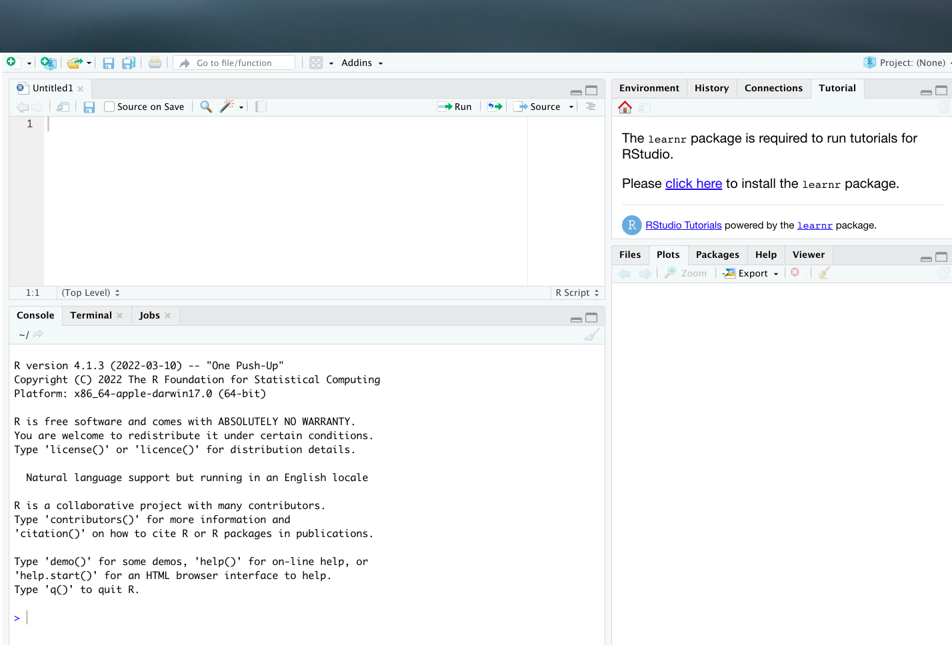
R studio

Slide 34
R surface

Slide 35
R surface
R is text based

Slide 36
R surface
R is text based
you type what you want to do

Slide 37
R surface
R is text based
you type what you want to do
English

Slide 38
R surface
R is text based
you type what you want to do
English
upper vs. lower case sensitive

Slide 39
R surface
R is text based
you type what you want to do
English
upper vs. lower case sensitive

Slide 40
Prepare data for R
English type setting (0.1)
simple column names
vegation cover
vegc
no “UMLAUTE”
NO SPACES, NO EMPTY FIELDS!!!!!
veg c
vegc, veg-c, veg_c
fill empty fields with NA (non available)
ALL COLUMNS MUST HAVE SAME LENGTH!

Slide 41
Prepare data for R
English type setting (0.1)
simple column names
vegation cover
vegc
no “UMLAUTE”
NO SPACES, NO EMPTY FIELDS!!!!!
veg c
vegc, veg-c, veg_c
fill empty fields with NA (non available)
ALL COLUMNS MUST HAVE SAME LENGTH!

Slide 42
Prepare data for R
English type setting (0.1)
simple column names
vegation cover
vegc
no “UMLAUTE”
NO SPACES, NO EMPTY FIELDS!!!!!
veg c
vegc, veg-c, veg_c
fill empty fields with NA (non available)
ALL COLUMNS MUST HAVE SAME LENGTH!

Slide 43
online help
31

Slide 44
online help
31
Manuals:

Slide 45
online help
31
Manuals:
An Introduction to R (94 pages)

Slide 46
online help
31
Manuals:
An Introduction to R (94 pages)
Einführung in R (170 pages)

Slide 47
online help
31
Manuals:
An Introduction to R (94 pages)
Einführung in R (170 pages)
R Reader (69 pages),

Slide 48
online help
31
Manuals:
An Introduction to R (94 pages)
Einführung in R (170 pages)
R Reader (69 pages),

Slide 49
online help
31
Manuals:
An Introduction to R (94 pages)
Einführung in R (170 pages)
R Reader (69 pages),
Translations into other languages than English are available from the contributed documentation section.

Slide 50
online help
31

Slide 51
online help
31
SEARCH function and MAILING LISTS on
r-project.org

Slide 52
online help
31
SEARCH function and MAILING LISTS on
r-project.org
stackoverflow.com

Slide 53
online help
31
SEARCH function and MAILING LISTS on
r-project.org
stackoverflow.com
put [r] in brackets before your search request

Slide 54
online help
31
SEARCH function and MAILING LISTS on
r-project.org
stackoverflow.com
put [r] in brackets before your search request

Slide 55
Literature
by Michael J. Crawley published at Wiley:
Statistics: An Introduction using R (2015), 2nd edition 38.50 €
PDF: http://www.bio.ic.ac.uk/research/crawley/statistics/
The R Book,(2013) 2nd edition 77.90 €
homepage: http://eu.wiley.com/WileyCDA/WileyTitle/ productCd-0470973927.html
** first edition available as PDF online! **

Slide 56
R surface
R Console = to type your commands and inspect results
R documents (script) = to type your commands and save them for later
graphic window
help window
» 4 active windows

Slide 57
R language
you can type directly into R Console OR
FILE —> New File: type in document and save document
hot key to send command line:
MAC cmd ENTER
Windows crtl (strg) r

Slide 58
help functions in R
help for a specific command
?plot
searching for a specific test
help.search(“Chi Square”)

Slide 59
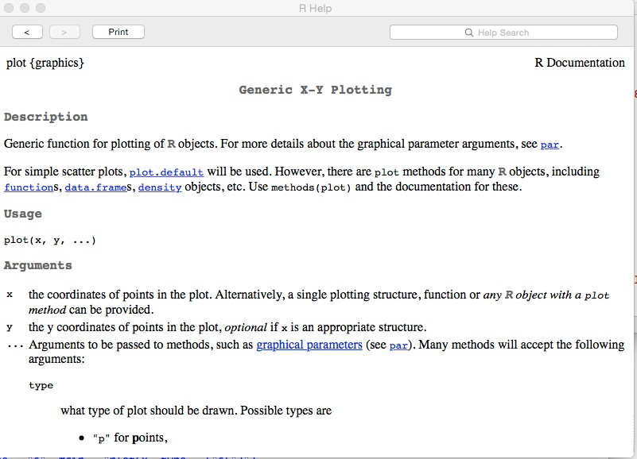
help functions in R

Slide 60
help functions in R

Slide 61
help functions in R

Slide 62
help functions in R

Slide 63
help functions in R

Slide 64
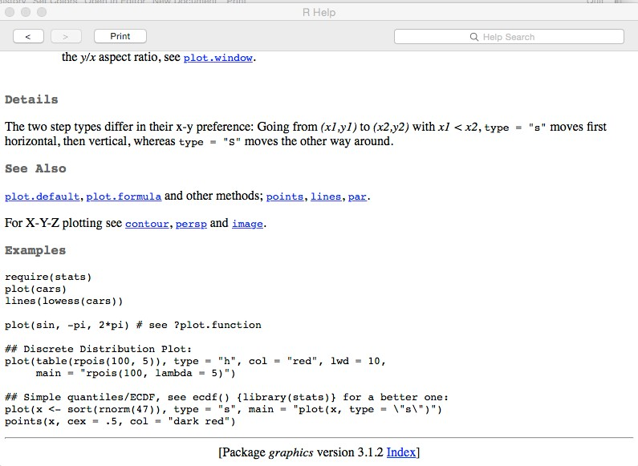
help function in R

Slide 65
help function in R

Slide 66
help function in R

Slide 67
packages
some functions require extra packages
packages are stored in the library
Packages & Data for managing and downloading

Slide 68
R Language
nums = 1:10 nums
nums<-1:10 nums + 1
[1] 2 3 4 5 6 7 8 91011

Slide 69


R Language
if you send line and you see nothing but > in the next line EVERYTHING IS OK!
if you send line and you see this: + in the next line YOU NEED TO CLOSE BRACKETS, PARENTHESIS OR QUOTATION MARKS!!!!

Slide 70
R Language
nums = 1:10
nums + c(1,2)
[1] 2 4 4 6 6 8 8 10 10 12

Slide 71
R Language
1:10
seq(1,10)
seq(10,100,5)
seq(10,by=5,length=10)
numbers from 4 to 760 in steps of 4?

Slide 72
R Language
nums <- c(12,9,8,14,7,16,3,2,9)
nums | > | 10
nums | > | 10 | & | nums | < | 16

Slide 73
R Language
which(nums>10) nums[nums > 10] = 0 nums

Slide 74
R language
?plot
copy & paste last example into R Console
## Simple plot(x <- points(x,
quantiles/ECDF, see ecdf() {library(stats)} for a better one: sort(rnorm(47)), type = "s", main = "plot(x, type = \"s\")") cex = .5, col = "dark red")

Slide 75
R Language
?where is my data? set working directory setwd
Mac setwd(“/Users/folder”) Windows setwd(“C:\\folder") or Rstudio (“C:/folder”)
?how to load data into R?
Read data table namen<-
read.table(“name.txt”,header=T)

Slide 76
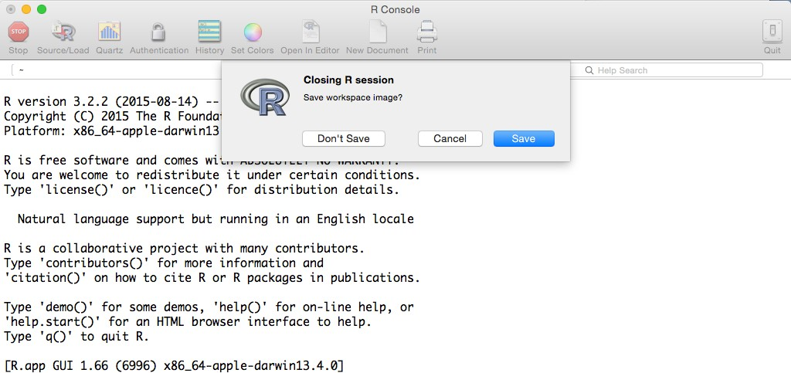


Never save the workspace!!!! only save the script!

