Slide 1
jQuery
What, Why , When, & How to use!

Slide 2
“Write less do more!”
jQuery motto

Slide 3
What is jQuery?
Its a free, open JavaScript Library
Eases the task of creating highly interactive web pages
Works across all modern browsers.
Takes care of the “browser specific features”, thus allowing you to concentrate on design.
Simplifies common scripting tasks.

Slide 4
Why jQuery?
You use jQuery to manipulate page contents.
High compliance with modern browser event model.
Helps in adding sophisticated effects.
The learning curve is very less.
Helps in using the jQuery code to do certain task rather than “You sit down to re-invent the wheel!”

Slide 5
Unobtrusive JavaScript
jQuery promotes Unobtrusive JavaScript definitions.
Unobtrusive means to separate the behavior from objects.
So here we are adding the behavior unclick along with the presentation object.
<button type="button“ onclick="document.getElementById('xyz').style.color='red';">
Click Me
</button>

Slide 6
Unobtrusive JavaScript
This method makes the code a little mess.
We may apply the same functionality as:
And add the onclick event to the onload of the page:
<button type="button“ >Click Me </button>
<script type="text/javascript">
window.onload = function() {
document.getElementById('testButton').onclick = makeItRed;
};
function makeItRed() {
document.getElementById('xyz').style.color = 'red';
}
</script>

Slide 7
When to use jQuery?
You may use jQuery when you want quick development.
Make rich internet applications.
Make cross browser compatible applications, thus saving time.
You can make use your existing knowledge of CSS.
You can use jQuery plug-in to extent the functionality.

Slide 8
jQuery Browser compatibility
Browser | Works with | Issues with
Internet Explorer | 6.0 and greater | Less than 5.x
Safari | 3 and greater | 1.0 to 2.1
Chrome | 1 and greater | N/A
Firefox | 2 and greater | 1.0.x
Opera | 9 and greater | 1.0 to 8.x

Slide 9
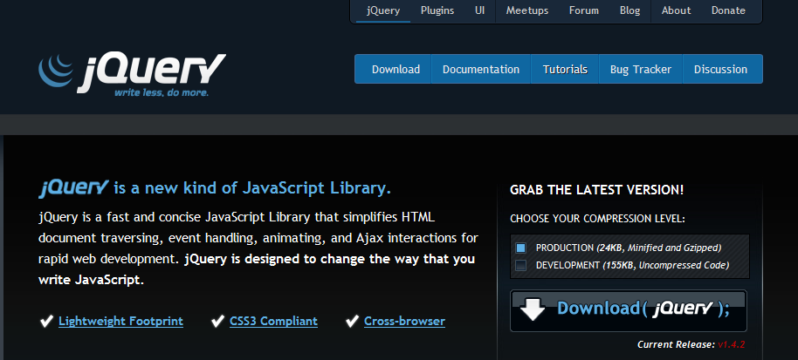
How to use jQuery?
You can download the jQuery core files from the url : http://jquery.com/

Slide 10
How to use jQuery?
You will have to include this file in a location where the rest of the files are stored.
Then write your code to do the scripting as :
<script type="text/javascript" src="../jquery-1.3.2.js"></script>
<script type="text/javascript">
$("document").ready(function() {
//some script
});
</script>

Slide 11
JavaScript onload v/s jQuery’s ready
When we wish to add a JavaScript script at the top of the page as an event handler, it would look like this:
Unfortunately this event runs only when all the page contents are loaded, including other scripts and images.
And when a need for multiple functions are needed then they will have to be clubbed with this one function.
<script type="text/javascript">
function runThisOnLoad(){
//Some actions to be run on page load
}
window.onload = runThisOnLoad;
</script>

Slide 12
JavaScript onload v/s jQuery’s ready
jQuery provides a simpler way to do this.
This is called the document.ready event
You may call this event multiple times and jQuery will chain it accordingly.(Although its not a good practice to write multiple ready functions).

Slide 13
jQuery semantics
The term "jQuery function" refers to the jQuery constructor function (jQuery() or alias $()) that is used to create an instance of the jQuery object.
The term "wrapper set" refers to DOM elements that are wrapped within jQuery methods.
Specifically, this term is used to refer to the elements selected using the jQuery function.
These are also known as "jQuery collection." or "wrapper”

Slide 14
jQuery semantics example
The first part will be the constructor and followed my some action or function.
<script type="text/javascript">
$("document").ready(function() {
$(“#someElement”).css(“width”,”200px”);
$(“.someClass”).fadeout();
});
</script>

Slide 15
Your first jQuery code.
Include the reference.
Write the event handler to respond to page load.
Add a script to alert some text.
Refer example jQuery-1-Introduction /firstCode.html

Slide 16
Features of jQuery
Core Functionality
Selection & Traversal
Manipulation & CSS
Events
Implements core jQuery functions as well as commonly used utilities.
Provides functions for finding content in documents and navigating among the contents of the page.
Provides functions for editing and changing documents content and working with CSS data such as positioning info.
Simplifies working with the modern DOM events and provides common event helper functions.
Effects
Provides functions for creating basic animations and effects, such as hiding and showing elements and moving objects around.
Ajax
Provides utilities for working with Ajax, such as loading content from pages and dealing with JSON data.
User Interface
Provides an official plug-in with commonly used interface widgets, like slider controls, progress bars, accordions, etc
Extensibility
Enables the construction of jQuery plug-ins that enhance the functionality of the base library.

Slide 17
?
Questions

