Slide 1
MusicX
MUSIC RECOMMENDATION PORTAL
Aditya Rathi
Kinshuk Juneja
Prakash Somasundaram

Slide 2
Project Deliverables
List of song tracks with various attributes.
Music filtering options for the user.
Managing database for user’s reviews about tracks.
Access to music trends by cumulating each user’s reviews and basing it on the popularity of the track/ album / artist / genre.

Slide 3
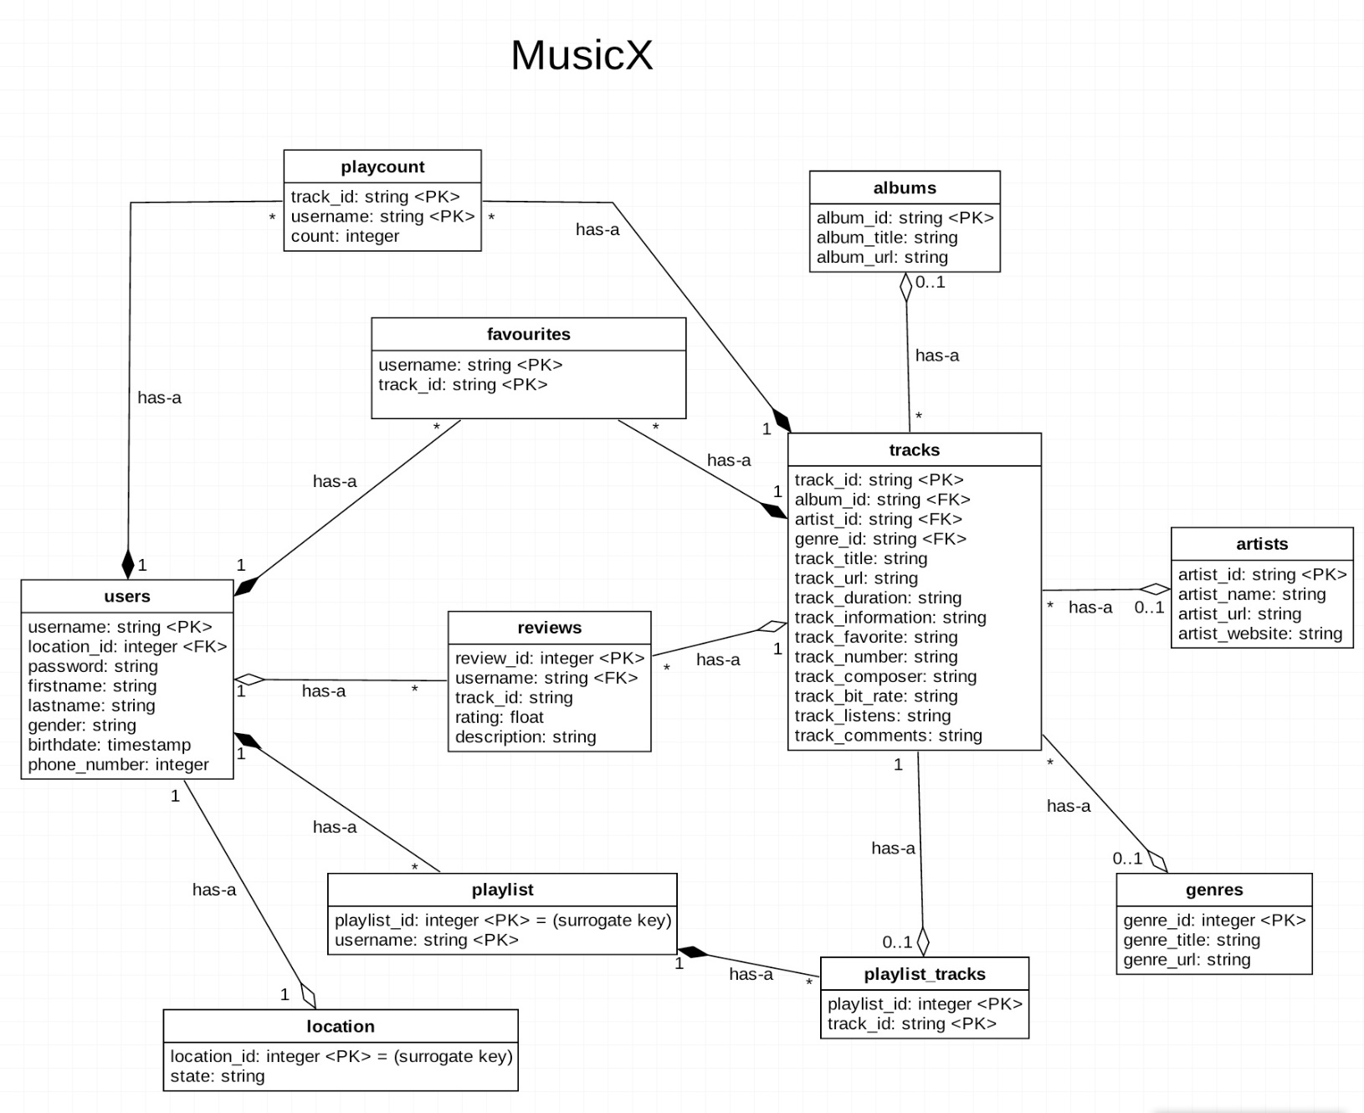
Project Overview
Data Source:
www.freemusicarchive.org
www.last.fm/api

Slide 4
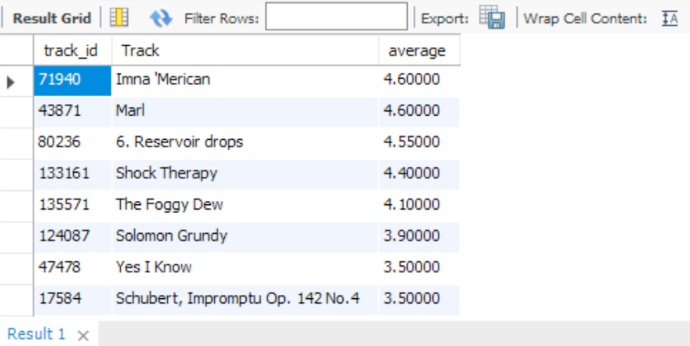
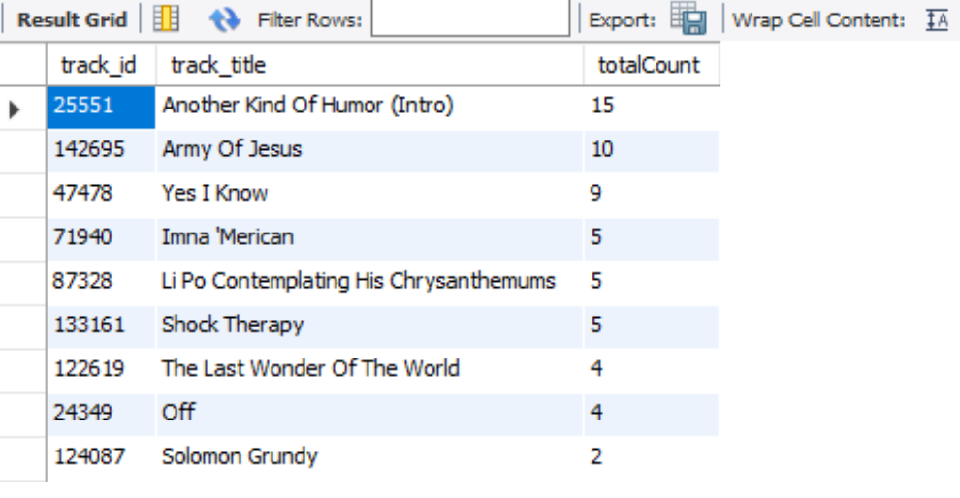
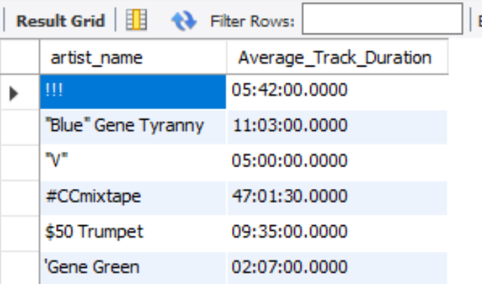
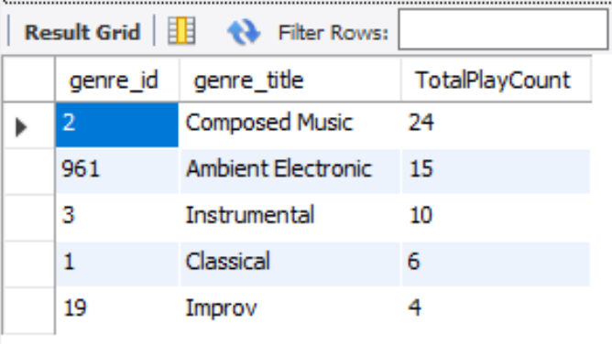
Business Insights
Which are the most top rated tracks?
Which are the most played tracks?
What is the average length of track duration for each of the artist?
What are the top 10 genres with most play count?

Slide 5
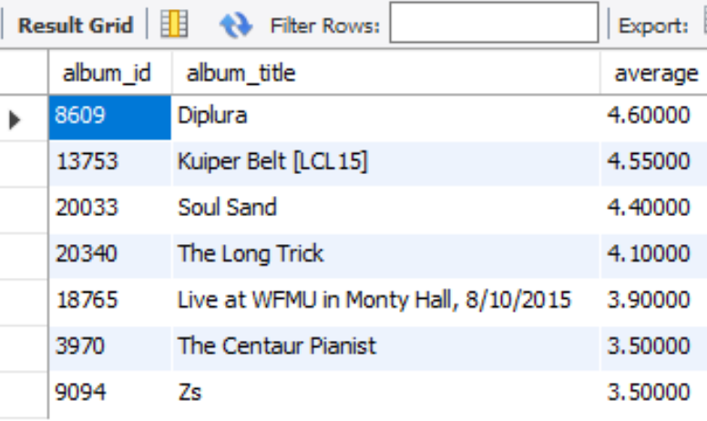
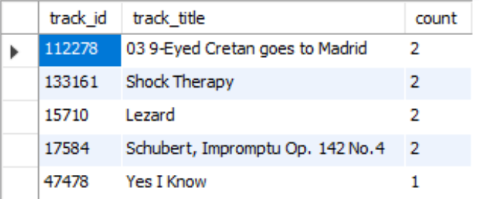
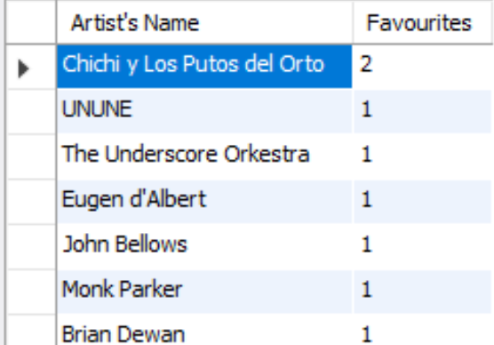
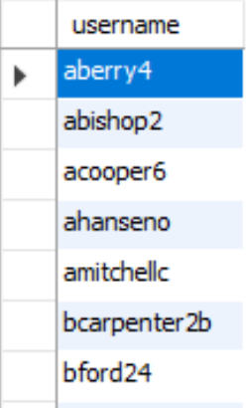
Business Insights
Which are the most top rated albums?
Which are the most common tracks in users’ playlists?
Who are the users who have neither created a review nor played any song?
Which are the top 100 artists with most favourite tracks?

Slide 6
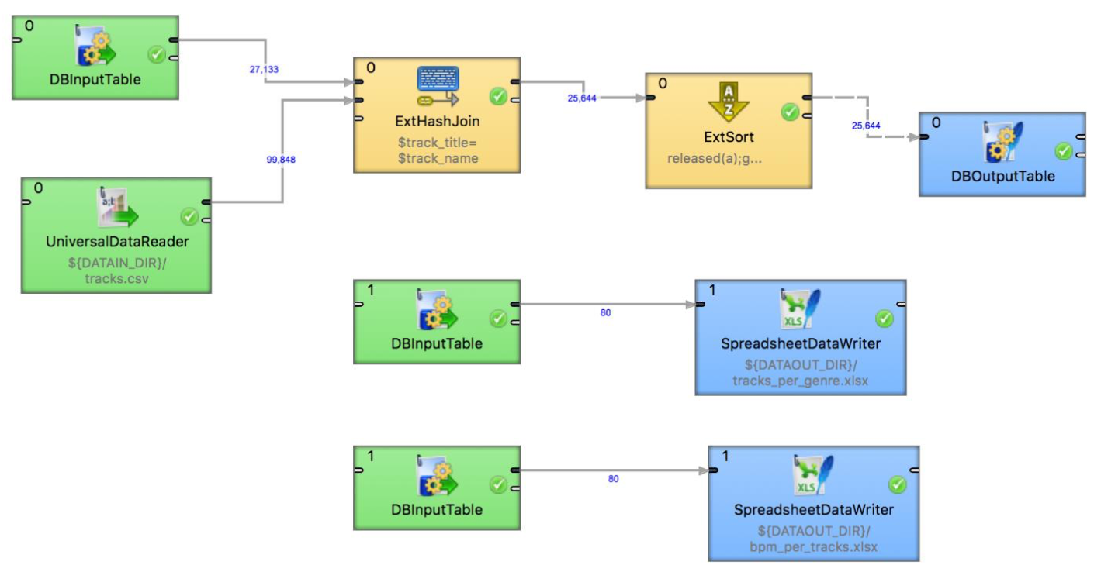
ETL Workflow
Data Source:
http://www.last.fm/api
http://labrosa.ee.columbia.edu/millionsong/

Slide 7
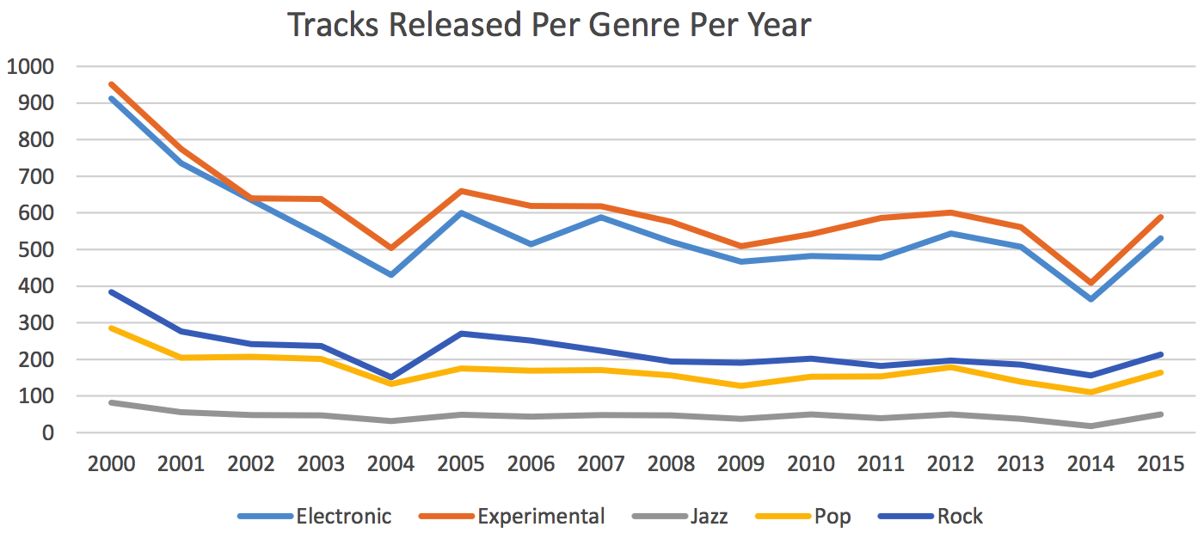
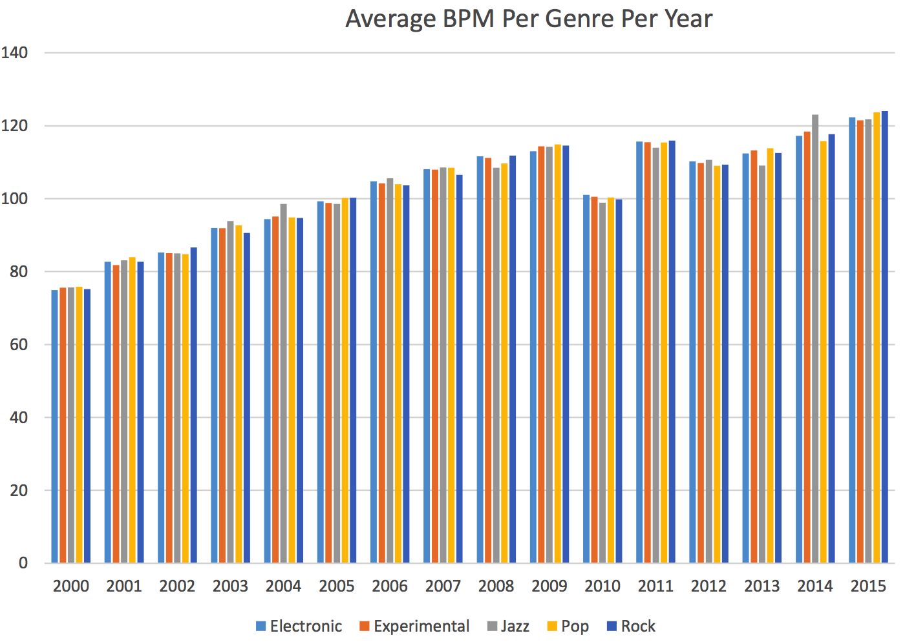
Result
Hypothesis:
1. Number of tracks released for their respective genres per year should vary from each other with respect to time(years).
2. The average Beats Per Minute(BPM) for each genre listed in the chart should be increasing each year.

Slide 8
Conclusion
What went well?
What would you do differently?
➢ We were able to find the data source that contained all the insertions for the fields listed
in our table. ✓ This greatly enhanced our project as we were able to manipulate the data by performing
SQL queries inserted in the database without having to make the insertions manually in any field.
➢ With enough time we could have added the following features to our project:
❖ Recommendation of tracks available to each user based on their interest.
❖ Add a lyrics column that shall display lyrics of all the tracks available in the database.
❖ Add Beats Per Minute(BPM) for all the tracks loaded in the database.

