Slide 1

Logic Design and Microprocessor
Topic Name: GSM Based Precision Irrigation Controller
Department of Computer Engineering
BRACT’S, Vishwakarma Institute of Technology, Pune
(An Autonomous Institute affiliated to Savitribai Phule Pune University)
(NBA and NAAC accredited, ISO 9001:2015 certified)

Slide 2
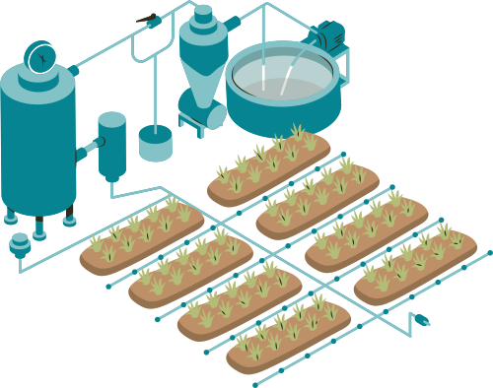
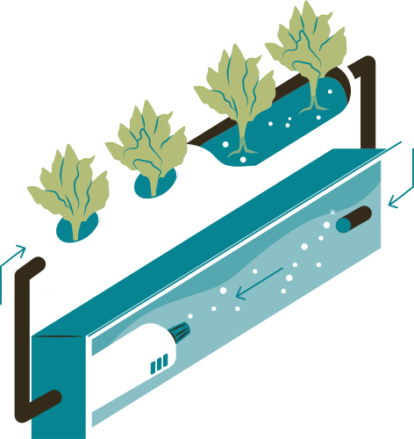

GSM-BASED
PRECISION IRRIGATION CONTROLLER
GROUP 18

Slide 3
Team Members
Name | Roll Number | PRN
Piyush Kanakdande | 75 | 12411031
Prakash Swami | 65 | 12410921
Akshita Verma | 77 | 12415032
Darsh Sonsale | 78 | 12415033

Slide 4


INTRODUCTION
  In many rural areas, farmers manually control irrigation, often leading to water wastage and time loss.
  To solve this, we developed a GSM-Based Precision Irrigation Controller.
  Farmers can turn the water pump ON/OFF via SMS and call, without visiting the field.
  The system uses Arduino UNO, SIM800L GSM module, relay, moisture sensor, and a 3.7V lithium battery.
  The added soil moisture sensor enables both Manual Mode (pump controlled through SMS/call) and Auto Mode (pump automatically switches ON/OFF based on soil moisture levels).
  This ensures smarter, efficient, and remote irrigation control with real-time soil monitoring, reducing water wastage and improving crop health.

Slide 5
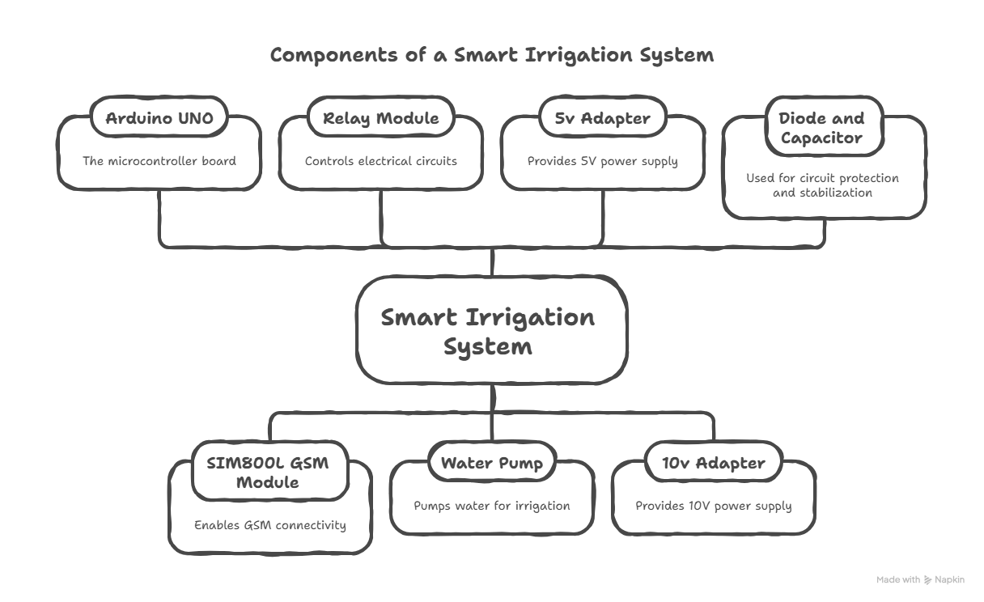
COMPONENTS USED

Slide 6
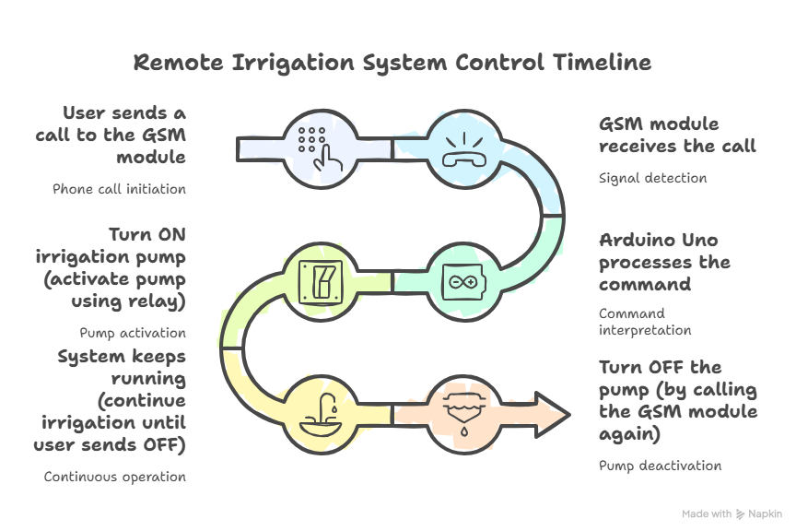
WORK FLOW

Slide 7
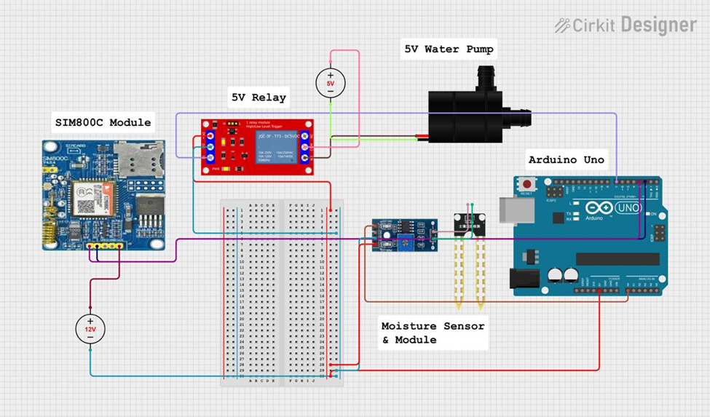
CIRCUIT DIAGRAM

Slide 8

FUTURE SCOPE
  Develop the system into a commercial, farmer-friendly product with a strong casing, long battery life, and easy setup, so it can be used in real farming conditions.
  Add IoT support so farmers can check soil moisture and pump status on a mobile app.
  Add more sensors like temperature and humidity to make the system smarter.
  Use simple AI to predict when the field will need watering based on moisture and weather.
  Expand the system so one controller can manage multiple fields.

Slide 9
CONCLUSION
  Farmers can operate the water pump remotely via SMS using GSM — no need to visit the field.
  Moisture sensor offers Manual and Auto modes for flexible control.
  Auto mode ensures the pump runs only when soil needs water, reducing wastage.
  With Arduino, GSM, and relay, the system is reliable, affordable, and easy to use.
  Overall — a simple, smart and effective solution for better irrigation and healthier crops.

Slide 10
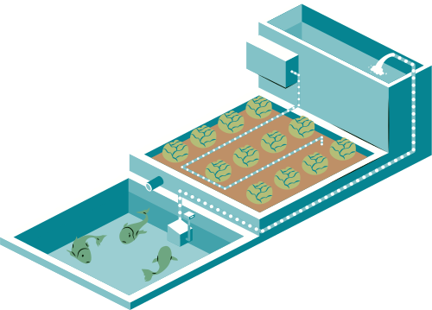
THANK YOU

