Slide 1
The Battle of Neighborhoods

Slide 2
Finding a Better Place in Scarborough, Toronto
The purpose of this Capstone Project is to help people in exploring better facilities around their neighborhood. It will help people making smart and efficient decision on selecting great neighborhood out of numbers of other neighborhoods in Scarborough, Toranto.
It will help people to get awareness of the area and neighborhood before moving to a new city, state, country or place for their work or to start a new fresh life.

Slide 3
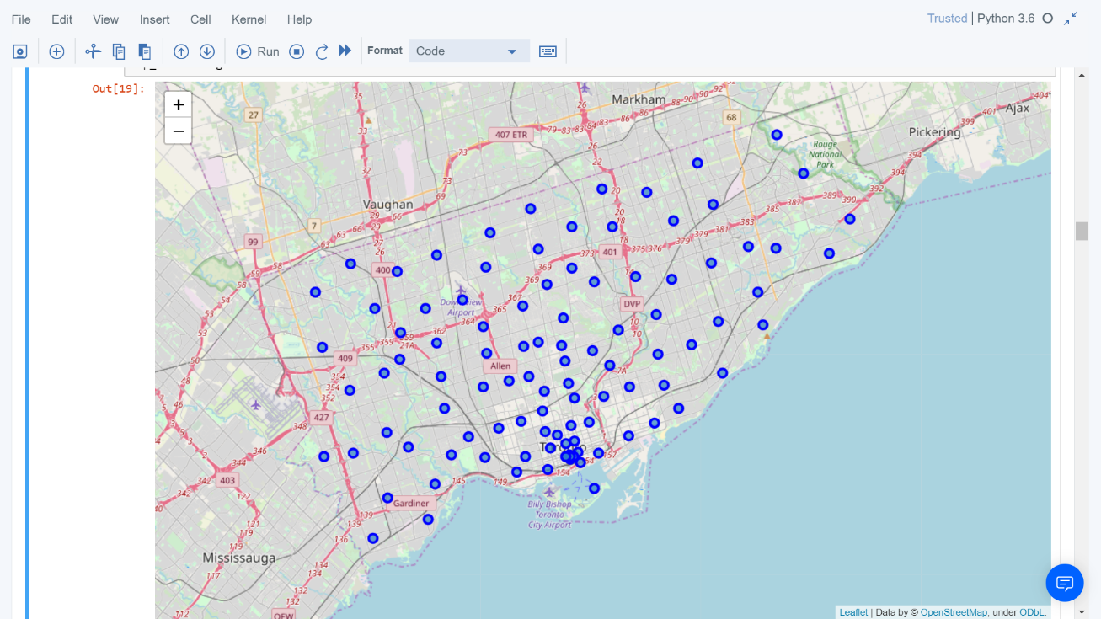
Data acquisition and cleaning
data link: https://en.wikipedia.org/wiki/list_of_postal_codes_of_canada:_m
will use Scarborough dataset which we scrapped from Wikipedia on week 3. dataset consisting of latitude and longitude, zip codes.

Slide 4
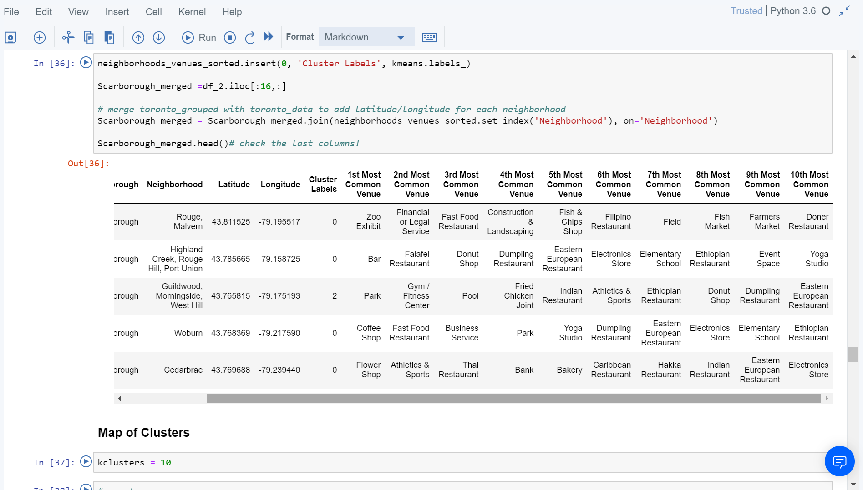
Methodology
Clustering approach:
To compare the similarities of two cities, we decided to explore neighborhoods, segment them, and group them into clusters to find similar neighborhoods in a big city like new York and Toronto. To be able to do that, we need to cluster data which is a form of unsupervised machine learning: k-means clustering algorithm.
Using K-Means Clustering Approach | Most Common Venue

Slide 5
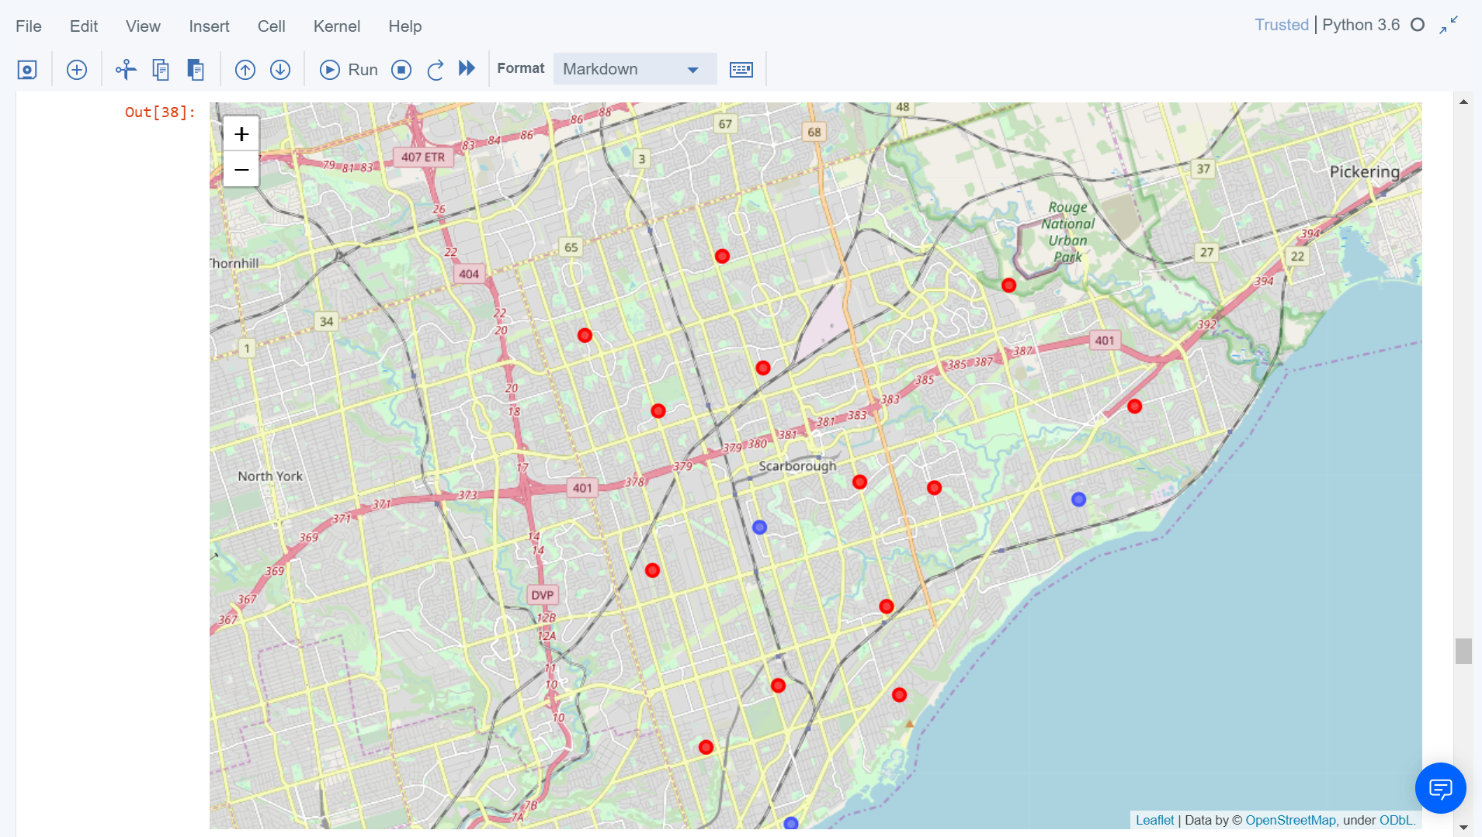
Results
Map of Clusters in Scarborough

Slide 6
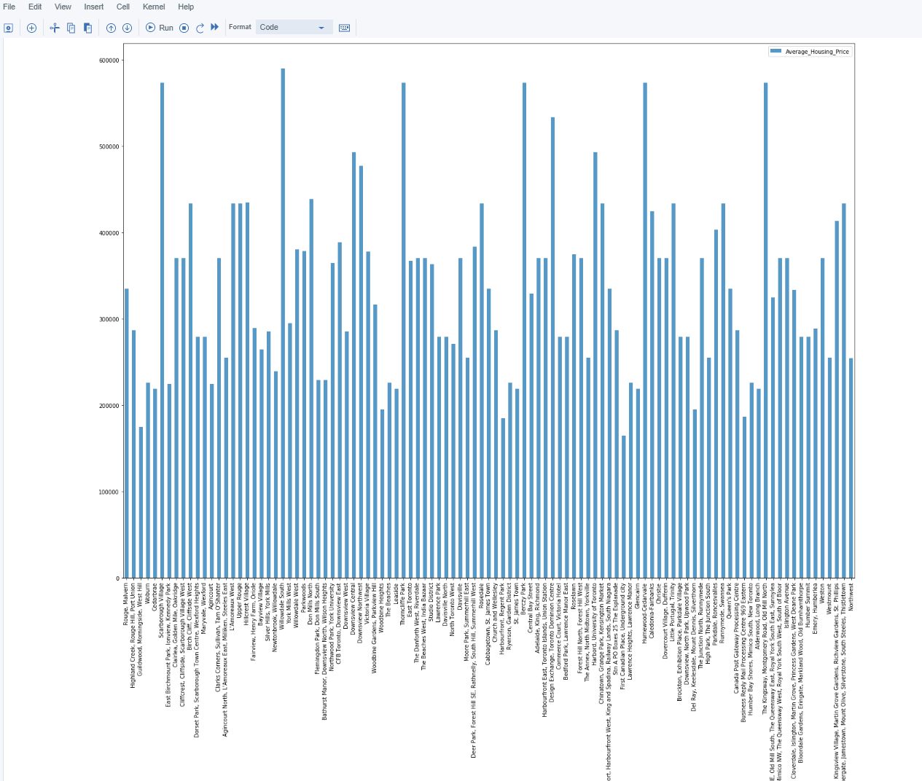
Average Housing Price by Clusters in Scarborough

Slide 7
Conclusion Section
In this capstone project, using k-means cluster algorithm I separated the neighborhood into 10(ten) different clusters and for 103 different latitude and longitude from dataset, which have very-similar neighborhoods around them. Using the charts above results presented to a particular neighborhood based on average house prices and school rating have been made.

Slide 8
Thank You ☺

