Slide 1
Railway Reservation System
Microservices Architecture
Spring Boot
Spring Cloud
MySQL per Service
RabbitMQ
JWT Security
01
Notes:
Open with the architectural thesis: this is not a monolith split into folders; it is service isolation, clear boundaries, and testable integrations.

Slide 2
WHAT WAS BUILT AND WHY
Executive Summary
A production-style railway booking platform designed around independent deployability, bounded contexts, and predictable failure boundaries.
Architecture Goal
Spring Boot microservices with API Gateway, Eureka discovery, and centralized configuration. Services own their schema and contracts.
Domain Coverage
Auth, User, Train, Schedule, Payment, Reservation, PNR, and Notification services map directly to business capabilities.
Engineering Quality
JWT zero-trust security, async email events, route bulk replace, profile upsert, and isolated Mockito tests for fast feedback.
Core evaluation message
• Scales through independent services and database-per-service ownership.
• Protects booking correctness through controlled orchestration and explicit state transitions.
• Optimizes evaluator confidence with deterministic tests and no external network dependency.
Railway Reservation System
02
Notes:
Use this slide to establish the business value and technical intent before going into the detailed architecture.

Slide 3
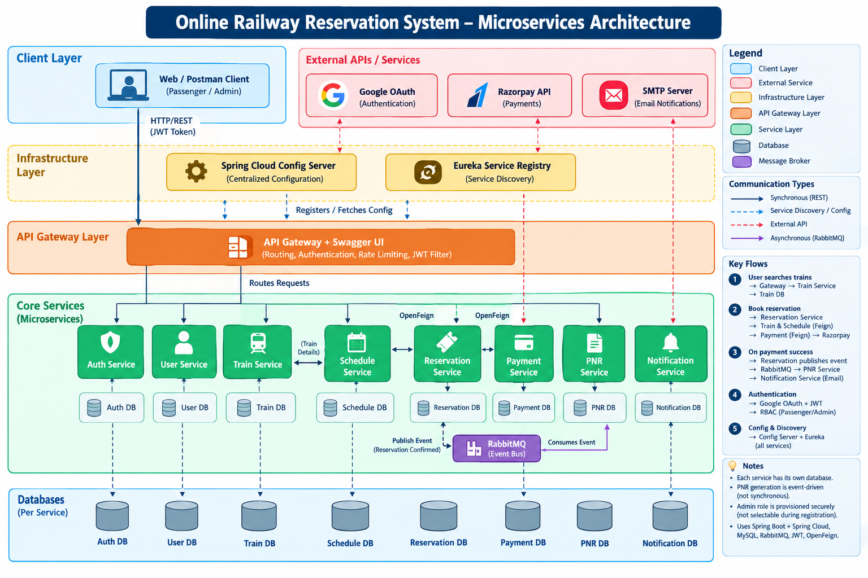
GATEWAY · DISCOVERY · CONFIG
High-Level Architecture
INFRASTRUCTURE SPINE
System Architecture Diagram
• API Gateway centralizes routing and request entry.
• Eureka enables service discovery and loose coupling.
• Config Server externalizes environment-specific configuration.
• Each microservice owns its own MySQL database.
• Cloud RabbitMQ decouples notification workflow from booking latency.
Design stance: infrastructure services are treated as platform capabilities, not domain logic.
.
Railway Reservation System
03
Notes:
Walk through external clients entering through the gateway, registry-based discovery, and service-owned databases. Paste your architecture image in the placeholder.

Slide 4
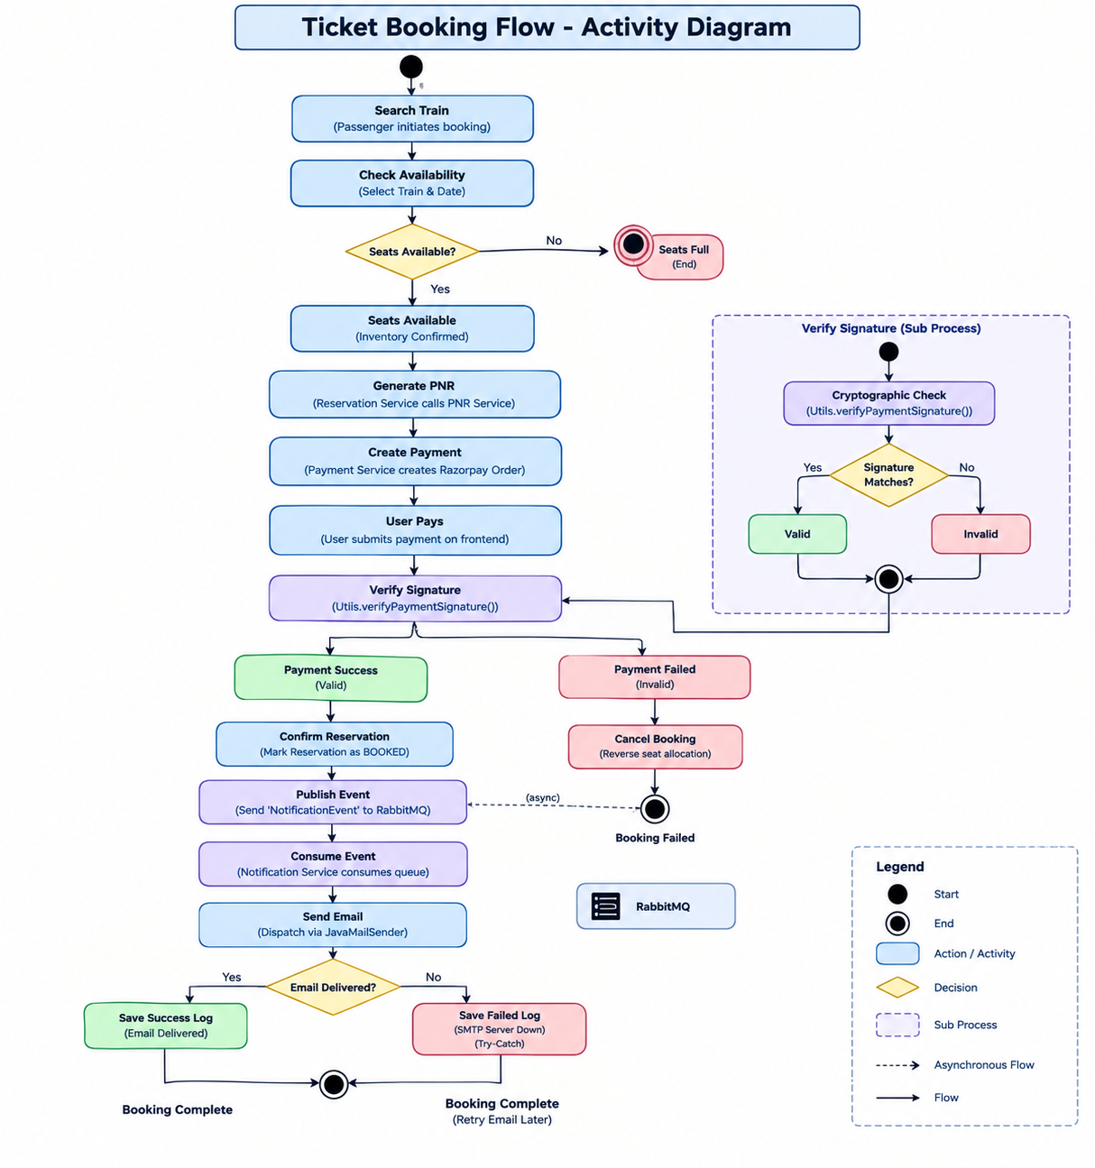
SYNCHRONOUS VS ASYNCHRONOUS FLOW
Inter-Service Communication
Sync path: Feign
Used for request/response needs during booking: train details, payment order creation, and reservation orchestration.
PASTE IMAGE HERE
Ticket Booking Activity Diagram
Async path: RabbitMQ
Used for notification events after booking confirmation so email delivery cannot block user-facing flow.
Failure boundary
Payment failure reverses booking state; notification failures are audited without corrupting reservation state.
Large empty placeholder intentionally left for your generated diagram.
Railway Reservation System
04
Notes:
Emphasize why communication style differs by business need: Feign for immediate decisions, RabbitMQ for eventual side effects. Paste your ticket booking activity diagram here.

Slide 5
CORRECTNESS UNDER DISTRIBUTED BOUNDARIES
Security & Data Integrity
The design assumes every service boundary is untrusted until identity, authorization, and state transitions are validated.
Zero-trust JWT
Identity is resolved through Spring Security Context and injected into controllers. Business operations never trust client-supplied username.
Bulk Replace Scheduling
Route schedule updates delete and recreate a train itinerary as one deterministic replace operation, preventing mixed old/new stops.
Profile Upsert
User profile creation and edit share one idempotent path, avoiding duplicate profiles while simplifying client behavior.
PNR & Status Flow
PNR generation is separated from reservation state transitions, keeping booking lifecycle explicit and auditable.
Integrity principles applied
• Never derive user identity from request body when authenticated context already exists.
• Prefer full replacement for ordered route data where partial updates can introduce inconsistencies.
• Make irreversible side effects asynchronous and auditable whenever possible.
Railway Reservation System
05
Notes:
This is the slide to show architectural maturity: security is not an annotation; it influences controller design and data mutation patterns.

Slide 6
FAST FEEDBACK WITHOUT EXTERNAL DEPENDENCIES
Enterprise Testing Strategy
Testing goal: validate orchestration and edge cases without starting slow Spring contexts or touching Razorpay/network resources.
Pure Mockito Unit Tests
No SpringBootTest for business logic. Constructor-injected collaborators are mocked directly for deterministic service tests.
SDK Isolation
mockConstruction intercepts RazorpayClient creation. mockStatic isolates signature verification utilities and prevents network calls.
Sub-second Feedback
Focused tests exercise success paths, payment failure paths, repository saves, and state transitions with minimal runtime overhead.
Evaluator-ready proof points
• External SDK is treated as an adapter boundary, not a dependency that leaks into domain tests.
• Tests assert interactions and outputs around payment creation, verification, and reservation state.
• Fast tests encourage more coverage and easier debugging during evaluation.
Railway Reservation System
06
Notes:
Highlight mockConstruction and mockStatic as the differentiator: this demonstrates deep understanding of test isolation with hard-to-mock SDKs.

Slide 7
Live Demonstration
Open Swagger UI
Demo path
1 Authenticate and capture JWT
2 Search train and inspect route schedule
3 Book ticket and initiate payment order
4 Verify payment and confirm reservation
5 Observe async notification event
07
Notes:
This slide gives you a clean pause before screen sharing Swagger UI. Keep the live demo under 8–10 minutes.

Slide 8
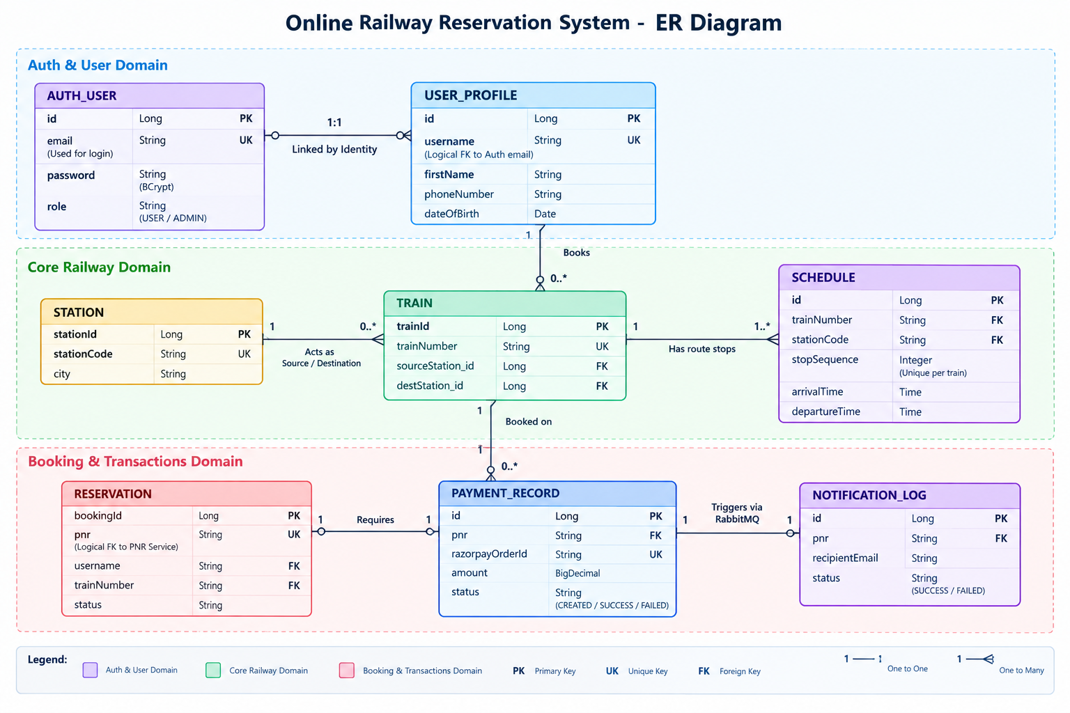
PERSISTENCE MODEL
Appendix — Database LLD
DATABASE-PER-SERVICE
PASTE IMAGE HERE
Logical ER Diagram
• MySQL schema ownership aligns with microservice boundaries.
• Cross-service references use stable IDs and API contracts rather than shared tables.
• Reservation and payment records preserve auditable lifecycle state.
• Notification logs capture asynchronous delivery outcomes separately.
Large empty placeholder intentionally left for your generated diagram.
Railway Reservation System
08
Notes:
Use the ERD appendix only if asked to deep dive on data boundaries, table ownership, or consistency.

Slide 9
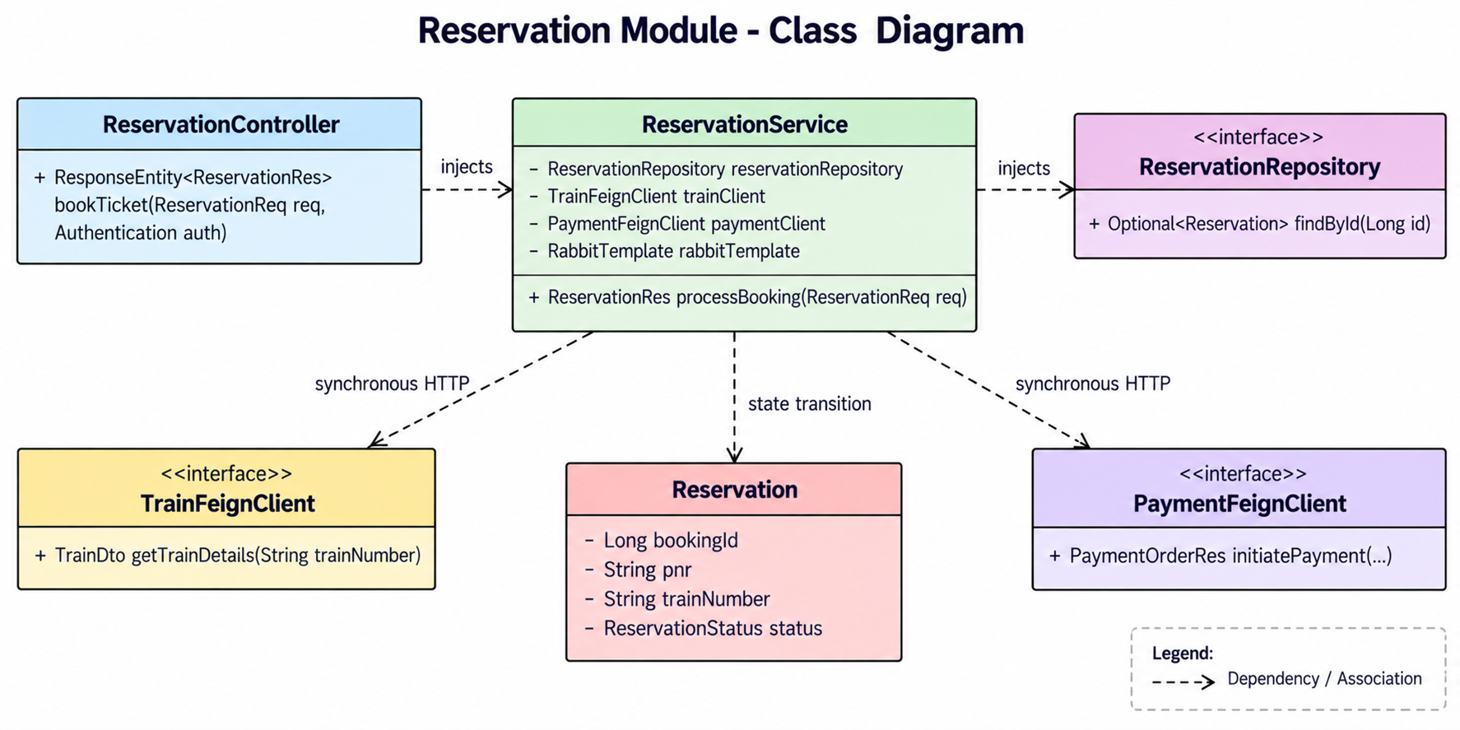
RESERVATION SERVICE DESIGN
Appendix — Internal Component LLD
RESERVATION ORCHESTRATION
PASTE IMAGE HERE
Reservation UML Class Diagram
• ReservationController accepts authenticated booking request.
• ReservationService coordinates train lookup, payment initiation, and booking state.
• Feign clients isolate synchronous service calls behind explicit interfaces.
• Repository persists reservation state transitions and generated PNR.
• RabbitTemplate publishes notification event after confirmed booking.
Large empty placeholder intentionally left for your generated diagram.
Railway Reservation System · Technical Evaluation
09
Notes:
Use this appendix when the evaluator asks for class-level LLD and dependency boundaries in the Reservation service.

