Slide 1
Assignment 4 – Sentiment Analysis
Pranavi Satheesan- 200536120
Rushda Najeeb- 200526636

Slide 2
Introduction
Sentiment analysis (opinion mining) on product reviews from Flipkart.
Importance of understanding customer sentiments for businesses.
Sentiment analysis as a powerful tool to extract valuable insights from textual data.
GitHub Link- https://github.com/spranavi28/Assignment_4_Sentiment_Analysis/

Slide 3
Flipkart Product Review Dataset
Dataset available on Kaggle- https://www.kaggle.com/datasets/mansithummar67/flipkart-product-review-dataset
Contains product reviews and ratings submitted by users
Rich collection of textual data from diverse product categories

Slide 4
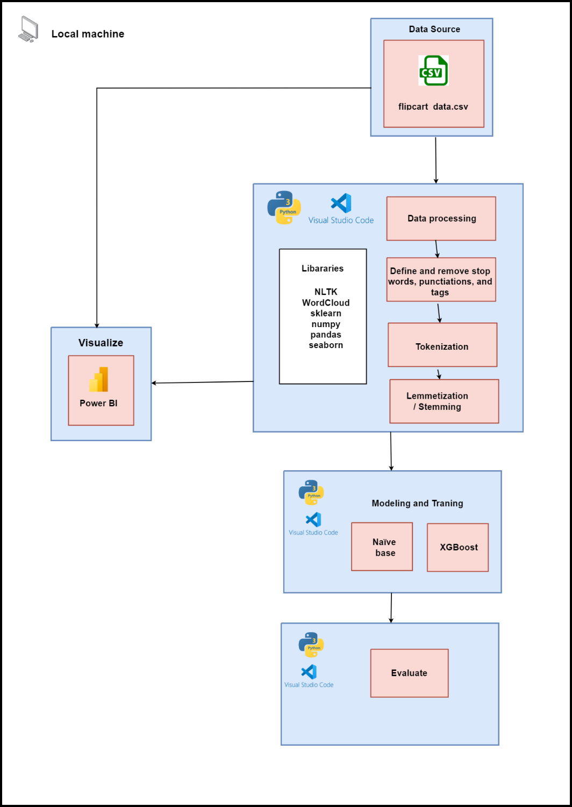
Project Architecture

Slide 5
Architecture Flow
Data source: Obtain raw text data.
Data preprocessing: Clean and format the text by removing irrelevant information, special characters, and punctuation. Stop words removal: Eliminate common words without significant meaning to reduce noise. Tokenization: Split the text into individual words or tokens. Vectorization: Use TF-IDF vectorizer to convert text data into numerical features, giving importance to words based on their occurrence in the document and dataset. Lemmatization: Reduce words to their base or root form to treat different inflections of the same word as a single entity.
Model training: Train a machine learning model (e.g., XGBoost or Multinomial Naive Bayes) to predict sentiment based on the processed data. Visualization: Use word clouds to visualize frequent words associated with positive and negative sentiment.
Model evaluation: Assess model performance using metrics like accuracy, F1-score, precision, and recall to predict sentiment on new, unseen data. Insight generation: Enable insights into the sentiment expressed in the text data for informed decision-making.

Slide 6
Objectives
Analyze customer sentiments towards products on Flipkart.
Gain insights into customer preferences and popular products.
Detect potential issues and areas for improvement in products and services.

Slide 7
Methodology
Data preprocessing: Tokenization, stop-word removal, stemming.
Feature extraction from textual data.
Model training and evaluation.
Algorithms: Naive Bayes, XGBoost.

Slide 8
Benefits
Optimize product offerings based on customer feedback.
Enhance customer satisfaction and experience.
Tailor marketing strategies to customer sentiments.

Slide 9
Business Impact
Decision-making insights for Flipkart and other e-commerce platforms.
Improving customer retention and loyalty.

Slide 10
Project Screenshots

Slide 11
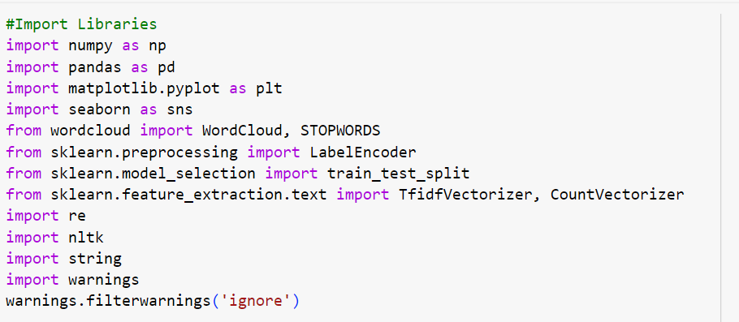
Importing libraries

Slide 12
Purpose of using Libraries
numpy (np): Numerical computing with arrays and math functions.
pandas (pd): Data manipulation and analysis with DataFrames.
matplotlib.pyplot (plt): Plotting library for visualizations.
seaborn (sns): Data visualization with statistical graphics.
wordcloud: Create word clouds to visualize text data.
STOPWORDS: Commonly removed words in text analysis.
sklearn.preprocessing.LabelEncoder: Encode categorical labels as numbers.
sklearn.model_selection.train_test_split: Split data for model training/testing.
sklearn.feature_extraction.text.TfidfVectorizer: Convert text to TF-IDF vectors.
sklearn.feature_extraction.text.CountVectorizer: Convert text to word count vectors.
re: Regular expressions for pattern matching and text manipulation.
nltk: Natural Language Toolkit for NLP tasks.
string: String manipulation functions and constants.
warnings: Control warning message display.

Slide 13
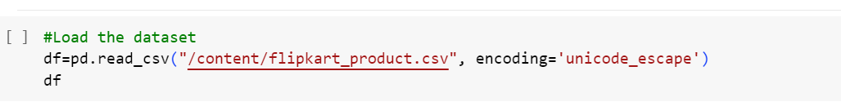
Loading the Data
The line reads data from the CSV file and converts it into a Pandas DataFrame. The df variable holds this DataFrame for further analysis or machine learning tasks.

Slide 14
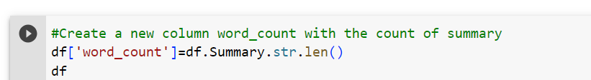
Adding a new word_count column
By using df.Summary.str.len(), we obtain a Pandas Series containing the count of characters in each summary.
We then assign this Series to the new column "word_count" in the DataFrame df. The reason for doing this might be to have a quick way to analyze or visualize the distribution of the summary lengths in the dataset or for any other analysis that requires the word count information.

Slide 15
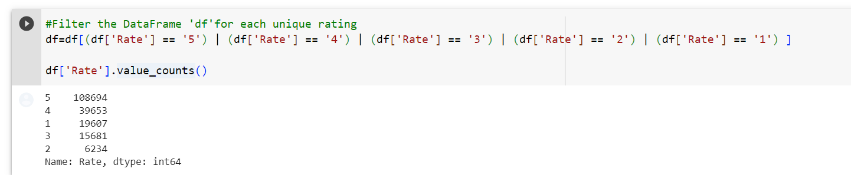
Count the Unique Rating
The code snippet filters the DataFrame df to keep only rows with ratings 1, 2, 3, 4, or 5. Then, it calculates and displays the count of each unique rating value in the "Rate" column.
108,694 rows with a rating of 5.
39,653 rows with a rating of 4.
19,607 rows with a rating of 1.
15,681 rows with a rating of 3.
6,234 rows with a rating of 2.

Slide 16
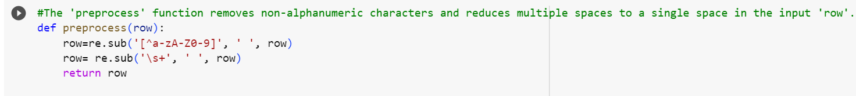
Preprocessing the Data
The purpose of these operations is to preprocess the text data in the input 'row' by removing special characters, punctuation, and extra spaces.
This step is commonly performed in natural language processing (NLP) tasks to normalize the text and make it cleaner and more consistent for further analysis or text processing tasks like tokenization or creating word embeddings.

Slide 17
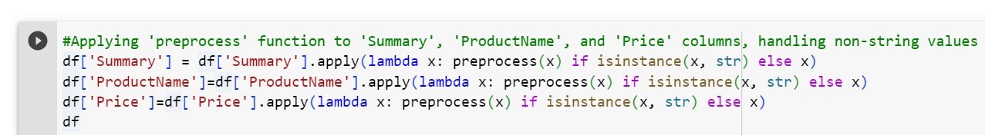
Apply preprocessing function to the column
The reason for doing this is to preprocess the text data in these columns in the DataFrame.
By removing non-alphanumeric characters and reducing multiple spaces, the text data becomes cleaner and more standardized.
This preprocessing is often essential before performing text-based analysis, natural language processing (NLP), or machine learning tasks involving textual data.
Additionally, by handling non-string values and keeping them unchanged, we ensure that the preprocessing doesn't interfere with other types of data present in these columns.

Slide 18
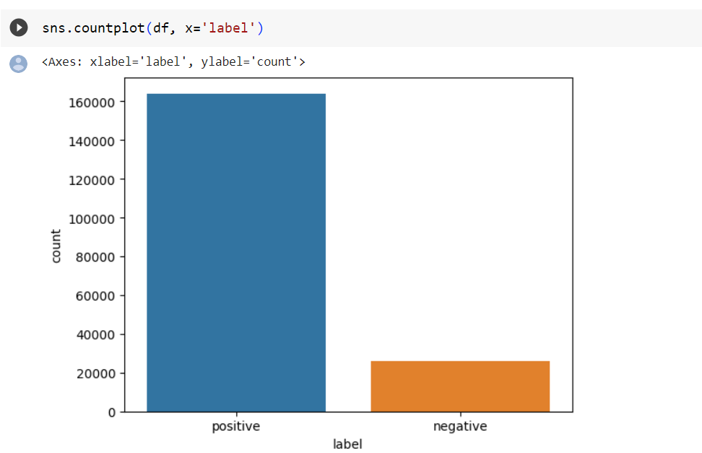
Positive and Negative Reviews
Positive Reviews- 164028
Negative Reviews- 25841

Slide 19
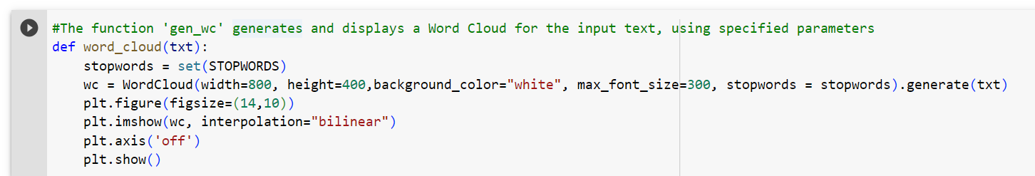
Word Cloud- Code
The word_cloud function generates and displays a Word Cloud for the input text.
Word Cloud is a visual representation of the most frequent words in the text, providing quick insights and summarization.
It uses the wordcloud library with specified parameters for appearance and excludes common words (STOPWORDS) to enhance the visualization.

Slide 20
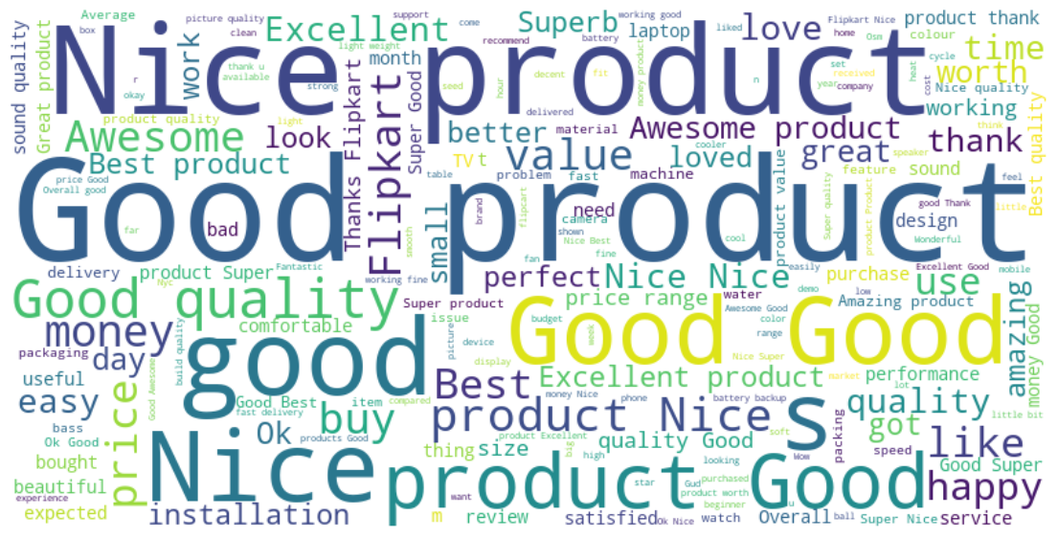
Word Cloud- Positive Reviews

Slide 21
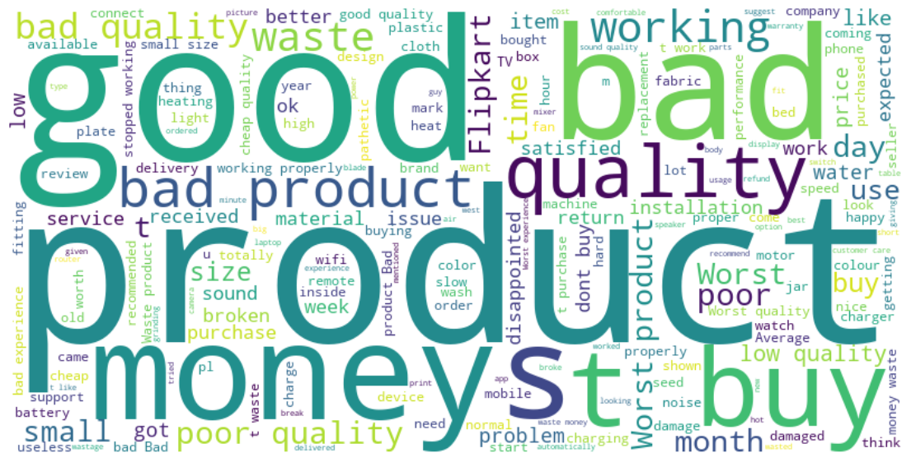
Word Cloud- Negative Reviews

Slide 22
Results
Multinomial Naive Bayes (MNB) with TF-IDF Embedding
Multinomial Naive Bayes (MNB) with Count Vectorizer
- Accuracy: 91% - Macro-average F1-score: 76% - Weighted-average F1-score: 90% - The MNB model performs reasonably well on precision and recall for class 1 (positive class) with a high F1-score of 95%, but its performance is weaker for class 0 (negative class) with an F1-score of 57%. This indicates that the model struggles to correctly classify the negative class instances. - The confusion matrix shows that the MNB model misclassifies a significant number of class 0 instances as class 1, leading to a lower recall for class 0.
- Accuracy: 94% - Macro-average F1-score: 86% - Weighted-average F1-score: 93% - The MNB model shows improved performance on precision and recall for class 0 with an F1-score of 76%. However, it continues to perform well on class 1 with an F1-score of 96%. - The confusion matrix indicates that the MNB model is better at classifying class 0 instances, but it still misclassifies some class 0 instances as class 1.

Slide 23
Results
XGBoost Classifier (XGBC) with TF-IDF Embedding
XGBoost Classifier (XGBC) with Count Vectorizer
- Accuracy: 95% - Macro-average F1-score: 90% - Weighted-average F1-score: 95% - The XGBC model shows high precision and recall for both classes, leading to high F1-scores for both class 0 (83%) and class 1 (97%). - The confusion matrix shows fewer misclassifications compared to MNB, with class 0 and class 1 instances being better separated.
- Accuracy: 96% - Macro-average F1-score: 92% - Weighted-average F1-score: 96% - Similar to XGBC with TF-IDF, this model exhibits high precision and recall for both classes, resulting in high F1-scores for class 0 (84%) and class 1 (98%). - The confusion matrix also demonstrates strong performance, with fewer misclassifications compared to the MNB mode

Slide 24
Comparison
Both XGBC models outperform the MNB models in terms of accuracy, F1-scores, and confusion matrix performance.
TF-IDF and Count Vectorizer both provide valuable information for the models, but the XGBC model shows more consistent and robust performance across both types of embeddings compared to MNB.
XGBoost tends to handle the class imbalance and the complexities of the dataset better than MNB.

Slide 25
Findings
The dataset exhibits a class imbalance, with the positive class (class 1) having significantly more instances than the negative class (class 0).
XGBoost models show better generalization to the test set compared to Multinomial Naive Bayes, as evident from higher accuracy and F1-scores on the test set.
Multinomial Naive Bayes is a simpler model with high interpretability, while XGBoost is more complex and less interpretable.
Lemmatization of the text data likely improved model performance by reducing the number of unique words and standardizing word forms.
XGBoost seems less sensitive to the choice of feature embeddings (TF-IDF or Count Vectorizer) compared to Multinomial Naive Bayes.
Overfitting should be considered, especially if the models were trained on a small dataset, and evaluation on a separate validation set is essential.
The business context and requirements play a vital role in selecting the final model. A trade-off between precision and recall might be necessary based on the application.
XGBoost with both TF-IDF and Count Vectorizer embeddings emerges as the top-performing model, demonstrating strong generalization and robustness to class imbalances.

Slide 26
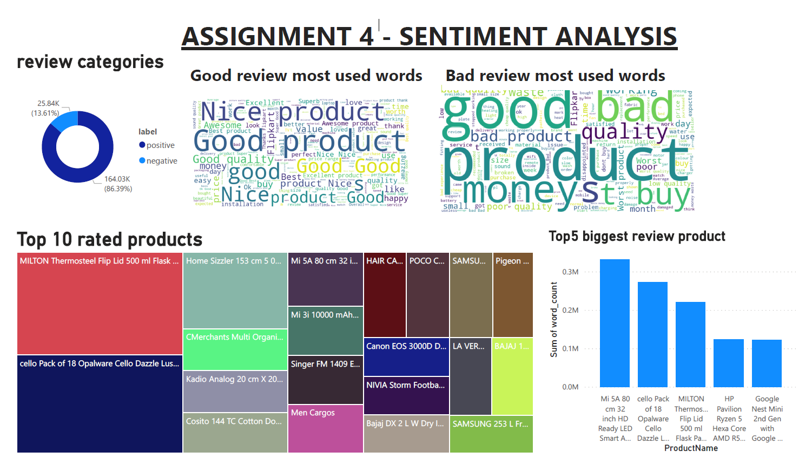
Power BI Dashboard

Slide 27
Conclusion
Sentiment analysis on product reviews from Flipkart provides valuable insights for businesses.
It aids in optimizing product offerings, enhancing customer satisfaction, and tailoring marketing strategies.
The Flipkart Product Review Dataset offers an excellent opportunity for exploring sentiment analysis in an e-commerce context.
Sentiment analysis is a powerful tool for understanding customer behavior and preferences, contributing to business success and competitiveness.

Slide 28
References
Flipkart Products review Dataset. (2023, January 26). Kaggle. https://www.kaggle.com/datasets/mansithummar67/flipkart-product-review-dataset
Python, R. (2022). Sentiment analysis: First steps with Python’s NLTK Library. realpython.com. https://realpython.com/python-nltk-sentiment-analysis/
Sklearn.feature_extraction.text.TfidFVectorizer. (n.d.). Scikit-learn. https://scikit-learn.org/stable/modules/generated/sklearn.feature_extraction.text.TfidfVectorizer.html

