Slide 1
DDOS ATTACK DETECTION
USING SUPERVISED
MACHINE LEARNING TECHNIQUES

Slide 2
Group Member Information
Kavya Addalapudi – 700730463
Sai prasad Surampudi – 700733605
Lohith Pradeep Volla – 700732926
Ramya Peram - 700728550

Slide 3
Role/Responsibilities and Contribution in project
Problem description and dataset formation: This phase includes the problem description and also drafting of clear objectives and outcomes, and the dataset is gathered using the references. This task is accomplished by Kavya Addalapudi, 700730463.
Data analysis and null value management: This phase includes the dataset loading and also listing the required modules in the m=python and then checking for the null values and filling them using the mean value. This task is accomplished by Sai prasad Surampudi, 700733605
Exploratory Data Analysis: Here all the columns in the dataset are studied well and correlation matrix and graphs are generated to finalize the features for modeling. This task is accomplished by Lohith Pradeep Volla, 700732926
Model training: Here in this phase all the available functions and classes available in the sklearn module that are useful for our project are studied. This task is accomplished by Ramya Peram, 700728550

Slide 4
Motivation
Security for web applications is a never-ending cat and mouse game. A web application is a computer program that works via the Internet using web technology and web browsers. A web application basically needs a web server to handle client requests, an application server to carry out the activities, and a database to store the data. A web application may be seriously threatened by web attacks. They obtain access to the application DB and cause significant harm by taking advantage of the application's vulnerability. ML algorithms are able to recognize various patterns in both malicious and legitimate requests, and they are successful at predicting them in real-world situations.

Slide 5
Objectives
The detection of DDoS attacks can be modelled as a classification issue that separates "attack" from "regular" network flow conditions. The model can determine if new, unlabeled network traffic is malicious or benign after training and testing. Four common assault techniques are generalized by the established classification model: After training and testing, the system was able to recognize User Datagram Protocol (UDP), Internet Control Message Protocol (ICMP), Transmission Control Protocol-SYN (TCP-SYN) flood attacks and determine if fresh, unlabeled network traffic is malicious or benign in real-time. Machine Learning (ML) algorithms-based DDoS attack detection solutions have recently gained in importance. based on the notion of rationality. Using this method's processing steps, the network data stream is abstracted into feature vectors by choosing the suitable classification features, and then each feature vector with a label, with the labels' range being 0 to 1. Using a suitable classification method to learn from the sample data, create a classification model, and then use the model to categorize new, unlabeled network traffic as benign or malicious, the two labels reflect normal network flow and attack network flow, respectively. On top of IP, the User Datagram Mechanism (UDP) is a simple data transfer protocol. While UDP offers a mechanism to identify corrupt data in packets, it makes no attempt to address other packet-related issues, like lost or out-of-order packets.

Slide 6
Related Work
For DDOS attack detection, the traditional method is, to note the source packets and total service count packets without basing on the protocols where the root cause lied. This enables us to know if the DDOS has occurred but takes time for root diagnosis and required action.
In the regular method of sql injection detection, old data is used and type of query is also taken into consideration for the detection. this may not result in accurate.

Slide 7
Problem Statement
An increasing number of Internet of Things (IoT) devices are connecting to the Internet, yet many of these devices are fundamentally insecure, exposing the Internet to a variety of attacks. Botnets such as Mirai have used insecure consumer IoT devices to conduct distributed denial of service (DDoS) attacks on critical Internet infrastructure. This motivates the development of new techniques to automatically detect consumer IoT attack traffic. We study DDoS attacks by botnet-infected IoT devices using multiple machine-learning classifiers. DDoS detection in IoT network traffic with a variety of machine learning classifiers, including neural networks. These results indicate that home gateway routers or other network middleboxes could detect local IoT device sources of DDoS attacks using low-cost machine learning algorithms and traffic data that are flow-based and protocol-agnostic. We will be classifying all the data and provide a graph for each and find the best algorithm that has the highest accuracy for the detection of the attack. The dataset is called as SDN attacks dataset and is sourced from the Wireshark website. The 3 types of DDOS attacks that we gonna classify are ICMP, TCP-Sync, and UDP.

Slide 8
Proposed Solution
Here we first categorized the given data into 3 different protocols that enable us to segregate the DDOS with the root cause i.e. ICMP, TCP_SYNC, and UDP. This enables us to build the model with more accuracy under high collinearity amongst the features. For SQL injection detection, we are finding out the different forms in the page using beautiful soup and from there we perform different post methods to diagnose the vulnerability.

Slide 9
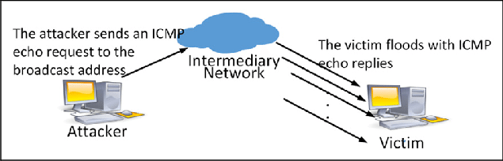
Icmp Protocol
An Internet Control Message Protocol (ICMP) flood DDoS attack, also known as a Ping flood attack, is a common Denial-of-Service (DoS) attack in which an attacker attempts to overwhelm a targeted device with ICMP echo-requests (pings).

Slide 10
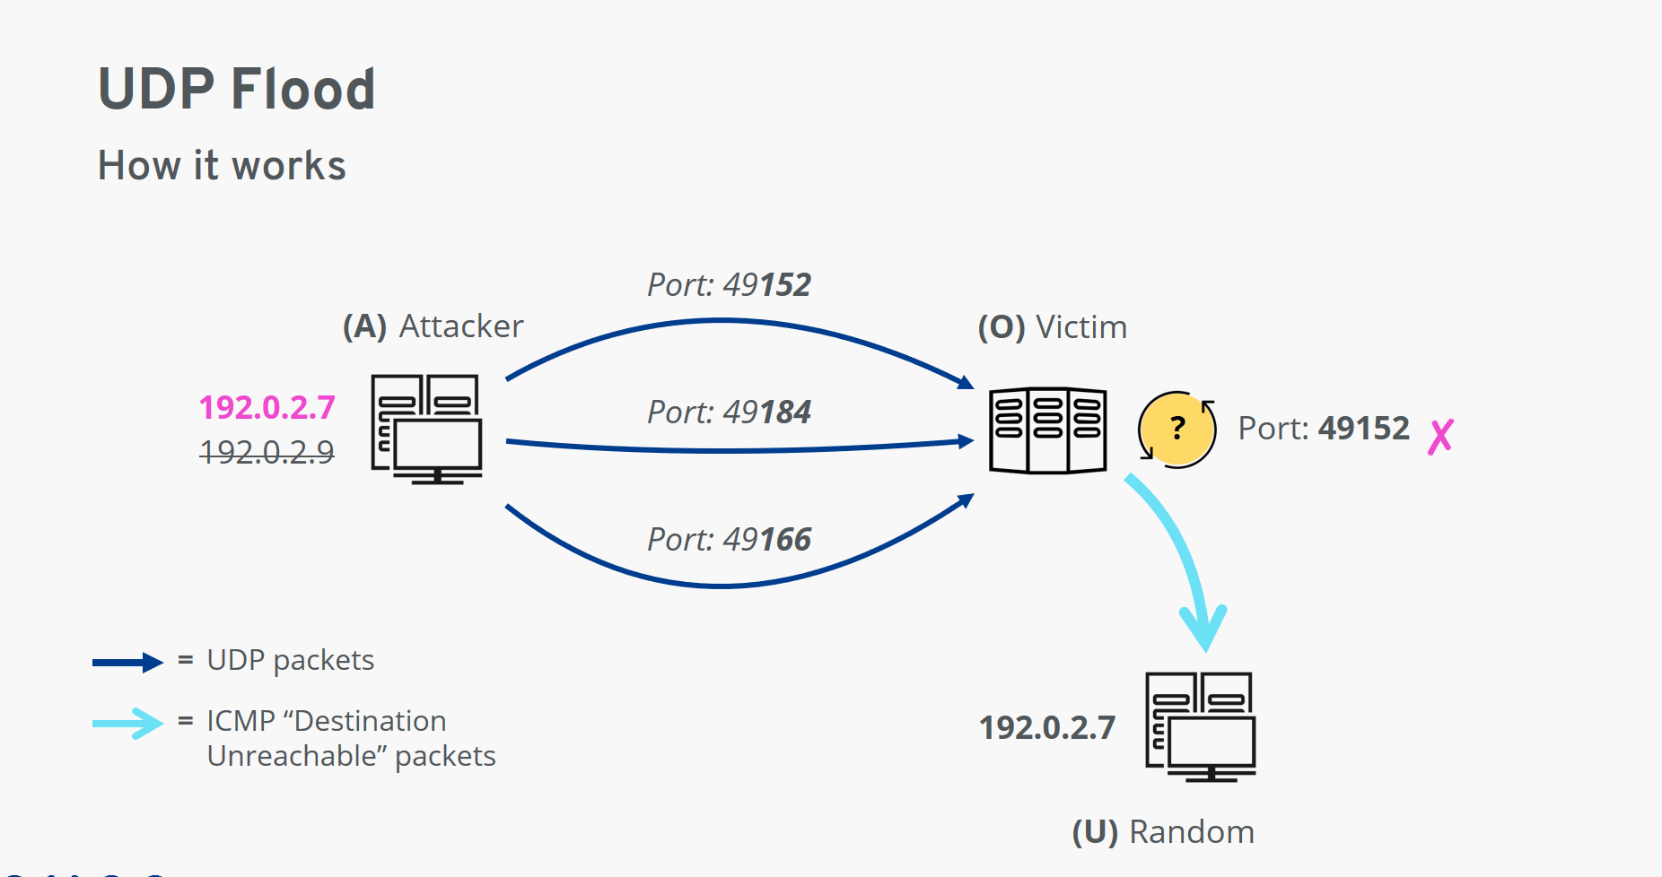
Udp Protocol
A UDP flood is a form of volumetric Denial-of-Service (DoS) attack where the attacker targets and overwhelms random ports on the host with IP packets containing User Datagram Protocol (UDP) packets.

Slide 11
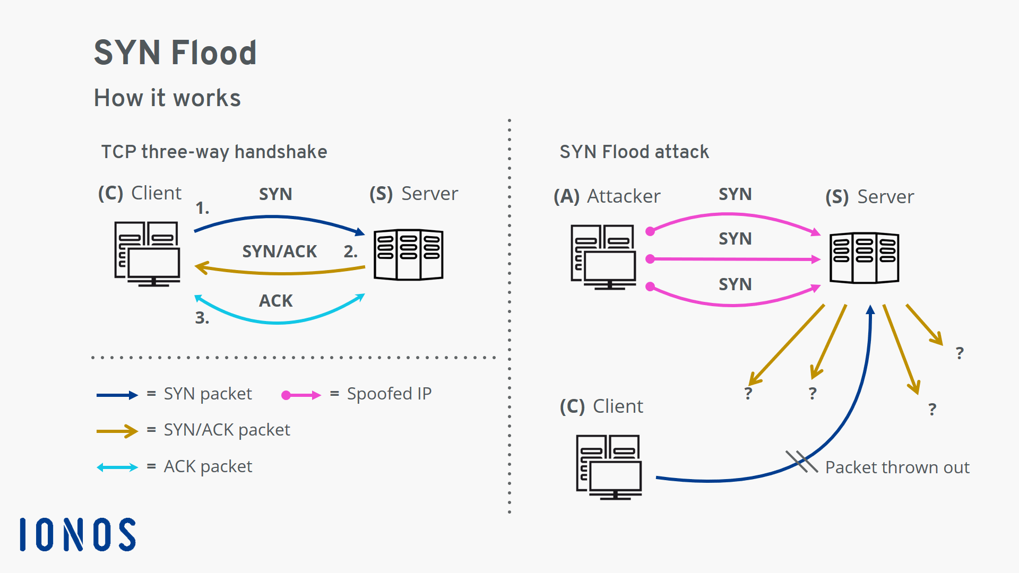
Tcp_Syn Protocol
A SYN Flood is a common form of Denial-of-Service (DDoS) attack that can target any system connected to the Internet and providing Transmission Control Protocol (TCP) services (e.g. web server, email server, file transfer). Every connection using the TCP protocol requires the three-way handshake, which is a set of messages exchanged between the client and server.

Slide 12
Algorithm:
Step 1:Collect data and read it.
Step 2:Extracting Icmp,Udp and Tcp packets from our dataset.sending icmp,udp, tcp_syn attack files as csv dataset. And immute all the null values.
Step3: Extracting all the important features as a "priori“ for feature extraction.
Step4:Consider ‘Features’ as service,src_bytes,wrong_fragment,count,urgent, num_compromised, srv_count and the ‘Target’ as Result from the available data.
Step5:Replacing all classes of attack with 1 and normal result with 0 in our icmp_df, udp_df, tcp_syn_df.
Step6:Find some covariance between certain features to plot a covariance heatmap.
Step-7: Split data into training data and test data in 7:3 ratio.
Step-8:Apply the Models like “LR,KNN,MLP,ID3” and find the confusion matrix forthefeatures and then calculate the Report(Accuracy,f1-score,precision,recall,support).

Slide 13
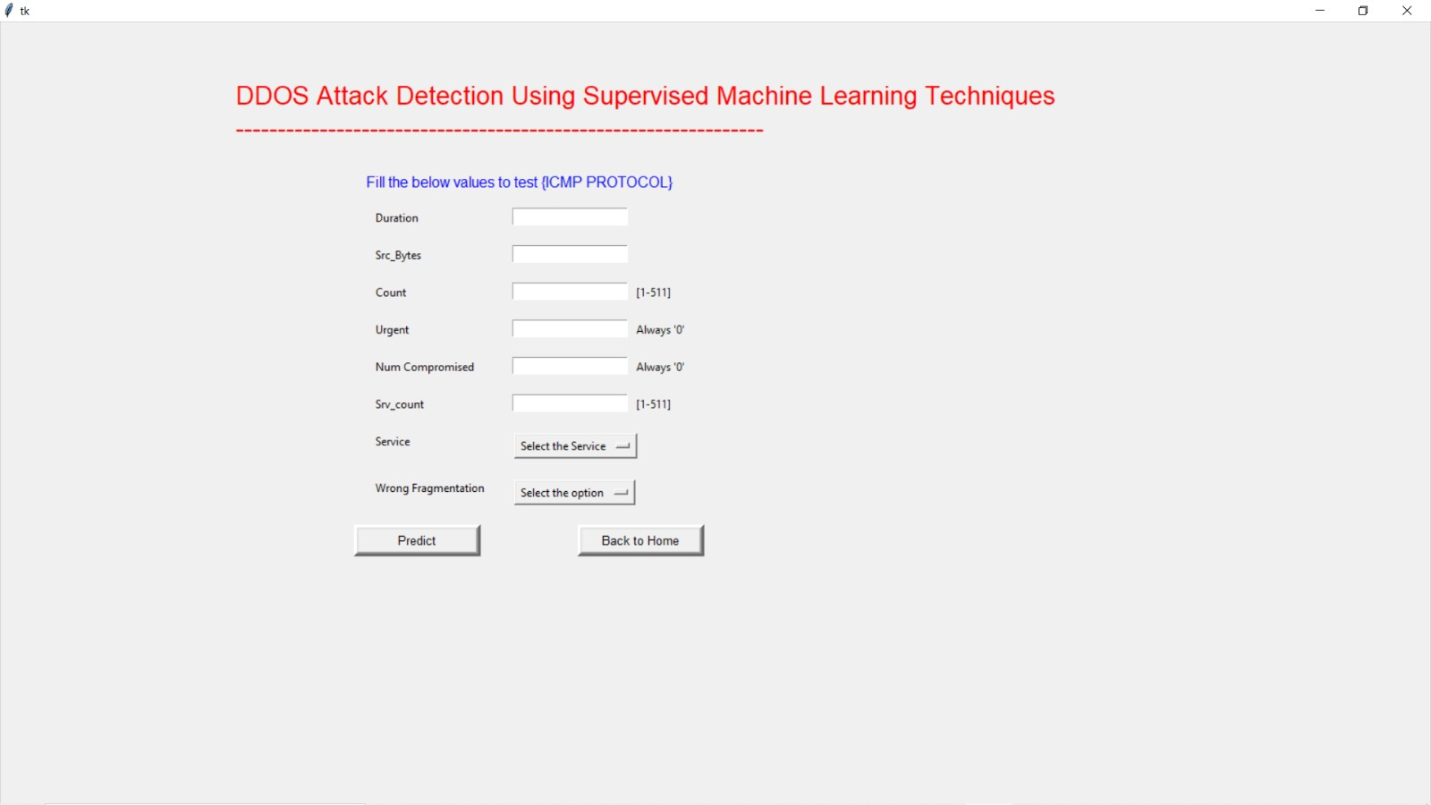
Results/Simulations:

Slide 14
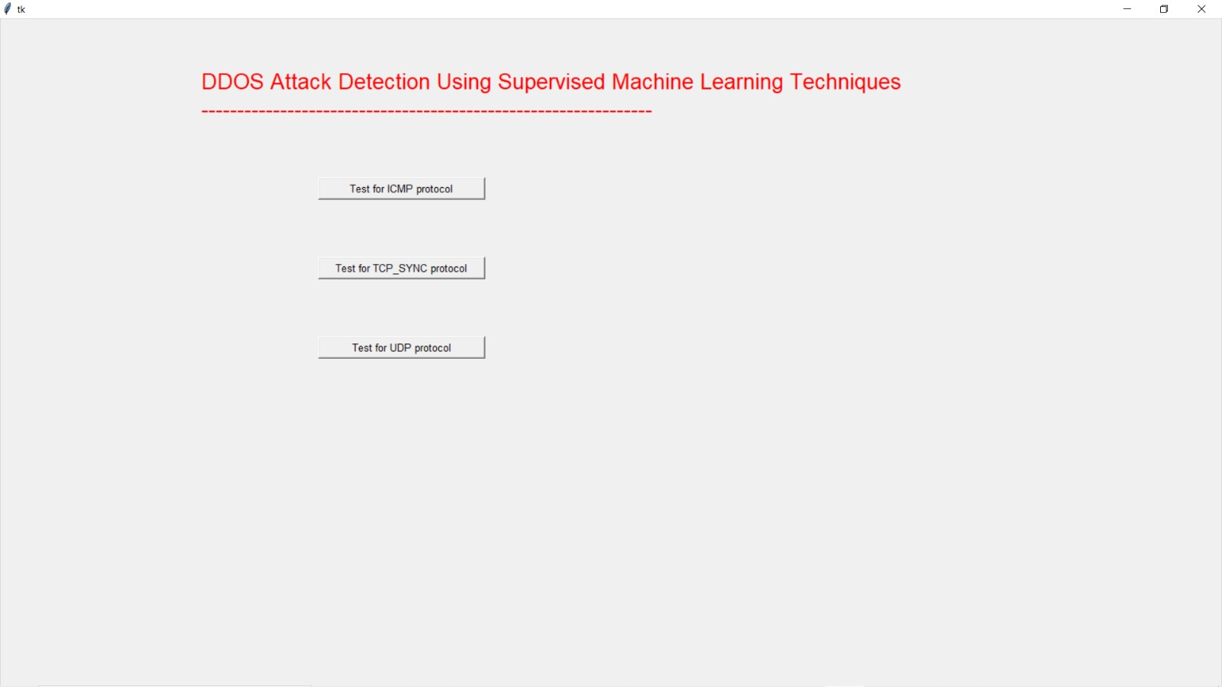
Results/Simulations:

Slide 15
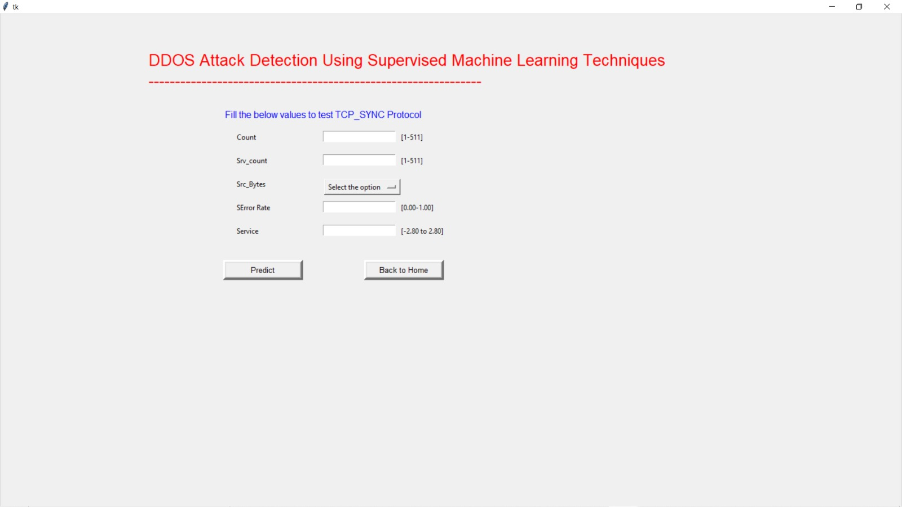
Results/Simulations:

Slide 16
Conclusion
While performing experiments, we cleaned and labeled SDN dataset that helped in distinguish between normal and abnormal traffic.The preprocessing of the data was done at a granular level using a python script to identify missing features for a common attack. Further, feature extraction from the dataset played a key role in identifying best input feature behavior with the help of Correlation Matrix and with the best features the best Accuracy is found by using various Machine Learning classifiers like Logistic Regression,K-Nearest Neighbor,Id3,Multilayer Perceptron.By this we can able to detect Ddos,Sql attacks.

Slide 17
References
[1]“Real-Time DDoS Attack Detection Based on Machine Learning Algorithms” The international conference on emerging trends in engineering yukthi-2021,Govt.engineering college kozhikode,24-26th september 2021.
[2]“Detection of Ddos Attack using Machine Learning Algorithms”The international conference on emerging trends in engineering yukthi-2021,Govt.engineering college kozhikode,24-26th september 2021
[3]”Survey of Network-based Intrusion Detection Data Sets”, Markus Ring, Sarah Wunderlich. In this survey, they have classified that Labeled data sets are necessary to train and evaluate anomaly-based network intrusion detection systems,6 July 2019.
[4] D. Chaudhary, K. Bhushan and B. B. Gupta, “Survey on DDoS attacks and defense mechanisms in cloud and fog computing”, Int. J. E-Services Mobile App., vol. 10, no. 3, pp 61-83, Jul. 2018.
[5] Qianmu Li, Yanjun Song, Jing Zhang, Victor S. Sheng. “Multiclass imbalanced learning with one versus-one decomposition and spectral clustering”. Expert Systems with Applications, Volume 147,2020.

Slide 18
Thank you!

